Slide 1
An investigation into FA minimization through Regex Hashing
Wikus Coetser
Prof. Dr. D.G. Kourie
Prof. Dr. B.W. Watson

Slide 2
Agenda
Motivation
The minimization process
Consequences
The hash function
Preliminary Results

Slide 3
1. Motivation
Context:
  Regex => FA
Gaol:
  Minimization
  Accuracy vs. size

Slide 4
2. The minimization Process
Minimization:
  L(FA) = L(FA minimized)
  num(states(FA minimized)) is minimal
Equivalence classes
if L(state 1) = L(state 2) then merge

Slide 5
2.1. Finding Equivalent States
Inefficient approach for FA
  String enumeration up to n
  N = Q -2
  Empty string

Slide 6
2.2. Finding Equivalent States
Process for regex
From PSC2006
Hashing Regexes => Right languages of states
hash(L(state 1)) = hash(L(state 2))

Slide 7
2.3. Using Brzozowski's algorithm
3 parts:
  Empty String test
  First symbol sets
  Left derivatives wrt. symbol

Slide 8
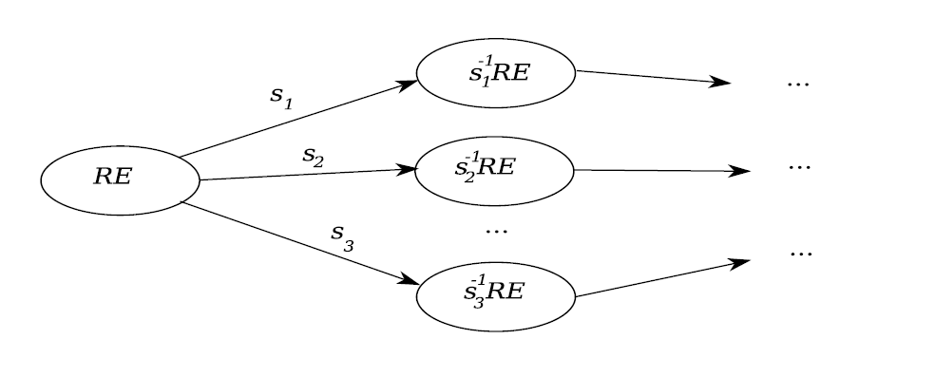
2.4. How? (Part 1 – remap)

Slide 9
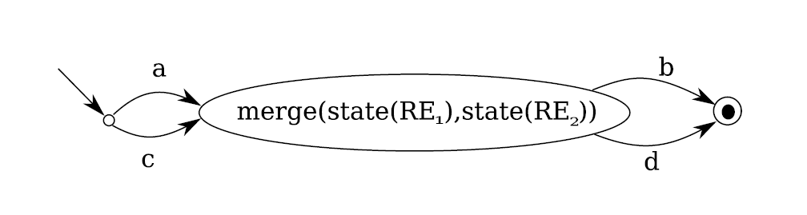
2.5. How ? (Part 2 – Hash)

Slide 10
3. Consequences
Super automaton
Non-determinism

Slide 11
3.1. Definitions
Super automaton
Exact Automaton
Sub automaton
Exact automaton != minimized automaton

Slide 12


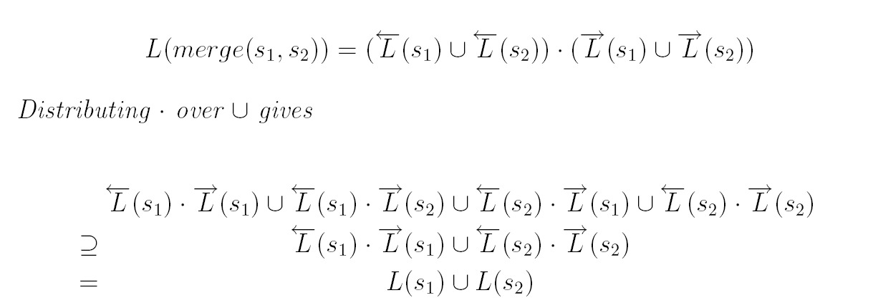
3.2. Proof: Super Automaton

Slide 13
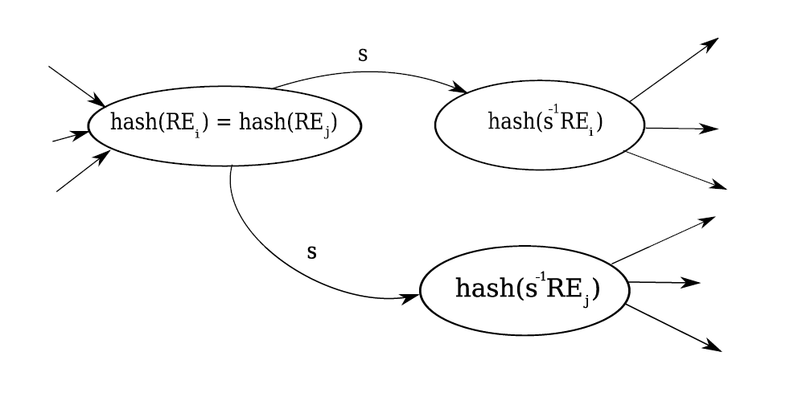
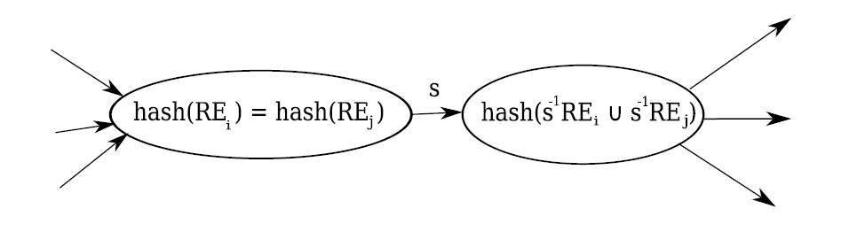
3.3. Non-determinism

Slide 14
4. Hash function
Ideal hash function
Difference: exact and super automaton

Slide 15

4.1. Ideal hash function
Definition:
with , and
exact minimal automaton

Slide 16
  4.2. Automaton quality: FA
Related: equivalence classes
Original definition: FA version
K-equivalent states: current
(K-1)-equivalent states: state transition function
0-case: accept XOR reject

Slide 17
4.3. Automaton quality: Regex
Equivalence classes: regexes
<= k – equivalence difference measure
Current states
First symbols, left derivatives and empty string test
k = Q-2
Relation: hash function quality

Slide 18
5. Preliminary empirical results
PSC 2006 recommendations
regex operators => bit string operators
Regexes of up to length 6
Measured <=k equivalence

Slide 19
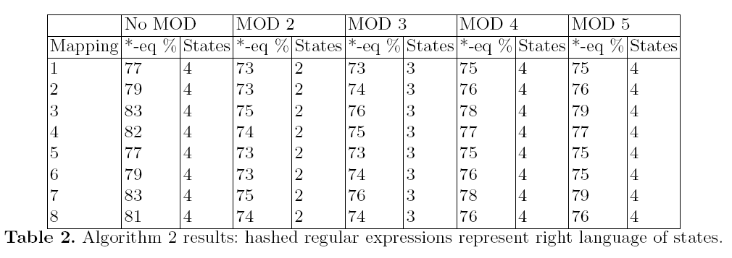
5.1. Results: Short regexes

Slide 20
5.2. Observations
The quality increases with mod N as expected
Consistency in hash function rankings
Results for the % exact automata

Slide 21
Further research
Finding better hash functions
Retaking the statistics for longer/more complex regexes
Measuring number of automata with an actual reduction in states

