Slide 1
Delta Encoding
in the compressed domain
A semi compressed domain scheme
with a compressed output

Slide 2
Agenda
Delta encoding types and schemes
Applications
The algorithm principles
Results
Similar works
Contributions
Notes:
עקרונות

Slide 3
The Problem
We would like to have a version updating algorithm which transforms a compressed reference into a compressed version without decoding and re-encoding a reference.

Slide 4
What is “Delta Encoding”
Definition: Delta Encoding is the task of compactly encoding a new version as a set of copy and add commands using a reference.

Slide 5
Types Of Delta Encoding
Uncompressed domain
Compressed domain
Semi Compressed domain
The proposed Semi Compressed domain with compressed output

Slide 6
Why Semi Compressed Scheme
Textual data is produced in an uncompressed form
Digital data is first acquired then compressed for most cases
This work focuses on the data network path

Slide 7
Compression Base
We uses LZSS (Storer-Syzmanski) as the compression base
LZSS has (off,len) & strings mixed structure
LZSS is a repetitions based algorithm (LZ family)

Slide 8
Delta Compression
The Schemes

Slide 9

Uncompressed Domain
version
Encoder
Delta
reference
Decoder

Slide 10
Compressed Domain
Ver_{c}
Encoder
Delta
Ref_{c}
Decoder
version

Slide 11
Semi Compressed Domain
version
Encoder
Delta
Ref_{c}
Decoder
version

Slide 12
The Proposed Semi Compressed Domain With Compressed Output
version
Encoder
Delta
Ref_{c}
Decoder
Ver_{c}

Slide 13
The Main Differences
Delta file has additional new commands
The decoder manipulates the compressed reference to become the compressed version
Decoder outputs the compressed version

Slide 14
Applications
Forward and reverse proxies
Caching devices
Traffic accelerators
Server farming
Low bandwidth networks
Online storage & backups
Version & source control
All the intermediate devices do not use the data but only transfer it ! ! !

Slide 15
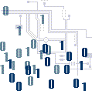




Application – The Topology

Slide 16
The Key Benefits
Eliminate the need to extract, compare and re-encode ⇒ reduction in CPU consumption
Network Hop by Hop scheme of data caching.
Reducing storage space
Reducing decompression work space.

Slide 17
The Algorithmic Steps For Each Scheme Type

Slide 18
Uncompressed Domain
step | Server | Network | Client
1 | Decompress (R_{c}) ⇒ R | Decode (R_{c}) ⇒ R | Decode (R_{c}) ⇒ R
2 | Delta Encode (R,V) ⇒ Δ | Delta Decode (R, Δ) ⇒ V | Delta Decode (R, Δ) ⇒ V
3 | Compress (V) ⇒ V_{c} | Compress (V) ⇒ V_{c} | Compress (V) ⇒ V_{c}
4 | Store V_{c} ⇒ R_{c}’ | Store V_{c} ⇒ R_{c}’ | Store V_{c} ⇒ R_{c}’
5 | Send Δ | Store Δ
6 | Store Δ | Send Δ

Slide 19
Compressed Domain
step | Server | Network | Client
1 | Compress (V) ⇒ V_{c} | Delta Decode (R_{c}, Δ) ⇒ V | Delta Decode (R_{c}, Δ) ⇒ V
2 | Delta Encode (R_{c}, V_{c}) ⇒ Δ | Compress (V) ⇒ V_{c} | Compress (V) ⇒ V_{c}
3 | Store V_{c} ⇒ R_{c}’ | Store V_{c} ⇒ R_{c}’ | Store V_{c} ⇒ R_{c}’
4 | Store Δ | Store Δ
5 | Send Δ | Send Δ
6

Slide 20
Semi Compressed Domain With Compressed Output
step | Server | Network | Client
1 | Delta Encode (R_{c}, V) ⇒ Δ | Delta Decode (R_{c}, Δ) ⇒ V_{c} | Delta Decode (R_{c}, Δ) ⇒ V_{c}
2 | Decode (R_{c}, Δ) ⇒ V_{c} | Store V_{c} ⇒ R_{c}’ | Store V_{c} ⇒ R_{c}’
3 | Store V_{c} ⇒ R_{c}’ | Store Δ | Decode (V_{c}) ⇒ V
4 | Store Δ | Send Δ
5 | Send Δ
6

Slide 21
The Algorithm Principles
Iterative Steps Of Encode And Compare
Local Reference Approach
Dependency chain breaking

Slide 22
Constraints And Assumptions
Both versions are highly correlated
The changes are local and sparse
The change size is very small compared to the size of the version
We do not seek optimal solution but rather to show that there exist a comprehensive solution

Slide 23
The Algorithm Principles
(10, 4)
Ver :
1234567890123466789012345678901234567890
Ref : 1234567890(10,10)(10,20)
Local Reconstruction :
123456789012345678901234567890
1st Ver: 123456890123456789012345678901234567890

Slide 24
The Algorithm Principles
How to detect mismatch type
How to handle a mismatch
Dependency chain breaking
Synchronizing the encoder to continue encode and compare

Slide 25
The Algorithm Principles - Replacement
Determined by scanning forward both version and the temporary local reconstructed buffer
Bounded by the change maximum length ( > i ) and by O ( I * synch )

Slide 26
The Algorithm Principles - Insertion
Determined by version skipping and comparing to the temporary local reconstructed buffer
Bounded by the change maximum length ( > j ) and by O ( j * synch )

Slide 27
The Algorithm Principles - Deletion
Determined by skipping forward in temporary local reconstructed buffer
Bounded by the change maximum length ( > j ) and by O ( j * synch )

Slide 28
Handling A Mismatch
According to mismatch type
  Add or remove characters
  Add or remove pointers
  Split pointers into 3 parts
    Prefix – up to the change
    The change
    Postfix – after the change

Slide 29
Handling A Mismatch - Example
(10, 4)
Ver :
1234567890123466789012345678901234567890
Ref : 1234567890(10,10)(10,20)
Local Reconstruction :
123456789012345678901234567890
1st Ver: 123456890123456789012345678901234567890
Output to Delta file :
SplitTo3 command for pointer (10,10)
  (10,4)
  [ 6 ]
  (10,5)
And we need to break the dependency chain of pointer (10,20)

Slide 30
Handling A Mismatch - Advance
If the mismatch covers a set of elements
  We will replace the entire section (pointers might be split and characters replaced)
  Break the dependency chain

Slide 31
Handling A Mismatch - Advance
(10, 4)
Ver :
12345678901234xxxxxxx2345678901234567890
Exceptional case: self pointer
For (10,20) we use the local reconstructed buffer to continue the reconstruction
(10,10)(10,20)
Ref : 1234567890
Local Reconstruction :
123456789012345678901234567890
1st Ver: 123456890123456789012345678901234567890
change result to Delta file :
SplitTo3 command
  (10,4)
  [ xxxxxx ]
  0
SplitTo3 command
  0
  [ x ]
  (20,9)!(=CB)
7. ADDP (30,10)

Slide 32
Handling A Mismatch - Advance
R _{c} = 1234567890(10,10)(10,20)
V _{c} = 1234567890(10,4)xxxxxxx(20,9)(30,10)
V _{c} = 1234567890(10,4)xxxxxx(0,0)(0,0)x(20,9)(30,10)
Delta File: (3 bit per command, offset = 16 bit , length = 8 bit )
Copy [0,9]
SplitTo3 (10,4) [xxxxxx] 0
SplitTo3 0 [x] (20,9)
ADDP (30,10)
Total of 172bits
Re-encoding V produces 208 bits output
1234567890(10,4)x(1,6)(10,3)(20,10)(10,6)
Saving ~20% of the bits in this short sample

Slide 33
Handling A Mismatch - LSP
LSP is calculated according to the reference
LSP might be located beyond the version’s change
Encoder’s internal data structure synchronization

Slide 34
Chain Breaking
A must, due to the repetition base algorithmic nature of LZ based compressions
Quarantines – restricted zones and change tags
Pointer modifications are bounded by window size – first occurrence elimination
Part of the encoder’s implementation (Hash, tags …)

Slide 35
The Delta File Commands
COPY – instruct the decoder to copy part of the reference
ADDP – Add a pointer to the compressed version
ADDS – Same but adds a string

Slide 36
The Delta File Commands
SplitTo3 – instruct the decoder to break an element into 3 parts
ADJUSTJP – instruct the decoder to adjust pointers offsets
CTag ( optional )- Marks to the decoder a specific tagged change boundaries (uncompressed)

Slide 37
The Decoder
Modifies the compressed reference to become the compressed version
Linear in time and space
Do not need temporary decompression space

Slide 38
The Decoder
Delta File:
Copy [0,9]
SplitTo3 (10,4) [xxxxxx] 0
SplitTo3 0 [x] (20,9)
ADDP (30,10)
R _{c} = 1234567890(10,10)(10,20)
1234567890
V _{c} =
(10,4)xxxxxx
x(20,9)(30,10)

Slide 39
Results
Linear Time & Space encoding/decoding
Constant bound addition of compares (Locality)
Throughput is very similar to base LZSS encoding/decoding

Slide 40
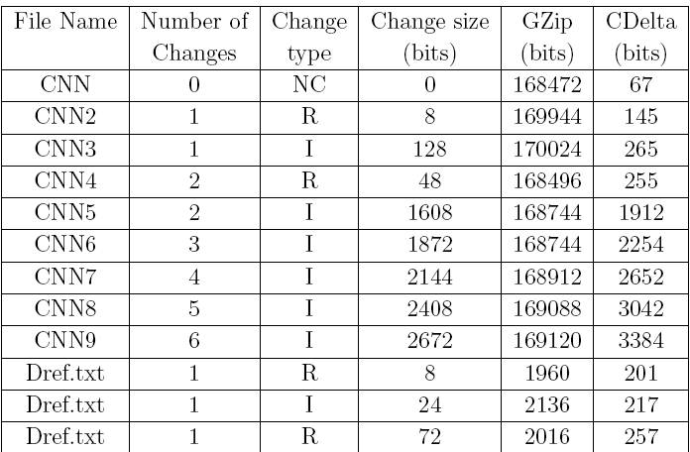
Results

Slide 41
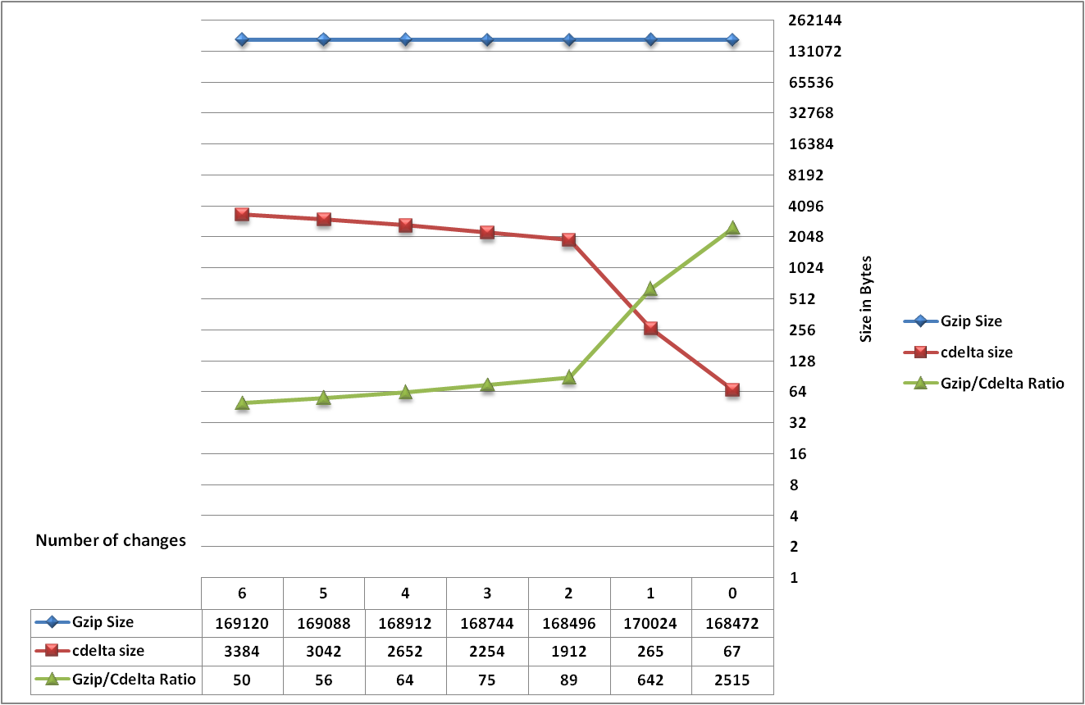
Results

Slide 42
Similar Works
T. Serebro - Modeling delta encoding of compressed files (2006)
S. Klein & D. Shapira - Compressed delta encoding for lzss encoded files (2007)

Slide 43
Contributions
Comprehensive solution Addresses insertion, deletion and replacement
local reference approach – no right to left decoding
CDELTA -New Delta File scheme
Ongoing Dependency chain breaking

Slide 44
Contributions
Utilization of textual data being produced uncompressed
Network perspective - devices along the path stores & forwards data (decoder compressed output)
Implementation of the algorithms – a proof of concept

Slide 45
Thank You

Slide 46
Chain Breaking

