Slide 1
Efficient Eager XPath Filtering over XML Streams
Kazuhito Hagio Takashi Ohgami
Hideo Bannai Masayuki Takeda
Kyushu University, Japan

Slide 2
Outline
XML data tree, XPath tree, embedding
Lazy algorithm
Eager algorithm
Extension to wider subclass of XPath
Conclusion

Slide 3
XML (Extensible Mark-up Language) [W3C, 1998]
XML document
<news>
<article>
<content> foo </content>
</article>
<article>
<keyword> bar </keyword>
</article>
<article>
<content>
<keyword> baz </keyword>
<keyword> hoge </keyword>
</content>
</article>
</news>
start tag
end tag
XML data tree
news
element node
article
article
article
text data
content
keyword
content
foo
bar
keyword
keyword
We omit the text nodes.
text node
baz
hoge

Slide 4
XML data tree
An XML data tree is an ordered tree where the nodes are labeled with tag-names.
a
a
a
b
a
b
c
b
c

Slide 5
XPath [W3C, 1999]
Language for specifying the selection of element nodes of within XML data trees
EX： /news/article[.//keyword]
news
article
article
article
news
article
article
child
content
keyword
content
article
child+
news の子の article で，
子孫に keyword を持つもの
keyword
keyword
keyword

Slide 6
Conjunctive XPath (CXP) tree
One important subclass of XPath.
A CXP tree is an unordered tree where
  the nodes are labeled with tag-names, and
  the edges are labeled with axes: child, child+.
a
a
child
child+
b
c
b
c

Slide 7
Embeddings
An embedding of P into D is a mapping from the nodes of P to the nodes of D such that for any node p of P:
  The label of p is preserved unless it is *.
  Each child of p is mapped to a child/proper descendant of the node to which p is mapped, according to the edge label.
child
child+
p
p
a
a
a
a
a
q
b
q
b
b
b
parent-child
ancestor-descendant

Slide 8
Embeddings
D
P
a
a
a
a
b
c
b
a
b
c
b
c

Slide 9
Occurrences
A CXP tree P is said to occur at u if there exists an embedding that maps root(P) to u.
D
P
a
a
a
a
b
c
b
a
b
c
b
c

Slide 10
Problem
AllOccurrence.
Given: a CXP tree P and an XML data tree D.
Find: all occurrences of P in D.
Applications.
  Filtering for XML data streams.
  Subroutine of XPath Query Evaluation algorithm.

Slide 11
Cf. Tree Inclusion Problem
[Kilpelainen&Mannila 95]
Differs from our problem in:
  Only child+ is allowed in the edge labels.
  Wild card * is not allowed in the node labels.
  Embedding should be an injection.
Unordered case: NP-complete.
Ordered case: O(|P||D|) time and space.
More efficient algorithms [e.g. Bille & Gørtz 05]

Slide 12
Streaming version
AllOccurrence (streaming version).
Given: a CXP tree P and a streaming XML data D=D[1..N].
Find: all occurrences of P in D.
a
a
a
b
a
b
depth-first traversal
<b>
</b>
c
b
c
 |  |  | _ |  |  | _ |  | _ | _ | _ |  |  |  | _ | _ | _ | _
a | a | b | b | a | c | c | b | b | a | a | a | b | c | c | b | a | a
Notes:
In this talk, we consider the streaming version of the problem,
Where input XML data tree is given as an XML data stream.
This is the XML data stream. We denote the start tag of b
as simply a, and the end tag of b as over-lined b.
We read from left to right the symbols of the XML data stream,
which corresponds to depth-first traversal of the tree.

Slide 13
Previous work
In-memory algorithm
  O(|P||D|) time and O(|D|) space.
  [Gottlob et al. 2005; Ramanan 2003]
Streaming algorithm
  O(|P||D|) time and O(r|P|log depth(D)) bits of space,
  where r is the recursion depth and r=O(depth(D)). [Gou and Chirkova 2007]
  O(|P||D|) time and O(|P| depth(D)) bits of space.
  [Ramanan 2009]
  These are lazy algorithms.

Slide 14
Main results
The first eager algorithm that uses O(|P||D|) time and O(|P| depth(D)) bits of space.
Extension to wider subclass of XPath.

Slide 15
Outline
XML data tree, XPath tree, embedding
Lazy algorithm
Eager algorithm
Extension to wider subclass of XPath
Conclusion

Slide 16
Predicate M(q,u)
For any node q of P and any node u of D, let
M(q,u)=T ⇔ the subtree rooted at q occurs at u
P
D
u
q

Slide 17
Hooked Subtree
Let q be any non-root node of P.
The hook of q is the edge between q and its parent.
The hooked subtree of q is the subtree rooted at q with hook.
P
Hook is labeled child or child+
q
q

Slide 18
Predicate T(q,u)
For any node q of P and any node u of D, let
T(q,u)=T ⇔ the hooked subtree of q hangs on u
child
child+
u
u
hang
hang
q
q
…
a child of u
a proper descendant of u

Slide 19
Computation of M(・, ・)
a
a
decompose
b
c
b
c
d
d
Lemma 1.
M(p, u)=(label(p)∈{label(u), *})∧(∧_{q is a child of p}T(q, u)).
node-labels are preserved
The hooked subtree of q hangs on u for every child q of p.

Slide 20
Computation of T(・, ・)
Lemma 2.
hook label of q

Slide 21
Lazy algorithm
for t:=1 to N do
if D[t] is the start-tag of node v then do nothing;
if D[t] is the end-tag of node v then
for each node q of P in post-order do
M[q, v]:=(label(q) ∈{label(v),＊})
∧ (∧_{c is a child of q} T[c, v]);
if v has parent u then
if χ(q)=child then T[q, u]:=T[q, u] ∨M[q, v];
if χ(q)=child+ then T[q, u]:=T[q, u] ∨M[q, v] ∨T[q, v];
if M[root(P), v] then report an occurrence at v;
Lemma 1
Lemma 2
Time: O(|P||D|) Space: O(|P||D|)

Slide 22
Lazy algorithm
for t:=1 to N do
if D[t] is the start-tag of node v then do nothing;
if D[t] is the end-tag of node v then
for each node q of P in post-order do
M[q, v]:=(label(q) ∈{label(v),＊})
∧ (∧_{c is a child of q} T[c, v]);
if v has parent u then
if χ(q)=child then T[q, d(u)]:=T[q, d(u)] ∨M[q, d(v)];
if χ(q)=child+ then T[q, d(u)]:=T[q, d(u)] ∨M[q, d(v)] ∨T[q, d(v)];
if M[root(P), d(v)] then report an occurrence at v;
Lemma 1
Lemma 2
Time: O(|P||D|) Space: O(|P|depth(D))

Slide 23
Move of Lazy Algorithm
Animation

Slide 24
Outline
XML data tree, XPath tree, embedding
Lazy algorithm
Eager algorithm
Extension to wider subclass of XPath
Conclusion

Slide 25
Delay in reporting pattern occurrences
Lazy algorithm causes an unnecessary delay in reporting pattern occurrences.

Slide 26
Delay (1/3)
a
a
b
c
a
a
b
a
b
c
b
c
delay
 |  |  | _ |  |  | _ |  | _ | _ | _ |  |  |  | _ | _ | _ | _
a | a | b | b | a | c | c | b | b | a | a | a | b | c | c | b | a | a

Slide 27
Delay (2/3)
a
a
b
c
a
a
b
a
b
c
b
c
delay
 |  |  | _ |  |  | _ |  | _ | _ | _ |  |  |  | _ | _ | _ | _
a | a | b | b | a | c | c | b | b | a | a | a | b | c | c | b | a | a

Slide 28
Delay (3/3)
a
a
b
c
a
a
b
a
b
c
b
c
delay
 |  |  | _ |  |  | _ |  | _ | _ | _ |  |  |  | _ | _ | _ | _
a | a | b | b | a | c | c | b | b | a | a | a | b | c | c | b | a | a

Slide 29
Definition of “Eagerness”
For any instant t∈[1..N], define M_{t}(q,u) to be:
  T, if the first t symbols of D imply M(q,u)=T,
  independently of the succeeding symbols.
  F, if the first t symbols of D imply M(q,u)=F,
  independently of the succeeding symbols.
  U, if the first t symbols of D do not convey
  sufficient information to decide the value M(q,u).
true
false
uncertain
  A steaming algorithm for AllOccurrence is eager if it correctly computes M_{t}(root(P),u) for all nodes u of D for any instant t.

Slide 30
The Idea for Eager Processing
Every time we find M[q,v]=T,
immediately raise the information
to the ancestors of v.
Time complexity might be O(|P||D|height(D))
or more?
We can do it only in O(|P||D|) time.

Slide 31
Move of Eager Algorithm
Animation

Slide 32
Eager Algorithm (1/2)
for t:=1 to N do
if D[t] is the start-tag of node v then
for each node q of P in post-order do updateM(q, v);
if D[t] is the end-tag of node v then
for each node q of P in post-order do
if M[q, v]=U then updateM(q, v);
if T[q, v]=U then T[q, v]:=F;
procedure updateM(q, v);
M[q, v]:=(label(q) ∈{label(v),＊}) ∧ (∧_{c is a child of q} T[c, v]);
if M[q, v]=T then
if q=root(P) then report an occurrence at v;
else updateT(q, v);
∧ | T | F | U
T | T | F | U
F | F | F | F
U | U | F | U

Slide 33
Eager Algorithm (2/2)
procedure updateT(q, v);
u := the parent of v;
p := the parent of q;
switch χ(q) do
case child :
if u≠nil and T[q, u]=U then
T[q, u]:=T; updateM(p, u);
case child+ :
while u≠nil and T[q, u]=U do
T[q, u]:=T; updateM(p, u);
u := the parent of u;

Slide 34
Time Complexity (amortized analysis)
For every (q,v), M[q,v] (T[q,v]) is initially set to U and changed exactly once into T or F.
updateT(q,v) is invoked only when
M[q,v] is changed from U into T, and therefore the total number of executions of updateT
is O(|P||D|).
Every iteration of the while-loop in updateT
changes T[q,u] from U to T, and therefore
the total number of iterations is O(|P||D|).
The over-all time complexity is O(|P||D|).

Slide 35
Outline
XML data tree, XPath tree, embedding
Lazy algorithm
Eager algorithm
Extension to wider subclass of XPath
Conclusion

Slide 36
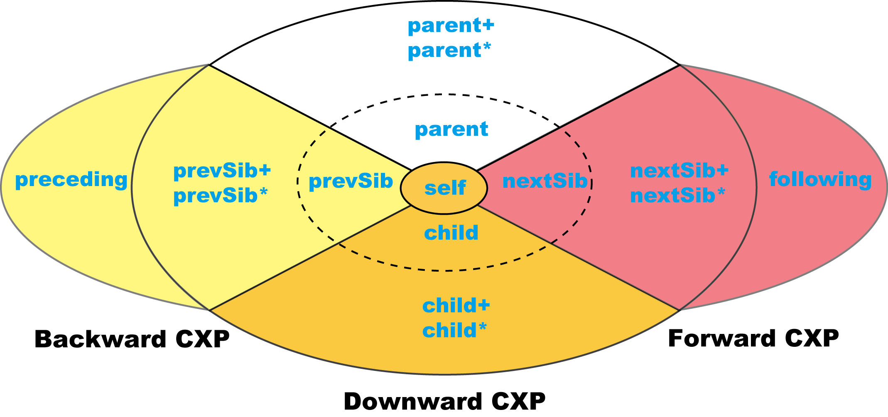
Axes other than child and child⁺
  child={(x,y)|x is the immediately left sibling of y} parent=child⁻¹
  nextSib={(x,y)|x is the next sibling of y} prevSib=nextSib⁻¹
  The +-closure and the ＊-closure of the above four relations.
  following=child+ prevSib* parent+ preceding=following⁻¹
  self={(x,x)|x is a node}

Slide 37
Downward CXP
All the nodes of P are mapped to descendants of the node u
to which root(P) is mapped.
D
P
u

Slide 38
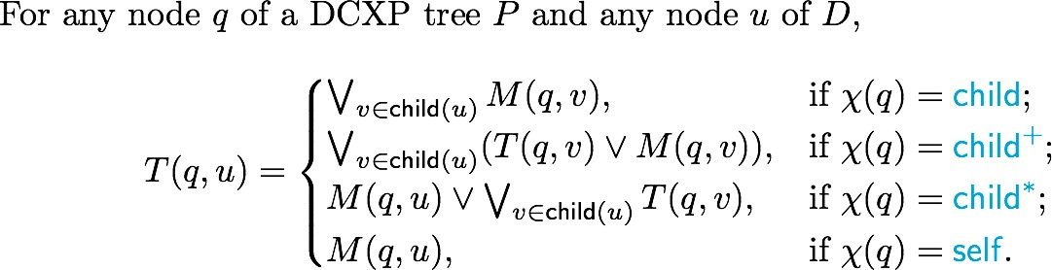
Downward CXP
Our algorithm can easily be modified to cope with Downward CXP.

Slide 39
Backward CXP
All the nodes of P are mapped to descendants or predecessors of the node u to which root(P) is mapped.
D
P
u

Slide 40
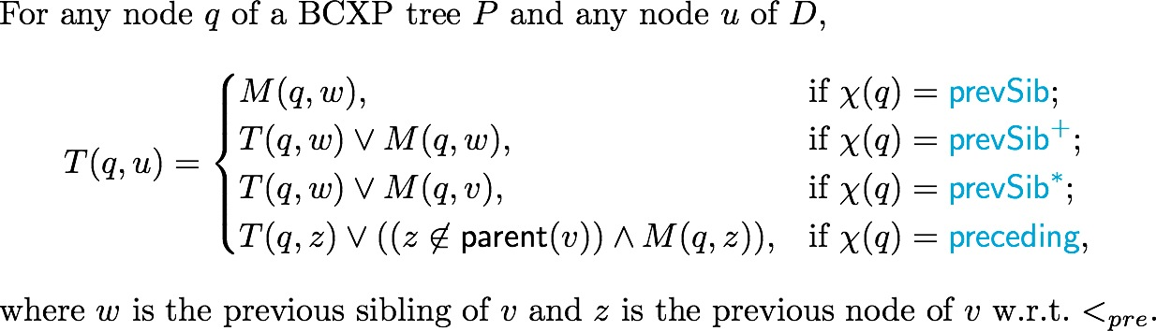
Backward CXP
Our algorithm can be extended to
Backward CXP, without increasing the computational complexity.

Slide 41
Conclusion
An eager streaming algorithm solving AllOccurrence for Downward CXP,
which takes O(|P||D|) time and O(|P| depth(D)) bits of space.
The computational complexity is
the same as the lazy algorithm [Rammanan 2009].
Extended to Backward CXP.

Slide 42
Query Evaluation Problem
To develop an eager streaming algorithm for QueryEvaluation.
QueryEvaluation.
Given: a CXP tree P, a node q_{out} of P and an XML data tree D.
Find: { φ(q_{out}) | φ is an embedding of P into D}.
Best known algorithm [Rammanan 2009].
  O(height(D)|P|+n·maxcands(P,D)) space
  → worst case optimal
  O((|P|+height(D)·n)|D|) time
  Lazy algorithm.
a
child+
q_{out}
b
b
b
child
child
c
d
n | length of path from root(P) to q_{out}
maxcand(P,D) | maximum number of candidates for answer nodes in any instant

Slide 43
Future Work
To develop an eager streaming algorithm for QueryEvaluation with the same computational complexity.

Slide 44
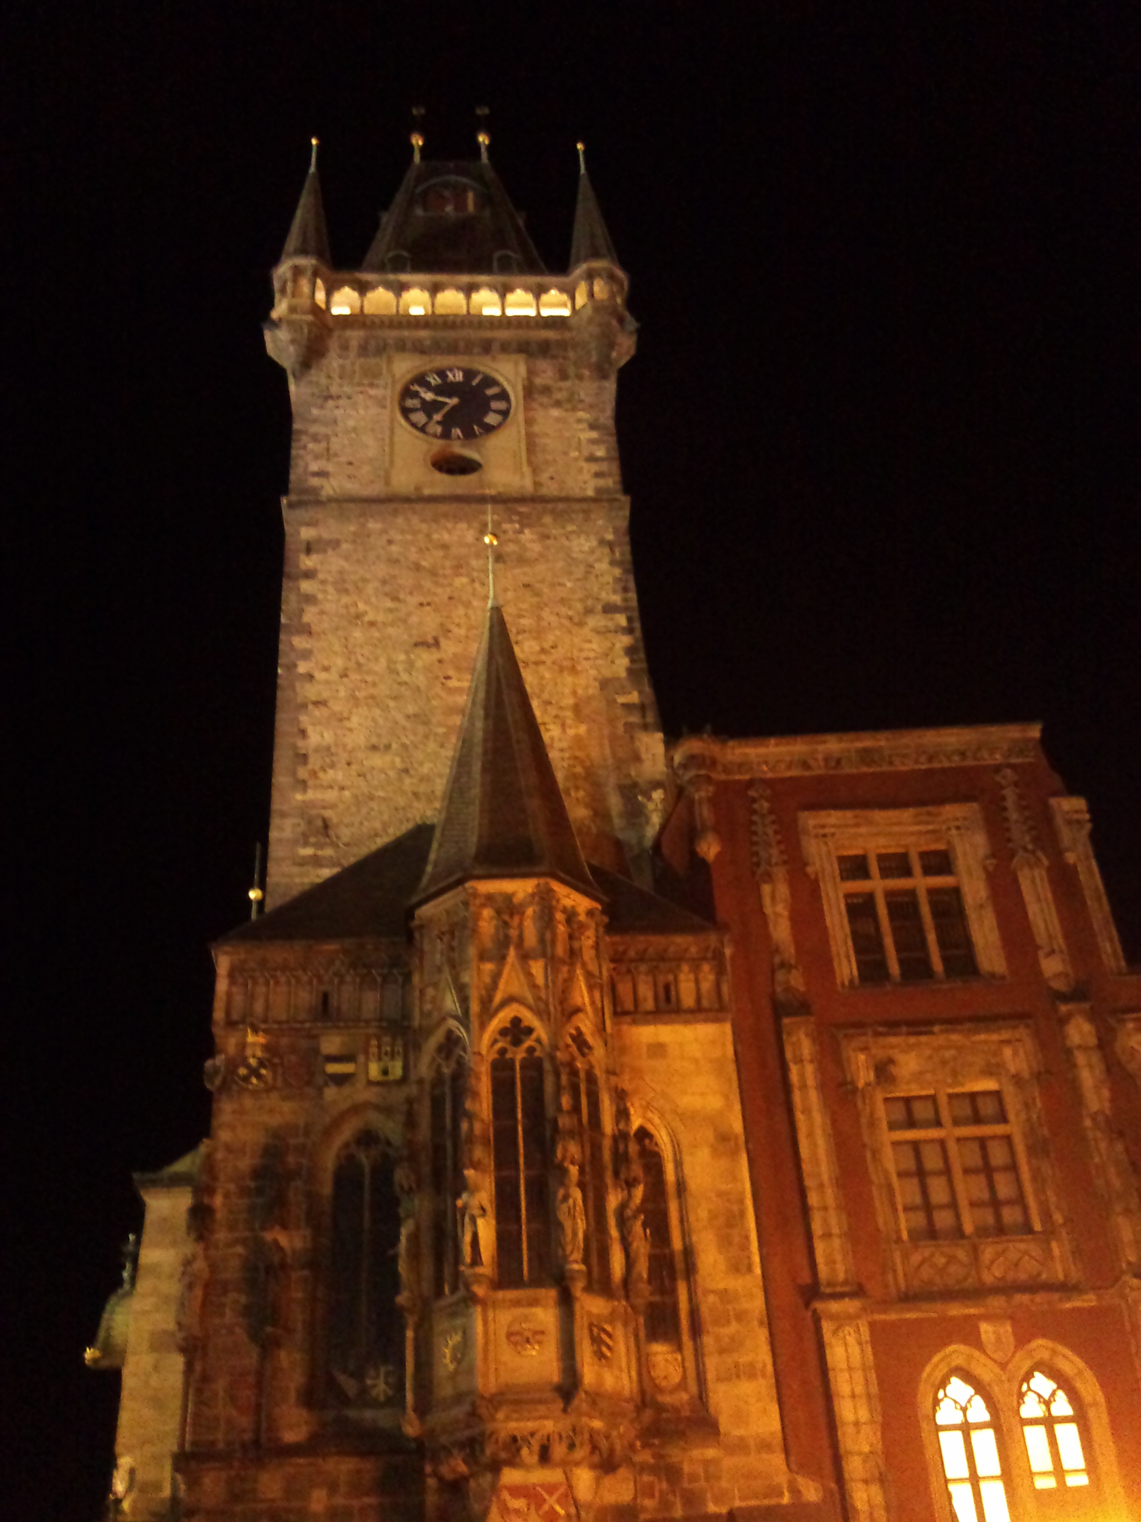
Thank you very much
I ♥ PRG

