Slide 1
Computing Longest Common
Substring/Subsequence of Non-linear Texts
Kouji Shimohira, Shunsuke Inenaga,
Hideo Bannai, Masayuki Takeda
Kyushu University, Japan
Notes:
I’d like to talk about our paper entitled “Computing Longest Common Substring/Subsequence of Non-linear Texts”
And my name is kouji Shimohira, from kyusyu university, Japan.
(This is the my first international conference.
and I am very tensed up.)
OK, Let’s start.

Slide 2
Outline
Non-linear Text
Computing Longest Common Subsequence of Acyclic Non-linear Texts
Computing Longest Common Subsequence of Cyclic Non-linear Texts
Conclusions and Future works
Notes:
This is outline of this talk.
At first, I will describe what “Non-linear text” are.
Next, I will introduce two problems and algorithms to solve these.
And finally I will conclude this talk and present future works.

Slide 3
Outline
Non-linear Text
Computing Longest Common Subsequence of Acyclic Non-linear Texts
Computing Longest Common Subsequence of Cyclic Non-linear Texts
Conclusions and Future works
Notes:
First of all, I introduce non-Linear text.

Slide 4
Non-linear Text
Non-linear Text G = (V,E,L）
A directed graph with vertices labeled by characters.
V : the set of vertices.
E : the set of arcs.
L : V → Σ ： a labeling function.
e.g.
V = ｛ v₁ , v₂ , v₃ , v₄ , v₅ , v₆ , v₇ , v₈ , v₉ ｝
E = ｛(v₁,v₂),(v₂,v₃),(v₂,v₇),(v₃,v₄),(v₄,v₅),
(v₅,v₆),(v₆,v₇),(v₆,v₈),(v₇,v₈),(v₈,v₉)｝
L = ｛ v₁ → a, v₂ → b, v₃ → c, v₄ → a, v₅ → a,
v₆ → b, v₇ → b, v₈ → a, v₉ → c ｝
G
c ₃
a ₄
a ₅
b ₆
a ₁
b ₂
a ₈
c ₉
b ₇
Notes:
Non-linear text is a directed graph with vertices labeled by characters.
And, it is defined by the set of vertices V, the set of arcs E and a labeling function L.
L maps each vertex in V to a character.
this is an example of non-linear text.
G is a non-linear text in which each vertex is labeled with a single character.

Slide 5
Non-linear Text
L(v) : the character label of vertex v
P(v) : the set of paths that end at vartex v.
L(P(v)) : the set of strings spelled by paths in P(v)
P(G) : the set of paths in G. ( P(G) = {P(v) | v∈V } )
L(P(G)) : the set of strings spelled by paths in P(G) (= L(G))
substr(L(G)) : the set of substrings of strings in L(G)
subseq(L(G)) : the set of subseqences of strings in L(G)
e.g.
L(v_{７}) = b
G’
c ₃
a ₄
a ₅
b ₆
P(v_{７}) = {v₁v₂v₃v₄v₅v₆v₇ , v₁v₂v₇ }
a ₁
b ₂
a ₈
c ₉
L(P(v_{７})) = {abcaabb , abb }
b ₇
bcaa ∈ substr(L(G))
aca ∈ subseq(L(G))
Notes:
Here, let L(v) be the character label of vertex v.
P(v) is the set of paths that end at vartex v.
L(P(v)) is the set of strings spelled by paths in P(v).
P(G) is the set of paths in G.
So namely P(G) equals union of P(v)s.
L(P(G)) is the set of strings spelled by pathes in P(G).
To simplify, in this talk, I call it L(G).
substr(L(G)) is the set of substring of strings in L(G).
and subseq(L(G)) is the set of subsequence of strings in L(G).
for example, L(v7) equals b.
P(v7) equals the set of v1v2v3v4v5v6v7 and v1v2v7.
L(P(v7)) equals the set of abcaabb and abb.
a string “bcaa” is in substr(L(G)).
and a string “aca”is in subseq(L(G))

Slide 6
Algorithms on Non-linear Text
problem | text | pattern | time complexity
Substring Matching | acyclic graph | linear | O(n+m|E|) [Park ＆ Kim, 1995]
 | tree | linear | O(n) [Akutsu, 1993]
 | graph | linear | O(n+m|E|) [Amir et al, 1997]
Approximate Matching | graph with edit operations | linear | NP-complete [Amir et al, 1997]
 | graph | linear with edit operations | O(m(n+e)) [Navarro, 2000]
 | text 1 | text 2
Longest Common Substring | acyclic graph | acyclic graph | O(|E₁||E₂|) (this work)
 | graph | acyclic graph | O(|E₁||E₂|) (this work)
Longest Common Subsequence | acyclic graph | acyclic graph | O(|Σ|²|E₁||E₂|) [Thang, 2011]
 | acyclic graph | acyclic graph | O(|E₁||E₂|) (this work)
 | graph | graph | O(|E₁||E₂|+|V₁||V₂|log|Σ|) (this work)
|E₁| : the number of arcs in text 1, |E₂| : the number of arcs in text 2, |Σ| : the alphabet size,
|V₁| : the number of vertices in text 1, |V₂| : the number of vertices in text 2.
Notes:
This table shows Algorithms on non-linear text
As you see, the previous works on pattern matching on non-linear texts assumed a linear pattern.
In this paper, we consider the longest common substring and longest common subsequence problems between two non-linear texts
First, If at least one of G₁ and G₂ is acyclic, then the Longest Common Substring problem can be solved in O(|E₁||E₂|) time.
Next, If G₁ and G₂ are acyclic, then the Longest Common Subseqence problem can be solved in O(|E₁||E₂|) time.
finaliy, If G₁ and/or G₂ is cyclic, then the Longest Common Subsequence problem can be solved in O(|E₁||E₂|+|V₁||V₂|log|Σ|) time.
Very recently, an algorithm to solve the Longest Common Subsequence problem between two acyclic non-linear texts is shown by Thang.
Compared to this work, our algorithms are faster and also apply to general graphs.
Today, I will show two Algorithms to compute the Longest Common subsequence on Non-linear texts,
because, the longest common substring can be computed to apply the Algorithm for subsequence.
色かえる
僕が研究した内容はこの三つです．
まず，サイクルを含まない非線形テキストにおける最長共通部分文字列問題を解きました，
また，同様の場合の最長共通部分列問題も解きました．
さらに，サイクルを含む場合の最長共通部分列問題をこの時間で解きました，（＊）
今回は時間の都合上，下の二つについて話したいと思います。

Slide 7
Outline
Non-linear Text
Computing Longest Common Subsequence of Acyclic Non-linear Texts
Computing Longest Common Subsequence of Cyclic Non-linear Texts
Conclusions and Future works
Notes:
now, I will talk about computing Longest common subsequence of acyclic Non-linear texts.

Slide 8
Longest Common Subsequence Problem for Acyclic Non-linear Texts
Problem 1
Input : Acyclic non-linear texts G₁=(V₁, E₁, L₁) and G₂=(V₂, E₂, L₂)
Output : Length of longest string in subseq(G₁)∩subseq(G₂)
e.g.
subseq(G₁) = { a ,b, c, d, ab, ac, ad, bb, bc, bd, cb, cd, db, abb, abc, abd, acb, acd, adb, bcb, bcd, bdb, cdb, abcb, abcd, abdb, acdb, bcdb, abcdb }
a ₁
c ₃
G₁
a ₁
b ₂
c ₃
c ₄
d ₅
b ₆
d ₅
b ₆
subseq(G₂) = { a, b, c, d, ab, ac, ad, ba, ca, cb, cd, da, db, aba, aca, acb, acd, ada, adb, cba, cda, cdb, dba, acba, acda, acdb, adba, cdba, acdba }
a ₁
c ₂
a ₁
c ₂
d ₃
G₂
d ₃
d ₄
b ₅
a ₆
b ₅
Output = 4
Notes:
First of all
I will introduce the longest common subsequence problem for acyclic non-linear texts.
Given two acyclic non-linear texts G₁ and G₂ ,The problem is to compute the length of a longest common subsequence of them.
Look at the example, given two acyclic non-linear texts like these,
subseq(G1) and subseq(G2) are these respectevely.
In this example, solution to the problem is 4, since there is longest common subsequence “acdb”.

Slide 9
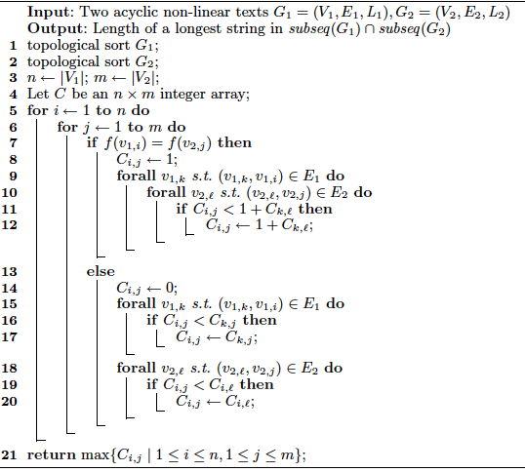
Algorithm 1
Algorithm 1 : Computing the length of longest common
subsequence of acyclic non-linear texts
Sort vertices of G₁ and G₂ in
topological order
Let C be a |V₁|×|V₂| integer table
(C_{i,j} : the length of a longest string
in subseq(P(v_{1,i}))∩subseq(P(v_{2,j}))
Compute C_{i,j} using dynamic programing for all 1≦ i ≦ |V₁| and 1≦ j ≦ |V₂|
Return max C_{i,j}
Notes:
Next,
I will present the algorithm to solve Problem 1.
This is a pseudo-code of it.
first, Sort vertices of G₁ and G₂ in topological order.
Next, Let C be a |V₁|×|V₂| integer table.
Here, the value of C_{i,j} will hold the length of a longest string in intersection of subseq(P(v_{1,i})) and subseq(P(v_{2,j}))
Then, Computing C_{i,j} using dymnamic programing for all i from 1 to |V1| and j from 1 to |V2|.
finary, the value of max Cij is solution to the problem.
I will explain it in detail. using an example.

Slide 10
Topological Sort
Sort vertices of G₁ and G₂ in topological order
G₁
a ₁
b ₂
G₁
a ₁
b ₂
c ₃
c ₃
c ₄
c ₄
d ₅
b ₆
sort
v_{1,1}
v_{1,2}
v_{1,3}
v_{1,4}
v_{1,5}
v_{1,6}
d ₅
a ₁
c ₂
d ₃
G₂
b ₆
G₂
a ₁
c ₂
d ₃
d ₄
b ₅
b ₆
d ₄
b ₅
a ₆
v_{2,1}
v_{2,2}
v_{2,3}
v_{2,4}
v_{2,5}
v_{2,6}
Notes:
given these two acyclic non-linear texts, compute the longest common subsequence of these.
first, sort vertices of G1 and G2 in topological order
and number the vertices from 1 to the size of V1 and V2.

Slide 11
Dynamic Programing table
Let C be a |V₁|×|V₂| integer table
(C_{i,j} : the length of a longest string in subseq(P(v_{1,i}))∩subseq(P(v_{2,j}))
G₁
a ₁
G₂
b ₂
a ₁
c ₂
d ₃
d ₄
b ₅
b ₆
C
c ₃
G₁
a ₁
c ₄
b ₂
d ₅
c ₃
G₂
b ₆
c ₄
a ₁
c ₂
d ₃
d ₄
b ₅
b ₆
d ₅
b ₆
Notes:
Next, let C be a V1 ×(times) V2 integer table.
each row of table C corresponds the vertex in G1,
and each column of table C corresponds the vertex in G2.
Here Cij is the length of the longest common subsequence of strings that end at v1,i and v2,j.
We will compute Cij for all i and j using dynamic programing.

Slide 12
L₁(v_{1,i}) ≠ L₂(v_{2,j})
Compute C_{i,j} using dynamic programing for all 1≦ i ≦ |V₁| and 1≦ j ≦ |V₂|
If L₁(v_{1,i}) ≠ L₂(v_{2,j}) then
C_{i,j} = max ({ C_{k,j} | (v_{1,k} , v_{1,i})∈E₁}∪{C_{i,ℓ} | (v_{2,ℓ} , v_{2,j})∈E₂}∪{0})
G₂
a ₁
c
b ₅
b ₆
c ₂
d ₃
d ₄
C
d ₃
d ₄
a
_{S} |  | _{1,1} |  | _{1,2} |  | _{1,1} |  | _{1,2} |  | _{S}
 | 1 |  | 1 |  | 1 |  | 1 |  | 1 |  | 1
_{1,1} |  | _{1,2} |  | _{1,3} |  | _{1,4} |  | _{1,2} |  | _{2,5}
 | 1 |  | 1 |  | 1 |  | 1 |  | 2 |  | 2
_{2,1} |  | _{2,1} |  | _{3,2} |  | _{2,4} |  | _{2,5} |  | _{2,6}
 | 1 |  | 2 |  | 2 |  | 1 |  | 2 |  | 2
_{S} |  | _{S} |  | _{4,3} |  | _{4,1} |  | _{4,2} |  | _{4,5}
 | 0 |  | 1 |  | 1 |  | 0 |  | 1 |  | 1
_{1,1} |  | _{3,2} |  | _{3,2} |  | _{1,1} |  | _{5,3}
 | 1 |  | 2 |  | 3 |  | 2 |  | 3
G₁
a ₁
G₁
a ₁
b ₂
c ₃
b ₂
c ₄
d ₅
b ₆
c ₃
c
c ₄
c
G₂
a ₁
c ₂
d ₃
d ₅
d ₄
b ₅
a ₆
b ₆
Notes:
First let’s consider the case where the vertex labels are different.
suppose we are computing the value of this element C55.
focus on the vertices that have out going arcs to this vertex v1,5.
we consider the elements which are in the rows of the vertices and in the colum of v2,5.
similarly, we also consider these elements.
the value for this element is the maximum of the values, according to this formula.
辺がないときは、０を入れる
このように二つの非線形テキストが与えられたときに，
T１の各頂点に行，T２の各頂点に列を対応させた行列を上の式で行方向に埋めていきます．
例えば（＊）C-５-５の値を求めたいときは（＊）T１の五番目の頂点とT２の五番目の頂点の文字が一致していないので，
下の式によって，値を求めます．
T１の五番目の頂点への有向辺を持つ頂点（＊）が対応する行（＊）とT２の五番目の頂点の列（＊）との交点（＊）と
T2の五番目の頂点への有向辺を持つ頂点（＊）が対応する列（＊）とT１の五番目の頂点の行（＊）との交点（＊）
の内で最大のものをC-５-５の値とします．

Slide 13
L₁(v_{1,i}) = L₂(v_{2,j})
Compute C_{i,j} using dynamic programing for all 1≦ i ≦ |V₁| and 1≦ j ≦ |V₂|
If L₁(v_{1,i}) = L₂(v_{2,j}) then
C_{i,j} = 1 + max ({ C_{k,ℓ} | (v_{1,k} , v_{1,i})∈E₁ , (v_{2,ℓ} , v_{2,j})∈E₂ }∪{0})
G₂
a ₁
c ₂
d ₃
b ₅
b ₆
d ₃
d ₄
C
c
d ₄
G₁
a ₁
_{S} |  | _{1,1} |  | _{1,2} |  | _{1,1} |  | _{1,2} |  | _{S}
 | 1 |  | 1 |  | 1 |  | 1 |  | 1 |  | 1
_{1,1} |  | _{1,2} |  | _{1,3} |  | _{1,4} |  | _{1,2} |  | _{2,5}
 | 1 |  | 1 |  | 1 |  | 1 |  | 2 |  | 2
_{2,1} |  | _{2,1} |  | _{3,2} |  | _{2,4} |  | _{2,5} |  | _{2,6}
 | 1 |  | 2 |  | 2 |  | 1 |  | 2 |  | 2
_{S} |  | _{S} |  | _{4,3} |  | _{4,1} |  | _{4,2} |  | _{4,5}
 | 0 |  | 1 |  | 1 |  | 0 |  | 1 |  | 1
_{1,1} |  | _{3,2} |  | _{3,2} |  | _{1,1} |  | _{5,3} |  | _{5,5}
 | 1 |  | 2 |  | 3 |  | 2 |  | 3 |  | 3
_{3,1} |  | _{3,2} |  | _{5,3} |  | _{5,4} |  | _{5,3}
 | 1 |  | 2 |  | 3 |  | 2 |  | 4
G₁
a ₁
b ₂
c ₃
b ₂
c ₄
d ₅
b ₆
c ₃
c ₃
c ₄
G₂
a ₁
c ₂
d ₃
d ₅
d ₅
d ₄
b ₅
a ₆
b ₆
+1
Notes:
the other case is where the vertex labels are same.
suppose we are computing the value of this element C65.
focus on the vertices that have out going arcs to this vertex v1,6 and vertices that have outgoing arcs to this vertex v2,5.
we consider the elements which are in the rows of these vertices and in the colums of these vertices.
the value for this element is the maximum of the values +(plus) 1, according to this fomula.
両方とも辺がないときは0を入れる。
このように二つの非線形テキストが与えられたときに，
T１の各頂点に行，T２の各頂点に列を対応させた行列を上の式で行方向に埋めていきます．
例えば（＊）C-５-５の値を求めたいときは（＊）T１の五番目の頂点とT２の五番目の頂点の文字が一致していないので，
下の式によって，値を求めます．
T１の五番目の頂点への有向辺を持つ頂点（＊）が対応する行（＊）とT２の五番目の頂点の列（＊）との交点（＊）と
T2の五番目の頂点への有向辺を持つ頂点（＊）が対応する列（＊）とT１の五番目の頂点の行（＊）との交点（＊）
の内で最大のものをC-５-５の値とします．

Slide 14
Output
Return max C_{i,j}
max C_{i,j} = 4
Output : 4
G₂
a ₁
c ₂
d ₃
d ₄
b ₅
b ₆
C
G₁
a ₁
_{S} |  | _{1,1} |  | _{1,2} |  | _{1,1} |  | _{1,2} |  | _{S}
 | 1 |  | 1 |  | 1 |  | 1 |  | 1 |  | 1
_{1,1} |  | _{1,2} |  | _{1,3} |  | _{1,4} |  | _{1,2} |  | _{2,5}
 | 1 |  | 1 |  | 1 |  | 1 |  | 2 |  | 2
_{2,1} |  | _{2,1} |  | _{3,2} |  | _{2,4} |  | _{2,5} |  | _{2,6}
 | 1 |  | 2 |  | 2 |  | 1 |  | 2 |  | 2
_{S} |  | _{S} |  | _{4,3} |  | _{4,1} |  | _{4,2} |  | _{4,5}
 | 0 |  | 1 |  | 1 |  | 0 |  | 1 |  | 1
_{1,1} |  | _{3,2} |  | _{3,2} |  | _{1,1} |  | _{5,3} |  | _{5,5}
 | 1 |  | 2 |  | 3 |  | 2 |  | 3 |  | 3
_{3,1} |  | _{3,2} |  | _{5,3} |  | _{5,4} |  | _{5,3} |  | _{6,5}
 | 1 |  | 2 |  | 3 |  | 2 |  | 4 |  | 4
G₁
a ₁
b ₂
c ₃
b ₂
c ₄
d ₅
b ₆
c ₃
c ₄
G₂
a ₁
c ₂
d ₃
d ₅
d ₄
b ₅
a ₆
b ₆
Notes:
we fill the table in this way
and find the maximum value in the table.
this value is solution to the problem.
両方とも辺がないときは0を入れる。
このように二つの非線形テキストが与えられたときに，
T１の各頂点に行，T２の各頂点に列を対応させた行列を上の式で行方向に埋めていきます．
例えば（＊）C-５-５の値を求めたいときは（＊）T１の五番目の頂点とT２の五番目の頂点の文字が一致していないので，
下の式によって，値を求めます．
T１の五番目の頂点への有向辺を持つ頂点（＊）が対応する行（＊）とT２の五番目の頂点の列（＊）との交点（＊）と
T2の五番目の頂点への有向辺を持つ頂点（＊）が対応する列（＊）とT１の五番目の頂点の行（＊）との交点（＊）
の内で最大のものをC-５-５の値とします．

Slide 15
Time Complexity
Sort vertices of G₁ and G₂ in
topological order
Linear time
Let C be a |V₁|×|V₂| integer table
(C_{i,j} : the length of a longest string
in subseq(P(v_{1,i}))∩subseq(P(v_{2,j}))
Compute C_{i,j} using dynamic programing for all 1≦ i ≦ |V₁| and 1≦ j ≦ |V₂|
O(|E₁||E₂|) time
Return max C_{i,j}
Notes:
Next, I talk about time complexity for algorithm 1.
First, it is well-known that topological sort can be computed in linear time.
Next, time complexity for this step is this time.
I will show it.
計算量についてです．
まず，トポロジカルソートは有向グラフに線形な時間で計算可能なので（＊）このようになります．
頂点の文字が一致した場合は（＊）アルゴリズム全体でO(E1E2)となります．
また，不一致の場合は，（＊）辺の数に線形な時間で計算可能です．（＊）
よってこのアルゴリズムの計算量は（＊）O(E1E2)時間，
また，領域計算量は行列を構成するだけなので，O(nm)領域で計算可能です．

Slide 16


Time Complexity
Compute C_{i,j} using dynamic programing for all 1≦ i ≦ |V₁| and 1≦ j ≦ |V₂|
case of L₁(v_{1,i}) ≠ L₂(v_{2,j})
e_{i} : the number of arcs incoming to v_{1,i}
G₂
f_{j} : the number of arcs incoming to v_{2,j}
a ₁
c
b ₅
b ₆
c ₂
d ₃
d ₄
C
d ₃
d ₄
a
_{S} |  | _{1,1} |  | _{1,2} |  | _{1,1} |  | _{1,2} |  | _{S}
 | 1 |  | 1 |  | 1 |  | 1 |  | 1 |  | 1
_{1,1} |  | _{1,2} |  | _{1,3} |  | _{1,4} |  | _{1,2} |  | _{2,5}
 | 1 |  | 1 |  | 1 |  | 1 |  | 2 |  | 2
_{2,1} |  | _{2,1} |  | _{3,2} |  | _{2,4} |  | _{2,5} |  | _{2,6}
 | 1 |  | 2 |  | 2 |  | 1 |  | 2 |  | 2
_{S} |  | _{S} |  | _{4,3} |  | _{4,1} |  | _{4,2} |  | _{4,5}
 | 0 |  | 1 |  | 1 |  | 0 |  | 1 |  | 1
_{1,1} |  | _{3,2} |  | _{3,2} |  | _{1,1} |  | _{5,3} |  | _{5,5}
 | 1 |  | 2 |  | 3 |  | 2 |  | 3 |  | 3
_{3,1} |  | _{3,2} |  | _{5,3} |  | _{5,4} |  | _{5,3} |  | _{6,5}
 | 1 |  | 2 |  | 3 |  | 2 |  | 4 |  | 4
To compute the value of C_{i,j} ,
e_{i} + f_{j} elements in table C are used.
G₁
a ₁
b ₂
To compute C_{i,j} for all 1≦ i ≦ |V₁| and 1≦ j ≦ |V₂|
c ₃
c
c ₄
c
d ₅
b ₆
= O(|E₁||E₂|)
Notes:
There are two cases to consider.
first is the case where the vertex labels are different like this example.
here, let e,i be the number of arcs incoming to v1j.
let f,j be the number of arcs incoming to v2,j
To compute the value of Cij, e,i +(plus) f,j elements are used.
In this example, e5=3 and f5=3.
And these six elements are used to compute the value of C55,
To fill the table C, the total number of elements used is the sum ei + fj for all i and j, which equals V2E1 + V1E2.

Slide 17


Time Complexity
Compute C_{i,j} using dynamic programing for all 1≦ i ≦ |V₁| and 1≦ j ≦ |V₂|
case of L₁(v_{1,i}) = L₂(v_{2,j})
e_{i} : the number of arcs incoming to v_{1,i}
G₂
f_{j} : the number of arcs incoming to v_{2,j}
a ₁
c ₂
d ₃
b ₅
b ₆
d ₃
d ₄
C
c
d ₄
To compute the value of C_{i,j} ,
e_{i}f_{j} elements in table C are used.
G₁
a ₁
_{S} |  | _{1,1} |  | _{1,2} |  | _{1,1} |  | _{1,2} |  | _{S}
 | 1 |  | 1 |  | 1 |  | 1 |  | 1 |  | 1
_{1,1} |  | _{1,2} |  | _{1,3} |  | _{1,4} |  | _{1,2} |  | _{2,5}
 | 1 |  | 1 |  | 1 |  | 1 |  | 2 |  | 2
_{2,1} |  | _{2,1} |  | _{3,2} |  | _{2,4} |  | _{2,5} |  | _{2,6}
 | 1 |  | 2 |  | 2 |  | 1 |  | 2 |  | 2
_{S} |  | _{S} |  | _{4,3} |  | _{4,1} |  | _{4,2} |  | _{4,5}
 | 0 |  | 1 |  | 1 |  | 0 |  | 1 |  | 1
_{1,1} |  | _{3,2} |  | _{3,2} |  | _{1,1} |  | _{5,3} |  | _{5,5}
 | 1 |  | 2 |  | 3 |  | 2 |  | 3 |  | 3
_{3,1} |  | _{3,2} |  | _{5,3} |  | _{5,4} |  | _{5,3} |  | _{6,5}
 | 1 |  | 2 |  | 3 |  | 2 |  | 4 |  | 4
b ₂
To compute C_{i,j} for all 1≦ i ≦ |V₁| and 1≦ j ≦ |V₁|
c ₃
c ₃
c ₄
d ₅
d ₅
b ₆
= O(|E₁||E₂|)
Notes:
Next is the case where vertex labels are same.
To compute the value of Ci,j, ei ×(times) fj elements are used
In this example, e6=2 and f5=3,
And these six elements are used to compute the value of C65,
To fill the table C, the total number of elements used is the sum ei × fj for all i and j, which equals E1E2.
Therefore the time complexity for this step is this time.

Slide 18
Time Complexity
Sort vertices of G₁ and G₂ in
topological order
Linear time
Let C be a |V₁|×|V₂| interger array
(C_{i,j} : the length of a longest string
in subseq(P(v_{1,i}))∩subseq(P(v_{2,j}))
Compute C_{i,j} using dymnamic programing for all 1≦ i ≦ |V₁| and 1≦ j ≦ |V₂|
O(|E₁||E₂|) time
Return max C_{i,j}
O(|V₁||V₂|) time
The total time complexity is O(|E₁||E₂|) time.
Notes:
Therefore the time complexity for this step is this time.
and final step can be computed, clearly, in this time.
Therefore the total time complexity for Algorithm 1 is this time.

Slide 19
Outline
Non-linear Text
Computing Longest Common Subsequence of Acyclic Non-linear Texts
Computing Longest Common Subsequence of Cyclic Non-linear Texts
Conclusions and Future works
Notes:
At until now I told about the case where the non-linear texts are acyclic.
Next I’d like to talk about the case where Non-linear texts are cyclic.

Slide 20
Longest Common Subsequence Problem for Cyclic Non-linear Texts
Problem 2
Input : Non-linear texts G₁=(V₁, E₁, L₁) and G₂=(V₂, E₂, L₂)
Output : ∞ (if subseq(G₁)∩subseq(G₂) is infinite)
The Length of longest string in subseq(G₁)∩subseq(G₂) (otherwise)
e.g. 1
G₁
a
a
c
Character “d” is in a cycle in both G₁ and G₂.
b
d
c
ccdccdccd······ ∈ L(G₁)
bdbdbdbd······ ∈ L(G₂)
G₂
a
c
d
dddddd········ ∈ subseq(G₁)∩subseq(G₂)
a
b
d
Output = ∞
Notes:
First I intriduce the longest common subseqence problem for cyclic non-linear texts.
The problem 2 is the same as Problem 1, excect that output can be infinty.
Since input texts can be cyclic, the strings produced from they can be infinitly long.
So, the length of the common subsequence of G1 and G2 can be also infinite.
In this case, we output infinity, otherwise we output the length of longest common subsequence of G1 and G2.
In this example, character “d” is in a cycle in both G1 and G2.
So string cddcdd………… is produced from G1.
and string bdbd………… is produced from G2.
So, a sequence “ddd……” is in the intersection of subseq(G1) and subseq(G2).
Therefore output is infinity.

Slide 21
Longest Common Subsequence Problem for Cyclic Non-linear Texts
Problem 2
Input : Non-linear texts G₁=(V₁, E₁, L₁) and G₂=(V₂, E₂, L₂)
Output : ∞ (if subseq(G₁)∩subseq(G₂) is infinite)
The Length of longest string in subseq(G₁)∩subseq(G₂) (otherwise)
e.g. 2
G₁
a
a
c
b
d
c
subseq(G₁)∩subseq(G₂) = {a, b, c, d, aa, ab, ac, ad, cd, aab, aac, aad, acd, aacd}
G₂
a
c
d
a
b
a
Output = 4
Notes:
Next, in the other example, there is no character in cycle in both of G1 and G2.
So the set of common sequence of G1 and G2 is finite.
And this is a set of common subsequence G1 and G2.
The longest string in this is “aacd”.
therefore, output is 4.
Now I will present the algorithm to solve Problem 2.

Slide 22
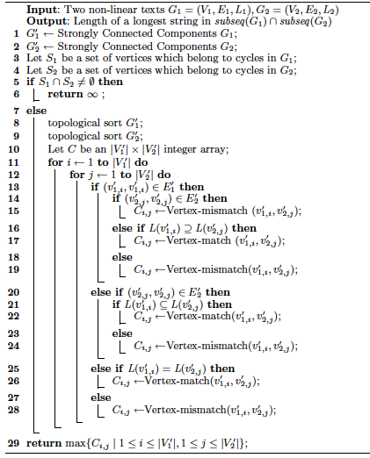
Algorithm 2
Algorithm 2 : Computing the length of longest common
subsequence of cyclic non-linear texts
Transform G₁ and G₂ into G’₁ and G’₂ based on the strongly connected components
Check whether subseq(G₁)∩subseq(G₂) is infinite or not
Sort vertices of G’₁ and G’₂ in
topological order
Let C be a |V’₁|×|V’₂| integer table
(C_{i,j} : the length of a longest string
in subseq(P(v’_{1,i}))∩subseq(P(v’_{2,j}))
Compute C_{i,j} using dynamic programing for all 1≦ i ≦ |V’₁| and 1≦ j ≦ |V’₂|
Return max C_{i,j}
Notes:
This is a pseudo code of Algorithm to solve Problem 2.
First transform G1 and G2, based on the strongly connected components.
Next, check whether output is infinity or not.
Then the rest is the same as Algorithm 1 for acyclic texts,
topological sort, compute Cij, and find maximum of table C.
Let me explain it in detail using an example.

Slide 23
Strongly Connected Component
Transform G₁ and G₂ into G’₁ and G’₂ based on the strongly connected components
G₁
a
a
c
G’₁
{a} ₁
{a} ₂
b
d
c
{b} ₃
{c,d} ₄
transform
G₂
a
c
d
G’₂
{a} ₁
{c} ₂
{d} ₃
a
b
a
{a,b} ₄
strongly connected component
cyclic non-linear texts
acyclic non-linear texts
Notes:
Given these cyclic non-linear text, compute the longest common subsequence of these.
first, group togather vertices which are strongly connected
so that each strongly connected component is contracted to a single vertex.
then the resulting graph is acyclic.
For technical reasons, we put self-loops on vertices that consist of more than one vertex.

Slide 24
Check whether output is infinity or not.
Check whether subseq(G₁)∩subseq(G₂) is infinite or not
S₁, S₂ : the union of sets of labels of vertices that have a self-loop in G’₁ , G’₂
case of S₁∩S₂ ≠ Ø
Let c be any character in S₁∩S₂.
An infinite repetition c* of c is a common subsequence of G₁ and G₂.
Hence, output = ∞.
case of S₁∩S₂ = Ø
subseq(G₁)∩subseq(G₂) is finite.
G’₁
{a} ₁
{a} ₂
G’₂
{a} ₁
{c} ₂
{d} ₃
S₁ = {c,d}
S₂ = {a}∪{a,b} = {a,b}
{b} ₃
{c,d} ₄
{a,b} ₄
S₁∩S₂ = {c,d}∩{a,b} = Ø
Notes:
Next, check whether output is infinity or not.
Let S1 and S2 be the union of sets of labels of vertices that have a self-loop in G’1 and G’2.
In this example, S1 is {c,d} and S2 is {a,b}.
There are two cases to consider.
First is the case where there is a character in the intersection of S1 and S2.
Let c be any character in the intersection of S1 and S2.
then an infinite repetition c* is a common subsequence of G1 and G2.
Hence, output is infinity.
Next case is where there is no character in the intersection of S1and S2.
In this case common subsequence of G1 and G2 is finite.
then goto next step.

Slide 25
Algorithm 2
Sort vertices of G’₁ and G’₂ in topological order
G’₁
{a} ₁
{a} ₂
G’₁
{b} ₃
{c,d} ₄
sort
{a} ₁
{a} ₂
{b} ₃
{c,d} ₄
v’_{1,1}
v’_{1,2}
v’_{1,3}
v’_{1,4}
G’₂
{a} ₁
{c} ₂
{d} ₃
G’₂
{a} ₁
{c} ₂
{d} ₃
{a,b} ₄
{a,b} ₄
v’_{2,1}
v’_{2,2}
v’_{2,3}
v’_{2,4}
Notes:
From here, do the same process of solusion to problem 1.
Sort vertices of G’1 and G’2 in topological order,
and number the vertices from 1 to the size of V’1 and V’2.

Slide 26
Algorithm 2
Let C be a |V’₁|×|V’₂| integer table
(C_{i,j} : the length of a longest string in subseq(P(v’_{1,i}))∩subseq(P(v’_{2,j}))
G’₂
G’₁
{a} ₁
{c} ₂
{d} ₃
{a,b} ₄
C
a ₁
a ₂
b ₃
{c,d} ₄
G’₁
 | 0 |  | 0 |  | 0 |  | 0
 | 0 |  | 0 |  | 0 |  | 0
 | 0 |  | 0 |  | 0 |  | 0
 | 0 |  | 0 |  | 0 |  | 0
{a} ₁
G’₂
{a} ₂
{a} ₁
c ₂
d ₃
{a,b} ₄
{b} ₃
{c,d} ₄
Notes:
Next, let C be a V’1 ×(times) V’2 integer table.
And each rows of table C corresponds the vertex in G’1,
and each columns of table C corresponds the vertex in G’2.
Here Cij is the length of the longest common subsequence of v'1,i and v2,j.
then compute Cij for all i and j using dynamic programing.

Slide 27
Algorithm 2
Compute C_{i,j} using dynamic programing for all 1≦ i ≦ |V’₁| and 1≦ j ≦ |V’₂|
If L’₁(v’_{1,i}) ∩ L’₂(v’_{2,j}) ≠ Ø then
C_{i,j} = 1 + max ({ C_{k,ℓ} | (v’_{1,k} , v’_{1,i})∈E’₁ , (v’_{2,ℓ} , v’_{2,j})∈E’₂ }∪{0})
G’₂
{a} ₁
{c} ₂
{c} ₂
{d} ₃
{a,b} ₄
{a} ₁
{a} ₂
C
G’₁
G’₁
_{S} |  | _{1,1} |  | _{1,2} |  | _{S}
 | 1 |  | 1 |  | 1 |  | 1
_{1,1} |  | _{2,1} |  | _{2,2} |  | _{1,2}
 | 2 |  | 2 |  | 2 |  | 2
_{2,1} |  | _{2,2} |  | _{2,3} |  | _{2,2}
 | 2 |  | 2 |  | 2 |  | 3
_{2,1} |  | _{2,1} |  | _{4,2}
 | 2 |  | 3 |  | 4
{a} ₁
{b} ₃
{c,d} ₄
{a} ₂
{a} ₂
G’₂
{a} ₁
{c} ₂
{d} ₃
{b} ₃
{b} ₃
{a,b} ₄
0
0
+1
{c,d} ₄
{c,d} ₄
Notes:
Let me consider the case where the vertex labels are the same.
suppose we are compute the value of this element C43.
Focus on the vertices that have outgoing arcs to these vertices v1,4, v2,3.
We consider the elements which are in rows and colums of the vertices.
The value for this element is the maximum of value +(plus) 1, according to this fomula.

Slide 28
Algorithm 2
Compute C_{i,j} using dynamic programing for all 1≦ i ≦ |V’₁| and 1≦ j ≦ |V’₂|
If L’₁(v’_{1,i}) ∩ L’₂(v’_{2,j}) = Ø then
C_{i,j} = max ({ C_{k,j} | (v’_{1,k} , v’_{1,i})∈E’₁}∪{C_{i,ℓ} | (v’_{2,ℓ} , v’_{2,j})∈E’₂}∪{0})
G’₂
{a} ₁
{c} ₂
{d} ₃
{a,b} ₄
{a} ₁
{a} ₂
C
G’₁
G’₁
_{S} |  | _{1,1} |  | _{1,2} |  | _{S}
 | 1 |  | 1 |  | 1 |  | 1
_{1,1} |  | _{2,1} |  | _{2,2} |  | _{1,2}
 | 2 |  | 2 |  | 2 |  | 2
_{2,1} |  | _{2,2} |  | _{2,3} |  | _{2,2}
 | 2 |  | 2 |  | 2 |  | 3
_{2,1} |  | _{2,1} |  | _{4,2} |  | _{4,3}
 | 2 |  | 3 |  | 4 |  | 4
{a} ₁
{b} ₃
{c,d} ₄
{a} ₂
{a} ₂
G’₂
{a} ₁
{c} ₂
{d} ₃
{b} ₃
{b} ₃
{a,b} ₄
0
{c,d} ₄
{c,d} ₄
Notes:
Next, let me consider the other case where the vertex labels are different.
suppose we are computing the value of this element C4,4.
focus on the vertices that have outgoing arcs to this vertex v1,4.
we consider the elements which are in the rows of the vertices and in the colum of v2,4.

Slide 29
Algorithm 2
Compute C_{i,j} using dynamic programing for all 1≦ i ≦ |V’₁| and 1≦ j ≦ |V’₂|
If L’₁(v’_{1,i}) ∩ L’₂(v’_{2,j}) = Ø then
C_{i,j} = max ({ C_{k,j} | (v’_{1,k} , v’_{1,i})∈E’₁}∪{C_{i,ℓ} | (v’_{2,ℓ} , v’_{2,j})∈E’₂}∪{0})
G’₂
{a} ₁
{c} ₂
{c} ₂
{d} ₃
{d} ₃
{a,b} ₄
{a,b} ₄
{a} ₁
{a} ₂
C
G’₁
G’₁
_{S} |  | _{1,1} |  | _{1,2} |  | _{S}
 | 1 |  | 1 |  | 1 |  | 1
_{1,1} |  | _{2,1} |  | _{2,2} |  | _{1,2}
 | 2 |  | 2 |  | 2 |  | 2
_{2,1} |  | _{2,2} |  | _{2,3} |  | _{2,2}
 | 2 |  | 2 |  | 2 |  | 3
_{2,1} |  | _{2,1} |  | _{4,2} |  | _{4,3}
 | 2 |  | 3 |  | 4 |  | 4
{a} ₁
{b} ₃
{c,d} ₄
{a} ₂
G’₂
{a} ₁
{c} ₂
{d} ₃
{b} ₃
{a,b} ₄
0
{c,d} ₄
Notes:
similarly, we also consider these elements.
the value for this element is the maximum of the values, according to this fomula.

Slide 30
Output
Return max C_{i,j}
G’₂
{a} ₁
{c} ₂
{d} ₃
{a,b} ₄
{a} ₁
{a} ₂
C
G’₁
G’₁
_{S} |  | _{1,1} |  | _{1,2} |  | _{S}
 | 1 |  | 1 |  | 1 |  | 1
_{1,1} |  | _{2,1} |  | _{2,2} |  | _{1,2}
 | 2 |  | 2 |  | 2 |  | 2
_{2,1} |  | _{2,2} |  | _{2,3} |  | _{2,2}
 | 2 |  | 2 |  | 2 |  | 3
_{2,1} |  | _{2,1} |  | _{4,2} |  | _{4,3}
 | 2 |  | 3 |  | 4 |  | 4
{a} ₁
{b} ₃
{c,d} ₄
{a} ₂
G’₂
{a} ₁
{c} ₂
{d} ₃
{b} ₃
{a,b} ₄
{c,d} ₄
Notes:
Finally, find the maximum value in the table C.
this value is solution to the problem.

Slide 31
Time Complexity
Transform G₁ and G₂ into G’₁ and G’₂ based on the strongly connected components
Linear time
Check whether subseq(G₁)∩subseq(G₂) is infinite or not
O(|Σ|log|Σ|) time
Sort vertices of G’₁ and G’₂ in
topological order
Linear time
Let C be a |V’₁|×|V’₂| integer table
(C_{i,j} : the length of a longest string
in subseq(P(v’_{1,i}))∩subseq(P(v’_{2,j}))
Compute C_{i,j}
Compute C_{i,j} using dynamic programing for all 1≦ i ≦ |V’₁| and 1≦ j ≦ |V’₂|
O(|E’₁||E’₂|+|V’₁||V’₂|log|Σ|) time
Return max C_{i,j}
Compare L’(v_{1,i}) and L’(v_{2,j})
Notes:
Now, let me talk about time complexity for algorithm 2.
First, it is well-known that the strongly connected components can found in Linear time.
Next, in this step, we only compare the two character sets which size is at most alphabet size.
So, the time complexity is this time, using balanced tree.
And topological sort can be Linear Time.
Next, in this step, we can compute in this time.
this part is the time for computing Cij for all i and j.
we can fill the table C in this time according to the same idea as algorithm 1.
and this part is the time to compare L’(v1i) and L’(v2j) for all i and j.

Slide 32
Time Complexity
Transform G₁ and G₂ into G’₁ and G’₂ based on the strongly connected components
Linear time
Check whether subseq(G₁)∩subseq(G₂) is infinite or not
O(|Σ|log|Σ|) time
Sort vertices of G’₁ and G’₂ in
topological order
Linear time
The total time complexity is O(|E₁||E₂|+|V₁||V₂|log|Σ|) time.
Let C be a |V’₁|×|V’₂| integer table
(C_{i,j} : the length of a longest string
in subseq(P(v’_{1,i}))∩subseq(P(v’_{2,j}))
Compute C_{i,j} using dynamic programing for all 1≦ i ≦ |V’₁| and 1≦ j ≦ |V’₂|
O(|E’₁||E’₂|+|V’₁||V’₂|log|Σ|) time
Return max C_{i,j}
O(|V’₁||V’₂|) time
Notes:
and final step can be computed, clearly, in this time.
Therefore the total time complexity for Algorithm 2 is this time.

Slide 33
Conclusions and Future works
problem | text 1 | text 2 | time complexity
Longest Common Substring | acyclic graph | acyclic graph | O(|E₁||E₂|)
 | graph | acyclic graph | O(|E₁||E₂|)
Longest Common Subsequence | acyclic graph | acyclic graph | O(|E₁||E₂|)
 | graph | graph | O(|E₁||E₂|+|V₁||V₂|log|Σ|)
Future works
・Longest Common Substring Problem on Cyclic Non-linear text
・the case where the number of times a vertex can be used is bounded
・pattern matching with non-linear patterns
Notes:
This is conclusions.
We considered the longest common substring and subsequebce problems between two non-linear texts.
And these are some open problems.
That’s all.

Slide 34
Thank You For Listening

Slide 35
Non-linear Text
Non-linear Text G = (V,E,L）
A directed graph with vertices labeled by strings.
V : the set of vertices.
E : the set of arcs.
L : V → Σ⁺ ： a labeling function.
e.g.
V = ｛ v₁ , v₂ , v₃ , v₄ ｝
E = ｛(v₁,v₂),(v₁,v₃),(v₂,v₃),(v₂,v₄),(v₃,v₄)｝
L = ｛ v₁→ ab , v₂→ caab , v₃→ b , v₄→ ac ｝
G
c a a b ₂
a b ₁
a c ₄
b ₃
Notes:
Non-linear text is a directed graph with vertices labeled by strings.
And, it is defined by the set of vertices V, the set of arcs E and a labeling function L.
L maps each vertex in V to a non-empty string.
this is an example of non-linear text.
And the non-linear text G can be transformed into G’ like this.

Slide 36
Non-linear Text
Non-linear Text G = (V,E,L）
A directed graph with vertices labeled by characters.
V : the set of vertices.
E : the set of arcs.
L : V → Σ ： a labeling function.
e.g.
V = ｛ v₁ , v₂ , v₃ , v₄ , v₅ , v₆ , v₇ , v₈ , v₉ ｝
E = ｛(v₁,v₂),(v₂,v₃),(v₂,v₇),(v₃,v₄),(v₄,v₅),
(v₅,v₆),(v₆,v₇),(v₆,v₈),(v₇,v₈),(v₈,v₉)｝
L = ｛ v₁ → a, v₂ → b, v₃ → c, v₄ → a, v₅ → a,
v₆ → b, v₇ → b, v₈ → a, v₉ → c ｝
G
c a a b ₂
G’
c ₃
a ₄
a ₅
b ₆
a b ₁
a c ₄
a ₁
b ₂
a ₈
c ₉
b ₃
b ₇
Notes:
G’ is a non-linear text in which each vertex is labeled with a single character.

Slide 37
Non-linear Text
L(v) : the string label of vertex v
L(G) : the set of strings spelled by paths on G
substr(G) : the set of substrings of non-linear text G
substrings of strings in L(G)
subseq (G) = subseq (G’) , substr (G) = substr (G’)
subseq(G) : the set of subsequences of non-linear text G
subsequences of strings in L(G)
e.g.
L(v₂) = caab
L(v’₄) = a
bcaa ∈ substr(G)
bcaa ∈ substr(G’)
aca ∈ subseq(G)
aca ∈ subseq(G’)
G
c a a b ₂
G’
c ₃
a ₄
a ₅
b ₆
a b ₁
a c ₄
a ₁
b ₂
a ₈
c ₉
b ₃
b ₇
Notes:
Here, let L(v) be the character label of vertex v.
L(G) is the set of strings spelled by pathes on graph G.
substr(G) is the set of substring in non-liear text G.
and here substring of non-linear text is the substrings of strings in L(G).
subseq(G) is the set of subsequence in non-liear text G.
and here subsequence of non-linear text is the subsequence of strings in L(G).
Then clearly,
P

Slide 38
Non-linear Text
L(v) : the string label of vertex v
P(v) : the set of all paths that end at vertex v
P(G) : the set of all paths in G (i.e. P(G) = {P(v) | v ∈V } )
L(p) : the string spelled out by p ∈P(G)
subseq(G) = {subseq(L(p)) | p∈P(G)} : the set of subsequences of a non-linear text
L(v₄) = a
aca ∈ subseq(G)
c ₃
a ₄
a ₅
b ₆
a ₁
b ₂
a ₈
c ₉
b ₇
Notes:
First of all, I introduce non-Linear text.
Non-linear text is a directed graph with vertices labeled by strings.
And, it is defined by the set of vertices V, the set of arcs E and a labeling function L.
L maps each vertex in V to a non-empty string.
For example
非線形テキストは，各頂点に文字列を持つ有向グラフのことであり，
有向グラフGと，頂点に文字列を与える関数 f で定義します。
この例はわかりやすくするため、頂点に文字列を与えた形で表しています。
また，各頂点の文字列の各文字を一つの頂点と見なし，
鎖状につなげることで，（＊）

Slide 39
Related studies
problem | text | pattern | time complexity
Substring Matching | acyclic graph | linear | O(n+m|E|) [Park ＆ Kim, 1995]
 | tree | linear | O(n) [Akutsu, 1993]
 | graph | linear | O(n+m|E|) [Amir et al, 1997]
Approximate Matching | graph with edit operations | linear | NP-complete [Amir et al, 1997]
 | graph | linear with edit operations | O(m(n+e)) [Navarro, 2000]
Longest Common Subsequence | text 1 | text 2 | O(|Σ|²|E₁||E₂|) [Thang, 2011]
 | acyclic graph | acyclic graph
n : the total length of string labels vertices，m : the pattern length，
|E| : the number of arcs，e : the number of arcs when the graph is converted,
|Σ| : the alphabet size.
Notes:
This table shows privious works on non-linear text
As you see, the previous works on pattern matching on non-linear texts assumed a linear pattern.
In this paper, we consider the longest common substring and longest common subsequence problems between two non-linear texts
Also, very recently, an algorithm to solve the Longest Common Subsequence problem between two finite languages is shown by Thang.
Compared to this work, our algorithms are faster and also apply to infinite languages.
非線形テキストに関しての関連研究はこのようになっています，
（もっと、一般の有向グラフについて語る）
しかし，これらはどれも（＊）
テキストが非線形テキスト，パターンが文字列の場合についてのみ研究されている．（＊）
なので，本研究では二つの非線形テキストに関する問題を考えます．

Slide 40
Our result
Theorem１
If at least one of G₁ and G₂ is acyclic, then the Longest Common Substring problem can be solved in O(|E₁||E₂|) time and O(|V₁||V₂|) space.
Theorem２
If G₁ and G₂ are acyclic, then the Longest Common Subseqence problem can be solved in O(|E₁||E₂|) time and O(|V₁||V₂|) space.
Theorem３
If G₁ and/or G₂ is cyclic, then the Longest Common Subsequence problem can be solved in O(|E₁||E₂|+|V₁||V₂|log|Σ|) time and O(|V₁||V₂|) space.
a
b
c
a
b
c
|E₁| : the number of arcs in G₁,
|E₂| : the number of arcs in G₂,
|V₁| : the number of vertices in G₁,
|V₂| : the number of vertices in G₂,
|Σ| : the alphabet size.
d
e
f
d
e
f
Acyclic non-Linear text
Cyclic non-linear text
Notes:
In this paper, we prove these three theolems.
First, If at least one of G₁ and G₂ is acyclic, then the Longest Common Substring problem can be solved in O(|E₁||E₂|) time and O(|V₁||V₂|) space.
Next, If G₁ and G₂ are acyclic, then the Longest Common Subseqence problem can be solved in O(|E₁||E₂|) time and O(|V₁||V₂|) space.
finaliy, If G₁ and/or G₂ is cyclic, then the Longest Common Subsequence problem can be solved in O(|E₁||E₂|+|V₁||V₂|log|Σ|) time and O(|V₁||V₂|) space.
Today, I will prove two theolems, theolem 2 and theolem 3,
because, theolem 1 can be showed to apply proof of theolem 2.
僕が研究した内容はこの三つです．
まず，サイクルを含まない非線形テキストにおける最長共通部分文字列問題を解きました，
また，同様の場合の最長共通部分列問題も解きました．
さらに，サイクルを含む場合の最長共通部分列問題をこの時間で解きました，（＊）
今回は時間の都合上，下の二つについて話したいと思います。

Slide 41
普通なら、一つ前の要素だけだけど、非線形ではこうだよ！（ドーン）
（予定地）

Slide 42
本当のフォント
G₁=(V₁, E₁, L₁) and G₂=(V₂, E₂, L₂)
subseq(G₁)∩subseq(G₂)
If L₁(v_{1,i}) = L₂(v_{2,j}) then
C_{i,j} = 1 + max{ C_{k,ℓ} | (v_{1,k} , v_{2,i})∈E₁ , (v_{1,ℓ} , v_{2,j})∈E₂ }
substr(G) = {substr(L(p)) | p∈P(G)} : the set of substrings of a non-linear text
suffix(G) = {suffix(L(p)) | p∈P(G)} : the set of suffices of a non-linear text
subseq(G) = {subseq(L(p)) | p∈P(G)} : the set of subsequences of a non-linear text

Slide 43
記号
zxcvbnm,./_asdfghjkl;:]qwertyuiop@[1234567890-^¥
Ω≈ç√∫˜µ≤≥÷`åß∂ƒ©˙∆˚¬…æ«œ∑´®†¥¨ˆøπ“‘¡™£¢∞§¶•ªº–≠\
ÇVBÂ¯˘¿`Ï˝ÓÔÒÚÆ»Œ´ˇ¨ˆØ∏”’⁄€‹›ﬁﬂ‡°·‚—±|

Slide 44
作業
G₂
G₂
a ₁
c ₂
d ₃
d ₄
b ₅
b ₆
a ₁
c ₂
d ₃
d ₄
b ₅
b ₆
G₁
a ₁
G₁
a ₁
_{S} |  | _{1,1} |  | _{1,2} |  | _{1,1} |  | _{1,2} |  | _{S}
 | 1 |  | 1 |  | 1 |  | 1 |  | 1 |  | 1
_{1,1} |  | _{1,2} |  | _{1,3} |  | _{1,4} |  | _{1,2} |  | _{2,5}
 | 1 |  | 1 |  | 1 |  | 1 |  | 2 |  | 2
_{2,1} |  | _{2,1} |  | _{3,2} |  | _{2,4} |  | _{2,5} |  | _{2,6}
 | 1 |  | 2 |  | 2 |  | 1 |  | 2 |  | 2
_{S} |  | _{S} |  | _{4,3} |  | _{4,1} |  | _{4,2} |  | _{4,5}
 | 0 |  | 1 |  | 1 |  | 0 |  | 1 |  | 1
_{1,1} |  | _{3,2} |  | _{3,2} |  | _{1,1} |  | _{5,3} |  | _{5,5}
 | 1 |  | 2 |  | 3 |  | 2 |  | 3 |  | 3
_{3,1} |  | _{3,2} |  | _{5,3} |  | _{5,4} |  | _{5,3} |  | _{6,5}
 | 1 |  | 2 |  | 3 |  | 2 |  | 4 |  | 4
b ₂
b ₂
c ₃
c ₃
c ₄
c ₄
d ₅
b ₅
b ₆
subseq(G₁) = { a ,b, c, d, ab, ac, ad, bb, bc, bd, cb, cd, db, abb, abc, abd, acb, acd, adb, bcb, bcd, bdb, cdb, abcb, abcd, abdb, acdb, bcdb, abcdb }
b ₆
subseq(G₂) = { a, b, c, d, ab, ac, ad, ba, ca, cb, cd, da, db, aba, aca, acb, acd, ada, adb, cba, cda, cdb, dba, acba, acda, acdb, adba, cdba, acdba }

Slide 45
作業
G₁
a ₁
b ₂
c ₃
c ₄
d ₅
b ₆
G₂
a ₁
c ₂
d ₃
d ₄
b ₅
a ₆

Slide 46
非線形テキストにおける
最長共通部分文字列/部分列
アルゴリズム
九州大学
下平浩二 稲永俊介
坂内英夫 竹田正幸
Notes:
済

Slide 47
目次
研究背景
非線形テキスト
関連研究
非線形テキストにおける最長共通部分列問題
サイクルを含む場合の最長共通部分列問題
まとめ

Slide 48
研究背景
世の中のすべてのものは文字列で表すことができる
タンパク質
プログラム
書籍
メール
DNA
暗号
写真
電子マネー
論文
文字列に対し様々な研究
パターン照合，文字列圧縮，最長共通部分列問題，符号化，‥‥‥‥‥‥‥‥
しかし
できれば
したい。
Wikipediaやバージョン管理システムソフト（SVNなど）で編集中の文章をそのまま書き表すと大変．
わたしは
今年
卒業
します
おなかが空きました
（笑）
Notes:
まず，研究背景です．
世の中のすべてのものは，文字列で表すことができます．（＊）
その文字列に対して，様々な研究が行われています．（＊）
しかし，wikipediaやSVNは，誰でもいつでも編集可能です．
たとえば（＊）
これをひとつひとつ文字列として表すのは大変である．
よって，この形のまま，処理するものとして，
非線形テキストと定義します．

Slide 49


非線形テキスト
非線形テキスト T = (G, f）
各頂点に文字列を保持する有向グラフ
：有向グラフ
：頂点に文字列を与える関数
V ＝｛ ab , cdef , g , hij ｝
E ＝｛ (ab,cdef),(ab,g),(cdef,g),(cdef,hij),(g,hij)｝
c d e f
a b
h i j
g
Notes:
非線形テキストは，各頂点に文字列を持つ有向グラフのことであり，
有向グラフGと，頂点に文字列を与える関数 f で定義します。
この例はわかりやすくするため、頂点に文字列を与えた形で表しています。
また，各頂点の文字列の各文字を一つの頂点と見なし，
鎖状につなげることで，（＊）

Slide 50

非線形テキスト
非線形テキスト T = (G, f）
各頂点に文字を保持する有向グラフ
：有向グラフ
：頂点に文字を与える関数
V ＝｛ a , b , c , d , e , f , g , h , i , j ｝
E ＝｛ (a,b),(b,c),(b,g),(c,d),(d,e),(e,f),(f,g),(f,h),
(g,h),(h,i),(i, j)｝
c
d
e
f
a
b
h
i
j
g
Notes:
このように，各頂点に一文字のみをもつ，非線形テキストに変換できます．
よって，今回は頂点に一文字のみを持つ非線形テキストを扱います．

Slide 51
関連研究
すべて、テキストが非線形テキスト、
パターンが文字列の場合のみ
問題 | テキスト | パターン | 時間計算量
パターン照合問題 | 木構造 | 文字列
 | 非循環有向グラフ | 文字列
 | 一般の有向グラフ | 文字列
近似文字列照合問題 | 一般の有向グラフ（編集操作あり） | 文字列 | NP-完全
 | 一般の有向グラフ （編集操作なし） | 文字列
[Akutsu,1993]
[Park & Kim,1995]
[Amir et al,1997]
[Amir et al,1997]
[Navarro,2000]
n :テキスト長の総和，m :パターン長，|E | :辺の数，e :頂点を一文字に分解した後の辺の数
本研究では，非線形テキスト間の類似性を考える
Notes:
非線形テキストに関しての関連研究はこのようになっています，
（もっと、一般の有向グラフについて語る）
しかし，これらはどれも（＊）
テキストが非線形テキスト，パターンが文字列の場合についてのみ研究されている．（＊）
なので，本研究では二つの非線形テキストに関する問題を考えます．

Slide 52


研究内容
a
b
c
a
b
c
d
e
f
d
e
f
サイクルを含まない非線形テキスト
サイクルを含む非線形テキスト
定理１
サイクルを含まない非線形テキストにおける
最長共通部分文字列問題は 時間で計算可能である
: の辺の数， : の辺の数
定理２
サイクルを含まない非線形テキストにおける
最長共通部分列問題は 時間で計算可能である
定理３
サイクルを含む非線形テキストにおける最長共通部分列問題は
時間で計算可能である
： の頂点数， ：アルファベットサイズ，
： のサイクルを一つの頂点と見なし変形した後の頂点と辺
Notes:
僕が研究した内容はこの三つです．
まず，サイクルを含まない非線形テキストにおける最長共通部分文字列問題を解きました，
また，同様の場合の最長共通部分列問題も解きました．
さらに，サイクルを含む場合の最長共通部分列問題をこの時間で解きました，（＊）
今回は時間の都合上，下の二つについて話したいと思います。

Slide 53
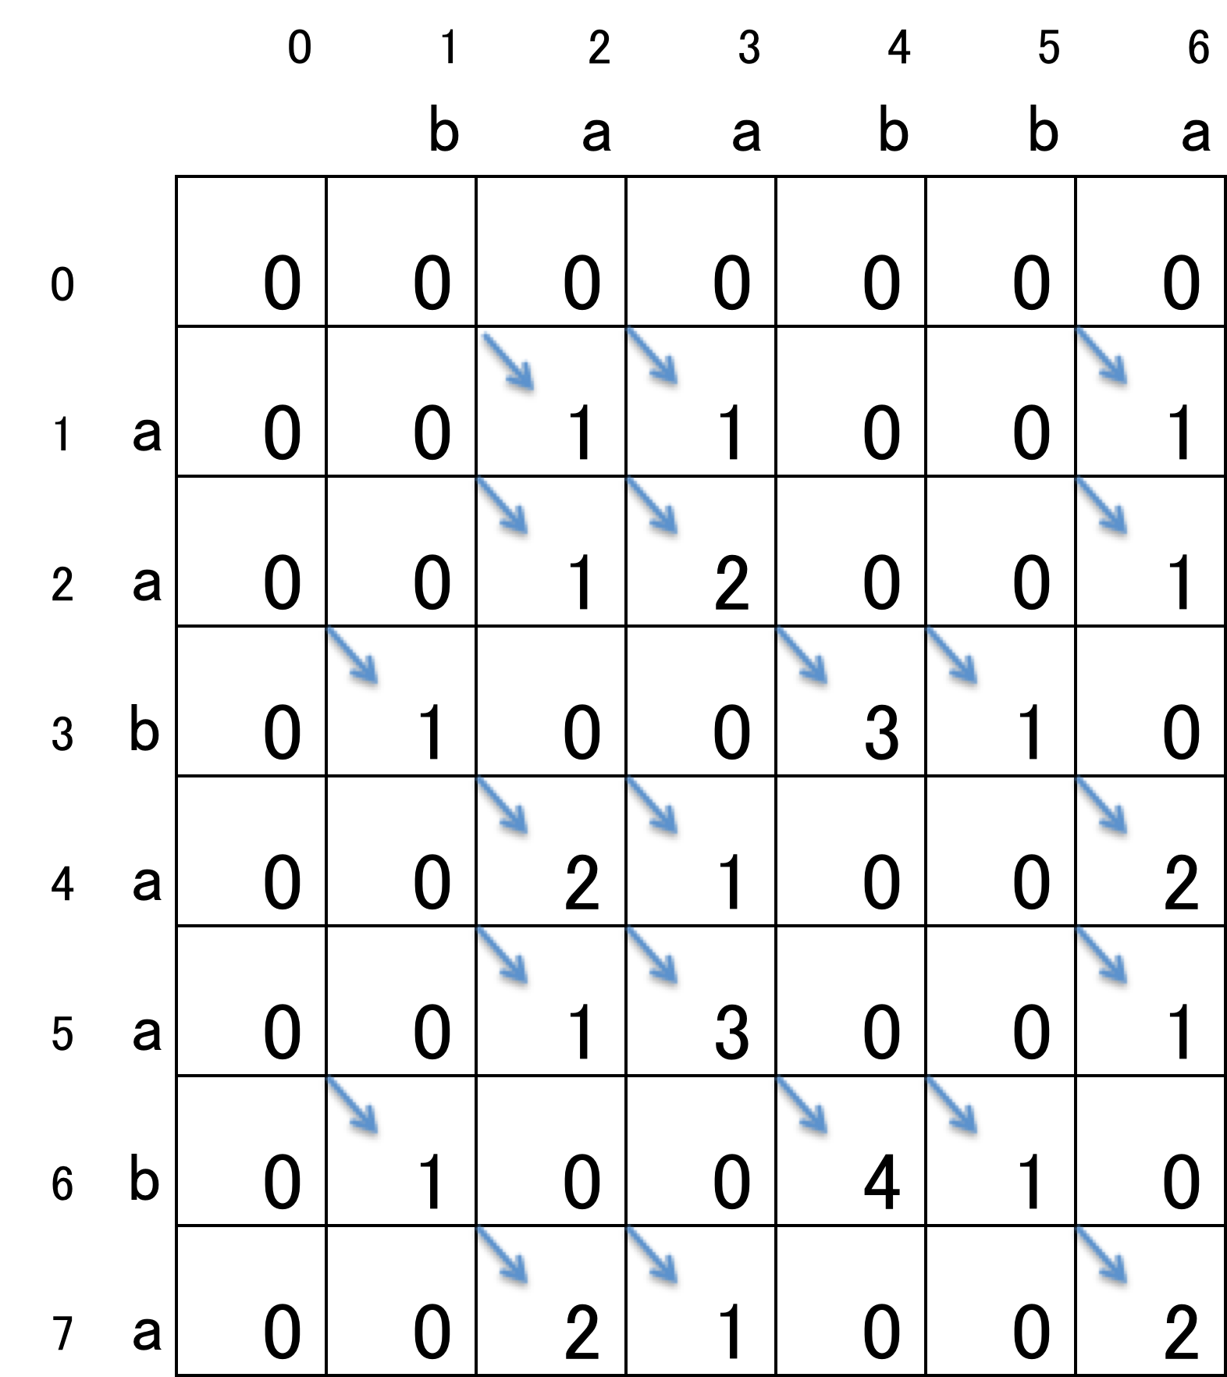





最長共通部分文字列問題
y
入力： x = a a b a a b a
y = b a a b b a
C
： と
の共通の接尾辞の長さ
x

Slide 54
ハイパーテキスト間における最長共通部分文字列問題
（サイクルなし、１頂点に１文字）
入力：２つのハイパーテキスト
出力：最長共通部分文字列
(Longest Common Substring)
G1
G2
a ₁
b ₃
b ₅
a ₁
c ₃
c ₅
b ₂
c ₄
a ₆
b ₂
b ₄
a ₆

Slide 55
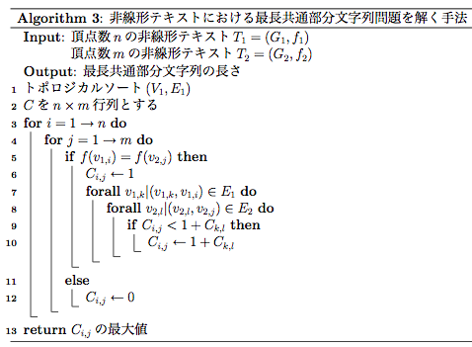
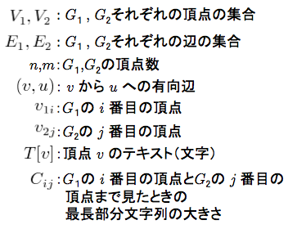

非線形テキストにおける
最長共通部分文字列問題の解法
： で終わる文字列と
で終わる文字列の
最長共通接尾辞の長さ
Notes:
Cijの定義

Slide 56
a ₁
b ₂
b ₃
G1
G2
b ₄
c ₅
a ₆
a ₁
c ₂
c ₃
a
c
c
b
b
a
C
 |  | 1 |  | 2 |  | 3 |  | 4 |  | 5 |  | 6
 | S |  |  |  |  |  |  |  |  |  | S
1 |  | 1 |  | 0 |  | 0 |  | 0 |  | 0 |  | 1
 |  |  |  |  |  |  | S |  | 1,1
2 |  | 0 |  | 0 |  | 0 |  | 1 |  | 2 |  | 0
 |  |  |  |  |  |  | S |  | 2,4
3 |  | 0 |  | 0 |  | 0 |  | 1 |  | 2 |  | 0
 |  |  |  |  |  |  | S |  | 1,1
4 |  | 0 |  | 0 |  | 0 |  | 1 |  | 2 |  | 0
 |  |  | 4,1 |  | 4,5
5 |  | 0 |  | 1 |  | 3 |  | 0 |  | 0 |  | 0
 |  |  |  |  |  |  |  |  |  |  | 5,3
6 |  | 1 |  | 0 |  | 0 |  | 0 |  | 0 |  | 4
G2
a
b ₄
b ₅
a ₆
b
G1
b
b
c
a

Slide 57


計算量
全体で
時間
領域

Slide 58
最長共通部分列問題
入力：長さ n の文字列 x
長さ m の文字列 y
出力： 最長共通部分列の長さ
部分列：文字列から任意の 0 個以上の文字を取り除いた文字列
入力： x = a b c b d a b
y = b d c a b a
出力： ４
最長共通部分列 : b c b a
この問題を解く手法として、
動的計画法に基づく 時間アルゴリズムが知られている
Notes:
まず，一般的なの最長共通部分列問題について説明します．
入力を長さ n の文字列 x と長さ m の文字列 y としたときに、
出力として，最長共通部分列の長さを求める問題です．
例題として，入力 x と y がこのように与えられたときに，この二つの最長共通部分列は（＊＊）
bcbaとなるので，このときの出力は（＊） ４となります．（＊）
この問題は動的計画法を用いて，O(nm)で解けることが知られています．
そのアルゴリズムを紹介します，

Slide 59
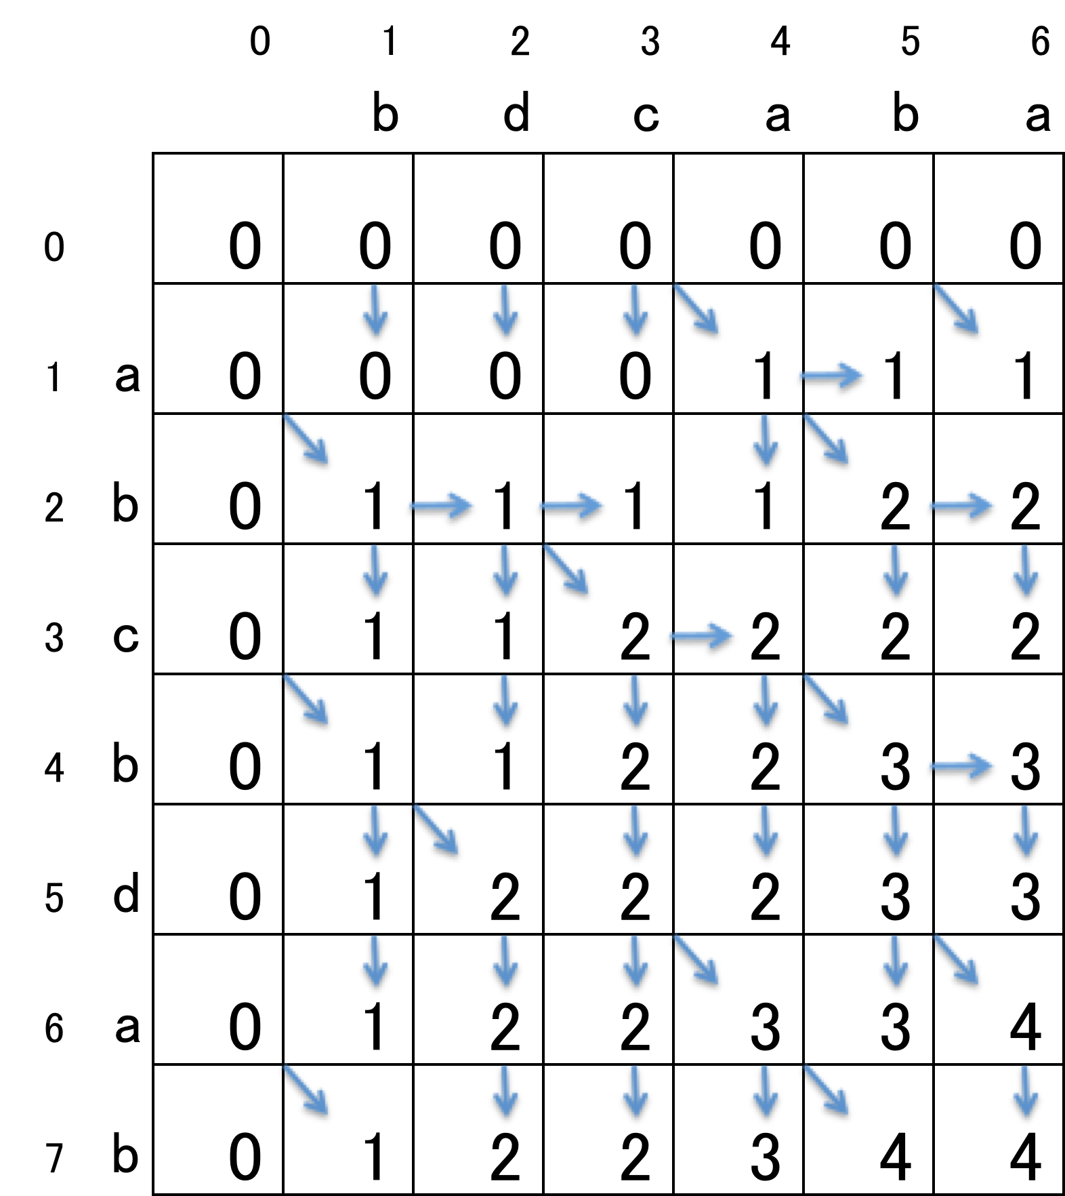


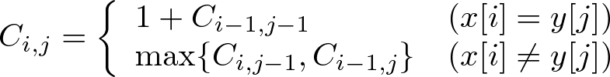
最長共通部分列問題の
動的計画法に基づいた解法
y
C
入力： x = a b c b d a b
y = b d c a b a
： と の
最長共通部分列の長さ
x
Notes:
このように，入力が与えられたときに，x の各文字に行を y の各文字に列を対応させた行列Cを与え，
左下の式で行列を行方向に埋めていきます．（＊）
例えば，C-５-５を求めたいときは，x の５文字目と y の５文字目がdとbで一致しないので，（＊）
x の一つ前の文字が対応する行と，（＊）y の５文字目が対応する列の交点（＊）と（＊）
y の一つ前の文字が対応する列と，（＊）x の５文字目が対応する行の交点（＊）の大きい方を
C-５-５の値とします．

Slide 60
最長共通部分列問題の
動的計画法に基づいた解法
y
C
入力： x = a b c b d a b
y = b d c a b a
： と の
最長共通部分列の長さ
x
Notes:
また，（＊）C-４-５の値を求めたいときは，
x の4文字目と y の５文字目が一致しているので，（＊）
x の一つ前の文字が対応する行と，（＊）y の一つ前の文字が対応する列の交点（＊）の値に
１を足した値をC-４-５の値とします．
（＊）このように行列を求めて，C-n-mの値，この場合はC-７-６の値を出力とします．
また，この矢印のようにどの成分の値を使って，求めたかを記憶しておき，
逆にたどることによって，（＊）最長共通部分列の一つを求めることができます．

Slide 61



非線形テキストにおける最長共通部分列問題
（サイクルなし、１頂点に１文字）
a ₁
c ₃
a ₁
c ₂
d ₃
入力：非線形テキスト T₁, T₂
出力：T₁, T₂ の最長共通部分列の長さ
d ₅
b ₆
b ₅
T1
T2
{ a ,b, c, d,
ab, ad, bc, cb, cd, db,
abc, adb, bcb, bcd, cdb,
abcb, abcd, bcdb,
abcdb }
{ a ,b, c, d,
ac, ad, ba, cb, cd, db,
acb, acd, adb, cba, cdb, dba
acba, acdb, adba, cdba,
acdba }
a ₁
b ₂
c ₃
a ₁
c ₂
d ₃
c ₄
d ₅
b ₆
d ₄
b ₅
a ₆
：非線形テキスト T が表す文字列の集合
Notes:
“表す”の説明 グラフの任意の道（パス）をたどり、通過した頂点の文字列の連結
次に非線形テキストにおける最長共通部分列問題を定義します．
非線形テキストT１，T２を入力として与えられたときに，最長共通部分列の長さを求める問題です．
例えば，このような二つの非線形テキストが与えられたときに，
これらの非線形テキストはそれぞれ（＊）このような文字列の集合を表しています．
この集合同士のすべての組み合わせの中で最長共通部分列を出力とします．
（＊）この場合は，acdbが最長共通部分列となり，出力は４となります．

Slide 62
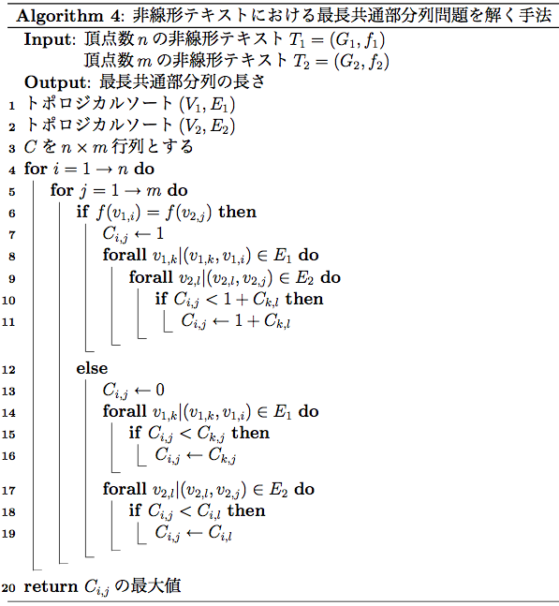
提案手法
： で終わる文字列と
で終わる文字列の
最長共通部分列の長さ
Notes:
次に提案手法です．
提案手法はこのようになっています．
まず，（＊）１、２行目のトポロジカルソートについて説明します．

Slide 63

トポロジカルソート
トポロジカルソートとは
非循環有向グラフ の頂点を有向辺の向きに
矛盾がないように並べること
任意の非循環グラフに対し，頂点数と辺の数に線形な時間で計算可能
a
b
c
ソート
a
d
b
c
e
f
d
e
f
Notes:
トポロジカルソートとは，非循環有向グラフの頂点を有向辺の向きに矛盾がないように並べることです．
例えば，この例では，（＊）このようにadbcefという順序で並べると．（＊）
このように有向辺の向きに矛盾がないことがわかります．
また，このトポロジカルソートは頂点数と辺の数に線形な時間で計算できます．

Slide 64
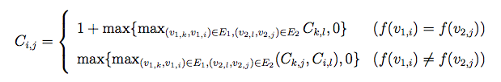
提案手法
： で終わる文字列と
で終わる文字列の
最長共通部分列の長さ
Notes:
アルゴリズムの残りの部分は（＊）この式を表しています．
（＊）青い部分は上の式，（＊）赤い部分は下の式を表しています．
これだけでは，わかりづらいと思うので例で示します．

Slide 65
T2
： で終わる文字列と で終わる文字列の
最長共通部分列の長さ
a
c
c
d
d
d
d
b
a
C
 |  | 1 |  | 2 |  | 3 |  | 4 |  | 5 |  | 6
 | S |  | 1,1 |  | 1,2 |  | 1,1 |  | 1,2 |  | S
1 |  | 1 |  | 1 |  | 1 |  | 1 |  | 1 |  | 1
 | 1,1 |  | 1,2 |  | 1,3 |  | 1,4 |  | 1,2 |  | 2,5
2 |  | 1 |  | 1 |  | 1 |  | 1 |  | 2 |  | 2
 | 2,1 |  | 2,1 |  | 3,2 |  | 2,4 |  | 2,5 |  | 2,6
3 |  | 1 |  | 2 |  | 2 |  | 1 |  | 2 |  | 2
 | S |  | S |  | 4,3 |  | 4,1 |  | 4,2 |  | 4,5
4 |  | 0 |  | 1 |  | 1 |  | 0 |  | 1 |  | 1
 | 1,1 |  | 3,2 |  | 3,2 |  | 1,1 |  | 5,3 |  | 5,5
5 |  | 1 |  | 2 |  | 3 |  | 2 |  | 3 |  | 3
 | 3,1 |  | 3,2 |  | 5,3 |  | 5,4 |  | 5,3 |  | 6,5
6 |  | 1 |  | 2 |  | 3 |  | 2 |  | 4 |  | 4
a ₁
b ₂
c ₃
a
a
T1
b
c ₄
d ₅
b ₆
c
c
T1
a ₁
c ₂
d ₃
c
c
T2
d
d ₄
b ₅
a ₆
b
Notes:
このように二つの非線形テキストが与えられたときに，
T１の各頂点に行，T２の各頂点に列を対応させた行列を上の式で行方向に埋めていきます．
例えば（＊）C-５-５の値を求めたいときは（＊）T１の五番目の頂点とT２の五番目の頂点の文字が一致していないので，
下の式によって，値を求めます．
T１の五番目の頂点への有向辺を持つ頂点（＊）が対応する行（＊）とT２の五番目の頂点の列（＊）との交点（＊）と
T2の五番目の頂点への有向辺を持つ頂点（＊）が対応する列（＊）とT１の五番目の頂点の行（＊）との交点（＊）
の内で最大のものをC-５-５の値とします．

Slide 66
T2
a
c
c
d
d
d
d
b
a
C
 |  | 1 |  | 2 |  | 3 |  | 4 |  | 5 |  | 6
 | S |  | 1,1 |  | 1,2 |  | 1,1 |  | 1,2 |  | S
1 |  | 1 |  | 1 |  | 1 |  | 1 |  | 1 |  | 1
 | 1,1 |  | 1,2 |  | 1,3 |  | 1,4 |  | 1,2 |  | 2,5
2 |  | 1 |  | 1 |  | 1 |  | 1 |  | 2 |  | 2
 | 2,1 |  | 2,1 |  | 3,2 |  | 2,4 |  | 2,5 |  | 2,6
3 |  | 1 |  | 2 |  | 2 |  | 1 |  | 2 |  | 2
 | S |  | S |  | 4,3 |  | 4,1 |  | 4,2 |  | 4,5
4 |  | 0 |  | 1 |  | 1 |  | 0 |  | 1 |  | 1
 | 1,1 |  | 3,2 |  | 3,2 |  | 1,1 |  | 5,3 |  | 5,5
5 |  | 1 |  | 2 |  | 3 |  | 2 |  | 3 |  | 3
 | 3,1 |  | 3,2 |  | 5,3 |  | 5,4 |  | 5,3 |  | 6,5
6 |  | 1 |  | 2 |  | 3 |  | 2 |  | 4 |  | 4
a ₁
b ₂
c ₃
a
T1
b
c ₄
d ₅
b ₆
c
c
T1
a ₁
c ₂
d ₃
c
T2
d
d
d ₄
b ₅
a ₆
b
Notes:
また，C-６-５の値を求めたいときは，（＊）T１の六番目の頂点とT２の五番目の頂点の文字が一致するので，
上の式によって，値を求めます．
T１の六番目の頂点への有向辺を持つ頂点（＊）が対応する行（＊）と
T2の五番目の頂点への有向辺を持つ頂点（＊）が対応する列（＊）との交点（＊）
の内で最大のものをC-６-５の値とします．
このようにして求めた行列の中で最大の値を出力とします．

Slide 67
計算量
Notes:
計算量についてです．
まず，トポロジカルソートは有向グラフに線形な時間で計算可能なので（＊）このようになります．
頂点の文字が一致した場合は（＊）アルゴリズム全体でO(E1E2)となります．
また，不一致の場合は，（＊）辺の数に線形な時間で計算可能です．（＊）
よってこのアルゴリズムの計算量は（＊）O(E1E2)時間，
また，領域計算量は行列を構成するだけなので，O(nm)領域で計算可能です．

Slide 68
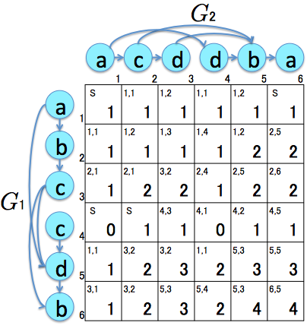
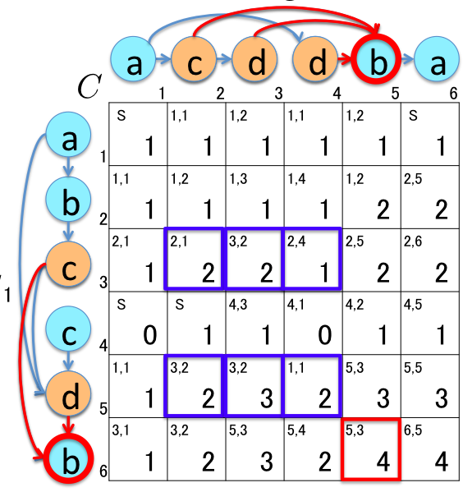
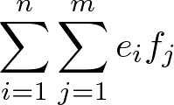
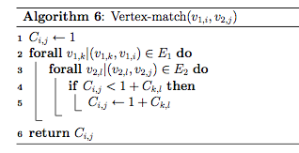
文字が一致したときの計算量
e_{i}：v_{1,i} に入ってくる辺の数
f_{j}：v_{2,j} に入ってくる辺の数
の値を決めるためには
e_{i}f_{j} 回の比較が必要
行列全体を求めるためには

Slide 69
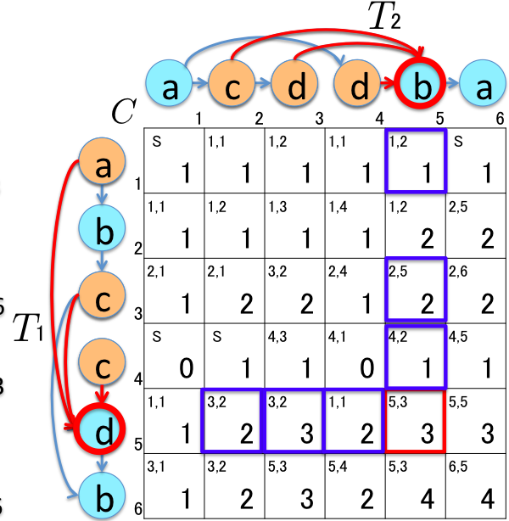

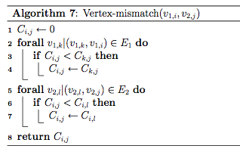
文字が不一致のときの計算量
e_{i}：v_{1,i} に入ってくる辺の数
f_{j}：v_{2,j} に入ってくる辺の数
の値を決めるためには
e_{i}+f_{j} 回の比較が必要
行列全体を求めるためには

Slide 70


計算量
時間
領域
Notes:
計算量についてです．
まず，トポロジカルソートは有向グラフに線形な時間で計算可能なので（＊）このようになります．
頂点の文字が一致した場合は（＊）アルゴリズム全体でO(E1E2)となります．
また，不一致の場合は，（＊）辺の数に線形な時間で計算可能です．（＊）
よってこのアルゴリズムの計算量は（＊）O(E1E2)時間，
また，領域計算量は行列を構成するだけなので，O(nm)領域で計算可能です．

Slide 71
サイクルを含む場合

Slide 72
サイクルを含む非線形テキストにおける
最長共通部分列問題
入力：２つの非線形テキスト
出力：最長共通部分列の長さ
サイクルを含む非線形テキストで示される文字列は無限長になりえる
最長共通部分列も無限長になりえる
有限長の共通部分列が存在するなら，その長さを出力とし，
存在しないなら，∞を出力する
a
a
c
a
c
d
T1
T2
b
d
c
a
b
d
Notes:
出力例

Slide 73
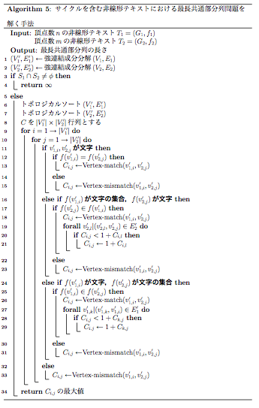
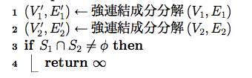
サイクルを含む非線形テキストにおける
最長共通部分列問題の解法
a
a
c
T1
b
d
c
a
c
d
T2
a
b
d
Notes:
記号の説明
1-４の説明 ∞

Slide 74


強連結成分分解
強連結成分分解とは
強連結（サイクル）を一つの頂点と見なし，
非循環有向グラフへ変換すること
a
a
c
a ₁
a ₂
T1
b
d
c
b ₃
{c,d} ₄
a
c
d
{a} ₁
c ₂
d ₃
T2
a
b
d
{b,d} ₄
任意の有向グラフに対して，線形時間で計算可能
Notes:
T’1 T’2

Slide 75
サイクルを含む非線形テキストにおける
最長共通部分列問題の解法
a ₁
a ₂
b ₃
{c,d} ₄
S₁=｛c,d｝
{a} ₁
c ₂
d ₃
{b,d} ₄
S₂=｛a,b,d｝
Notes:
記号の説明
1-４の説明 ∞

Slide 76
サイクルを含む非線形テキストにおける
最長共通部分列問題の解法
a
a
c
T1
b
d
c
a
c
d
T2
a
b
a
Notes:
記号の説明

Slide 77
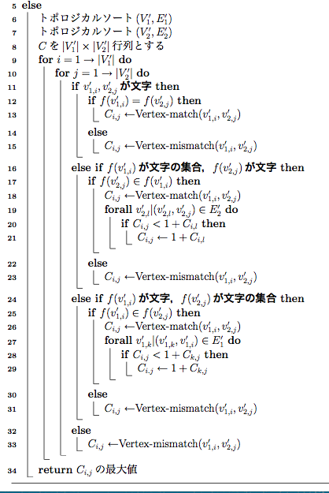
サイクルを含む非線形テキストにおける
最長共通部分列問題の解法
a ₁
a ₂
b ₃
{c,d} ₄
S₁=｛c,d｝
{a} ₁
c ₂
d ₃
{a,b} ₄
S₂=｛a,b｝
Notes:
記号の説明

Slide 78
サイクルを含む非線形テキストにおける
最長共通部分列問題の解法
{a}
c
c
d
{a,b}
 |  | 1 |  | 2 |  | 3 |  | 4
 | S |  | 1,1 |  | 1,2 |  | S
1 |  | 1 |  | 1 |  | 1 |  | 1
 | 1,1 |  | 2,1 |  | 2,2 |  | 1,2
2 |  | 2 |  | 2 |  | 2 |  | 2
 | 2,1 |  | 2,2 |  | 2,3 |  | 2,2
3 |  | 2 |  | 2 |  | 2 |  | 3
 | 2,1 |  | 2,1 |  | 4,2 |  | 4,3
4 |  | 2 |  | 3 |  | 4 |  | 4
C
a ₁
a ₂
a
b ₃
{c,d} ₄
a
a
{a} ₁
c ₂
d ₃
b
b
{a,b} ₄
{c,d}
3
Notes:
行列Cを与え、行方向に値を埋めていく。
頂点が文字同士の場合は、サイクルを含まない場合と変わらないので、説明省略

Slide 79
サイクルを含む非線形テキストにおける
最長共通部分列問題の解法
{a}
c
c
d
{a,b}
 |  | 1 |  | 2 |  | 3 |  | 4
 | S |  | 1,1 |  | 1,2 |  | S
1 |  | 1 |  | 1 |  | 1 |  | 1
 | 1,1 |  | 2,1 |  | 2,2 |  | 1,2
2 |  | 2 |  | 2 |  | 2 |  | 2
 | 2,1 |  | 2,2 |  | 2,3 |  | 2,2
3 |  | 2 |  | 2 |  | 2 |  | 3
 | 2,1 |  | 2,1 |  | 4,2 |  | 4,3
4 |  | 2 |  | 3 |  | 4 |  | 4
C
a ₁
a ₂
a
b ₃
{c,d} ₄
a
{a} ₁
c ₂
d ₃
b
{a,b} ₄
{c,d}
3
Notes:
サイクルを表す頂点の場合、その頂点内で文字を付け足せる

Slide 80
サイクルを含む非線形テキストにおける
最長共通部分列問題の解法
{a}
c
c
d
d
{a,b}
 |  | 1 |  | 2 |  | 3 |  | 4
 | S |  | 1,1 |  | 1,2 |  | S
1 |  | 1 |  | 1 |  | 1 |  | 1
 | 1,1 |  | 2,1 |  | 2,2 |  | 1,2
2 |  | 2 |  | 2 |  | 2 |  | 2
 | 2,1 |  | 2,2 |  | 2,3 |  | 2,2
3 |  | 2 |  | 2 |  | 2 |  | 3
 | 2,1 |  | 2,1 |  | 4,2 |  | 4,3
4 |  | 2 |  | 3 |  | 4 |  | 4
C
a ₁
a ₂
a
b ₃
{c,d} ₄
a
a
{a} ₁
c ₂
d ₃
b
b
{a,b} ₄
{c,d}
Notes:
最初に同じ文字を含まないことを確認→不一致の処理

Slide 81
計算量
強連結成分分解
トポロジカルソート
S₁とS₂の比較
関数Vertex-matchとVertex-mismatch
文字と文字の集合の比較
一つの頂点から複数の文字を選ぶ操作
時間
時間
時間
Notes:
強連結成分分解とトポロジカルソートはグラフの大きさに線形
S１とS２の比較はS1とS２の大きさは高々アルファベットサイズ、平衡木を用いて
関数は

Slide 82
関数Vertex-match,Vertex-mismatch
Notes:
iとjを選び、Cijを決めるときはVertex-matchかVertex-mismatchのどちらか一方を一回だけ行う。

Slide 83
Vertex-matchの計算量
e_{i}：v_{1,i} に入ってくる辺の数
f_{j}：v_{2,j} に入ってくる辺の数
の値を決めるためには
e_{i}f_{j} 回の比較が必要
行列全体を求めるためには

Slide 84
Vertex-mismatchの計算量
e_{i}：v_{1,i} に入ってくる辺の数
f_{j}：v_{2,j} に入ってくる辺の数
の値を決めるためには
e_{i}+f_{j} 回の比較が必要
行列全体を求めるためには

Slide 85
計算量
強連結成分分解
トポロジカルソート
S₁とS₂の比較
関数Vertex-matchとVertex-mismatch
文字と文字の集合の比較
一つの頂点から複数の文字を選ぶ操作
時間
時間
時間
時間
時間
Notes:
文字と文字の集合との比較、一つの文字と一つの集合の比較は平衡木を用いてO(log|Σ|)
すべての頂点間で比較を行うと（＊）

Slide 86
Notes:
Vertex-mismatchと同じ動作

Slide 87
計算量
強連結成分分解
トポロジカルソート
S₁とS₂の比較
関数Vertex-matchとVertex-mismatch
文字と文字の集合の比較
一つの頂点から複数の文字を選ぶ操作
時間
時間
時間
時間
時間
時間
時間
Notes:
文字と文字の集合との比較、一つの文字と一つの集合の比較はO(log|Σ|)
すべての頂点間で比較を行うと（＊）

Slide 88

まとめと今後の課題
問題 | 非線形テキスト T₁ | 非線形テキスト T₂ | 時間計算量
最長共通部分文字列問題 | 非循環有向グラフ | 非循環有向グラフ
 | 非循環有向グラフ | 一般の有向グラフ
最長共通部分列 問題 | 非循環有向グラフ | 非循環有向グラフ
 | 一般の有向グラフ | 一般の有向グラフ
今後の課題
・サイクルを含む非線形テキストにおける最長共通部分文字列問題
・サイクルを含む非線形テキストの各辺を通過する回数を制限をつけた問題
・文字列における様々な問題（パターン照合問題や近似文字列照合問題など）の
非線形テキストへの適用
Notes:
まとめと今後の課題です．
本研究ではこのような問題を定義し，解きました．
最長共通部分文字列問題に関しては，先ほど紹介したアルゴリズムの
頂点の文字が不一致の場合をすべて０にすることで，解くことができます，
またこの場合は，片方がサイクルを含んでいても，計算可能です．
さらに，今回は紹介できませんでしたが，サイクルを含む場合の最長共通部分列問題も定義し，この時間で解きました
今後の課題として〜〜が挙げられます．また〜も今後の課題と言えます． 以上で発表を終わります．
．

