Slide 1

On Morphisms Generating
Run-Rich Strings
Kazuhiko Kusano, Kazuyuki Narisawa and
Ayumi Shinohara
GSIS, Tohoku University, Japan
PSC2013

Slide 2


On Morphisms Generating
Run-Rich Strings
April 2013~
Kazuhiko Kusano, Kazuyuki Narisawa and
Ayumi Shinohara
GSIS, Tohoku University, Japan
PSC2013
Notes:
This is Ayumi SHINOHARA, from Tohoku University, JAPAN.
I will talk on Morphisms generating Run-rich Strings.
This is a joint work with Kazuhiko KUSANO and Kazuyuki Narisawa.
The first author Kazuhiko got his Ph.D in Spring this year, and he is now working at an IT company DWANGO.

Slide 3

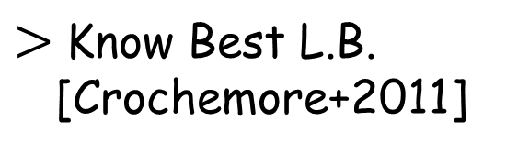
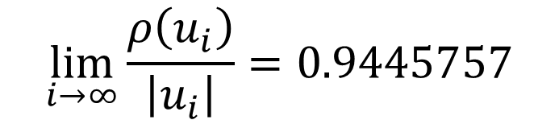
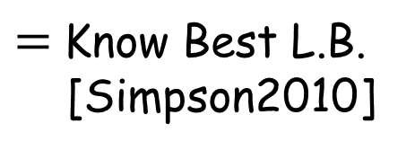


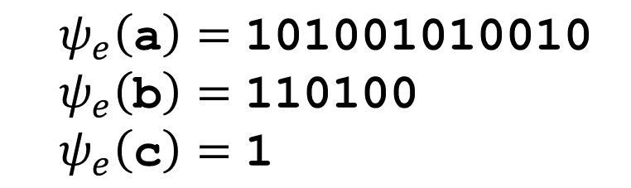

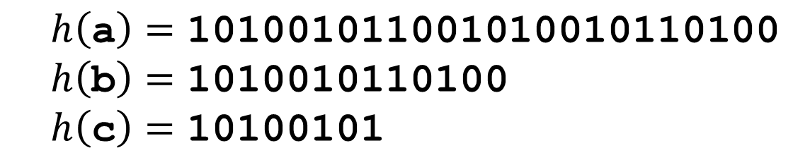
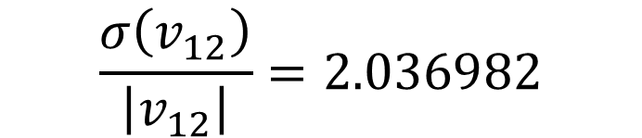
We found good morphisms that generate Run-Rich Strings
In Short,
$$φ_{r}\left(\text{a}\right)=\text{abac} { φ}_{r}\left(\text{b}\right)=\text{aac} φ_{r}\left(\text{c}\right)=\text{a}$$
$$h\left(\text{a}\right)=\text{101001011001010010110100}$$
$$h\left(\text{b}\right)=\text{1010010110100}$$
$$h\left(\text{c}\right)=\text{10100101}$$
$$ψ_{e}\left(\text{a}\right)=\text{10}\text{1001010010}$$
$$ψ_{e}\left(\text{b}\right)=\text{110100}$$
$$ψ_{e}\left(\text{c}\right)=\text{1}$$
$$u_{i}=h(φ_{r}^{i}\left(\text{a}\right))$$
$$v_{i}=ψ_{e}(φ_{r}^{i}\left(\text{a}\right))$$
$$\lim_{i→∞}{\frac{ρ\left(u_{i}\right)}{\left|u_{i}\right|}}=0.9445757$$
$$\frac{σ\left(v_{12}\right)}{\left|v_{12}\right|}=2.036982$$
$=$Know Best L.B.
[Simpson2010]
$>$Know Best L.B.
[Crochemore+2011]
$ρ\left(w\right)$ : Number of Runs in $w$
$σ\left(w\right)$ : Sum of Exponents of Runs in $w$
Notes:
In short words, we found good morphisms that generate run-rich strings.

Slide 4
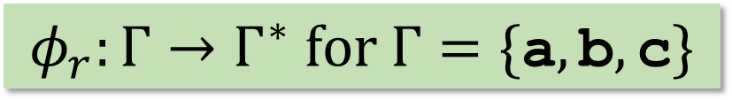
We found good morphisms that generate Run-Rich Strings
In Short,
$$φ_{r}\left(\text{a}\right)=\text{abac} { φ}_{r}\left(\text{b}\right)=\text{aac} φ_{r}\left(\text{c}\right)=\text{a}$$
$$h\left(\text{a}\right)=\text{101001011001010010110100}$$
$$h\left(\text{b}\right)=\text{1010010110100}$$
$$h\left(\text{c}\right)=\text{10100101}$$
$$φ_{r}:Γ→Γ^{∗} \text{for} Γ=\{\text{a},\text{b},\text{c}\}$$
$$ψ_{e}\left(\text{a}\right)=\text{10}\text{1001010010}$$
$$ψ_{e}\left(\text{b}\right)=\text{110100}$$
$$ψ_{e}\left(\text{c}\right)=\text{1}$$
$$u_{i}=h(φ_{r}^{i}\left(\text{a}\right))$$
$$v_{i}=ψ_{e}(φ_{r}^{i}\left(\text{a}\right))$$
$$\lim_{i→∞}{\frac{ρ\left(u_{i}\right)}{\left|u_{i}\right|}}=0.9445757$$
$$\frac{σ\left(v_{12}\right)}{\left|v_{12}\right|}=2.036982$$
$=$Know Best L.B.
[Simpson2010]
$>$Know Best L.B.
[Crochemore+2011]
$ρ\left(w\right)$ : Number of Runs in $w$
$σ\left(w\right)$ : Sum of Exponents of Runs in $w$
Notes:
This is a morphism that we found it interesting, because it can be regarded as a generator of run-rich strings.
It is a morphism defined over a ternary alphabet.

Slide 5

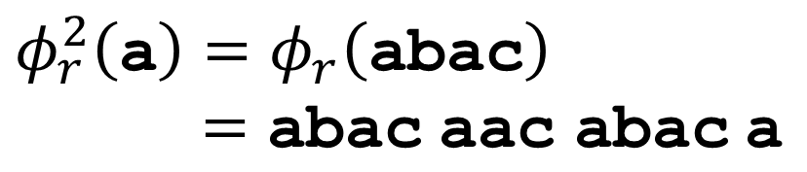

We found good morphisms that generate Run-Rich Strings
In Short,
$$φ_{r}\left(\text{a}\right)=\text{abac} { φ}_{r}\left(\text{b}\right)=\text{aac} φ_{r}\left(\text{c}\right)=\text{a}$$
$$h\left(\text{a}\right)=\text{101001011001010010110100}$$
$$h\left(\text{b}\right)=\text{1010010110100}$$
$$h\left(\text{c}\right)=\text{10100101}$$
$$φ_{r}\left(\text{a}\right)=\text{abac}$$
$$φ_{r}:Γ→Γ^{∗} \text{for} Γ=\{\text{a},\text{b},\text{c}\}$$
$$ψ_{e}\left(\text{a}\right)=\text{10}\text{1001010010}$$
$$ψ_{e}\left(\text{b}\right)=\text{110100}$$
$$ψ_{e}\left(\text{c}\right)=\text{1}$$
$$φ_{r}^{2}\left(\text{a}\right)=φ_{r}\left(\text{ab}\text{ac}\right)$$
$=$ $\text{a}\text{bac} \text{a}\text{a}\text{c}$ $\text{a}\text{b}\text{ac} \text{a}$
$$u_{i}=h(φ_{r}^{i}\left(\text{a}\right))$$
$φ_{r}^{3}\left(\text{a}\right)=$ $\text{a}\text{bac} \text{aac} \text{abac} \text{a} \text{abac} \text{a}\text{bac} \text{a} \text{abac} \text{a}\text{ac} \text{abac}$ $\text{a} \text{ab}\text{ac}$
$$v_{i}=ψ_{e}(φ_{r}^{i}\left(\text{a}\right))$$
$$\lim_{i→∞}{\frac{ρ\left(u_{i}\right)}{\left|u_{i}\right|}}=0.9445757$$
$$⋮$$
$$\frac{σ\left(v_{12}\right)}{\left|v_{12}\right|}=2.036982$$
$=$Know Best L.B.
[Simpson2010]
$>$Know Best L.B.
[Crochemore+2011]
$ρ\left(w\right)$ : Number of Runs in $w$
$σ\left(w\right)$ : Sum of Exponents of Runs in $w$
Notes:
By apply it to a string, we get a longer string.
For instance, from a sring “a”, we get a string “abac”.
By applying it twice, we get a string “abac aac abac’, because it is a morphism.
If we apply it again, we get a string “abac aac abac a abac ……”.

Slide 6
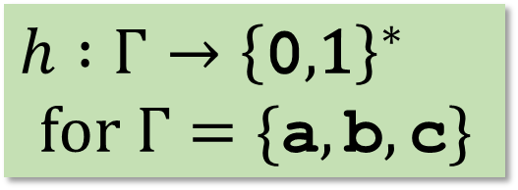
We found good morphisms that generate Run-Rich Strings
In Short,
$$φ_{r}\left(\text{a}\right)=\text{abac} { φ}_{r}\left(\text{b}\right)=\text{aac} φ_{r}\left(\text{c}\right)=\text{a}$$
$$h\left(\text{a}\right)=\text{101001011001010010110100}$$
$$h\left(\text{b}\right)=\text{1010010110100}$$
$$h\left(\text{c}\right)=\text{10100101}$$
$$ψ_{e}\left(\text{a}\right)=\text{10}\text{1001010010}$$
$$ψ_{e}\left(\text{b}\right)=\text{110100}$$
$$ψ_{e}\left(\text{c}\right)=\text{1}$$
$$h :Γ→{\left\{\text{0},\text{1}\right\}}^{∗}$$
$for Γ=\{\text{a},\text{b},\text{c}\}$
$$u_{i}=h(φ_{r}^{i}\left(\text{a}\right))$$
$$v_{i}=ψ_{e}(φ_{r}^{i}\left(\text{a}\right))$$
$$\lim_{i→∞}{\frac{ρ\left(u_{i}\right)}{\left|u_{i}\right|}}=0.9445757$$
$$\frac{σ\left(v_{12}\right)}{\left|v_{12}\right|}=2.036982$$
$=$Know Best L.B.
[Simpson2010]
$>$Know Best L.B.
[Crochemore+2011]
$ρ\left(w\right)$ : Number of Runs in $w$
$σ\left(w\right)$ : Sum of Exponents of Runs in $w$
Notes:
Let us consider another morphism h, from the ternary alphabet into a binary alphabet {0,1}.
Define a series of strings u_i, like this.
It is obtained from a string “a”, by applying the morphism phi_r i-times, and then applying h once.
Then, the series of strings u_i achieves the same lower bound for the number of runs in a string, as the currently best lower bound given by Simpson in 2010.
Here, rho of w denotes the number of runs in w. (I will give a definition of a run later.)
The ratio of the number of runs in the string u_i to the length of it, approaches to the value 0.9445 in the limit, that is exactly equal to the best lower bound.

Slide 7

We found good morphisms that generate Run-Rich Strings
In Short,
$$φ_{r}\left(\text{a}\right)=\text{abac} { φ}_{r}\left(\text{b}\right)=\text{aac} φ_{r}\left(\text{c}\right)=\text{a}$$
$$h\left(\text{a}\right)=\text{101001011001010010110100}$$
$$h\left(\text{b}\right)=\text{1010010110100}$$
$$h\left(\text{c}\right)=\text{10100101}$$
$$ψ_{e}\left(\text{a}\right)=\text{10}\text{1001010010}$$
$$ψ_{e}\left(\text{b}\right)=\text{110100}$$
$$ψ_{e}\left(\text{c}\right)=\text{1}$$
$$u_{i}=h(φ_{r}^{i}\left(\text{a}\right))$$
$$ψ_{e}:Γ→{\left\{\text{0},\text{1}\right\}}^{∗}$$
$$v_{i}=ψ_{e}(φ_{r}^{i}\left(\text{a}\right))$$
$$\lim_{i→∞}{\frac{ρ\left(u_{i}\right)}{\left|u_{i}\right|}}=0.9445757$$
$$\frac{σ\left(v_{12}\right)}{\left|v_{12}\right|}=2.036982$$
$=$Know Best L.B.
[Simpson2010]
$>$Know Best L.B.
[Crochemore+2011]
$ρ\left(w\right)$ : Number of Runs in $w$
$σ\left(w\right)$ : Sum of Exponents of Runs in $w$
Notes:
More interestingly, if we replace the morphism h by this morphism psi_e, then we get another series of run-rich strings.
The strings v_i, do not contain so many numbers of runs, compared to the strings u_i.
However, the sum of exponents of runs, relative to its length, is clearly greater than the current best lower bound, given by Crochemore and others in 2011.
In this sense, we can regard that the simple morphism psi_r, from “a” to “abac”, from “b” to “aac”, from “c” to “a”, is an excellent generator of strings that contains many runs.

Slide 8
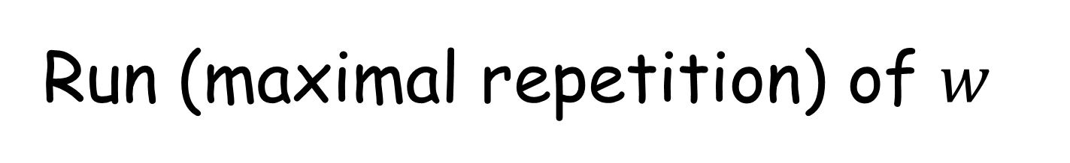
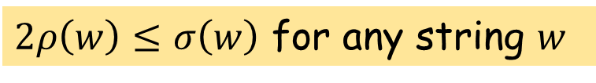



Run (maximal repetition) of $w$
Periodic substring of $w$which is extendable
neither to the left nor to the right
with the same period.
$ρ\left(w\right)$ : the number of runs in string $w$
$σ\left(w\right)$ : sum of exponents of runs in string $w$
abaababaaab
period : 1
exponent : 2
period : 1
exponent : 3
period : 3
exponent : 2
period : 2
exponent : 2.5
$$ρ\left(w\right)=4$$
$$σ\left(w\right)=9.5$$
$2ρ\left(w\right)≤σ\left(w\right)$ for any string $w$
Notes:
OK, we begin by definitions and notations on runs.
A run of string w is a periodic substring of w, which cannot extendable with the same period.
In this sense, a runs is also called a maximal repetition.
For instance, let us consider a string “abaababaaab”.
It contains four runs.
The first one is “aa” here, whose period is 1, and the exponent of it is 2.
The exponent of a run is the number of repetitions of the root string.
The second run is “aaa” here, with period 1 and exponent 3, because the string “a” repeats three times.
The blue one, “abaaba”, is also a run, with period 3 and exponent 2.
The last run, “ababa” is of period 2 and its exponent is 2.5, because it is “ab” “ab”, and “a”.
So the exponent can be fractional numbers.
Let us denote by rho of w, the number of runs in string w, and denote by sigma of w, the sum of exponents of runs in string w.
For instance, for this string w, rho of w is 4, because it contains 4 runs.
And sigma of w is 9.5, because the exponents of runs in this string is 2 and 2 and 2.5 and 3.
By summing up these values, we get 9.5.
From the definitions, it is clear that sigma of w is greater than or equal to the twice of rho of w for any string w, because each exponent of a run is at least two.

Slide 9

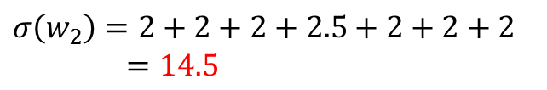
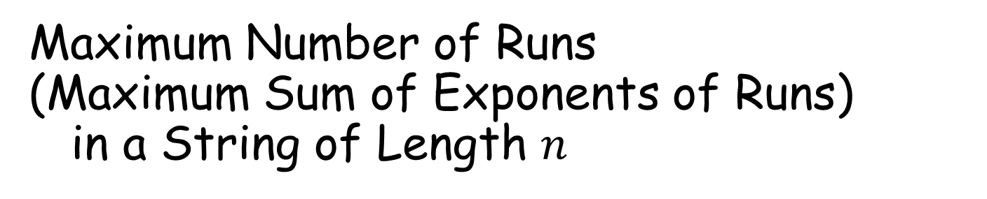
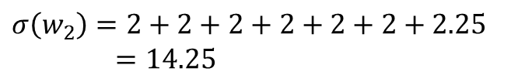


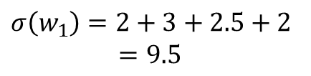

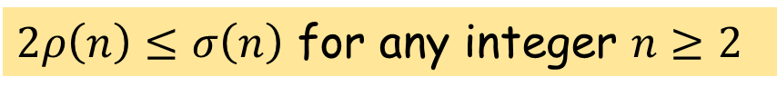


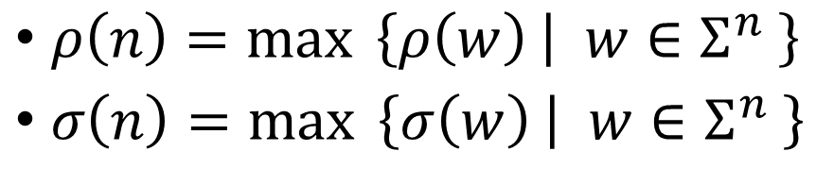


Maximum Number of Runs
(Maximum Sum of Exponents of Runs) in a String of Length $n$
$$n=11$$
abaababaaab
$$σ\left(w_{1}\right)=4$$
$$σ\left(w_{1}\right)=2+3+2.5+2$$
$=9.5$
run-maximal string
aabaabbaabb
$$σ\left(w_{2}\right)=7$$
$$σ\left(w_{2}\right)=2+2+2+2+2+2+2.25 \\ =14.25$$
aaaaaaaaaaa
$$σ\left(w_{3}\right)=1$$
$$σ\left(w_{3}\right)=11$$
run-maximal string
aababaababb
$$σ\left(w_{4}\right)=7$$
$$σ\left(w_{2}\right)=2+2+2+2.5+2+2+2 \\ =14.5$$
SoE-maximal string
$ρ\left(n\right)=\max{ \left\{ρ\left(w\right) | w∈Σ^{n} \right\}}$
$σ\left(n\right)=\max{ \left\{σ\left(w\right) | w∈Σ^{n} \right\}}$
$ρ\left(11\right)=7$
$σ\left(11\right)=14.5$
$2ρ\left(n\right)≤σ\left(n\right)$ for any integer $n≥2$
Notes:
Now lets pay our attentions to the maximum number of runs, and the maximum value of the sum of exponents of runs in a string of length n.
This is one of the main topics in our community, I suppose.
Let us consider several strings of length 11.
The first string “abaababaaab” contains four runs, and the sum of exponents of runs is 9.5, as we verified in the previous slide.
Let us consider the second string “aabaabbaabb”.
It contains 7 runs, that is larger than 4, and in fact, it is the maximum number of runs.
We can verify it by enumerating all strings of length 11.
Let us denote by rho of n, for an integer n, the maxmum number of runs in a string of length n.
So rho of 11 is 7.
OK, let’s go to the third strings, “aaaaaaaaaaa”. It is 11 repetitions of a character “a”, and it looks to contain many repetitions.
However, in our definition, it contains only one one.
Because, “aa” is a repetition of another string “a”, so that we do not regard that “aa aa aa” is a run.
So it contains only one run.
Concerning with the sum of exponents of runs, we denote its maximum value by sigma of n for an integer n.
For instance, sigma of w_1 is 9.5, and sigma of w_2 is 14.25.
Moreover, sigma of w_3 is 11.
As you see, w_3 contains only one runs, but the sum of exponents is large, compared to the first string w_1.
So the number of runs and the sum of exponents are different. Of couse they are somehow related, as we will see it soon.
We call a string which contains the maximum number of runs, a “run-maximal string”.
So the second string “aabaabbaabb” is a run-maximal string.
Similary, we call a string whose sum of exponents is the maximum, a “sum-of-exponents maximal string”.
The second string w_2 is not sum-of-exponents maximal, because it is not the maximum.
In fact, the string w_4, is both the run-maximal and sum-of-exponents maximal.
We note that the inequality is also clear from the definitions.

Slide 10
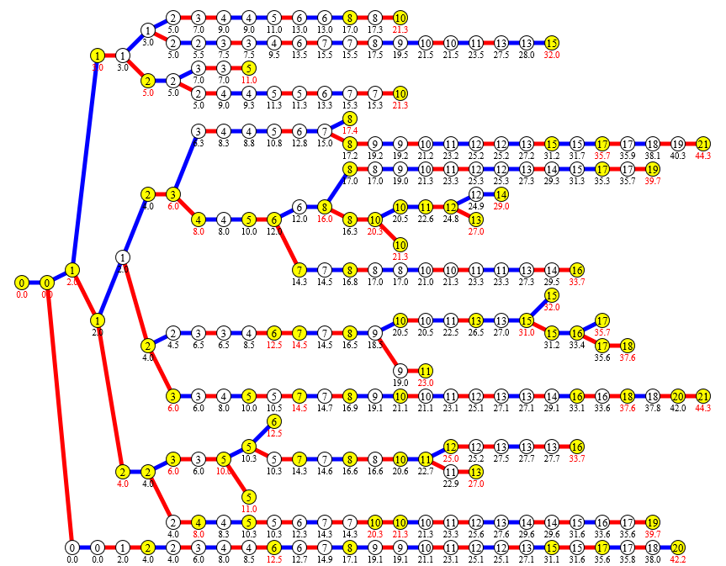






Run-Rich Strings
All run-maximal and SOE-maximal strings ≤ 27
a
b
$$ρ(w)$$
$$σ(w)$$
run-maximal
$$ρ(w)$$
$$σ(w)$$
SOE-maximal
$$ρ(w)$$
$$σ(w)$$
Notes:
Now we are interested in run-rich strings, that contain many runs.
The Trie in this figure shows all run-maximal strings and all sum-of-exponents strings of length up to 27.
(We omitted the duplications by assuming that the first character is “a”, because the number of runs does not changed by reversal, nor replacing the characters.)
The number, shown in each circle, is the number of runs in the corresponding string.
And, the factional number shown below the circle is the value of sum of exponents.
For instane, the string ……
The yellow circle show that the corresponding string is run-maximal, and if the string is sum-of-exponents maximal, the value is colored by red.
You see that various run-rich strings here.
For instance, the string …. Is interesting because most of its substrings are also run-maximal and/or sum-of-exponents maximal.
Of our ultimate goal is to discover a grammar that generates all run-maximal strings only, or discover a grammar that generates all sum-of-exponents strings only, but it is difficult.
Our morphisms generate strings that contais many runs, but they are not necessarily the run-maximal.

Slide 11
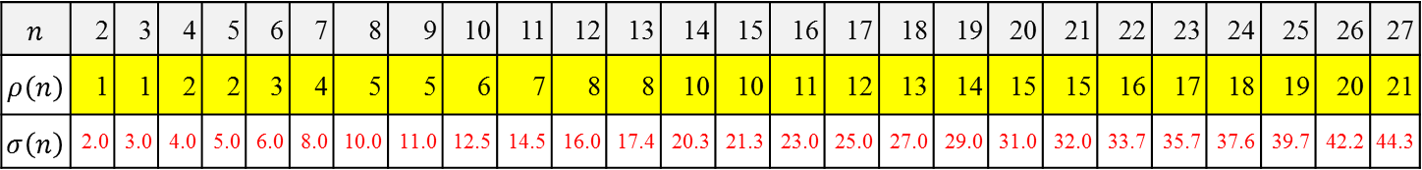
Run-Rich Strings
$$n$$ | 2 | 3 | 4 | 5 | 6 | 7 | 8 | 9 | 10 | 11 | 12 | 13 | 14 | 15 | 16 | 17 | 18 | 19 | 20 | 21 | 22 | 23 | 24 | 25 | 26 | 27
$$ρ\left(n\right)$$ | 1 | 1 | 2 | 2 | 3 | 4 | 5 | 5 | 6 | 7 | 8 | 8 | 10 | 10 | 11 | 12 | 13 | 14 | 15 | 15 | 16 | 17 | 18 | 19 | 20 | 21
$$σ\left(n\right)$$ | 2.0 | 3.0 | 4.0 | 5.0 | 6.0 | 8.0 | 10.0 | 11.0 | 12.5 | 14.5 | 16.0 | 17.4 | 20.3 | 21.3 | 23.0 | 25.0 | 27.0 | 29.0 | 31.0 | 32.0 | 33.7 | 35.7 | 37.6 | 39.7 | 42.2 | 44.3
All run-maximal and SOE-maximal strings ≤ 27
a
b
$$ρ(w)$$
$$σ(w)$$
run-maximal
$$ρ(w)$$
$$σ(w)$$
SOE-maximal
$$ρ(w)$$
$$σ(w)$$
Notes:
OK, let’s turn our attention to the integer sequences, rho of n and sigma of n for integers n.
The table can be constructed from this Trie, by choosing the values in yellow circles for rho of n, the maximum number runs, and by choosing the values in red colored for sigma of n, the maximum sum-of-exponents.

Slide 12
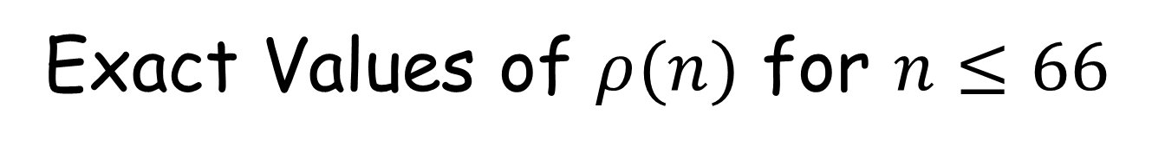


Exact Values of $ρ(n)$ for $n≤66$
$$\frac{ρ(n)}{n}$$
ρ(11) / 11
= 7 / 11
= 0.63636...
$$ρ(n)$$
ρ(11) = 7
= run(aabaabbaabb)
$$n$$ | 2 | 3 | 4 | 5 | 6 | 7 | 8 | 9 | 10 | 11 | 12 | 13 | 14 | 15 | 16 | 17 | 18 | 19 | 20 | 21 | 22 | 23 | 24 | 25 | 26 | 27
$$ρ\left(n\right)$$ | 1 | 1 | 2 | 2 | 3 | 4 | 5 | 5 | 6 | 7 | 8 | 8 | 10 | 10 | 11 | 12 | 13 | 14 | 15 | 15 | 16 | 17 | 18 | 19 | 20 | 21
Notes:
First we focus on the number of runs. Later I will mention of the sum exponents briefly.
This is the table of the integer sequence of rho of n, the maximum number of runs in a string of length n.
For instance, as I mentioned, rho of 11 is 7, and the string “aabaabbaabb” is the run-maximal string of length 11.
This line shows the ratio of the rho n devided by n. For instance, for n=11, the ratio is 7 / 11, that is, 0.63636…

Slide 13
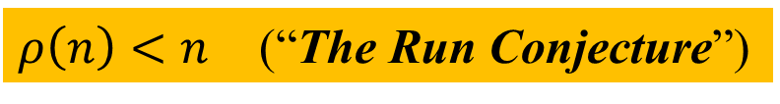


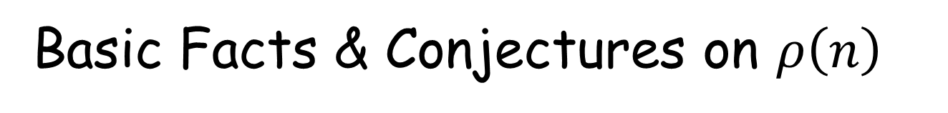


Basic Facts & Conjectures on $ρ\left(n\right)$
$$\frac{ρ(n)}{n}$$
ρ(42) = ρ(41) + 2
$$ρ\left(n\right) ≤ρ(n+1)$$
$$ρ\left(n\right) <ρ(n+2)$$
ρ(14) = ρ(13) + 2
$ρ\left(n\right)<n$ (“The Run Conjecture”)
$$ρ\left(n+1\right) ≤ ρ\left(n\right)+2$$
$ρ\left(n\right)= ρ_{2}\left(n\right)$: Max #runs in binary strings
$$n$$ | 2 | 3 | 4 | 5 | 6 | 7 | 8 | 9 | 10 | 11 | 12 | 13 | 14 | 15 | 16 | 17 | 18 | 19 | 20 | 21 | 22 | 23 | 24 | 25 | 26 | 27
$$ρ\left(n\right)$$ | 1 | 1 | 2 | 2 | 3 | 4 | 5 | 5 | 6 | 7 | 8 | 8 | 10 | 10 | 11 | 12 | 13 | 14 | 15 | 15 | 16 | 17 | 18 | 19 | 20 | 21
Notes:
Concerning with rho of n, I will introduce some basic facts, and cojectures.
The function rho of n is a non-decreasing function, and it increases slowly.
At some points, it increases by two, but in most of the cases, it increases by only one.
But this ( rho(n) <= rho(n) + 2 ) is a conjecture, and it is not formally proved.
The maximum value is believed to be given by binary strings, although it is not proved either.
The most important conjecture is, so-called “the run conjecture”, that rho of ne is less than n for any n.

Slide 14




Basic Facts & Conjectures on $ρ\left(n\right)$
$$\frac{ρ(n)}{n}$$
ρ(42) = ρ(41) + 2
$$ρ\left(n\right) ≤ρ(n+1)$$
$$ρ\left(n\right) <ρ(n+2)$$
ρ(14) = ρ(13) + 2
$ρ\left(n\right)<n$ (“The Run Conjecture”)
$ρ\left(n\right)<n$ (“The Run Conjecture”)
$$ρ\left(n+1\right) ≤ ρ\left(n\right)+2$$
$ρ\left(n\right)= ρ_{2}\left(n\right)$: Max #runs in binary strings
$$n$$ | 2 | 3 | 4 | 5 | 6 | 7 | 8 | 9 | 10 | 11 | 12 | 13 | 14 | 15 | 16 | 17 | 18 | 19 | 20 | 21 | 22 | 23 | 24 | 25 | 26 | 27
$$ρ\left(n\right)$$ | 1 | 1 | 2 | 2 | 3 | 4 | 5 | 5 | 6 | 7 | 8 | 8 | 10 | 10 | 11 | 12 | 13 | 14 | 15 | 15 | 16 | 17 | 18 | 19 | 20 | 21

Slide 15
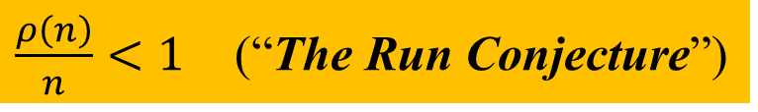
Basic Facts & Conjectures on $ρ\left(n\right)$
$$\frac{ρ(n)}{n}$$
$\frac{ρ\left(n\right)}{n}<1$ (“The Run Conjecture”)
$ρ\left(n\right)<n$ (“The Run Conjecture”)
$ρ\left(n\right)<n$ (“The Run Conjecture”)
$$n$$ | 2 | 3 | 4 | 5 | 6 | 7 | 8 | 9 | 10 | 11 | 12 | 13 | 14 | 15 | 16 | 17 | 18 | 19 | 20 | 21 | 22 | 23 | 24 | 25 | 26 | 27
$$ρ\left(n\right)$$ | 1 | 1 | 2 | 2 | 3 | 4 | 5 | 5 | 6 | 7 | 8 | 8 | 10 | 10 | 11 | 12 | 13 | 14 | 15 | 15 | 16 | 17 | 18 | 19 | 20 | 21
Notes:
Lets focus on the run conjecture.
This is another expression of the run conjecture.
We are interested in this value.

Slide 16
Basic Facts & Conjectures on $ρ\left(n\right)$
$$\frac{ρ(n)}{n}$$
$\frac{ρ\left(n\right)}{n}<1$ (“The Run Conjecture”)
$ρ\left(n\right)<n$ (“The Run Conjecture”)
$$n$$ | 2 | 3 | 4 | 5 | 6 | 7 | 8 | 9 | 10 | 11 | 12 | 13 | 14 | 15 | 16 | 17 | 18 | 19 | 20 | 21 | 22 | 23 | 24 | 25 | 26 | 27
$$ρ\left(n\right)$$ | 1 | 1 | 2 | 2 | 3 | 4 | 5 | 5 | 6 | 7 | 8 | 8 | 10 | 10 | 11 | 12 | 13 | 14 | 15 | 15 | 16 | 17 | 18 | 19 | 20 | 21

Slide 17
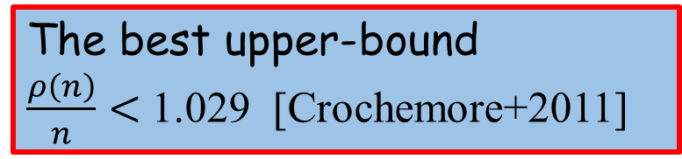
Basic Facts & Conjectures on $ρ\left(n\right)$
1.029
$$\frac{ρ(n)}{n}$$
omitted deep history
in this talk
The best upper-bound
$\frac{ρ\left(n\right)}{n}<$ 1.029 [Crochemore+2011]
$\frac{ρ\left(n\right)}{n}<1$ (“The Run Conjecture”)
Notes:
The best upper bound for it is, 1.029 given by Crochemore and others.
We omit the deep history to achieve the bound, because we focus on the lower bound in this talk.
The line 1.029 locates here.

Slide 18

Basic Facts & Conjectures on $ρ\left(n\right)$
1.029
$$\frac{ρ(n)}{n}$$
omitted deep history
in this talk
The best upper-bound
$\frac{ρ\left(n\right)}{n}<$ 1.029 [Crochemore+2011]
$\frac{ρ\left(n\right)}{n}<1$ (“The Run Conjecture”)
The known lower-bounds for
0.9445757 [Simpson 2010, (Matsubara+2009)]
0.9445756 [Matsubara+2009]
0.9445648 [Matsubara+2008]
0.9270509 [Franek+2003]
$$\underset{n→∞}{lim sup}{\frac{ρ\left(n\right)}{n}}$$
Notes:
We now turn our attention to the lower bounds.
In 2003, Franek and others showed the first non-trivial lower bound for the maximum number of runs.
And the lower bounds are also improved by several researches.
I will show you some of the history more in detail.

Slide 19
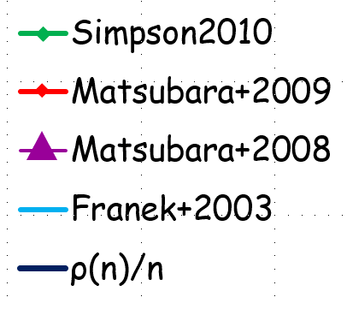
History of Lower Bounds
0.9270509
Notes:
This is the line of rho of n divided by n, that are exactly computed by computer experiments, up to 66.
In 2003, Franek showed the lower bound 0.92, by defining a grammar that generates run-rich strings.

Slide 20
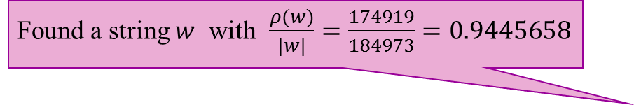
History of Lower Bounds
Found a string $w$ with $\frac{ρ(w)}{|w|}=\frac{174919}{184973}=0.9445658$
0.9270509
Notes:
After five years, Matsubara and others, including me, discovered an interesting string by chance.
The string was run-rich. The length is about one-hundred and eighty-four thousand, and it contains many runs.
The value 0.9445 was clearly larger than the lower bound.

Slide 21
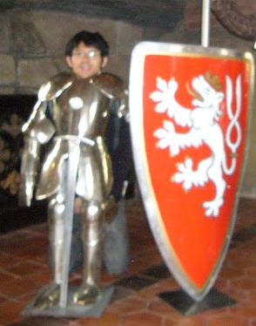
History of Lower Bounds
Found a string $w$ with $\frac{ρ(w)}{|w|}=\frac{174919}{184973}=0.9445658$
0.9445757
0.9445757
0.9270509
NTT Software
April 2012~
t₀ = 1001010010110100101
t₁ = 1001010010110
t₂ = 100101001011010010100101
t_{k} = t_{k-1} t_{k-2} (k mod 3 = 0, k>2)
t_{k} = t_{k-1} t_{k-4} (k mod 3 ≠ 0, k>2)
Notes:
Next year, we slightly improved the bound, by defining a recurrence like this.
The recurrence is discovered by Matsubara-kun, who was a student of us.
He discovered this recurrent formula, by watching, watching, and watching the known run-maximal strings everyday.
He said that, suddenly, the formulae appeared in his brain.

Slide 22
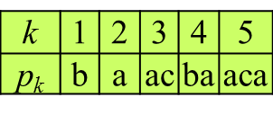
History of Lower Bounds
Found a string $w$ with $\frac{ρ(w)}{|w|}=\frac{174919}{184973}=0.9445658$
0.9445757
The Modified Padovan Words
f (a) = aacab
f (b) = acab
f (c) = ac
h(a) = 101001011001010010110100
h(b) = 1010010110100
h(c) = 10100101
0.9270509
p_{k}=R(f(p_{k-5})) for k>5
t₀ = 1001010010110100101
t₁ = 1001010010110
t₂ = 100101001011010010100101
t_{k} = t_{k-1} t_{k-2} (k mod 3 = 0, k>2)
t_{k} = t_{k-1} t_{k-4} (k mod 3 ≠ 0, k>2)
Notes:
Next year, Simpson defined a very interesting series of strings, called the modified Padovan words, and proved the lower bound, that is currently the best one.
The series of strings is defined by two morphism, f and h, and a reversal function R.
He showed a general term of the number of runs in these strings, and get the bound as a limit value.

Slide 23
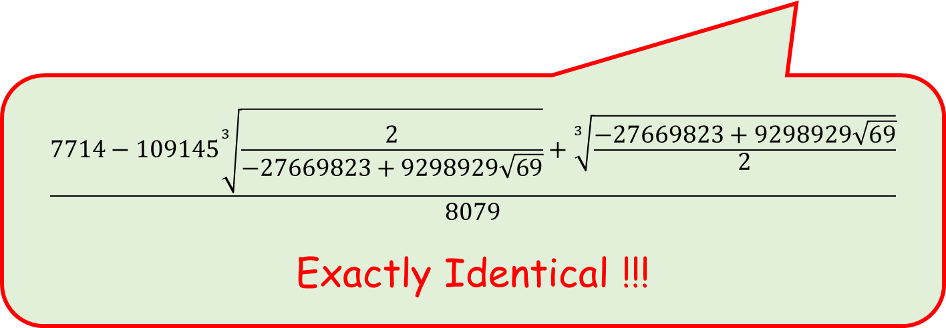
History of Lower Bounds
Found a string $w$ with $\frac{ρ(w)}{|w|}=\frac{174919}{184973}=0.9445658$
0.9445757
The Modified Padovan Words
f (a) = aacab
f (b) = acab
f (c) = ac
h(a) = 101001011001010010110100
h(b) = 1010010110100
h(c) = 10100101
$$\frac{7714−109145\sqrt[3]{\frac{2}{−27669823+9298929\sqrt{69}}}+\sqrt[3]{\frac{−27669823+9298929\sqrt{69}}{2}}}{8079}$$
Exactly Identical !!!
p_{k}=R(f(p_{k-5})) for k>5
t₀ = 1001010010110100101
t₁ = 1001010010110
t₂ = 100101001011010010100101
t_{k} = t_{k-1} t_{k-2} (k mod 3 = 0, k>2)
t_{k} = t_{k-1} t_{k-4} (k mod 3 ≠ 0, k>2)
Notes:
Interestingly, the value of the currently the best lower bound, is also given by our strings.
The value is exactly identical.
The value is given as a root of a cubic equation.

Slide 24
History of Lower Bounds
Found a string $w$ with $\frac{ρ(w)}{|w|}=\frac{174919}{184973}=0.9445658$
0.9445757
The Modified Padovan Words
f (a) = aacab
f (b) = acab
f (c) = ac
h(a) = 101001011001010010110100
h(b) = 1010010110100
h(c) = 10100101
p_{k}=R(f(p_{k-5})) for k>5
t₀ = 1001010010110100101
t₁ = 1001010010110
t₂ = 100101001011010010100101
t_{k} = t_{k-1} t_{k-2} (k mod 3 = 0, k>2)
t_{k} = t_{k-1} t_{k-4} (k mod 3 ≠ 0, k>2)

Slide 25
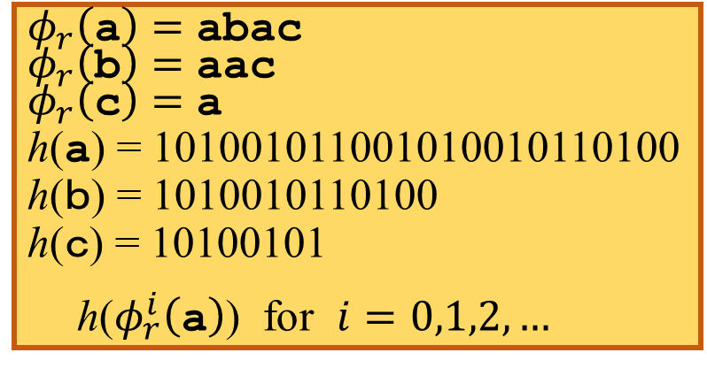

We found yet another good morphisms
$$φ_{r}\left(\text{a}\right)=\text{abac}$$
$$φ_{r}\left(\text{b}\right)=\text{aac}$$
$$φ_{r}\left(\text{c}\right)=\text{a}$$
h($\text{a}$) = 101001011001010010110100
h($ｂ$) = 1010010110100
h($ｃ$) = 10100101
h($φ_{r}^{i}\left(\text{a}\right)$) for $i=0,1,2,…$
New
0.9445757
The Modified Padovan Words
f (a) = aacab
f (b) = acab
f (c) = ac
h(a) = 101001011001010010110100
h(b) = 1010010110100
h(c) = 10100101 h($p_{i}$)
p_{k}=R(f(p_{k-5})) for k>5
t₀ = 1001010010110100101
t₁ = 1001010010110
t₂ = 100101001011010010100101
t_{k} = t_{k-1} t_{k-2} (k mod 3 = 0, k>2)
t_{k} = t_{k-1} t_{k-4} (k mod 3 ≠ 0, k>2)
Notes:
In this work, we succeeded to give yet another series of strings, which gives exactly the same lower bound.
Although these three definitions look differently, but the limit value of the number of runs is exactly the same.
In my personal opinion, our is the most simple.
We note that the morphism h is the same as Simpson’s.

Slide 26
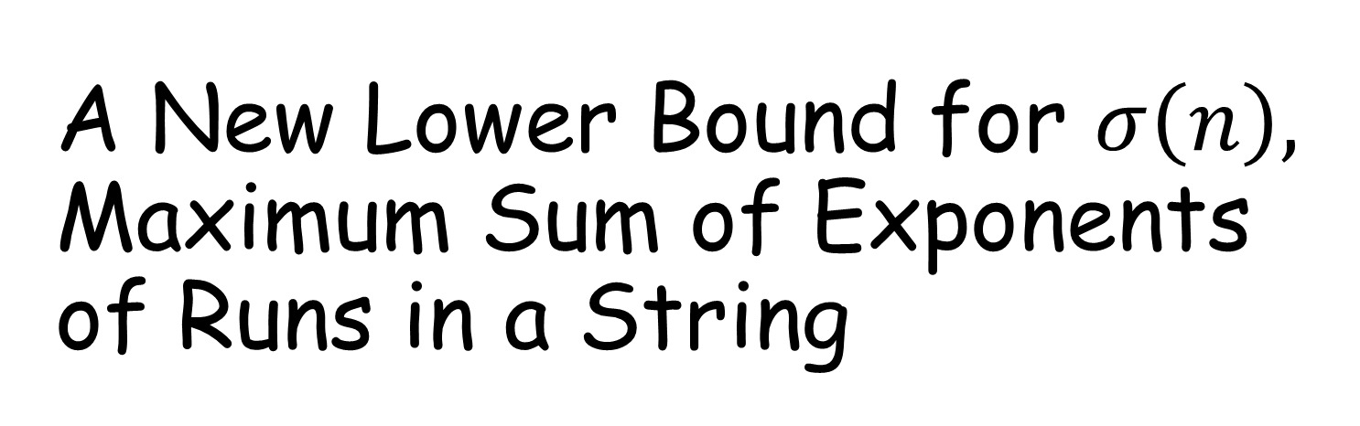
A New Lower Bound for $σ\left(n\right),$
Maximum Sum of Exponents of Runs in a String
Notes:
OK, then we briefly mention on sigma, the maximum value of the sum of exponents of runs in a string of length n.

Slide 27
Run-Rich Strings
$$n$$ | 2 | 3 | 4 | 5 | 6 | 7 | 8 | 9 | 10 | 11 | 12 | 13 | 14 | 15 | 16 | 17 | 18 | 19 | 20 | 21 | 22 | 23 | 24 | 25 | 26 | 27
$$ρ\left(n\right)$$ | 1 | 1 | 2 | 2 | 3 | 4 | 5 | 5 | 6 | 7 | 8 | 8 | 10 | 10 | 11 | 12 | 13 | 14 | 15 | 15 | 16 | 17 | 18 | 19 | 20 | 21
$$σ\left(n\right)$$ | 2.0 | 3.0 | 4.0 | 5.0 | 6.0 | 8.0 | 10.0 | 11.0 | 12.5 | 14.5 | 16.0 | 17.4 | 20.3 | 21.3 | 23.0 | 25.0 | 27.0 | 29.0 | 31.0 | 32.0 | 33.7 | 35.7 | 37.6 | 39.7 | 42.2 | 44.3
All run-maximal and SOE-maximal strings ≤ 27
a
b
$$ρ(w)$$
$$σ(w)$$
run-maximal
$$ρ(w)$$
$$σ(w)$$
SOE-maximal
$$ρ(w)$$
$$σ(w)$$
Notes:
This is the slide I showed you at the beginning of this talk.
We focus on the values of this line, the maximum sum of exponents.

Slide 28



Maximum Sum of Exponents of Runs in a string
The best
  upper bound for $\frac{σ(n)}{n}$ is 4.087 [Crochemore+2011]
  lower bound is 2.035267 [Crochemore+2011]
$$φ_{c}\left(\text{a}\right)=\text{baaba}$$
$$φ_{c}\left(\text{b}\right)=\text{ca}$$
$$φ_{c}\left(\text{c}\right)=\text{bca}$$
$$ψ_{c}\left(\text{a}\right)=\text{0}\text{10}\text{11}$$
$$ψ_{c}\left(\text{b}\right)=\text{010}\text{0}\text{1}\text{01}\text{1}$$
$$ψ_{c}\left(\text{c}\right)=\text{010}\text{010}\text{11}$$
$ψ_{c}\left( φ_{c}^{i}\left(\text{a}\right)\right)$
Notes:
The currently the best upper bound and the lower bound are given by Crochemore and others in the same paper.
The upper bound is 4.087, and the lower bound is 2.035.
The lower bound is given by these morphisms.
We thought that the morphisms are simple and elegant, so that we were interested in finding another morphisms.
That was our original motivation of this work.

Slide 29




Maximum Sum of Exponents of Runs in a string
The best
  upper bound for $\frac{σ(n)}{n}$ is 4.087 [Crochemore+2011]
  lower bound is 2.035267 [Crochemore+2011]
  lower bound is 2.036992 [This paper]
New
$$φ_{c}\left(\text{a}\right)=\text{baaba}$$
$$φ_{c}\left(\text{b}\right)=\text{ca}$$
$$φ_{c}\left(\text{c}\right)=\text{bca}$$
$$φ_{r}\left(\text{a}\right)=\text{abac}$$
$$φ_{r}\left(\text{b}\right)=\text{aac}$$
$$φ_{r}\left(\text{c}\right)=\text{a}$$
identical
for $ρ\left(n\right)$
$$ψ_{c}\left(\text{a}\right)=\text{0}\text{10}\text{11}$$
$$ψ_{c}\left(\text{b}\right)=\text{010}\text{0}\text{1}\text{01}\text{1}$$
$$ψ_{c}\left(\text{c}\right)=\text{010}\text{010}\text{11}$$
$ψ_{c}\left( φ_{c}^{i}\left(\text{a}\right)\right)$
$$ψ_{e}\left(\text{a}\right)=\text{10}\text{1001010010}$$
$$ψ_{e}\left(\text{b}\right)=\text{110100}$$
$$ψ_{e}\left(\text{c}\right)=\text{1}$$
$ψ_{e}\left( φ_{r}^{i}\left(\text{a}\right)\right)$
Notes:
By intensive computational experiments, we found a better morphisms.
By combining these two morphisms, we get a slightly better lower bound for the sum of exponents of runs in a string.
An interesting thing is that, the morphism phi_r, is identical to the one that I used for the maximum number of runs.
I can share the same base morphism phi_r, to get good run-rich strings.

Slide 30
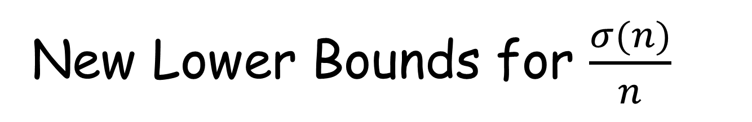
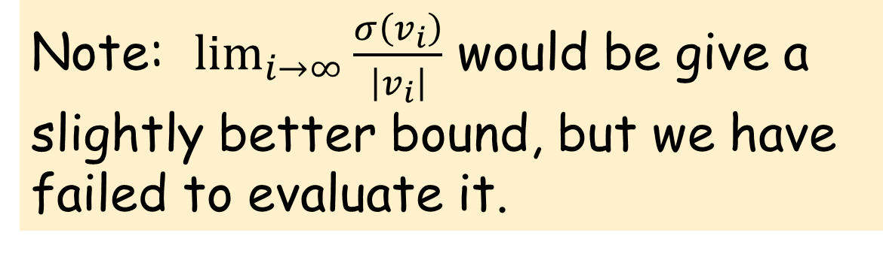

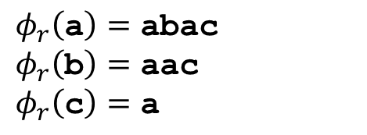

New Lower Bounds for $\frac{σ(n)}{n}$
2.035267 : current best [Crochemore+2011]
2.036982 $= \frac{σ\left(v_{12}\right)}{\left|v_{12}\right|}= \frac{15389914.96}{7555252}$
2.036992 $= \lim_{k→∞}{\frac{σ\left({\left(v_{12}\right)}^{k}\right)}{\left|{\left(v_{12}\right)}^{k}\right|}}$
New
New
$$φ_{r}\left(\text{a}\right)=\text{abac}$$
$$φ_{r}\left(\text{b}\right)=\text{aac}$$
$$φ_{r}\left(\text{c}\right)=\text{a}$$
$$ψ_{e}\left(\text{a}\right)=\text{10}\text{1001010010}$$
$$ψ_{e}\left(\text{b}\right)=\text{110100}$$
$$ψ_{e}\left(\text{c}\right)=\text{1} \\ v_{i}= ψ_{e}\left( φ_{r}^{i}\left(\text{a}\right)\right)$$
Note: $\lim_{i→∞}{\frac{σ\left(v_{i}\right)}{\left|v_{i}\right|}}$ would be give a slightly better bound, but we have failed to evaluate it.
Notes:
By intensive computational experiments, we found a better morphisms.
An interesting thing is that, the morphism phi_r, is identical to the one that I used for the maximum number of runs.
I can share the same base morphism phi_r, to get good run-rich strings.

Slide 31
We found good morphisms that generate Run-Rich Strings
Summary
$$φ_{r}\left(\text{a}\right)=\text{abac} { φ}_{r}\left(\text{b}\right)=\text{aac} φ_{r}\left(\text{c}\right)=\text{a}$$
$$h\left(\text{a}\right)=\text{101001011001010010110100}$$
$$h\left(\text{b}\right)=\text{1010010110100}$$
$$h\left(\text{c}\right)=\text{10100101}$$
$$ψ_{e}\left(\text{a}\right)=\text{10}\text{1001010010}$$
$$ψ_{e}\left(\text{b}\right)=\text{110100}$$
$$ψ_{e}\left(\text{c}\right)=\text{1}$$
$$u_{i}=h(φ_{r}^{i}\left(\text{a}\right))$$
$$v_{i}=ψ_{e}(φ_{r}^{i}\left(\text{a}\right))$$
$$\lim_{i→∞}{\frac{ρ\left(u_{i}\right)}{\left|u_{i}\right|}}=0.9445757$$
$$\frac{σ\left(v_{12}\right)}{\left|v_{12}\right|}=2.036982$$
$=$Know Best L.B.
[Simpson2010]
$>$Know Best L.B.
[Crochemore+2011]
$ρ\left(w\right)$ : Number of Runs in $w$
$σ\left(w\right)$ : Sum of Exponents of Runs in $w$
Notes:
We now summarize my talk.

Slide 32
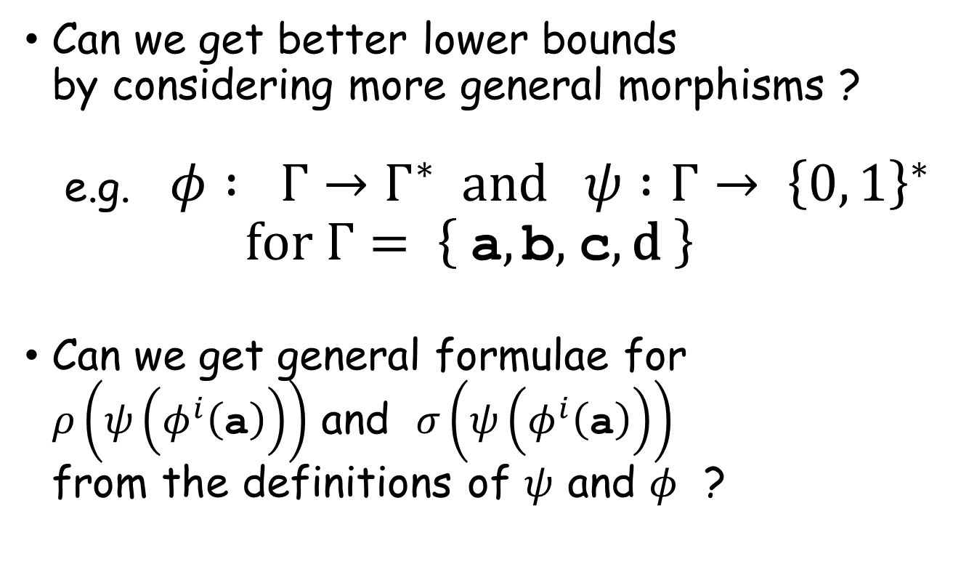
Future Work
Can we get better lower bounds
by considering more general morphisms ?
e.g. $φ : Γ→Γ^{∗} \text{and} ψ :Γ→ {\left\{0, 1\right\}}^{∗}$
$\text{for} Γ= \left\{ \text{a}, \text{b}\text{, }\text{c}, \text{d} \right\}$
Can we get general formulae for
$ρ\left(ψ\left(φ^{i}\left(\text{a}\right)\right)\right)$ and $σ\left(ψ\left(φ^{i}\left(\text{a}\right)\right)\right)$
from the definitions of $ψ$ and $φ$ ?
(cf. for Strumian words
[Franek+2000, Baturo+2008, Piątkowski2013] )

Slide 33
Thank you.

Slide 35
We found good morphisms that generate Run-Rich Strings
In Short,
$$φ_{r}\left(\text{a}\right)=\text{abac} { φ}_{r}\left(\text{b}\right)=\text{aac} φ_{r}\left(\text{c}\right)=\text{a}$$
$$h\left(\text{a}\right)=\text{101001011001010010110100}$$
$$h\left(\text{b}\right)=\text{1010010110100}$$
$$h\left(\text{c}\right)=\text{10100101}$$
$$ψ_{e}\left(\text{a}\right)=\text{10}\text{1001010010}$$
$$ψ_{e}\left(\text{b}\right)=\text{110100}$$
$$ψ_{e}\left(\text{c}\right)=\text{1}$$
$$u_{i}=h(φ_{r}^{i}\left(\text{a}\right))$$
$$v_{i}=ψ_{e}(φ_{r}^{i}\left(\text{a}\right))$$
$$\lim_{i→∞}{\frac{ρ\left(u_{i}\right)}{\left|u_{i}\right|}}=0.9445757$$
$$\frac{σ\left(v_{12}\right)}{\left|v_{12}\right|}=2.036982$$
$=$Know Best L.B.
[Simpson2010]
$>$Know Best L.B.
[Crochemore+2011]
$ρ\left(w\right)$ : Number of Runs in $w$
$σ\left(w\right)$ : Sum of Exponents of Runs in $w$

Slide 36
We found good morphisms that generate Run-Rich Strings
In Short,
$$φ_{r}\left(\text{a}\right)=\text{abac} { φ}_{r}\left(\text{b}\right)=\text{aac} φ_{r}\left(\text{c}\right)=\text{a}$$
$$h\left(\text{a}\right)=\text{101001011001010010110100}$$
$$h\left(\text{b}\right)=\text{1010010110100}$$
$$h\left(\text{c}\right)=\text{10100101}$$
$$φ_{r}\left(\text{a}\right)=\text{abac}$$
$$ψ_{e}\left(\text{a}\right)=\text{10}\text{1001010010}$$
$$ψ_{e}\left(\text{b}\right)=\text{110100}$$
$$ψ_{e}\left(\text{c}\right)=\text{1}$$
$$φ_{r}^{2}\left(\text{a}\right)=φ_{r}\left(\text{ab}\text{ac}\right)$$
$=$ $\text{a}\text{bac} \text{a}\text{a}\text{c}$ $\text{a}\text{b}\text{ac} \text{a}$
$$u_{i}=h(φ_{r}^{i}\left(\text{a}\right))$$
$φ_{r}^{3}\left(\text{a}\right)=$ $\text{a}\text{bac} \text{aac} \text{abac} \text{a} \text{abac} \text{a}\text{bac} \text{a} \text{abac} \text{a}\text{ac} \text{abac}$ $\text{a} \text{ab}\text{ac}$
$$v_{i}=ψ_{e}(φ_{r}^{i}\left(\text{a}\right))$$
$$\lim_{i→∞}{\frac{ρ\left(u_{i}\right)}{\left|u_{i}\right|}}=0.9445757$$
$$⋮$$
$$\frac{σ\left(v_{12}\right)}{\left|v_{12}\right|}=2.036982$$
$=$Know Best L.B.
[Simpson2010]
$>$Know Best L.B.
[Crochemore+2011]
$ρ\left(w\right)$ : Number of Runs in $w$
$σ\left(w\right)$ : Sum of Exponents of Runs in $w$

Slide 37


We found good morphisms that generate Run-Rich Strings
In Short,
$$φ_{r}\left(\text{a}\right)=\text{abac} { φ}_{r}\left(\text{b}\right)=\text{aac} φ_{r}\left(\text{c}\right)=\text{a}$$
$$h\left(\text{a}\right)=\text{101001011001010010110100}$$
$$h\left(\text{b}\right)=\text{1010010110100}$$
$$h\left(\text{c}\right)=\text{10100101}$$
$$ψ_{e}\left(\text{a}\right)=\text{10}\text{1001010010}$$
$$ψ_{e}\left(\text{b}\right)=\text{110100}$$
$$ψ_{e}\left(\text{c}\right)=\text{1}$$
$$u_{i}=h(φ_{r}^{i}\left(\text{a}\right))$$
$$v_{i}=ψ_{e}(φ_{r}^{i}\left(\text{a}\right))$$
$$\lim_{i→∞}{\frac{ρ\left(u_{i}\right)}{\left|u_{i}\right|}}=0.9445757$$
$$φ_{r}\left(\text{a}\right)=\text{abac}$$
$$\frac{σ\left(v_{12}\right)}{\left|v_{12}\right|}=2.036982$$
$=$Know Best L.B.
[Simpson2010]
$$φ_{r}^{2}\left(\text{a}\right)=φ_{r}\left(\text{ab}\text{ac}\right)$$
$=$ $\text{a}\text{bac} \text{a}\text{a}\text{c}$ $\text{a}\text{b}\text{ac} \text{a}$
$>$Know Best L.B.
[Crochemore+2011]
$ρ\left(w\right)$ : Number of Runs in $w$
$σ\left(w\right)$ : Sum of Exponents of Runs in $w$
$φ_{r}^{3}\left(\text{a}\right)=$ $\text{a}\text{bac} \text{aac} \text{abac} \text{a} \text{abac} \text{a}\text{bac} \text{a} \text{abac} \text{a}\text{ac} \text{abac}$ $\text{a} \text{ab}\text{ac}$
$$⋮$$

Slide 38
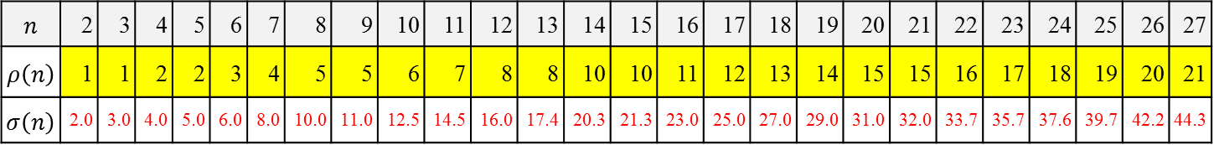
$$n$$ | 2 | 3 | 4 | 5 | 6 | 7 | 8 | 9 | 10 | 11 | 12 | 13 | 14 | 15 | 16 | 17 | 18 | 19 | 20 | 21 | 22 | 23 | 24 | 25 | 26 | 27
$$ρ\left(n\right)$$ | 1 | 1 | 2 | 2 | 3 | 4 | 5 | 5 | 6 | 7 | 8 | 8 | 10 | 10 | 11 | 12 | 13 | 14 | 15 | 15 | 16 | 17 | 18 | 19 | 20 | 21
$$σ\left(n\right)$$ | 2.0 | 3.0 | 4.0 | 5.0 | 6.0 | 8.0 | 10.0 | 11.0 | 12.5 | 14.5 | 16.0 | 17.4 | 20.3 | 21.3 | 23.0 | 25.0 | 27.0 | 29.0 | 31.0 | 32.0 | 33.7 | 35.7 | 37.6 | 39.7 | 42.2 | 44.3

