Slide 1
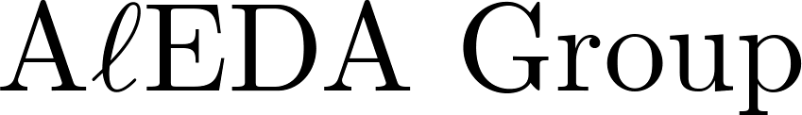
Degenerate String Reconstruction from Cover Arrays (Extended Abstract)
Dipankar Ranjan Baisya,
Mir Md. Faysal &
M. Sohel Rahman
CSE, BUET
Dhaka 1000

Slide 2
Motivation
Extensive use of degenerate string in molecular biology.
      used to model biological sequences. (e.g., FASTA format for representing either nucleotide sequences or peptide sequences)
      very efficient in expressing polymorphism in biological sequences. (e.g., Single Nucleotide Polymorphism (SNP))

Slide 3
Goal of the Paper
Present efficient algorithms to reconstruct a degenerate string from a valid cover array.
We have derived two algorithms one using unbounded alphabet and other using minimum sized alphabet for that purpose.

Slide 4

Degenerate String
Let = { A, C, G, T }

Slide 5
Degenerate String
Let = { A, C, G, T }
Then we can get 2^4 -1 = 15 non-empty sets of letters.

Slide 6
Degenerate String
Let = { A, C, G, T }
Then we can get 2^4 -1 = 15 non-empty sets of letters.
At each position of an degenerate string we have one of those sets.

Slide 7






Degenerate String

Slide 8
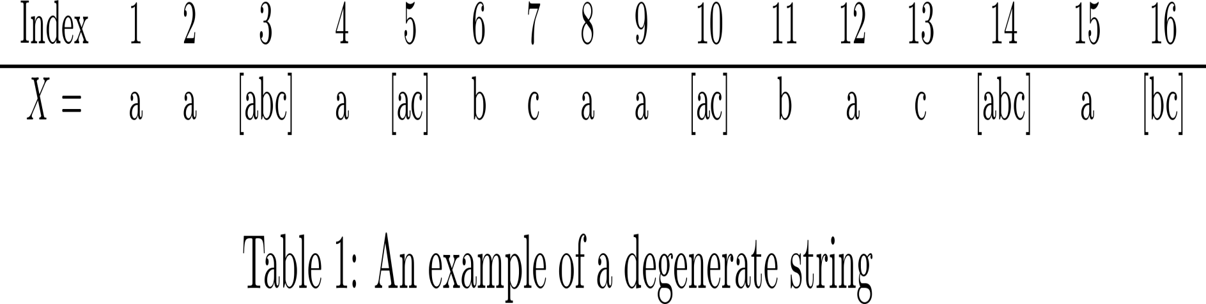
Degenerate String Example

Slide 9
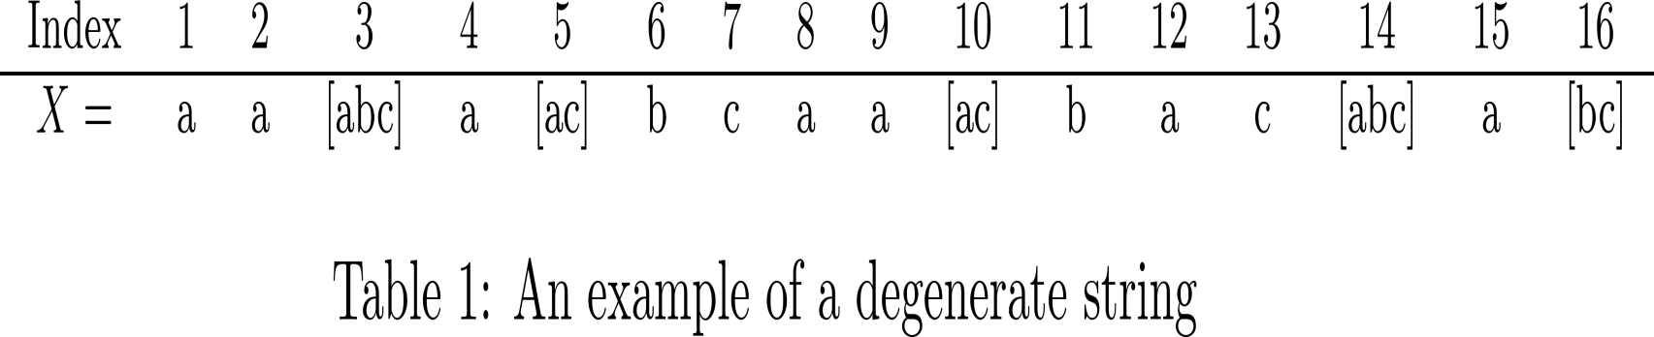
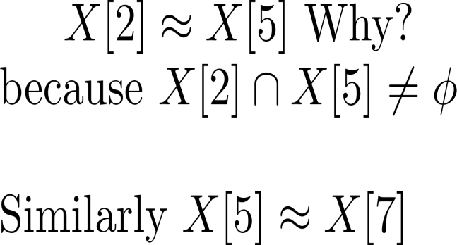
Degenerate String: Equality/Match

Slide 10
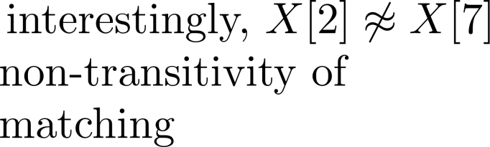
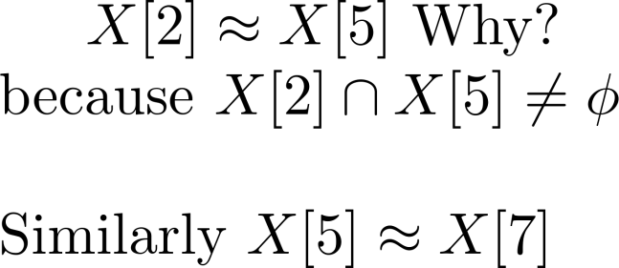
Degenerate String: Equality/Match

Slide 11
Cover Array of Regular String
We say that a string S covers a string U if every letter of U is contained in some occurrence of S as a substring of U. Then S is called a cover of U.

Slide 12
Cover Array of Regular String
We say that a string S covers a string U if every letter of U is contained in some occurrence of S as a substring of U. Then S is called a cover of U.
The cover array C of a regular string X[1..n], is a data structure used to store the length of the longest proper cover of every prefix of X.

Slide 13
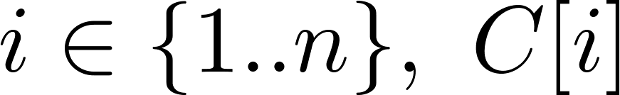
Cover Array of Regular String
so for all stores the length of the longest cover of X[1..i] or 0.

Slide 14
Cover Array of Regular String
so for all stores the length of the longest cover of X[1..i] or 0.
since every cover of any cover of X is also a cover of X, it turns out that, the cover array C compactly describes all the covers of every prefix of X.

Slide 15
Exp. of Cover Array of Regular string
Table 2 : Cover array of abaababaabaababaaba

Slide 16
Exp. of Cover Array of Regular string
From Table 2 we can see that, cover array of X, has the entries
representing the three covers of X having length 11, 6 and 3 respectively.

Slide 17
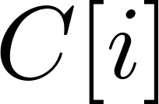
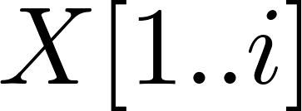
Cover Array for Degenerate String
For a degenerate string, stores the list of
the lengths of the covers of .

Slide 18

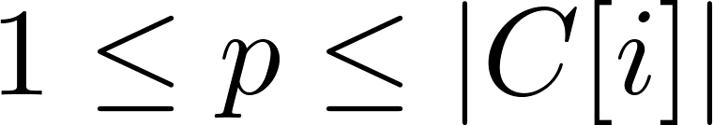
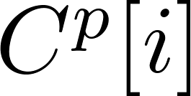
Cover Array for Degenerate String
For a degenerate string, stores the list of the lengths of the covers of .
More elaborately, each is a list such that where denotes the p-th largest cover of X[1..i].

Slide 19
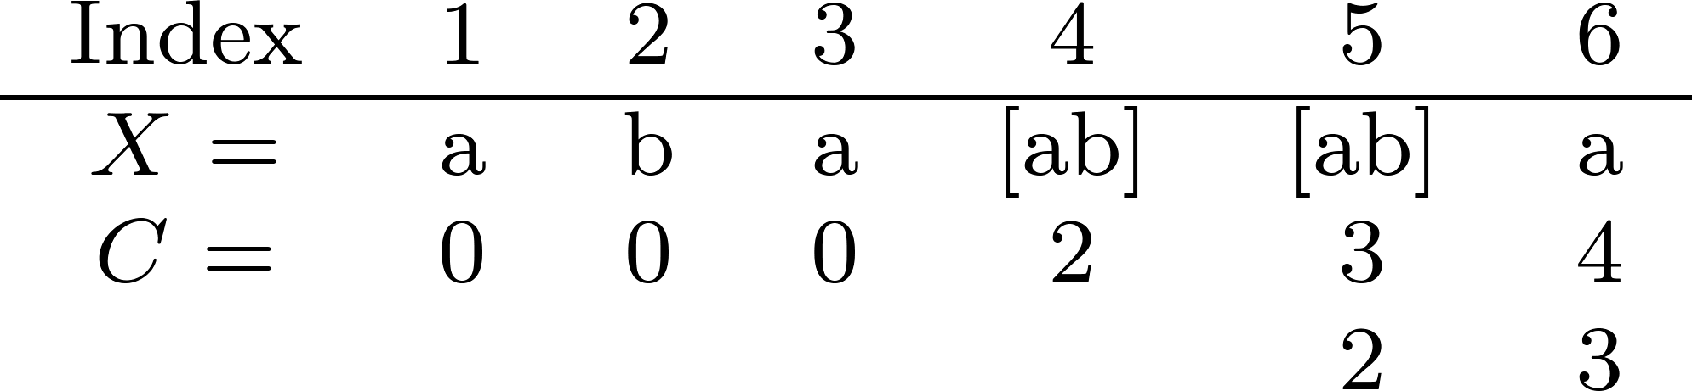
Example of Cover Array for Degenerate String
Table 3. Cover Array of aba[ab][ab]a

Slide 20
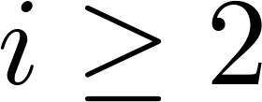

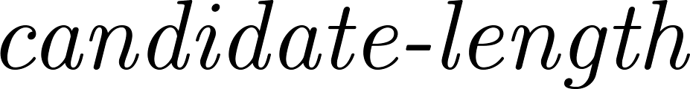
Basic Validation of a Cover Array
for we define as
of a Cover of .

Slide 21
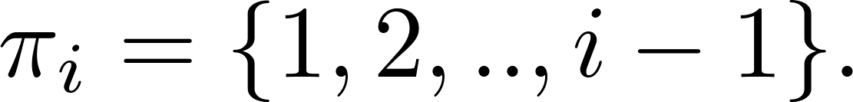
Basic Validation of a Cover Array
for we define as
of a Cover of .
candidate-lengths of covers of is

Slide 22
Basic Validation of a Cover Array

Slide 23
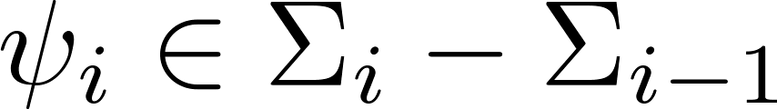
Basic Validation of a Cover Array
Further we assume that a symbol
is required by .
k

Slide 24

Basic Validation of a Cover Array
Further we assume that a symbol
is required by .
Notably .
k

Slide 25
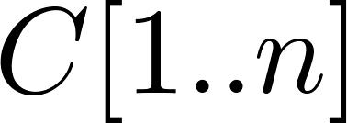
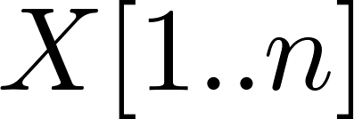
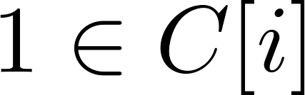
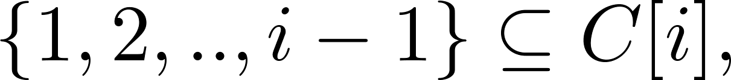

Basic Validation of a Cover Array
Lemma 1. Suppose is the cover array of a string . If , then

Slide 26
Basic Validation of a Cover Array
Lemma 1. Suppose is the cover array of a string . If , then
Proof. proof will be provided in the journal version.

Slide 27
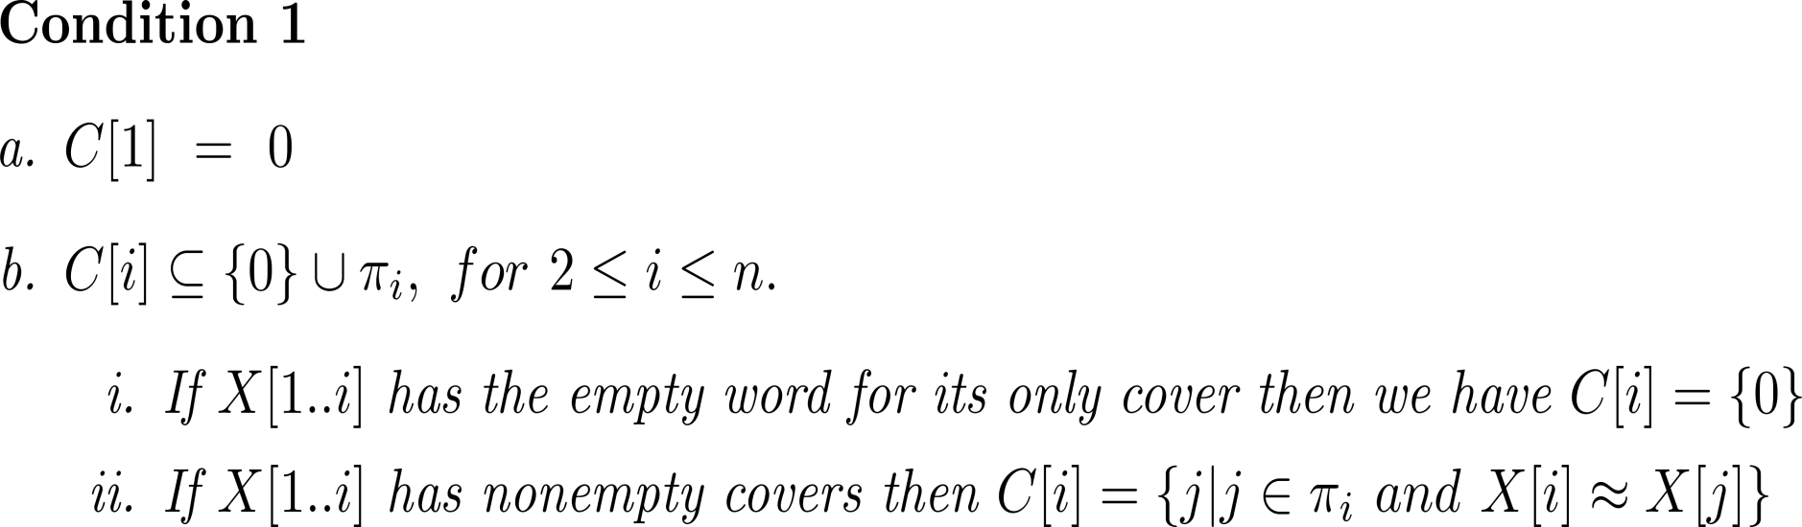
Basic Validation of a Cover Array
Theorem 2.
Proof. proof will be provided in the journal version.

Slide 28
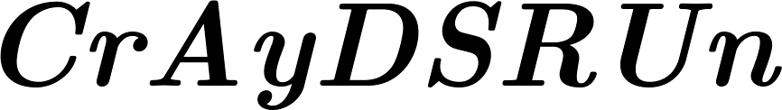
Our Algorithms

Slide 29
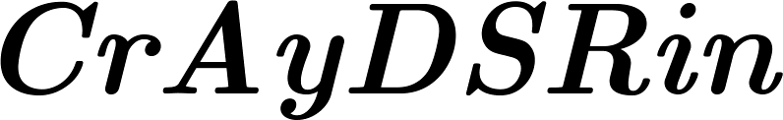
Our Algorithms

Slide 30
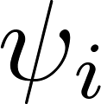
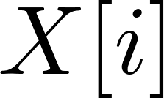
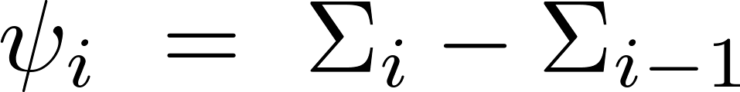
CrAyDSRUn
we denote by the new set of characters introduced in , i.e., .

Slide 31
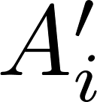

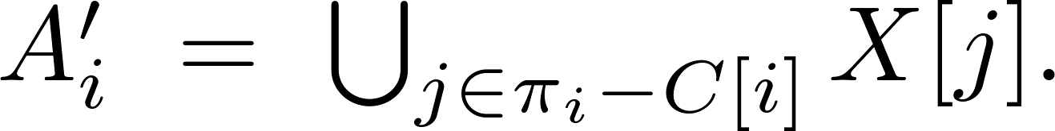
CrAyDSRUn
we denote by the new set of characters introduced in , i.e., .
we denote by the set of symbols that are not allowed only at Position , i.e.,

Slide 32
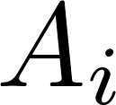
CrAyDSRUn
we denote by the new set of characters introduced in , i.e., .
we denote by the set of symbols that are not allowed only at Position , i.e.,
denotes the set of symbols that can be assigned to .

Slide 33
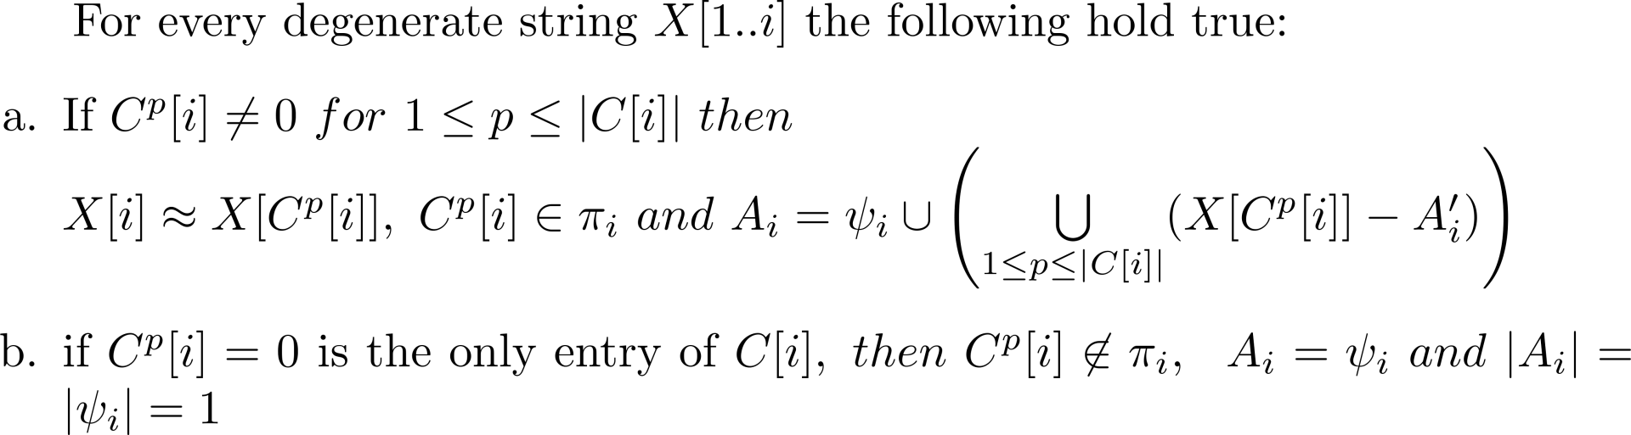
CrAyDSRUn
Lemma 3.
Proof. proof will be provided in the journal version.

Slide 34



CrAyDSRUn: Basic Steps
Suppose, we have a cover array where is the product of maximum string length and maximum list length of cover array .

Slide 35

CrAyDSRUn: Basic Steps
Suppose, we have a cover array where is the product of maximum string length and maximum list length of cover array .
so,

Slide 36
CrAyDSRUn: Basic Steps
step 1, validity checking.

Slide 37
CrAyDSRUn: Basic Steps
step 1, validity checking.
step 2, find .

Slide 38
CrAyDSRUn: Basic Steps
step 1, validity checking.
step 2, find .
step 3, find .

Slide 39
CrAyDSRUn: Basic Steps
step 1, validity checking.
step 2, find .
step 3, find .
step 4, place new character in proper positions.

Slide 40
CrAyDSRUn: Step 1
scan/proceed one position at a time from left to right i.e., in an online fashion.
check validity at each position of input array according to “Basic Validation” section of a cover array.

Slide 41
CrAyDSRUn: Step 1
as soon as it finds a violation of validity the algorithms returns the input array as invalid.
for further validation see Lemma 4 and Lemma 5 (Slide no. 45 and 46).

Slide 42

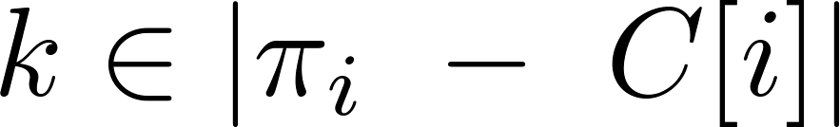
CrAyDSRUn: Step 2
for each , our algorithm finds for each .
.

Slide 43
CrAyDSRUn: Step 2
for each , our algorithm finds for each .
.
our algorithm finds with the help of Lemma 4 and Lemma 5.(see next slides)

Slide 44
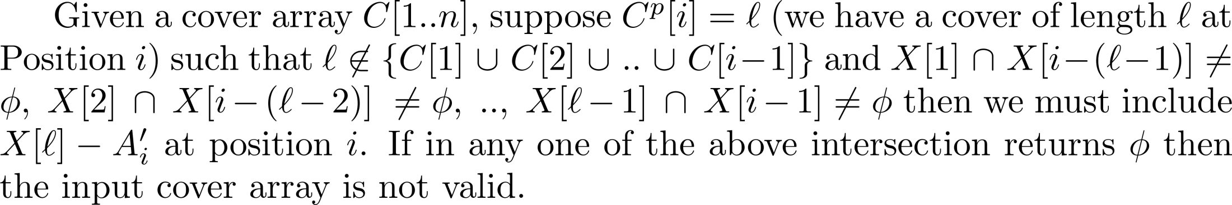
CrAyDSRUn: Step 2
Lemma 4.
Proof. proof will be provided in the journal version.

Slide 45
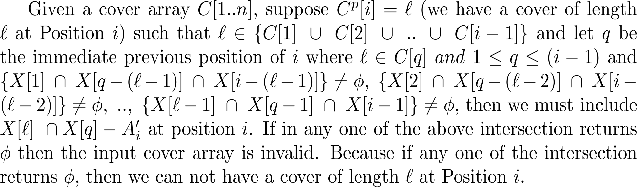
CrAyDSRUn: Step 2
Lemma 5.
Proof. proof will be provided in the journal version.

Slide 46


CrAyDSRUn: Step 2
we can see from Lemma 4 and Lemma 5 that we need to perform intersection operation. Finding intersection will take .
so for each position step 2 takes .

Slide 47
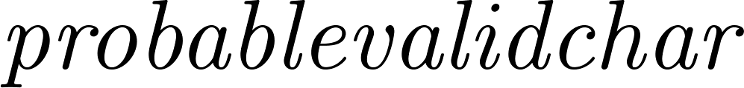
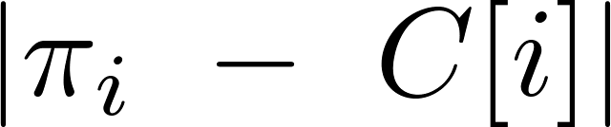

CrAyDSRUn: Step 3
similar to step 2.
find using Lemma 3.(see slide no.34)
for that our algorithms finds a set of
in a similar way of finding in previous step
except that instead of there will be
iterations for each .

Slide 48
CrAyDSRUn: Step 3
similar to step 2.
find using Lemma 3.(see slide no.34)
for that our algorithms finds a set of
in a similar way of finding in previous step
except that instead of there will be
iterations for each .
then .

Slide 49
CrAyDSRUn: Step 3
so for each position step 3 takes .

Slide 50
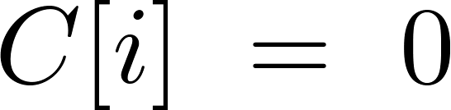
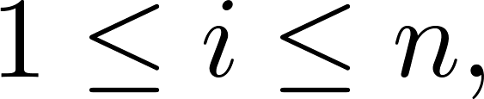
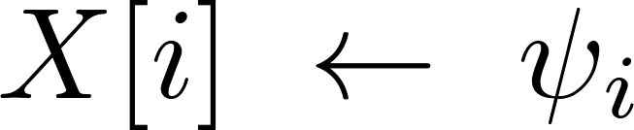
CrAyDSRUn: Step 4
if where
then

Slide 51
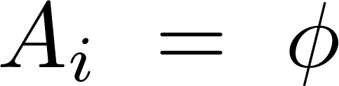
CrAyDSRUn: Step 4
if where
then
if then new characters will be placed in proper positions.

Slide 52
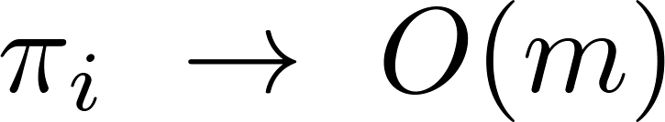
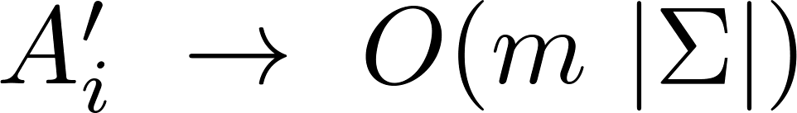
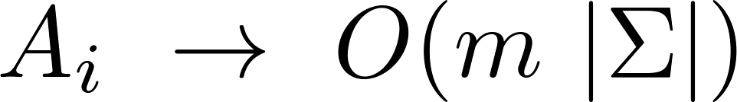

CrAyDSRUn: Running Time
for each position i,
  Construction of
  Construction of
  Construction of
  Construction of

Slide 53
CrAyDSRUn: Running Time
for each position i,
  Construction of
  Construction of
  Construction of
  Construction of
so for positions, we need

Slide 54

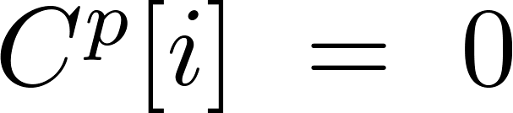

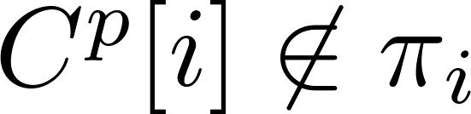
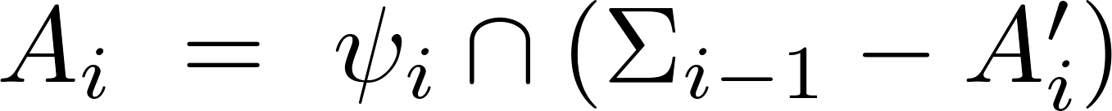
CrAyDSRin
Lemma 6. for every degenerate string if
is the only entry in , then
and
Proof. proof will be provided in the journal version.

Slide 55
CrAyDSRin
works exactly like except it computes slight differently.

Slide 56
CrAyDSRin
works exactly like except it computes slight differently.
it computes following Lemmas 3.a and 6 (instead of Lemma 3.b).

Slide 57
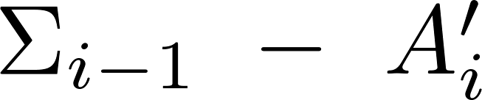
CrAyDSRin: Running Time
Runtime analysis follows readily from analysis of .
only extra calculation which can be done in .

Slide 58

CrAyDSRin: Running Time
Runtime analysis follows readily from analysis of .
only extra calculation which can be done in .
therefore overall runtime complexity .

Slide 59
Thank you

