Slide 1
Random Access to Fibonacci Codes
Shmuel T. Klein Dana Shapira
Bar Ilan University Ashkelon Academic College
Ariel University

Slide 2
Random Access to Variable length Codes
Divide the encoded file into blocks of size b
Use an auxiliary bit vector to indicate the beginning of each block
Time – O(b)
Time vs. Memory storage tradeoff

Slide 3
Wavelet trees
Grossi, Gupta and Vitter – 2003
00010011101010011
110010100
00110001
10100
0101
01001
010
10
100
10
01

Slide 4
Previous Work
Grossi and Ottaviano - Wavelet trees based on Patricia trie
Brisaboa, Ladra, Navarro (IPM 2013) – Wavelet tree for Byte Codes
Kulekci (DCC 2014) - Elias and Rice code
P. Prochazka, J. Holub – (DCC 2014) compression for similar biological sequences

Slide 5
Outline
Fibonacci Codes
Rank and Select
Random Access using auxiliary index
Random Access using Wavelet trees
Improved Wavelet trees for Random Access
Experimental Results

Slide 6
Outline
Fibonacci Codes
Rank and Select
Random Access using auxiliary index
Random Access using Wavelet trees
Improved Wavelet trees for Random Access
Experimental Results

Slide 7
Fibonacci Numbers
0 1 1 2 3 5 8 13 21 34 55 89 144 …
Basis elements of a numeration system

Slide 8
Binary Representation of integers
Basis elements:
128
64
32
16
8
4
2
1
73 =
0
1
0
0
1
0
0
1
Fibonacci:
55
34
21
13
8
5
3
2
1
73 =
1
0
0
1
0
1
0
0
0
No adjacent 1’s

Slide 9
Fibonacci Code
Example: 19 = 101001
Problem: Not instantaneous
Solution: Reverse the codeword
Example: 19 =
{11, 011, 0011, 1011, 00011, 10011, 01011, 000011, 100011, 010011, 001011, 101011, 0000011, …}
1
1101001
1001011

Slide 10
Fibonacci Code
Set of strings ending in 11 with no other adjacent 1’s
{11, 011, 0011, 1011, 00011, 10011, 01011, 000011, 100011, 010011, 001011, 101011, 0000011, …}

Slide 11
Outline
Fibonacci Codes
Rank and Select
Random Access using auxiliary index
Random Access using Wavelet trees
Improved Wavelet trees for Random Access
Experimental Results

Slide 12
Rank and select
Given a bit vector B of length n
rank₁(B,i)- (resp. rank₀(B,i)) - the number of 1s (resp. 0s) up to and including position i in B
select₁(B,i)- (resp. select₀(B,i)) - returns the index of the ith 1 (resp. 0s)

Slide 13
Rank data structure
rank₁(B,i) = i-rank₀(B,i)
  → compute only rank₁(B,i)
Naive Solution: Store rank answers:
Example:
1 | 2 | 3 | 4 | 5 | 6 | 7 | 8 | 9 | 10 | 11 | 12 | 13 | 14 | 15 | 16 | 17 | 18 | 19 | 20
0 | 1 | 0 | 0 | 0 | 1 | 0 | 1 | 1 | 0 | 0 | 0 | 0 | 1 | 1 | 1 | 1 | 0 | 0 | 1
0 | 1 | 1 | 1 | 1 | 2 | 2 | 3 | 4 | 4 | 4 | 4 | 4 | 5 | 6 | 7 | 8 | 8 | 8 | 9

Slide 14
Jacobson’s rank data structure
Store rank answers every lg²n bits of B.
  Use lg n bits for each answer
Divide each chunk into (lg n)/2 chunks ,
Store rank answers relative to last sample every
(lg n)/2 bits
  Use 2lglg n bits per sub-sample
Bottom Level – use a simple Lookup table.
Space Complexity -

Slide 15
Rank
blocks
7041
21627
. . .
613
950
...
000…00 | 0
000…01 | 1
000…10 | 1
000…11 | 2
…
1111…0
1111…1
Output = 7041+613+

Slide 16
Outline
Fibonacci Codes
Rank and Select
Random Access using auxiliary index
Random Access using Wavelet trees
Improved Wavelet trees for Random Access
Experimental Results

Slide 17
Using an Auxiliary Index
1. E(T) compress T
2. Generate B of size |E(T)| so that:
B[i] 1 iff E(T)[i] is the first bit of a codeword
3. Construct a rank/select data structure for B
Space Complexity

Slide 18
Outline
Fibonacci Codes
Rank and Select
Random Access using auxiliary index
Random Access using Wavelet trees
Improved Wavelet trees for Random Access
Experimental Results

Slide 19
Using Wavelet Trees
T = COMPRESSORS
Σ = {C, M, P, E, O, R, S}
Occ = {1,1,1,1,2,2,3}
E(T)= 01011 0011 10011 00011 011 1011
      11 11 0011 011 11
00100111001
100101
00111
101
011
01
1
11
1
1
1
1
1
1

Slide 20
Extract
extract(V_{root}, i){
code ε
v V_{root}
while v is not a leaf
if B_{v}[i] = 0;
v left(v)
code code⋅0
i rank₀(B_{v}, i)
else
v right(v)
code code⋅1
i rank₁(B_{v}, i)
return D(code)

Slide 21
Select
select_{x}(T, i){
w leaf corresponding to f(x)
v father of w
while v ≠ V_{root}
if w is a left child of v
i index of the i^{th} 0 in B_{v}
else
i index of the i^{th} 1 in B_{v}
return i

Slide 22
Enhanced Wavelet tree for Fibonacci codes
Redundant information for single child nodes.
  Similar to the collapsing strategy suffix trees

Slide 23
Enhanced Wavelet tree for Fibonacci codes
00100111001
00100111001
100101
100101
00111
00111
011
011
01
101
01
101
1
11
1
1
1
1
1
1
E(T)= 01011 0011 10011 00011 011 1011
      11 11 0011 011 11
E(T)= 01011 0011 10011 00011 011 1011
      11 11 0011 011 11

Slide 24
Minor Adjustments to Extract
if suffix of code = 0
code code⋅11
if suffix of code ≠ 11
code code⋅1
return D(code)

Slide 25
Analysis
Recursive definition of a FWT of depth h+1
Assumption: if the tree is of depth h+1 then all the F_{h} codewords of length h+1 are in the alphabet.

Slide 26
Obtaining the FWT recursively
N_{h+1}=N_{h}+N_{h-1}+3
T_{h+1}
T_{h}
T_{h-1}

Slide 27
Extending a FWT
N_{h+1}=N_{h}+3F_{h}
N_{h+1}=3F_{h+2}-3
P_{h-1}=2F_{h+2}-3
P_{h-1}/N_{h+1}=(2F_{h+2}-3)/3F_{h+2}-3 ⅔
                ^{h→∞}
2
3
4
5

Slide 28
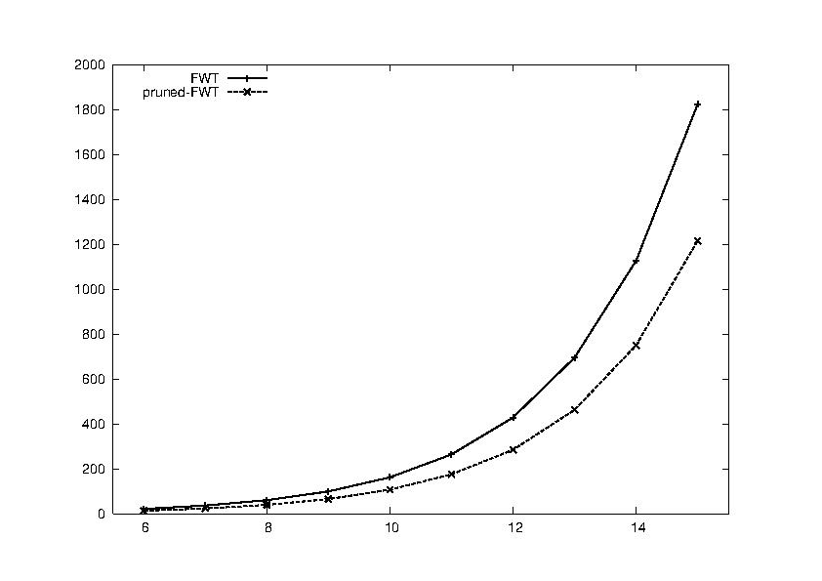
Number of nodes in original and pruned FWT

Slide 29
Experimental Results
English Heaps – distribution of 26 characters and 371 bigram
Finnish – Pesonen- 29 letters
French – Trésor de la Langue Française 26 letters
German Bauer & Goos– 30 letters
Hebrew and Aramaic The Responsa Retrieval Project– 30 letters, 735 bigrams
Italian – 26 letters
Spanish – 26 letters
Portuguese – 26 letters

Slide 30
Compression Performance
File | n | Height | FWT | Pruned | Huffman
English | 26 | 8 | 4.90 | 4.43 | 4.19
Finnish | 29 | 8 | 4.76 | 4.44 | 4.04
French | 26 | 8 | 4.53 | 4.14 | 4.00
German | 30 | 8 | 4.70 | 4.37 | 4.15
Hebrew | 30 | 8 | 4.82 | 4.42 | 4.29
Italian | 26 | 8 | 4.70 | 4.32 | 4.00
Portuguese | 26 | 8 | 4.67 | 4.28 | 4.01
Spanish | 26 | 8 | 4.71 | 4.30 | 4.05
Russian | 32 | 8 | 5.13 | 4.76 | 4.47
English-2 | 378 | 14 | 8.78 | 8.56 | 7.44
Hebrew-2 | 743 | 15 | 9.13 | 8.97 | 8.04

Slide 31
Thank You !!!

