Slide 1


Two simple full-text indexes based on the suffix array
Szymon Grabowski, Marcin Raniszewski
Institute of Applied Computer Science, Lodz University of Technology, Poland
The Prague Stringology Conference, 1-3 September 2014

Slide 2
Presentation plan
Introduction
Related work
SA-hash
FBCSA
Experimental results
Conclusions / Future work

Slide 3
Introduction: full-text index
T (text):
P (pattern):
In this book, the first of several which I am writing, I must confine myself to a chronicle of those events which I myself observed and experienced, and those supported by reliable evidence; preceded by two chapters briefly outlining the background and causes of the November Revolution. I am aware that these two chapters make difficult reading, but they are essential to an understanding of what follows.
are
In this book, the first of several which I am writing, I must confine myself to a chronicle of those events which I myself observed and experienced, and those supported by reliable evidence; preceded by two chapters briefly outlining the background and causes of the November Revolution. I am aware that these two chapters make difficult reading, but they are essential to an understanding of what follows.
Operations:
count:
2
locate:
[291, 351]
find all j that:
P = T[j .. j + len(P)]
allow searches for any substring

Slide 4
Introduction: suffix array (SA)
n = len(T), m = len(P)
Suffix array [Manber & Myers, 1990]: array of n pointers to text suffixes arranged in the lexicographic order
Typically needs 5n bytes (n log n (structure) + n log |Σ| (text))
The pattern is searched using binary search (search time is O(m log n) in the worst case)

Slide 5
Related work
Suffix tree:
  can be built in a linear time
  efficient for small alphabet (widely use in bioinformatics)
  not-efficient for large alphabet
  large space requirements (most implementations need 20n bytes or even more!)

Slide 6
Related work
Since around 2000 great interest in succinct text indexes: compressed suffix array (CSA), FM-index
Compressed indexes:
  not much slower than SA in count queries
  from 2 to 3 orders of magnitude slower in locate queries (large number of matches)
Exploited repetitions in the SA [Mäkinen, 2003], [González et al., 2014]
Semi-external data structures [Gog & Moffat, 2013]

Slide 7
1. SA-hash
Manber and Myers presented a nice trick saving several first steps in the binary search: if we know the SA interval for all the possible first k symbols of pattern, we can immediately start the binary search in a corresponding interval
Our proposal is to apply hashing on relatively long strings with extra trick to reduce the number of unnecessary references to the text

Slide 8
1. SA-hash
The hash function is calculated for the distinct k-symbol (k ≥ 2) prefixes of suffixes from the suffix array
The value written to hash table (HT) is a pair: the position in the SA of the first and last suffixes with the given prefix
Linear probing is used as the collision resolution method

Slide 9
1. SA-hash: hash function
unsigned long sdbm(unsigned char* str) {
unsigned long hash = 0;
int c;
while (c = *str++)
hash = c + (hash << 6) + (hash << 16) - hash;
return hash;
}
http://www.cse.yorku.ca/~oz/hash.html

Slide 10
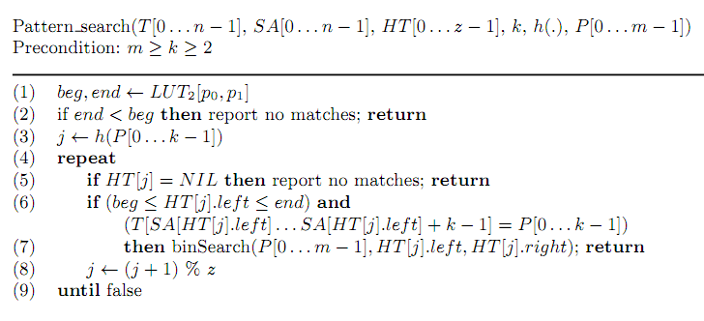
1. SA-hash: locate query

Slide 11
2. Fixed Block based Compact SA (FBCSA)
A variant of Mäkinen's compact suffix array (finding repeating suffix areas of fixed size, e.g., 32 bytes)
Maintain a int32-aligned data layout, beneficial for speed and simplicity
Result: two arrays arr1 and arr2:
  arr1 stores bits and references to areas in arr2
  arr2 stores SA and text indexes (32-bit integers)
We used: SA, SA⁻¹ and T^{BWT:}
  SA⁻¹[j] = i ⇔ SA[i] = j
  T^{BWT} [i] = T[SA[i] – 1]

Slide 12
2. FBCSA: parameters
There are two construction-time parameters:
  block size bs
  sampling step ss
The parameter bs tells how many successive SA indexes are encoded together and is assumed to be a multiple of 32
The parameter ss means that every ss-th text index will be represented verbatim

Slide 13
2. FBCSA: compression idea (example)
SA[400..407] = [1000, 522, 801, 303, 906, 477, 52, 610]
bs = 8
Σ = {a, b, c, d, e}
T^{BWT}[400..407] = [a, b, a, c, d, d, b, b]
text indexes:
[999, 521, 800, 302, 905, 476, 51, 609]
we choose 3 most common symbols:
b, a, d
we conclude that
SA has areas of values:
[521, 51, 609] [999, 800] [905, 476]
SA⁻¹[521] = 506 ⇒ SA[506..508] = [521, 51, 609]
SA⁻¹[999] = 287 ⇒ SA[287..288] = [999, 800]
SA⁻¹[905] = 845 ⇒ SA[845..846] = [905, 476]

Slide 14
2. FBCSA: compression idea (example)
SA[400..407] = [1000, 522, 801, 303, 906, 477, 52, 610]
ss = 5
SA[400..407] = [1000, 522, 801, 303, 906, 477, 52, 610]
SA[400..407] = [1000, 522, 801, 303, 906, 477, 52, 610]
T^{BWT}[400..407] = [a, b, a, c, d, d, b, b]
most common symbols: b, a, d
SA[506..508] = [521, 51, 609]
SA[287..288] = [999, 800]
SA[845..846] = [905, 476]
We code:
b→00
a→01
d→10
c→11
arr1.appendBits([01, 00, 01,11,10, 10, 00, 00])
arr1.appendBits([1, 0, 0, 1, 0, 0, 0, 1])
arr1.appendInts([start_key_arr2])
arr2.appendInts([506, 287, 845])
arr2.appendInts([1000, 303, 610])

Slide 15
2. FBCSA: decompression
Recursive calls until verbatim written text index is found
Maximum number of recursions cannot exceed ss parameter
ss parameter is a time-space tradeoff: using larger ss reduces the overall space but decoding a particular SA index typically involves more recursive invocations

Slide 16
Experimental results: platform
All experiments were run on a laptop computer with an Intel i3 2.1 GHz CPU, equipped with 8GB of DDR3 RAM and running Windows 7 Home Premium SP1 64-bit
All codes were written in C++ and compiled with Microsoft Visual Studio 2010
We used A_strcmp function from asmlib library v. 2.34 written by Agner Fog (http://www.agner.org/optimize/asmlib.zip)

Slide 17
Experimental results: datasets
The test datasets were taken from the Pizza & Chili site
We used the 200-megabyte versions of the files:
  dna
  english
  proteins
  sources
  xml
In order to test the search algorithms, we generated 500K patterns for each used pattern length
Each pattern returns at least one match

Slide 18
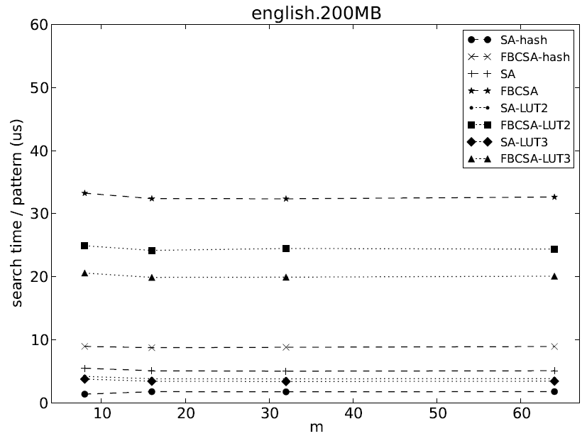
Experimental results: count queries

Slide 19
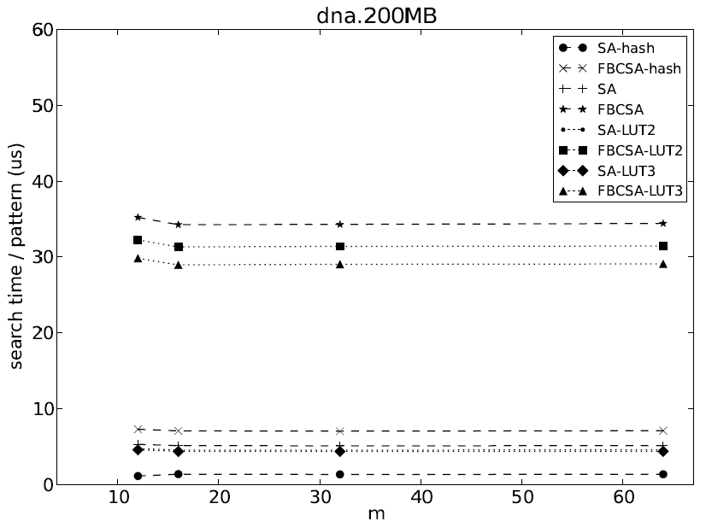
Experimental results: count queries

Slide 20
Experimental results: SA-allHT
SA-hash:
  fastest index
  requires significantly more space than SA
  minimal pattern length
SA-allHT (not implemented): additional hash table for each pattern length from 1 to k (price: even more space use)

Slide 21
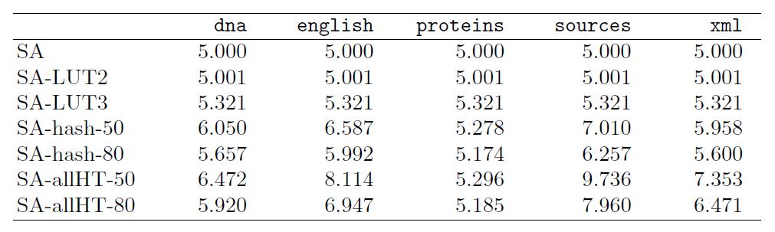
Experimental results: hash and LUT variants overall space used

Slide 22
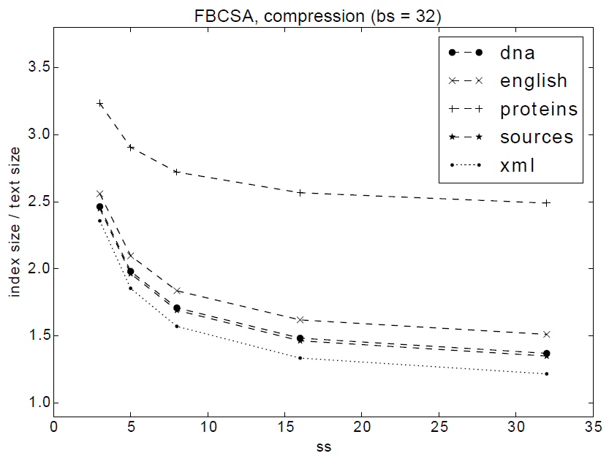
Experimental results: space used by FBCSA

Slide 23
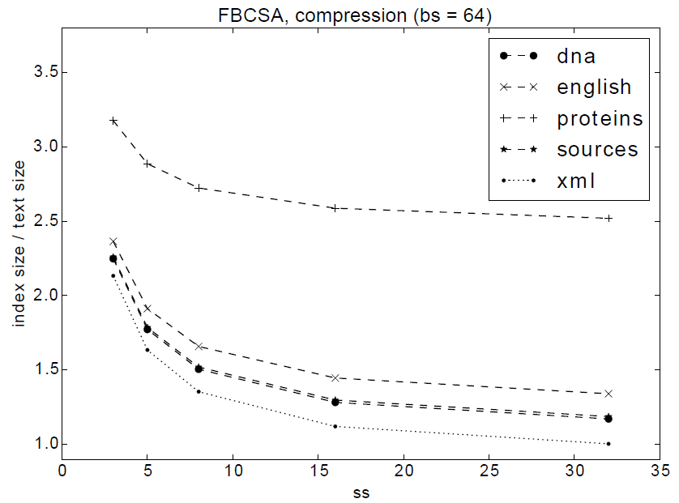
Experimental results: space used by FBCSA

Slide 24
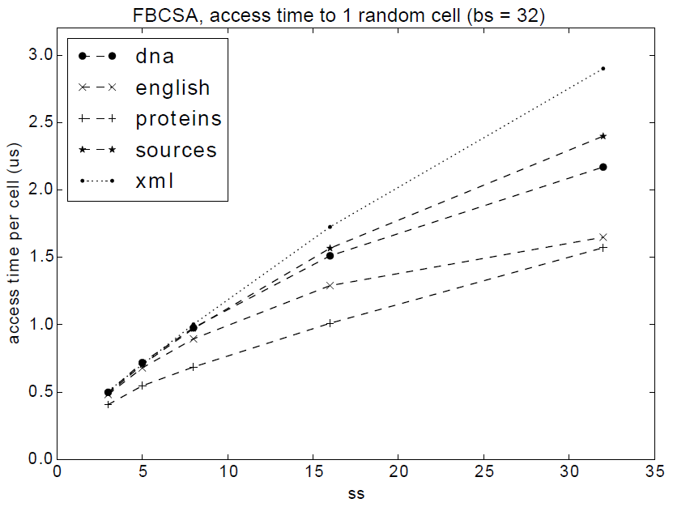
Experimental results: FBCSA access time per cell (averages over 10M)

Slide 25
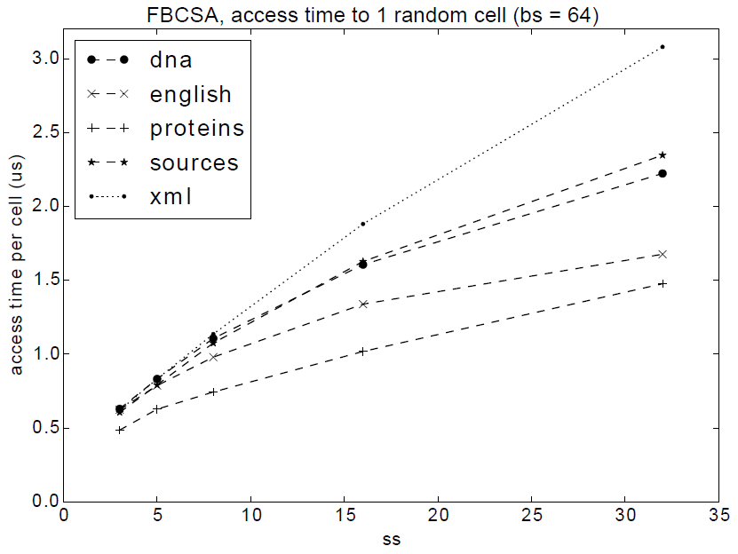
Experimental results: FBCSA access time per cell (averages over 10M)

Slide 26
Conclusions
We proposed two suffix array based full-text indexes with interesting space-time tradeoffs
SA-hash augments the standard SA with a hash table, to speed up searches by factor about 2.5–3, with 0.3n – 2.0n bytes of extra space
Fixed Block based Compact SA (FBCSA) is related to Mäkinen's CSA, but uses an int32-aligned data layout

Slide 27
Future work
SA-hash: replace sdbm hash function with a more sophisticated one (xxhash?) with fewer collisions. Or try perfect or cuckoo hashing
SA-hash: variable-length prefixes as hash keys?
FBCSA: some design decisions were rather ad hoc and should be tested in more systematic ways, with hopefully new relevant space-time tradeoffs

Slide 28
Thank you for your attention

