Slide 1
Alternative Algorithms for
Order-Preserving Matching
Tamanna Chhabra, M. Oguzhan Kulekci, and Jorma Tarhio
Aalto University

Slide 2
Order Preserving Matching
Order preserving matching has gained much attention lately.
String of numbers.
Finding all substrings in the text which have the same relative order and length as the pattern.
Relative order means the numerical order of the numbers in the string.

Slide 3
Example of OPM
Suppose P = (10, 22, 15, 30, 20, 18, 27) and T = (22, 85, 79, 24, 42, 27,62, 40, 32, 47, 69, 55, 25), then the relative order of P matches the substring u = (24, 42, 27, 62, 40, 32, 47) of T.
In the pattern P the relative order of the numbers is: 1, 5, 2, 7, 4, 3, 6.
This means 10 is the smallest number in the string, 15 is the second smallest, 18 the third smallest and so on.
Similarly in the substring u of text T, 24 is the smallest number, 27 is the second smallest and so on.

Slide 4
Example of OPM

Slide 5
Example of OPM
T = (22, 85, 79, 24, 42, 27,62, 40, 32, 47, 69, 55, 25)
t_{r[i]} <= t_{r[j]}

Slide 6
Previous Solutions
Kubica et al. and Kim et al. have presented solutions based on the KMP algorithm.
Both the solutions were linear.
Later, Cho et al. demonstrated that the bad character heuristic works.

Slide 7
Previous Solutions
The BMH approach is based on the bad character rule applied to q-grams, i.e. strings of q characters.
A q-gram is treated as a single character to make shifts longer.
A large amount of text can be skipped for long patterns, and the algorithm is sublinear on the average.
First sublinear solution for order-preserving matching.

Slide 8
Previous Solutions
At the same time, Belazzougui et al. derived an optimal algorithm which is sublinear on average.
Chhabra and Tarhio presented another sublinear average-case solution based on filtration.
Faster in practice than the previous solutions and we will refer to this solution as OPMF.
Crochemore et al. proposed an offline solution based on indexing.

Slide 9
Our solutions
Two new online solutions utilizing the SIMD (single instruction, multiple data) architecture and one offline solution based on the FM-index.
The OPMF algorithm is based on computing a transformed pattern and text by creating their respective bitmaps where a 1 bit means the successive element is greater than the current one and a 0 bit means the opposite.

Slide 10
SIMD(Single Instruction Multiple data)
The SIMD architecture allows the execution of multiple data on single instruction.
Intel added sixteen new 128-bit registers known as XMM0 through XMM15.
Four floating point numbers could be handled at the same time.
AVX provides support for 256-bit registers known as YMM0 through YMM15.

Slide 11
Online Solutions
We aimed to perform this transformation quickly with SSE4.2 (streaming SIMD extensions) and AVX (Advanced Vector Extensions) instructions.
Otherwise, approach is similar as is used in the OPMF algorithm.
The text is filtered and then verified using a checking routine.

Slide 12
Filtration
The consecutive numbers in the pattern P = p₁p₂…p_{m} are compared pairwise.
This is achieved effectively by using the _mm_cmpgt_ps instruction.
Compares the packed single precision floating-point values in the source operand and the destination operand. and
Returns the results of the comparison to the destination operand.

Slide 13
Contd.....
MOVMSK instruction ( mm128 movemask ps()) is used which extracts the most significant bits from the packed single-precision floating-point value.
Thus a mask is obtained.
Thereafter a shift table is constructed which is initialized to m-1.
We apply binary 4 - grams and set the size of the shift table delta to 16 .

Slide 14
Contd.....
The entry delta[x] is zero if x is the reverse of the last 4- gram of P₀.
The tested 4-gram is formed online with SIMD instructions in the same way as used for the pattern.
As each occurrence of P₀ in T₀ is only a match candidate, it should be verified.

Slide 15
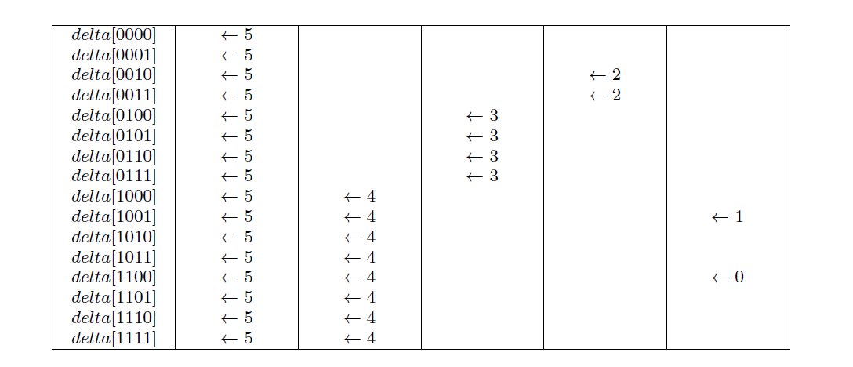
Computation of the shift table for mask = 11001 for P₀ = 10011

Slide 16
Verification
If P = (15, 18, 20, 16) and T = (2, 4, 6, 1, 5, 3)
Transformed pattern P₀ and T₀ are 110 and 11010.
The relative order of the numbers is 0,2,3,1 in the pattern and 1,2,3,0 in the text.
The potential candidates obtained from the filtration phase are traversed in accordance with the table r.

Slide 17
Contd.....
t_{r[i]} <= t_{r[j]}

Slide 18
Online solution using AVX
Difference is that eight numbers can be compared simultaneously since it has 256 bit registers.
Therefore is fast as compared to SSE4.2.

Slide 19
Offline Solution
Also enumerates the bitmaps but they are stored in the compressed form via the FM-index.
Pattern P is transformed into a bitmap P₀ in the same way as in OPMF.
The text is also encoded and an FM-index is created of the encoded text.
Occurrences of transformed pattern P₀ are found within the compressed text.

Slide 20
Experiments
We compared our new solutions with our earlier OPMF solutions based on the SBNDM2 and SBNDM4 algorithms.

Slide 21
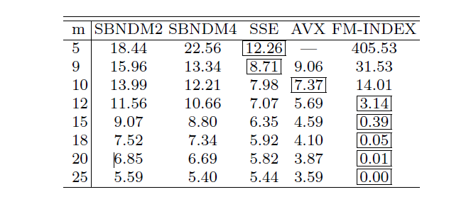
Execution times of algorithms in seconds for random data

Slide 22
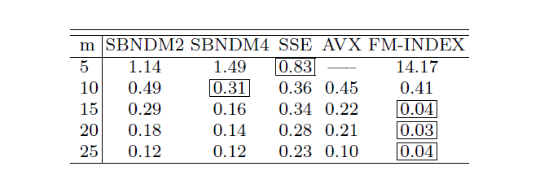
Execution times of algorithms in 10 of milliseconds for Dow Jones data

Slide 23
Conclusuions
Introduced two online solutions and one offline solution.
The experimental results proved that our solutions were the fastest irrespective of the data.

Slide 24
THANK YOU!!!!!

