Slide 1
Multi-delimiter data compression codes
Іgor Zavadskyi, Anatoly Anisimov
Taras Shevchenko National University of Kyiv, Ukraine

Slide 2
Without
delimiters
With
delimiters
Huffman
Tagged Huffman
ETDC, SCDS
Data compression codes
Finite state entropy
Fibonacci,
Arithmetic
Multi-delimiter

Slide 3
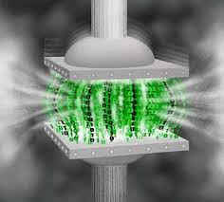
Key features: compression rate
Arithmetic
Finite state entropy
Huffman
Multi-delimiter
Fibonacci
ETDC, SCDC
codes with delimiters

Slide 4
Key features: synchronization
Arithmetic, FSE and Huffman codes are not synchronizable
Error
Tagged Huffman codes, ETDC-codes, SCDC-codes, Fibonacci and multi-delimiter codes contain the synchronization marks
Error

Slide 5
Key features: synchronization
Bit inversions
+
T-Huffman, ETDC,SCDC
+
Fibonacci, Multi-delimiter
Bit insertions or deletions
–
T-Huffman, ETDC,SCDC
+
Fibonacci, Multi-delimiter

Slide 6

Key features: search in compressed file
We have developed a new class of variable length prefix codes, so called (; k)-codes, which can be used for efficient data compression.
efficient
Huffman, arithmetic, FSE
–
ETDC, SCDC, Fibonacci, multi-delimiter
+

Slide 7
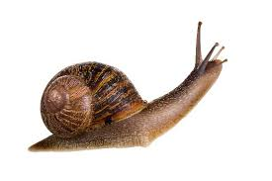
Key features: encoding/decoding speed
The byte-by-byte algorithms for ETDC and SCDC codes.
Byte decoding algorithms for multi-delimiter codes.
Byte decoding algorithms for Fibonacci codes.
Huffman and FSE codes.
Arithmetic codes.

Slide 8
Fibonacci codes compression efficiency
(natural language text compression)
Fib3
?
Fib3
Fib2
Fib4
Fib4
Fib2

Slide 9
Delimiters
Fibonacci codes
Delimiter Sequences
–
–
–
111
1111 11111 11111
Multi-delimiter codes
s
Delimiter Sequences
+
+
+
,
011110
0110
01110 0111110
D_{2,4}

Slide 10
Multi-delimiter codes are not the pattern codes
Delimiters
0110, 01110
(D_{2,3})
Codewords of type 1
110, 1110
110, 1110
110, 1110
Codewords of type 2
0110, 01110, 00110, 10110, 001110,
101110, 0101110 etc.

Slide 11
Multi-delimiter code definition
Let m₁ ,… , m_{t} be some natural numbers, 0 < m₁ <…< m_{t}
Code contains:
- codewords 1…10, … , 1…10
- codewords …01…10, … , …01…10
(type 1)
m₁
m_{t}
(type 2)
m₁
m_{t}
Type 2 codeword contains the delimiter only in the end and doesn’t contain type 1 codewords as a prefix

Slide 12
Example of the code D_{2,3}
codewords
1101110010110110
delimiters

Slide 13
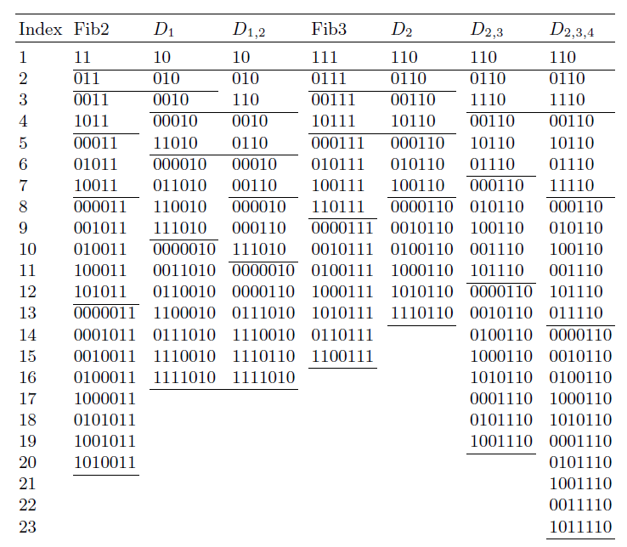
Сodeword sets

Slide 14
MD vs Fibonacci codes: density

Slide 15
Adapting codes to a given source probability distribution
 | Number of short codewords | Asymptotic density
Longer delimiters
More delimiters

Slide 16
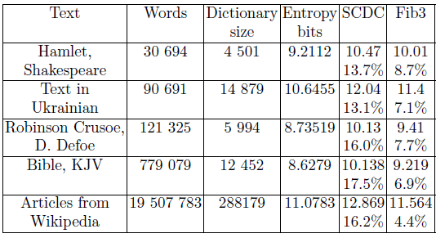
Natural language text compression rate
D_{2,3,5}
D_{2,3}
Fib3
SCDC

Slide 17
MD vs Fibonacci codes: text compression

Slide 18
MD vs Fibonacci codes: instantaneousness
The shortest codeword in Fibm code is the same as a delimiter: 1…1
Thus, Fibonacci codewords can “glue” into long run of ones
Example. Code Fib3
…0111111111110…
Where is the true beginning of a codeword?
We should check the sequence of previous bits, in general case infinite.
The MD-codewords don’t “glue”, as the delimiter is 01…10
…01101110110110…
We should check ≤m_{t} bits at the longest for the code .

Slide 19
Multi-delimiter codes: completeness and universality
Theorem. Each MD-code is uniquely decodable, complete and universal in the sense of Elias.
Completeness means that no codeword can be added to a code in a way that preserves the uniquely decodability property.
Universality means that given any countable set of natural numbers with any monotonically decreasing probability function defined on them, assigning to numbers their codewords gives an expected codeword lengths lying within a constant multiple of the entropy lower bound.

Slide 20
Code : encoding
– numbers that do not belong to
1. Delete the leftmost 1.
2. Each sequence 01…10 01…10
3. Append the delimiter 01…10
Not for
01…10
(m₂,…,m_{t}) suffixes
d
j_{d}
m₁
1 → 1
11 → 111
111 → 1111
Example. Encoding to D₂. J = {1, 3, 4, …}
…
10111
01011
0
1
1
0110

Slide 21
Decoding: automaton for D_{2,3,5}

Slide 22
Fast byte-aligned decoding for D_{2,3,5}

Slide 23
Fast decoding lookup table (D_{2,3,5})
11000111 01101011 11001011 01100110 11111000
a_{start} | Text[i] | g | x₁ | x₂ | x₃ | x | a_{fin}
 | 11000111 | 1 | 1 |  |  | 10011 | 4
4 | 01101011 | 2 | 10 | 1 |  | 10 | 8
8 | 11001011 | 0 |  |  |  | 11001 | 8
8 | 01100110 | 3 |  | 1 | 10 |  | 1
1 | 10011000 | 1 | 1111110 |  |  | 100 | 1
The unpacked lookup table size: 20K
The packed version: 10K

Slide 24
Experimental decoding time

Slide 25
Enlarging the dictionary
Example: code D₂
Decoding
1
2
4
3
8
5
6
16
9
10
12
13
7
110
0110
00110
10110
000110
010110
100110
0000110
0010110
0100110
1000110
1010110
1110110
codeword → i → Text[i]
smaller number ≠
shorter codeword
Enlarging the dictionary 4 times provides the compression rate 0.1% away from optimal

Slide 26
Conclusion: MD-codes features
(vs Fibonacci codes)
(i) Adaptability. Varying delimiters we can adapt a
multi-delimiter code to a given source probability
distribution and an alphabet size.
(ii) The better compression rate for natural
language text compressing.
(iii) The faster byte aligned decoding method.
(iv) Instantaneous separation of codeword
allowing faster compressed search.

Slide 27
Thank you!
ihorza@gmail.com

