Slide 1



New Compression Schemes for
Natural Number Sequences
Sapir Asraf, Shmuel T. Klein and Dana Shapira
Ariel University, Bar Ilan University
1/19

Slide 2
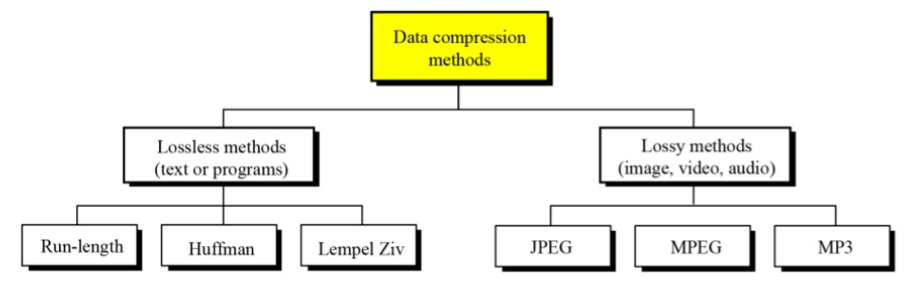
Different Compression Techniques
2/19

Slide 3
Fixed length codes Variable length codes
Each symbol (or codeword) is coded with the same number of bits, such as the American Standard Code for Information Interchange ASCII code.
Symbols may be coded with variable-length, for instance, Huffman, Elias and Fibonacci codes.
Example:
A code with Fixed length codes words:
S1->00; S2->01; S3-> 10
Example:
A code with Variable length codes words:
S1->0; S2->10; S3-> 11
3/19

Slide 4
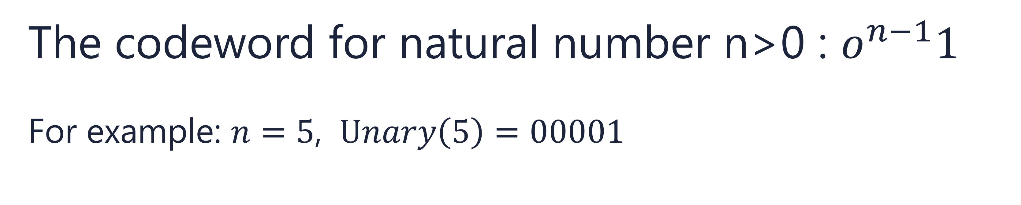
Unary Code
The codeword for natural number n>0 : $o^{n−1}1$
For example: $n=5$, $Unary\left(5\right)=00001$
4/19

Slide 5

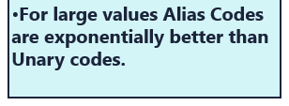
Elias Codes:
x | Unary Code | Elias C_{γ} Code
1 | 1 | 1
2 | 01 | 01 0
3 | 001 | 01 1
4 | 0001 | 001 00
5 | 00001 | 001 01
6 | 000001 | 001 10
7 | 0000001 | 001 11
8 | 00000001 | 0001 000
9 | 000000001 | 0001 001
5/19

Slide 6

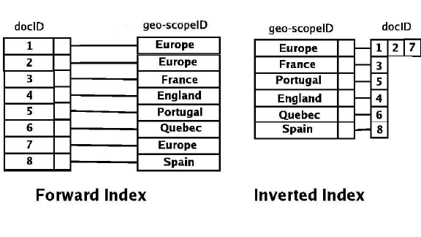
Motivations
There are quite a few motivations for the interest in monotonic sequence,
an Inverted Index is one of them.
Inverted indices
Backbone of modern search engines
In Big Data such tasks become extremely powerful
More efficient:
  Save disk space
  Reduce disk and main memory
  Resulting faster performance
6/19

Slide 7
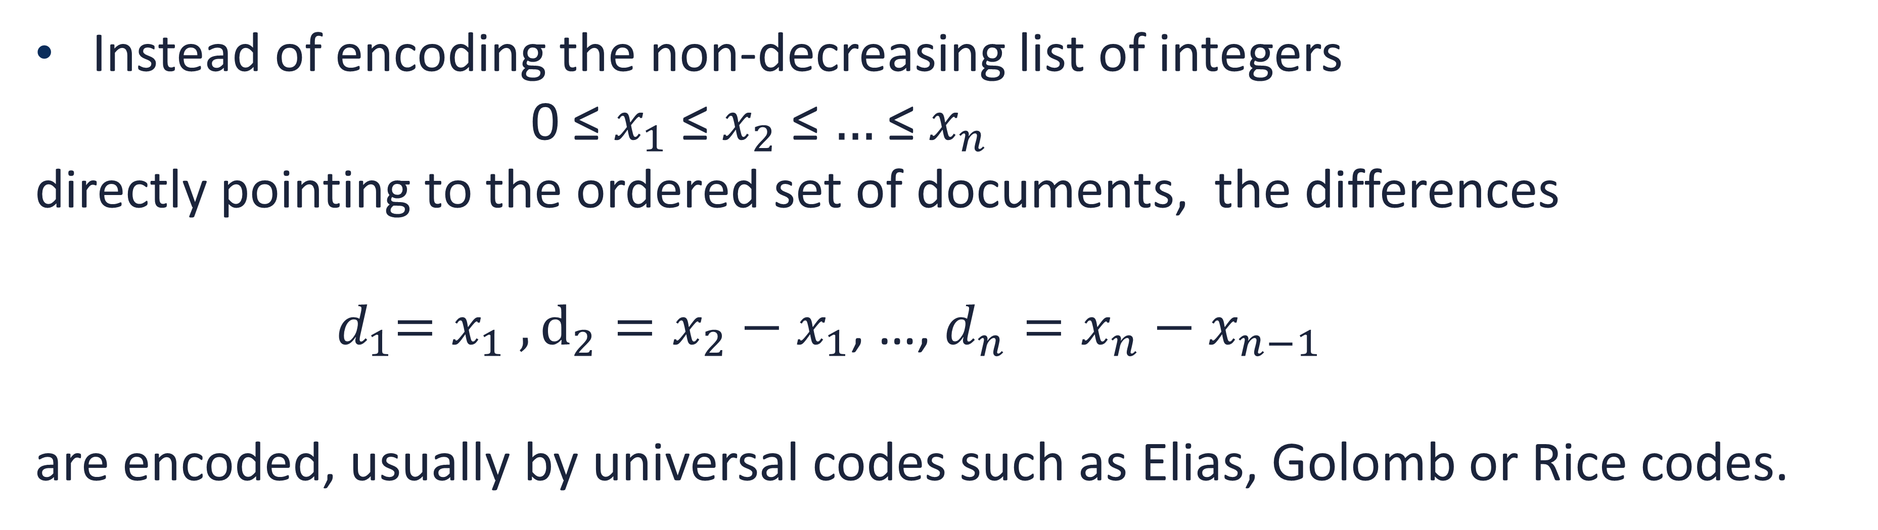
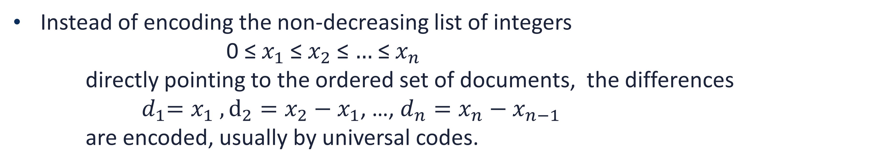
Gap Encoding
A classical way to encode a monotonic set of integers is differential encoding, also called gap encoding.
Instead of encoding the non-decreasing list of integers
0 ≤ $x_{1}$≤ $x_{2}$ ≤ $…$≤ $x_{n}$
directly pointing to the ordered set of documents, the differences
${ d}_{1}=x_{1} , d_{2}=x_{2}−x_{1}$, …, $d_{n}=x_{n}−x_{n−1}$
are encoded, usually by universal codes.
docID
1 | 2 | 7
1 | 1 | 5
7/19

Slide 8
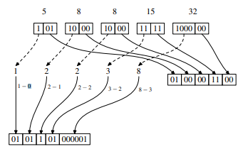

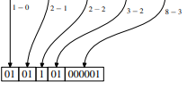
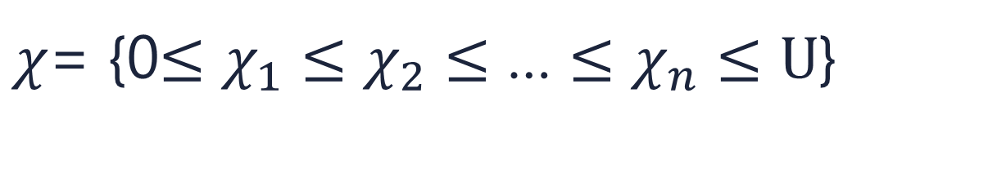

Elias-Fano
$χ$= {0$≤χ_{1}≤χ_{2}≤$ … $≤χ_{n}≤U$}
Where U is a given upper bound on $χ_{n}$, possibly equal to $χ_{n}$
$$non−decreasing sequence χ:$$
5 8 8 15 32
$$Binary\left(χ_{i}\right)=$$
Lower bits array
L(2)
1 1 0 1 5
Upper bits array
U(3)
8/19

Slide 9

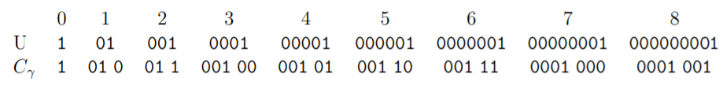
We propose a representation, especially useful for:
non-uniform monotonic sequences
large standard deviation.
9/19

Slide 10

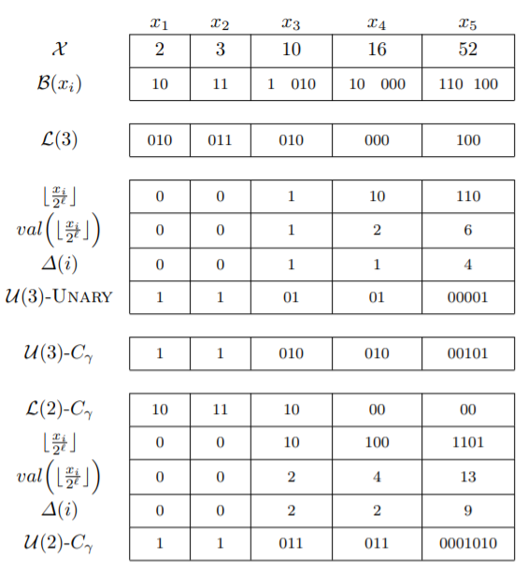
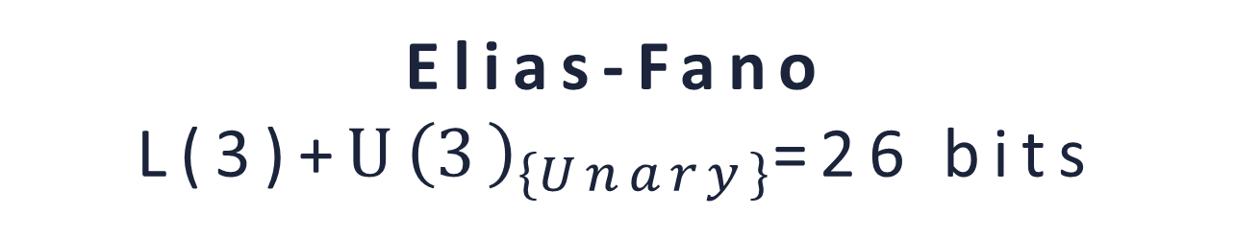


15 bits
11 bits
13 bits
10 bits
15 bits
1 bit ?
10/19

Slide 11
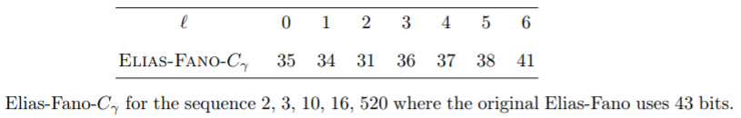


Higher standard deviation
2, 3, 10, 16, 52 2, 3, 10, 16, 520
Standard deviation- grows from 18.41 to 204.96
The storage for all values of $ℓ$ is less than the original Elias-Fano coding.
11/19

Slide 12
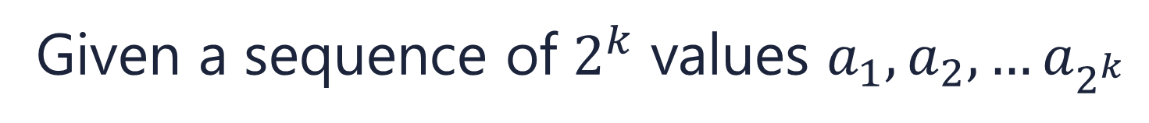
Haar transform
Given a sequence of $2^{k}$ values $a_{1}, a_{2}, …a_{2^{k}}$
1 | 2 | 3 | 4 | 5 | 6 |  | 7 | 8
1840 | 1680 | 1632 | 1504 | 1536 | 1472 |  | 1360 | 1328
1760 |  | 1568 |  | 1504 |  |  | 1344 |  |  | 80 64 32 16
 | 1664 |  |  |  | 1424 |  |  |  |  | 96 80
 |  |  | 1544 |  |  |  |  |  |  | 120
 |  |  | 1544 |  |  |  |  | 120 96 80 80 64 32 16
HAAR
The elements contributed to the resulting Haar vector, are shown in green :
1544, 120, 96, 80, 80, 64, 32, 12
12/19

Slide 13

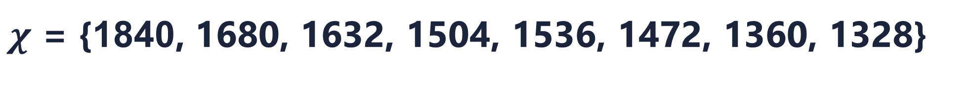
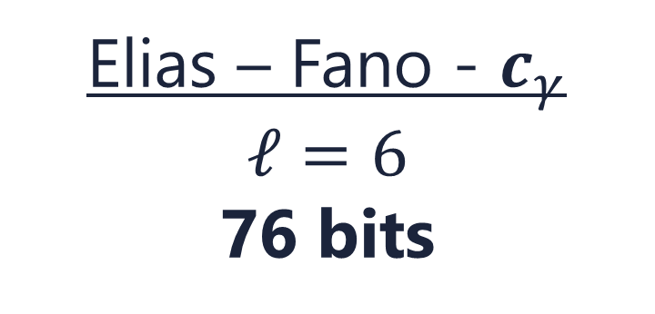
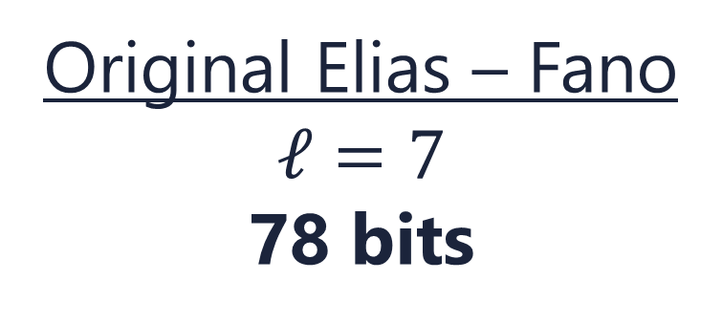


Haar- $c_{γ}$ $algorithm$
Original Elias – Fano
$$ℓ=7$$
78 bits
$χ$ = {1840, 1680, 1632, 1504, 1536, 1472, 1360, 1328}
Elias – Fano - $c_{γ}$
$$ℓ=6$$
76 bits
Haar - $c_{γ}$
$$ℓ=3$$
62 bits
$Haar$= {1544, 120, 96, 80, 80, 64, 32, 16}
13/19

Slide 14

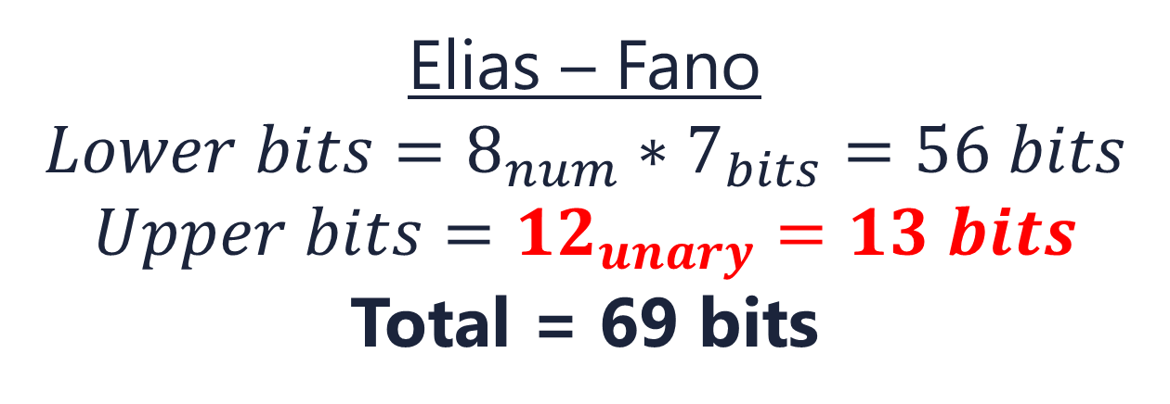


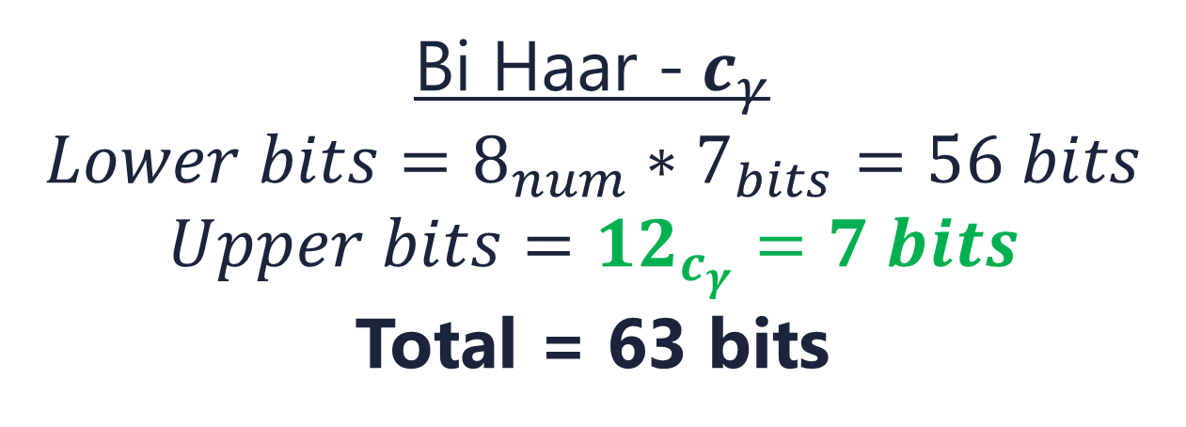
Bi Haar- $c_{γ}$ $algorithm$
$Haar$ = {16, 32, 80, 64, 80, 96, 120, 1544}
{16, 32, 80, 64, 80, 96, 120}
{1544}
Elias – Fano
$$Lower bits=8_{num}∗7_{bits}=56 bits$$
$$Upper bits=12_{unary}=13 bits$$
Total = 69 bits
Bi Haar -$c_{γ}$
$$Lower bits=8_{num}∗7_{bits}=56 bits$$
$$Upper bits=12_{c_{γ}}=7 bits$$
Total = 63 bits
The corresponding values of U(i)-$C_{γ}$ are thserefore all 0, so they can be omitted.
This encoding does not require a monotonic series as all coordinates, except the first, are written explicitly in the lower bits L array
14/19

Slide 15

Integer Haar-$c_{γ}$ $algorithm$
Algorithm 3 presents a variant of the Haar transform that makes sure the outcome consists only of integers
1 | 2 | 3 | 4 | 5 | 6 |  | 7 | 8
115 | 106 | 102 | 94 | 96 | 92 |  | 85 | 84
110 |  | 98 |  | 94 |  |  | 84 |  | (1)4 (0)4 (0)2 (1)0
 | 104 |  |  |  | 89 |  |  |  | (0)6 (0)5
 |  |  | 96 |  |  |  |  |  | (1)7
 |  |  | 96 |  |  | (1)7 (0)6 (0)5 (1)4 (0)4 (0)2 (1)0
HAAR
15/19

Slide 16
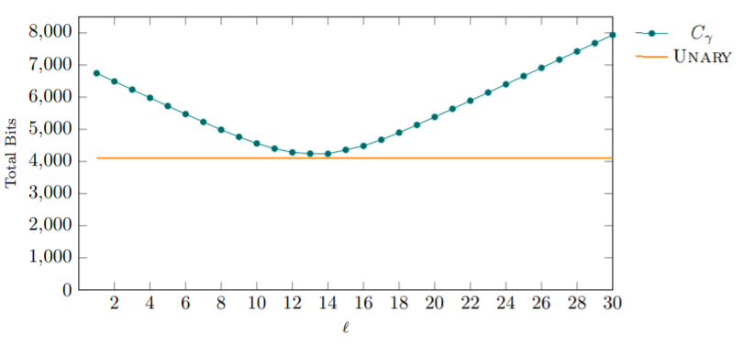
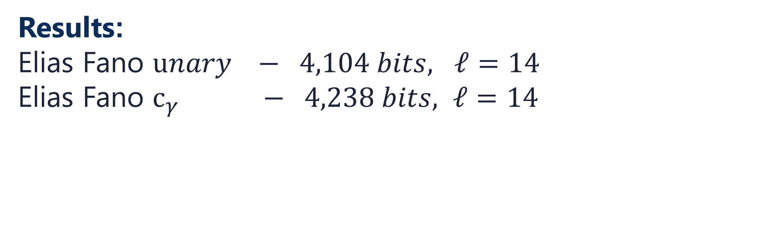
Experimental results
Results:
Elias Fano $unary − 4,104 bits, ℓ=14$
Elias Fano $c_{γ} − 4,238 bits, ℓ=14$
16/19

Slide 17
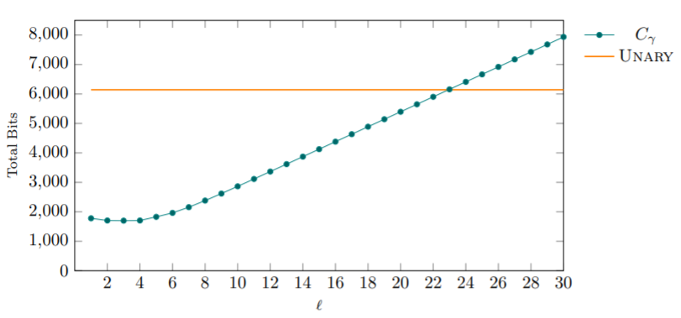

Experimental results
Results:
Elias Fano $unary − 6,144 bits, ℓ=22$
Elias Fano $c_{γ} − 1,698 bits, ℓ=3$
17/19

Slide 18
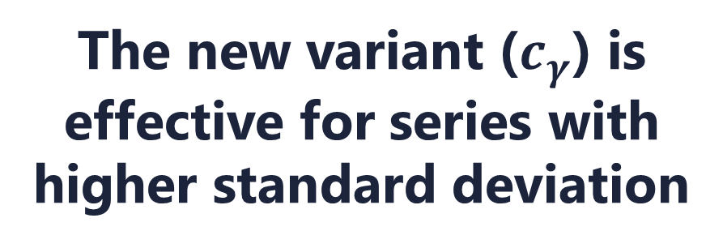


OUR PROCESS
Experimental results
5
Elias-Fano-Unary
Haar transform
6
18/19

Slide 19
Thanks!
Any questions?
19/19

