Slide 1
Fast exact pattern matching in a bitstream and 256-ary strings
Igor Zavadskyi
National Taras Shevchenko University of Kyiv

Slide 2
Bitstream search problem
Text
Pattern

Slide 3
Motivations
Multi-delimiter compression codes compress natural language text close to entropy, providing the possibility of direct search in a compressed file.
A.V. Anisimov, I.O. Zavadskyi. Variable-Length Prefix Codes With Multiple Delimiters // IEEE Transactions on Information Theory, vol. 63, issue 5, p. 2885-2895. – 2017.
I.O. Zavadskyi, A.V. Anisimov. Reverse Multi-Delimiter Compression Codes, in Proc. Data Compression Conference (DCC), 2020, pp. 173–182.

Slide 4
Known solutions
S. Klein and M. Ben-Nissan: Accelerating Boyer Moore searches on binary texts (2007)
Boyer-Moore
Quick Search +
Comentz-Walter
J. Kim, E. Kim, and K. Park: Fast matching method for DNA sequences (2007) – FED
S. Faro, T. Lecroq: Efficient Pattern Matching on Binary Strings (2008) – Binary Hash, Binary Skip-Search
Q-Hash and
Skip-Search
S. Faro and T. Lecroq: An eﬃcient matching algorithm for encoded DNA sequences and binary strings (2009) – BFL (Binary Faro Lecroq)
BNDM +
Comentz-Walter
General idea: avoid bit-level operations as far as possible

Slide 5
Notations
T – text to be searched in
P – pattern
n – byte length of the text
m – byte length of the pattern
Σ – input alphabet
|Σ| – number of symbols in alphabet
Z – shift table

Slide 6
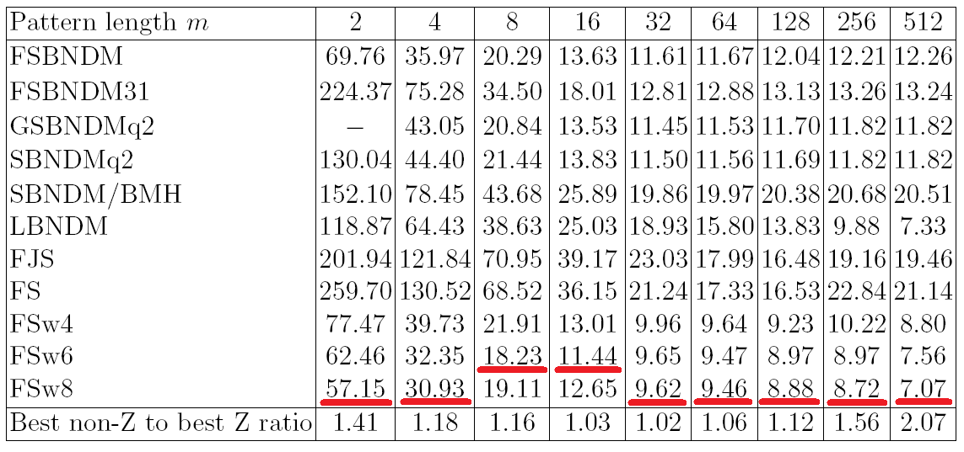
Known algorithms timing (seconds), |Σ|=256

Slide 7
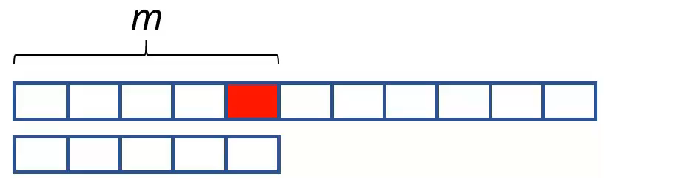
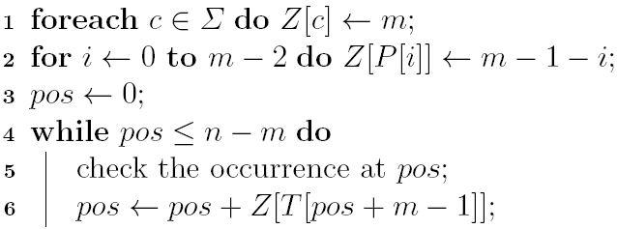
Boyer-Moore-Horspool method
m | Average shift length
2 | 1.99
4 | 3.97
8 | 7.88
16 | 15.5
32 | 30.1
64 | 56.7
128 | 101
256 | 162
512 | 221
T:
P:

Slide 8
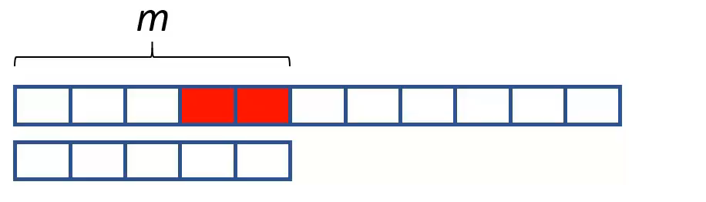
2 bad characters shift
BERRY, T., RAVINDRAN, S., 1999, A fast string matching algorithm and experimental results, in Proceedings of the Prague Stringology Club Workshop`99, pp 16-26.
T:
P:
pos ← pos + Z[T[i]][T[i+1]]

Slide 9
2-byte read
pos ← pos + Z[T[i]][T[i+1]]
pos ← pos + Z[word(T[i],T[i+1])]
word(T[i],T[i+1]) ∼ (unsigned short*)(T+i)
K. Fredriksson. Faster string matching with super-alphabets. In String Processing and Information Retrieval, pp. 207–214. Springer, 2002.
H. Peltola and J. Tarhio: String matching with lookahead. Discrete Applied Mathematics, 163: pp. 352–360, 2014.

Slide 10
1.5-byte read
pos ← pos + Z[word(T[i],T[i+1])&mask]
The mask contains between 8 and 16 significant bits.
B. W. Watson, F. Franek, J. Holub, C. Iliopoulos, and B. Smyth: Fractional
n-grams for shifting. Idea presented at StringMasters 2014 at McMaster University, Hamilton, Ontario, Canada, 2014.

Slide 11
Shift probability and table size, m=512
Shift type | Probability of a maximal shift | Shift table size
1-byte | 0.13 | 256 B
2-byte | 0.99 | 64 K
14-bit | 0.97 | 16 K
L1
…&0xfffc

Slide 12
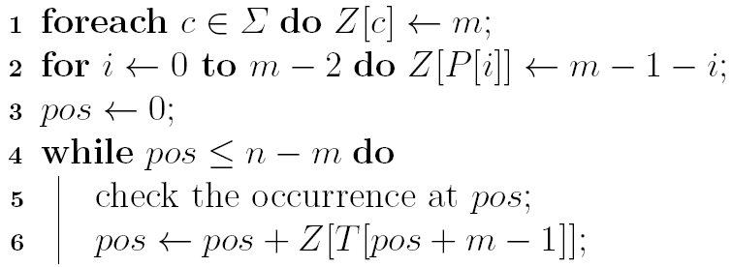
Overcoming the BMH shortcomings
Skip loop (FS)
while( k = Z[T[pos]] )
pos+=k;

Slide 13
Modified skip loop: avoid reading shift lengths
If the maximal shift is highly probable, we can store not the shift lengths, but the flags indicating if the shift is maximal:
0, the shift is not maximal;
Z[x] =
1, the shift is maximal.
while( k = Z[T[pos]] )
pos+=k;
while( Z[T[pos]] )
pos+=m;

Slide 14
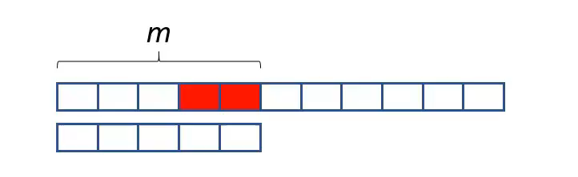
Double skip loop
Single skip loop
m
Double skip loop

Slide 15
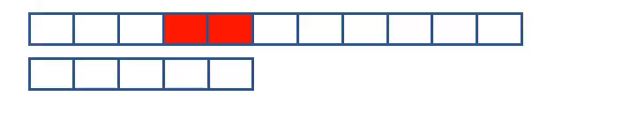
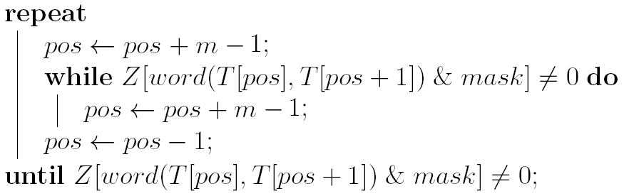
Double skip loop
Single skip loop
Double skip loop

Slide 16
Longer shifts
m
Shift of length m-1
P[0]
P[0]
m
Shift of length m
≠P[0]
P[0]

Slide 17
Longer shifts
Idea If the last character of a search window is P[0],
consider the shift as non-maximal:
Z [word (…,P [0])&mask ] ← 0
Then 1. The length of the maximal shift can be m.
2. The probability of non-maximal shift
increases by 1/256 at most.

Slide 18
Endianness
word (T [ i ],T [ i +1 ]) = (unsigned short*)(T+i)
Big endian machine Little endian machine
memory:
T[i]
T[i+1]
T[i]
T[i+1]
CPU register:
T[i]
T[i+1]
T[i+1]
T[i]

Slide 19
1.5-byte read on a little-endian machine
Z [word (…,P [0])&mask ] ← 0
The probability of maximal shift decreases by 1/16 (if using 12 bits)
P[0]
memory:
CPU register:

Slide 20
Right-to-left search on a little-endian machine
P[m-1]
Z [word (…,P [m – 1]) & mask ] ← 0

Slide 21
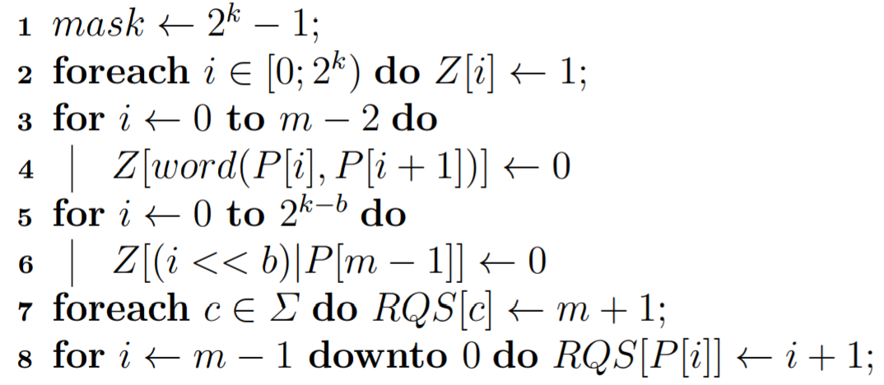
RL-search with k-bit read and maximal shift m
on a little-endian machine, preprocessing

Slide 22
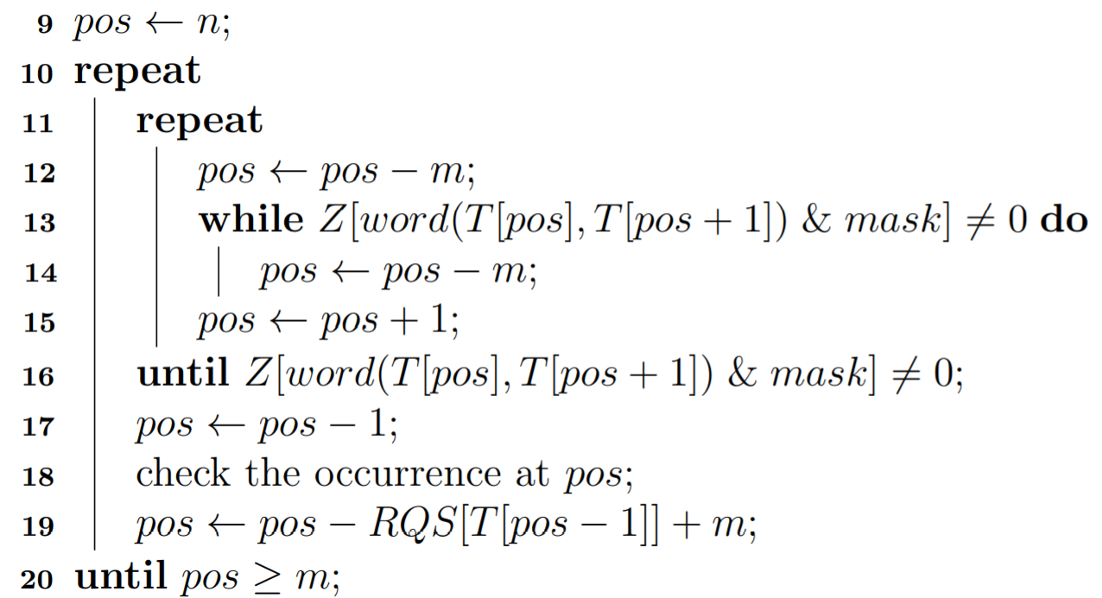
RL-search with k-bit read and maximal shift m
on a little-endian machine, search phase

Slide 23
Sliding windows
Classical 2-way search
Right-to-left search only

Slide 24
Testing Environment
40 computers, Intel and AMD CPU, 24K – 64K L1 cache
500 runs of each algorithm on each computer
10MB text encoded by D_{2,4–8} multi-delimiter code, close to random
Patterns randomly taken from the text, new one for each run
Running times normalized to make computers the units of equal importance

Slide 25
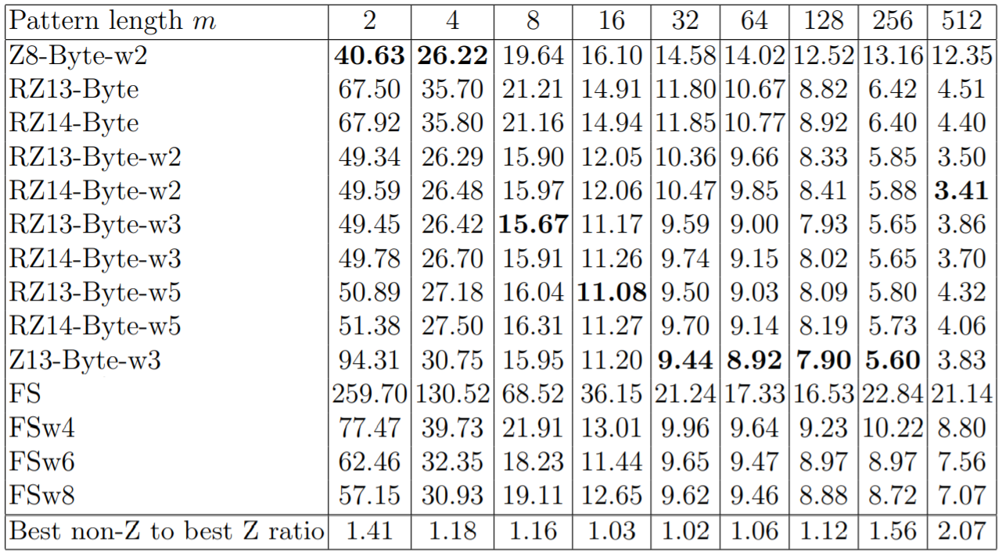
256-ary search – experimental results

Slide 26
Pattern alignments in a bitstream search
Text
…
…
…
…
Pattern
…
…
…
…
…

Slide 27
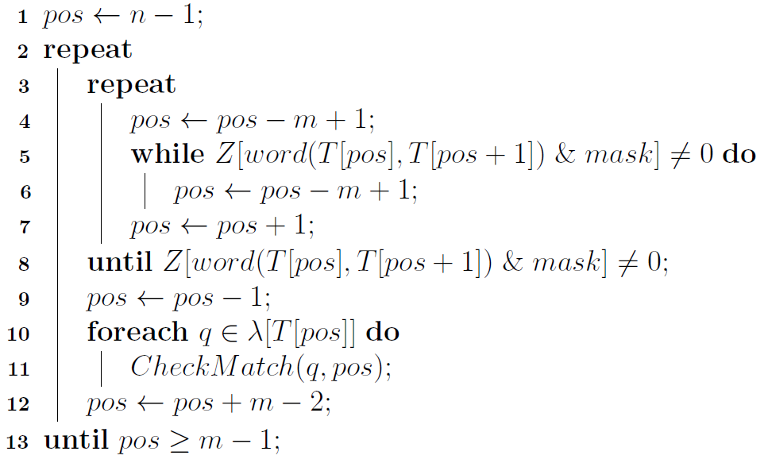
Bitstream search algorithm
…
…
…
Text
…
…
Pattern
…
…
…
…
λ[c] is the set of all values q<8 such that c coincides with P[q…q+7]
Check the match at T[pos], when the pattern is shifted q bits to the right

Slide 28
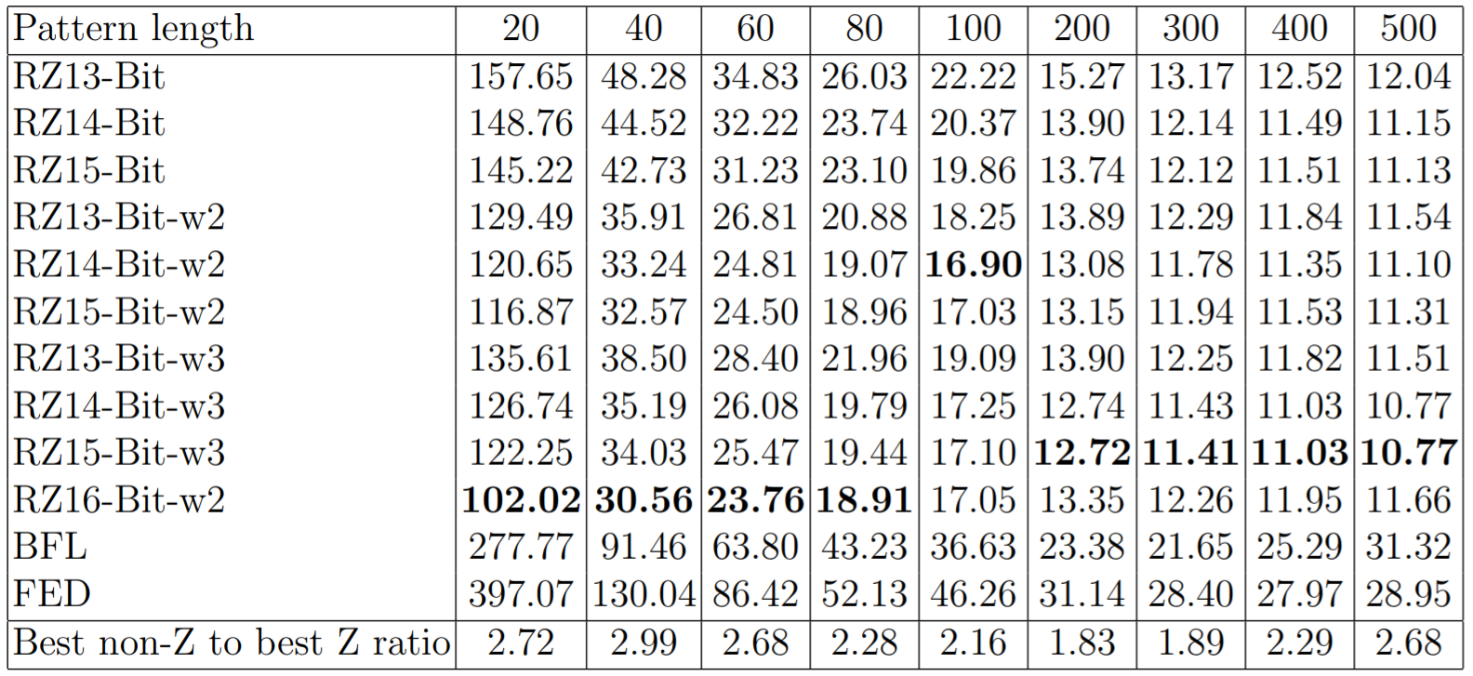
Bitstream search performance (seconds)

Slide 29
Factors of outperformance
Bitstream search
although the maximal length of a long-shift in the BFL algorithm is 2m − 1, in practice it is often 2m − 3 or less, while any total maximal shift in two sliding windows of RZ-Bit algorithm is 2m − 2, i.e. longer in average;
higher efficiency of a bit-alignment checking technique implemented in the RZ-Bit algorithms;
All algorithms
involving bits of more than one character into bad-character comparisons;
the double fast loop technique;
eliminating reading the shift lengths from the search tables.

Slide 30
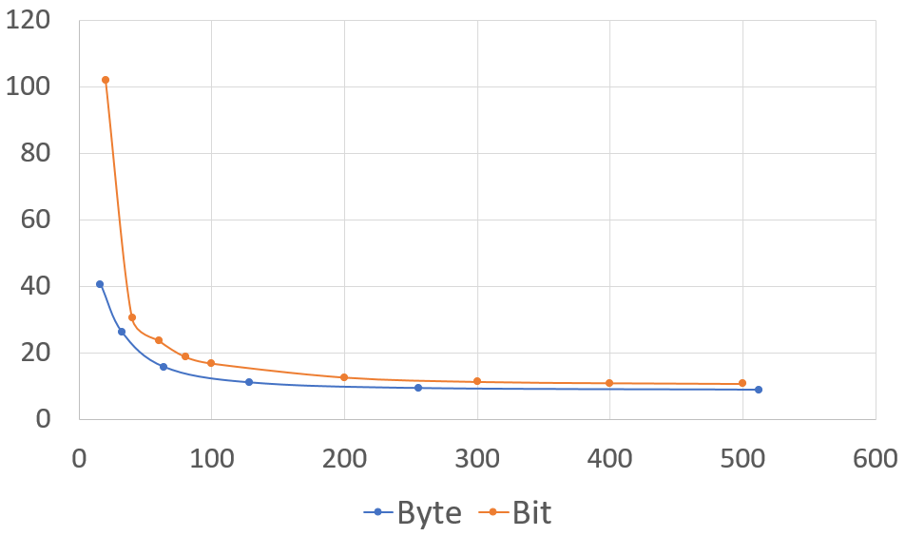
Bit vs. 256-ary
time
m

Slide 31
Source codes
[22] https://github.com/zavadsky/stringology

Slide 32
Thank you for attention!

