Slide 1
Pitfalls of Algorithm Comparison
Waltteri Pakalén
Hannu Peltola
Jorma Tarhio
Bruce W. Watson

Slide 2

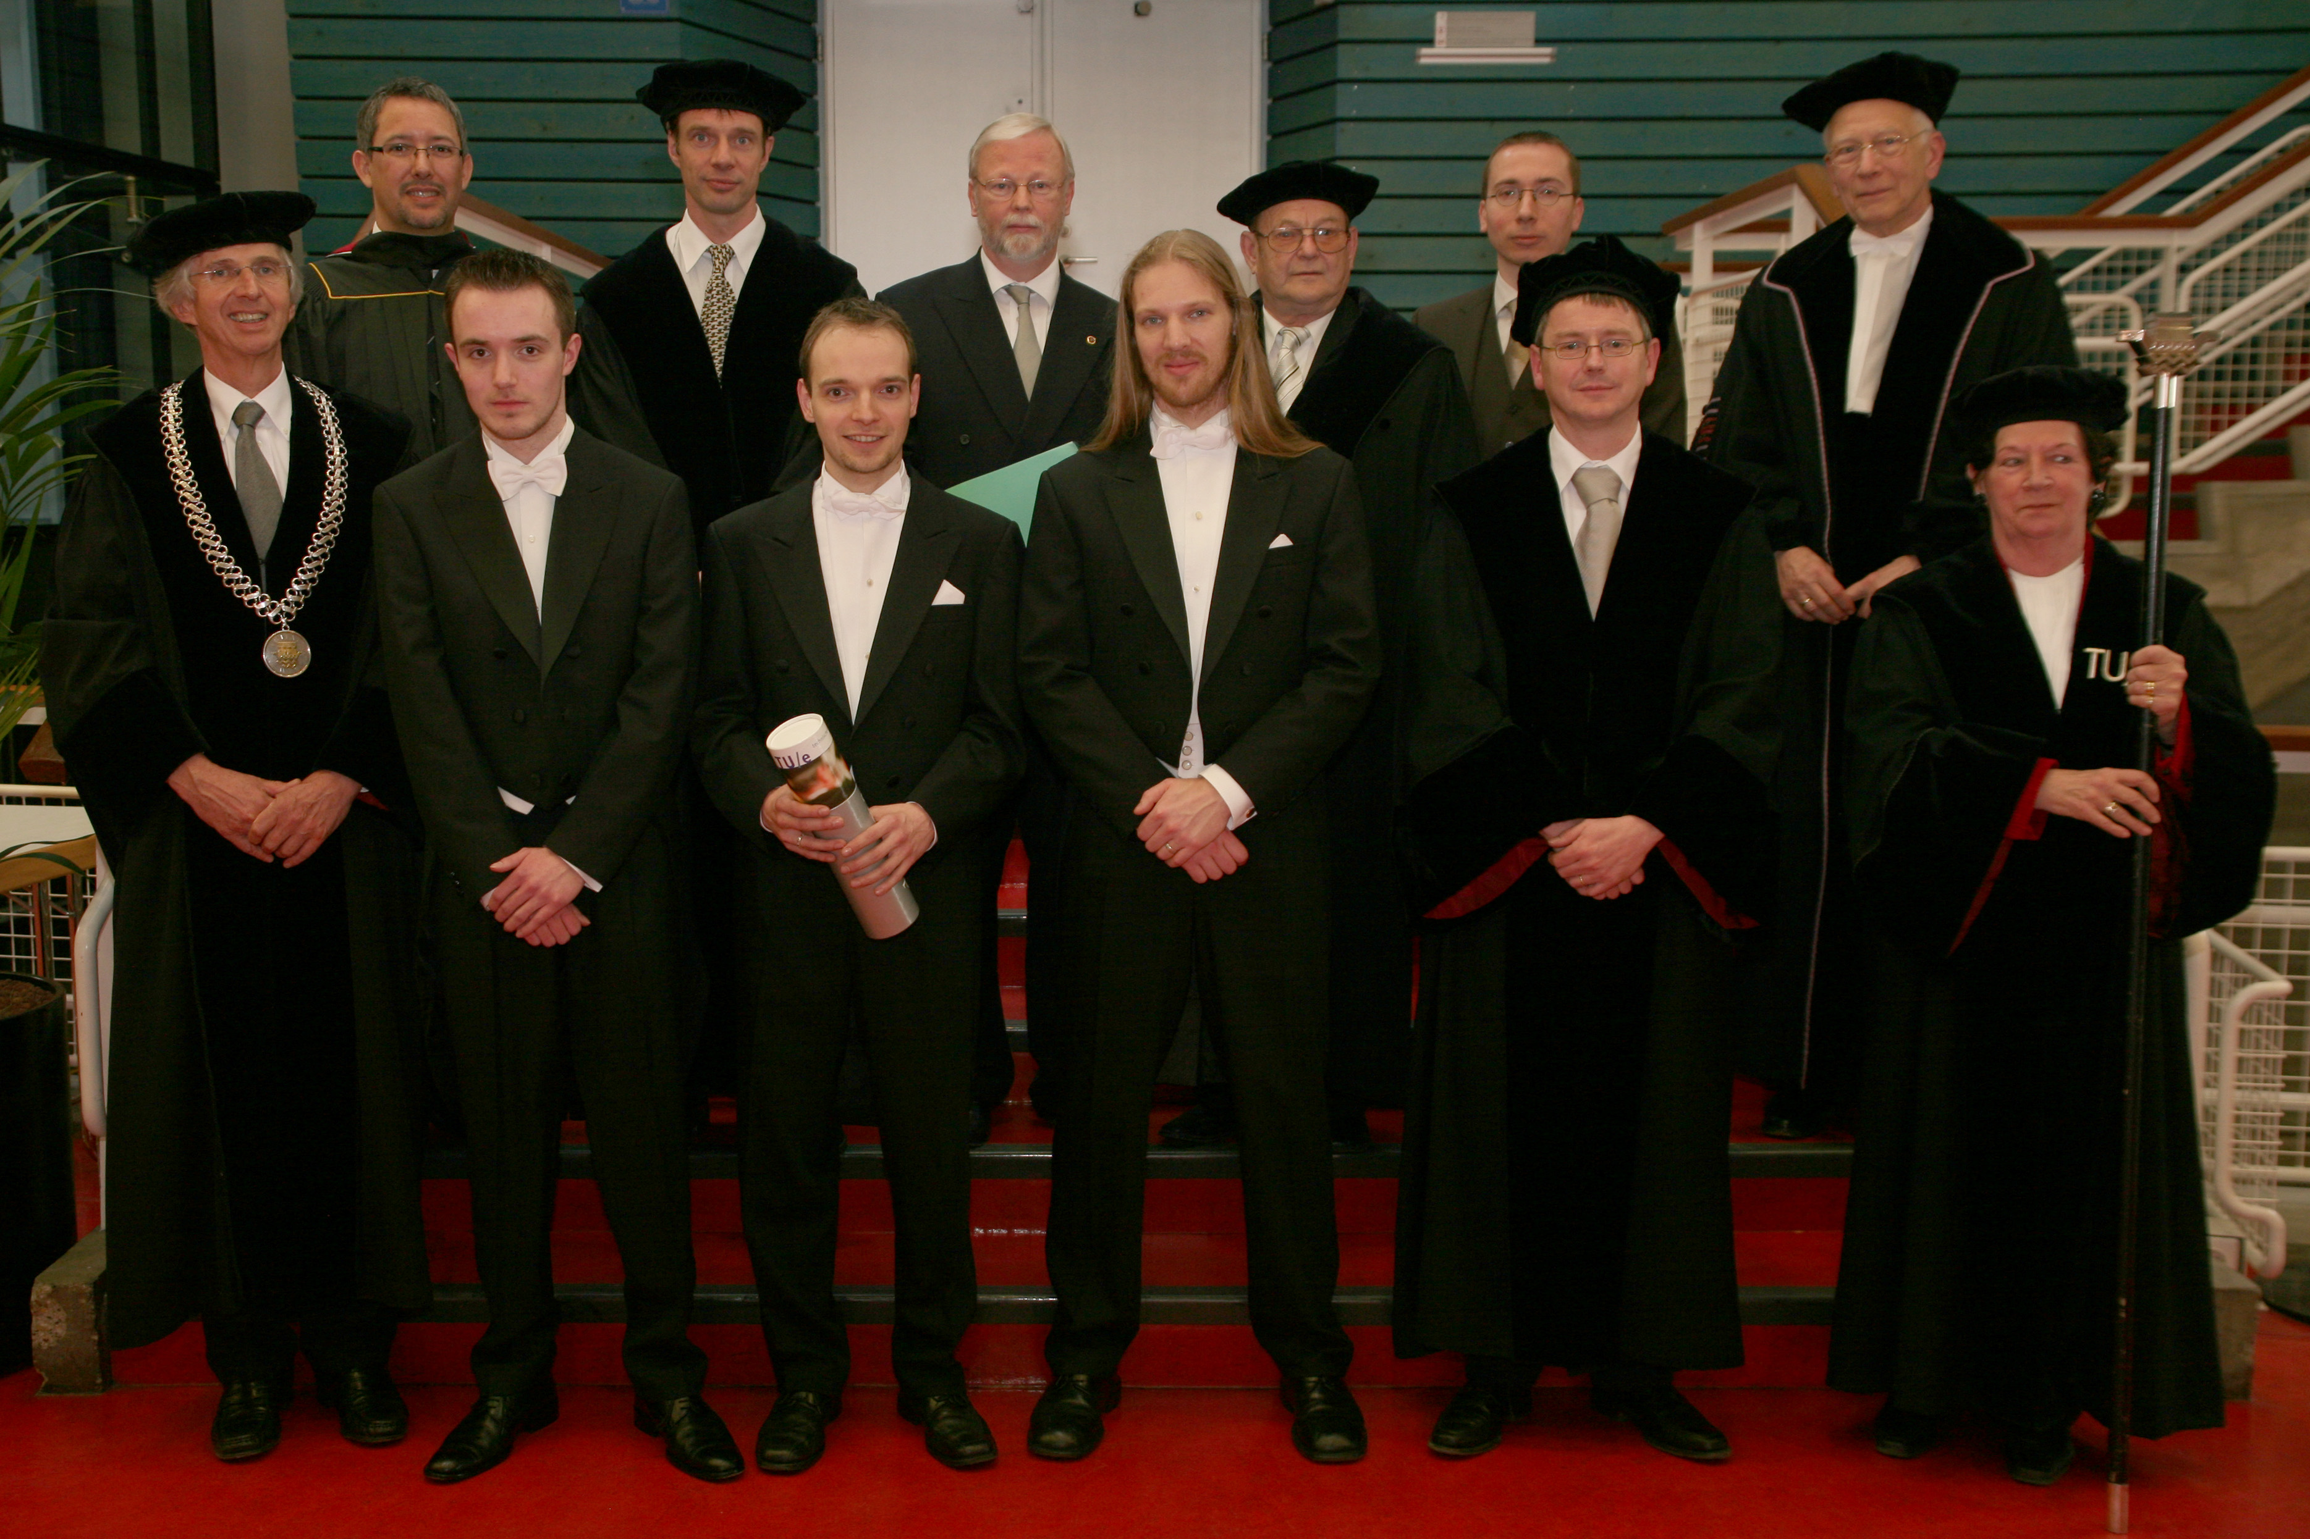
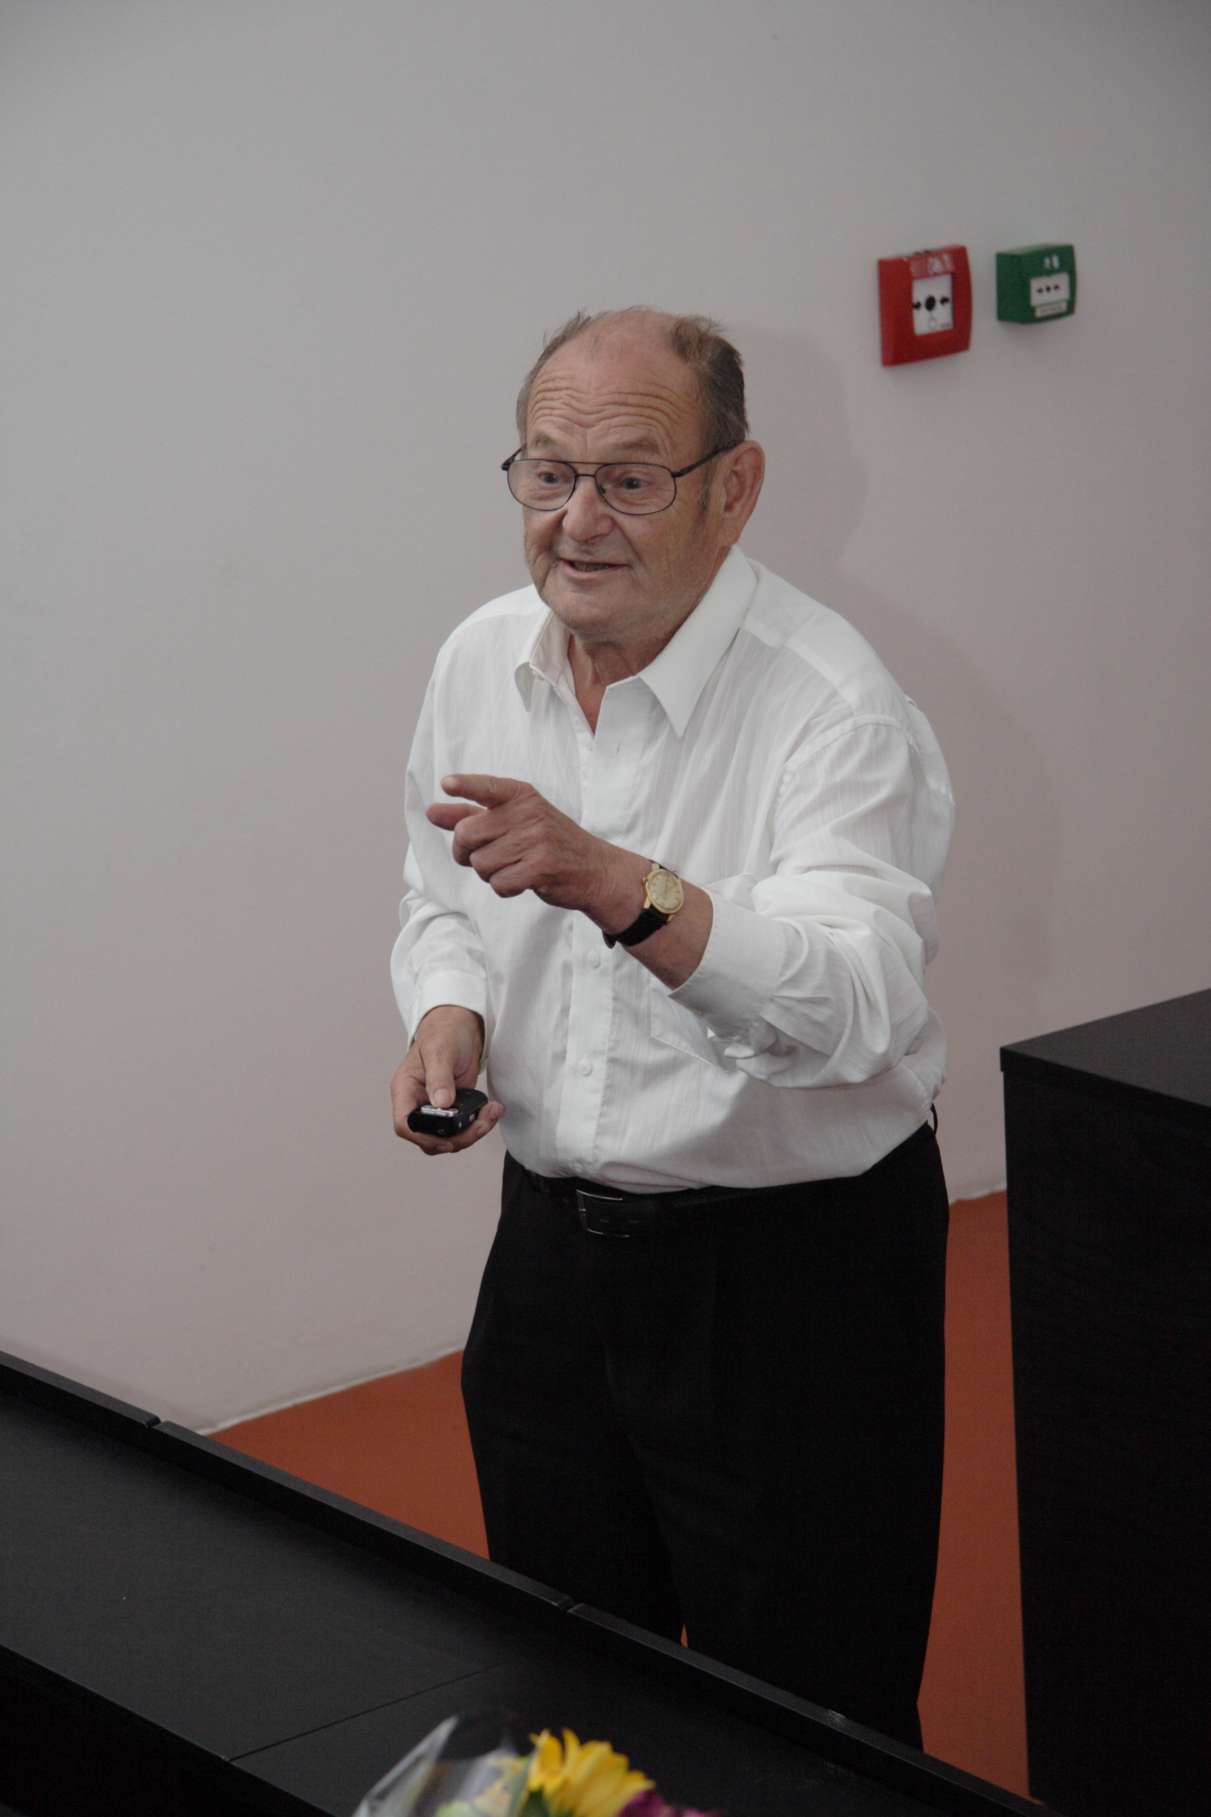


Slide 3
Contents
Introduction
General aspects of benchmarking
Measuring running time
Cache memory effects
Shared memory effects
Miscellaneous additional effects
Conclusions
Notes:
Read the colour PDF of the paper!

Slide 4
Problem
Single keyword exact pattern matching
Given text t and pattern p (lengths n, m respectively),
Find all occurences of p in t
Compare the performance of algorithms solving the same problem
Notes:
Nothing to do with Quantum computing

Slide 5
General aspects
Focus on Hume & Sunday (HS) and SMART
Benchmark running time
Clean-up algorithms to not include:
  Preprocessing
  Actual reporting of matches
  Cleanup
Correctness and testing
  Most frameworks have at least some infra for this
What to report?
  Median of running time
  Memory consumption not often reported

Slide 6
Measuring running time
Time system calls
  Widely varying resolution
  Varying accuracy
  Include/exclude system time
Additional options: TSC registers
  Clock cycle resolution
  Not always present
Often, only part of a tick actually consumed
Clearly, match long enough to make these issues negligible

Slide 7
Cache memory effects
Runs typically depend heavily on this
Typically 3 levels, with dramatically different performance
  L1: 32K
  L2: 256K
  L3: 4M
HS seems to have some amount of cache reuse
SMART has quite a bit more interaction
  Processes, which potentially move to other cores
Instruction caching: relative non-issue

Slide 8
Cache memory (cont.)
Most algorithms are sliding windows
Sliding windows walk memory largely left to right
  Dead-zone is a deviation
Input text typically larger than cache
Cache fetches are then part of the picture

Slide 9
Expected

Slide 10
Expected
Notes:
Clearly, something is happening with cache reuse.

Slide 11
Actual cache impact

Slide 12
Shared memory effects
SMART is smart: uses shared memory
Actual implementation of shared memory is tricky in various *nix:
  Creating memory can be a simple page-table edit
  Copy on write/create policies
  Page faults are very expensive

Slide 13
Minor page faults

Slide 14
Solutions
Walk the memory to force page-ins
Lock:

Slide 15
Improvement by pre-faulting

Slide 16
Pre-faulting (cont.)

Slide 17
Pre-faulting (cont.)

Slide 18
Miscellaneous additional effects
Level of tuning per-algorithm varies dramatically
  Use of intrinsics such as memcmp()
Different processor generations vary
Compiler generations vary
  gcc
  LLVM

Slide 19
Conclusions
There is much work to do, even in the established frameworks
A performance difference of 5% is very small and can be overturned
Perhaps a fully synthetic environment is needed
  Specialized OS
  Simulator
Consider switching everything off
  No cache
  No virtual memory
Benchmarking over processor generations would be interesting

Slide 20
Thanks!

