Slide 1
SEQ-IC-LCS Computation of Labeled Graphs
Yuki Yonemoto, Yuto Nakashima
and Shunsuke Inenaga
Kyushu Univ.
Notes:
I’d like to talk about our paper entitled “SEQ-IC-LCS Computation
of Labeled Graphs”
And my name is Yuki Yonemoto, from Kyusyu university, Japan.
OK, Let’s start.
"SEQ-IC-LCS Computation of Labeled Graphs "についてお話したいと思います。
九州大学の米本優生です。
それでは始めましょう。

Slide 2
Outline
Labeled Graphs
SEQ-IC-LCS (Constrained LCS)
Computing SEQ-IC-LCS of Acyclic Labeled Graphs
Computing SEQ-IC-LCS of Cyclic Labeled Graphs
Conclusions and Future works
Notes:
This is an outline of this talk.
At first, I will describe what “ Labeled Graphs” are.
Next, I will explain about SEQ-IC-LCS on strings.
Next, I will introduce two problems and algorithms to solve them.
And finally I will conclude this talk and present some future work.
以上が本講演の概要である。
まず、「ラベル付きグラフ」とは何かを説明する。
次に、2つの問題とそのアルゴリズムを紹介する。
最後に、本講演の結論と今後の展望について述べる。

Slide 3
Outline
Labeled Graphs
SEQ-IC-LCS (Constrained LCS)
Computing SEQ-IC-LCS of Acyclic Labeled Graphs
Computing SEQ-IC-LCS of Cyclic Labeled Graphs
Conclusions and Future works
Notes:
First of all, I introduce labeled graphs.

Slide 4

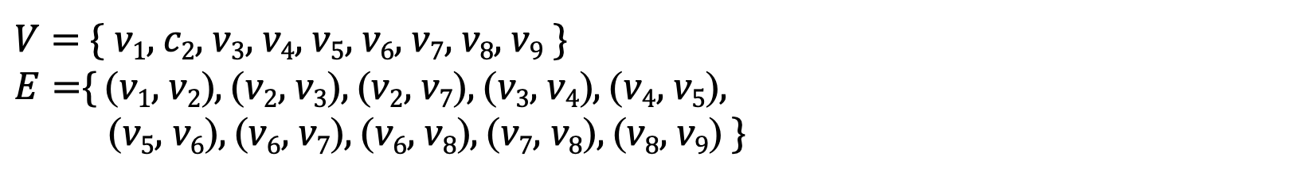
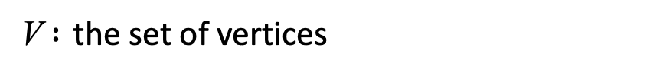
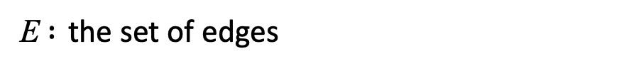


Labeled Graphs
Labeled Graph $G=\left(V, E,L\right)$
A directed graph with vertices labeled by characters.
V $:$ the set of vertices
E $:$ the set of edges
$L :V→Σ :$ a labeling function
e.g.
$V=${ v₁, c₂$,$ v₃$,$ v₄$,$ v₅$,$ v₆$,$ v₇$,$ v₈$,$ v₉ }
$E=${ (v₁, v₂), (v₂, v₃), (v₂, v₇), (v₃, v₄), (v₄, v₅),
(v₅, v₆), (v₆, v₇), (v₆, v₈), (v₇, v₈), (v₈, v₉) }
$$G$$
c
a
a
b
3
4
5
6
a
b
a
c
1
2
b
8
9
7
Notes:
A labeled graph is a directed graph where each vertex is labeled by a character.
It is defined by the set V of vertices, the set E of edges, and a labeling function L.
L maps each vertex in V to a character.
This graph G is an example of a labeled graph.
The character in each vertex is its label.
ラベル付きグラフは、頂点が文字でラベル付けされた有向グラフである。
そして、頂点の集合V、辺の集合E、ラベリング関数Lによって定義される。
LはVの各頂点を文字にマッピングする。
これはラベル付きグラフの例である。
Gは、各頂点が1つの文字でラベル付けされたラベル付きグラフである。

Slide 5
Labeled Graphs
L(v) : the character label of vertex v .
P(v) : the set of paths that end at vertex v.
L(P(v)) : the set of strings spelled by paths in P(v) .
P(G) : the set of paths in G. ( P(G) = {P(v) | v ∈ V } )
L(π) : the set of strings spelled by paths in π (: the set of paths) .
subseq(L(π)) : the set of subsequences of strings in L(π) .
e.g.
c
a
a
b
L(v₇) = b
G
3
4
5
6
P(v₇) = {v₃v₄v₅v₆v₇ , v₁v₂v₇ , … }
a
b
a
c
L(P(v₇)) = {caabb , abb, … }
1
2
b
8
9
aca ∈ subseq(L(P(G)))
7
Notes:
Here, let L(v) be the character label of vertex v.
P(v) is the set of paths that end at vertex v.
L(P(v)) is the set of strings spelled by paths in P(v).
P(G) is the set of paths in G.
So namely P(G) equals union of P(v)s.
L(pi) is the set of strings spelled by paths in pi where pi is the set of paths.
subseq(L(pi)) is the set of subsequence of strings in L(pi).
for example, L(v7) equals b.
P(v7) equals the set of v3v4v5v6v7, v1v2v7 and so on.
L(P(v7)) equals the set of abcaabb, abb, and so on.
A string “aca”is in subseq(L(P(G))
ここで、L(v)を頂点vの文字ラベルとする。
P(v)は頂点vを終点とするパスの集合である。
v_sは入辺を持たない頂点である。
v_e は出辺を持たない頂点である。
MP(v)はvsを始点とし、頂点vを終点とするパスの集合である。
L(P(v))は、P(v)のパスでできる文字列の集合である。
P(G)はGのパスの集合である。
つまりP(G)はP(v)の集合に等しい。
MP(G)は、Gの頂点vsから始まり頂点veで終わるパスの集合である。
簡略化のため、本講演ではこのような経路を「極大経路」と呼ぶ。
L(pi)はpiのパスによってできる文字列の集合であり、piはパスの集合である。
subseq(L(pi))はL(pi)中の文字列の部分集合である。
例えば、L(v7)はbに等しい。
P(v7)はv3v4v5v6v7、v1v2v7などの集合に等しい。
L(P(v7))はabcaabb、abbなどの集合に等しい。
文字列 “aca ”はsubseq(L(G))に含まれる。

Slide 6
Known Algorithms on Labeled Graphs
problem | text | pattern | time complexity
Pattern Matching | acyclic graph | string | O(n+m|E|) [Park ＆ Kim, 1995]
 | tree | string | O(n) [Akutsu, 1993]
 | graph | string | O(n+m|E|) [Amir et al, 1997]
Approximate Matching | graph with edit operations | string | NP-complete [Amir et al, 1997]
 | graph | string with edit operations | O(m(n+|E|)) [Navarro, 2000]
n : sum of the length of strings in the text, m : length of the pattern.
problem | text 1 | text 2 | time complexity
Longest Common Substring | acyclic graph | acyclic graph | O(|E₁||E₂|) [Shimohira et al., 2011]
 | graph | acyclic graph
Longest Common Subsequence | acyclic graph | acyclic graph | O(|E₁||E₂|) [Shimohira et al., 2011]
 | graph | graph | O(|E₁||E₂|+|V₁||V₂|log|Σ|) [Shimohira et al., 2011]
|E_{i}| : the number of edges in text i, |V_{i}| : the number of vertices in text i, |Σ| : the alphabet size.
Notes:
This table shows known algorithms on labeled graph.
As you can see, the previous work on pattern matching on labeled graph assumed a string pattern.
And the longest common substring and longest common subsequence problems between two labeled graph are considered by Shimohira et al.
First, if at least one of labeled graphs is acyclic, then the Longest Common Substring problem can be solved in this time.
Next, if both labeled graphs are acyclic, then the Longest Common Subsequence problem can be solved in this time.
finally, If both labeled graphs are cyclic, then the Longest Common Subsequence problem can be solved in this time.
この表は、ラベル付きグラフに対するアルゴリズムを示したものである。
非線形テキストに対するパターンマッチングでは、線形パターンを仮定している。
そして、shimohiraらは、二つのラベル付きグラフ間の最長共通部分文字列と最長共通部分列の問題を考えている。
まず、ラベル付きグラフの少なくとも一方が非であれば、最長共通部分文字列問題はO(|E1||E2|)時間で解くことができる。
次に、ラベル付きグラフの両方が非巡回であれば、最長共通部分文字列問題は O(|E1||E2|)時間で解くことができる。
最後に、もし両方のラベル付きグラフが巡回であれば、最長共通後続問題はO(|E1||E2|+|V1||V2|log|Σ|)時間で解くことができる。

Slide 7
Outline
Labeled Graphs
SEQ-IC-LCS (Constrained LCS)
Computing SEQ-IC-LCS of Acyclic Labeled Graphs
Computing SEQ-IC-LCS of Cyclic Labeled Graphs
Conclusions and Future works
Notes:
now, I will talk about Constrained LCS problems, especially about SEQ-IC-LCS problem.
ここでは、制約付きLCS問題、特にSEQ-IC-LCS問題について述べる。

Slide 8
Constrained LCS [Chen et al., 2011]
In the field of molecular biology,
there are cases where the same sequence appears
between different species, and there are demand to
incorporate this into similarity measurements.
In recent years,
Constrained LCS problems for string inputs
derived from the LCS problem are considered.
Notes:
In the field of molecular biology,
there are cases where the same sequence appears
between different species, and there are demand to
incorporate this into similarity measurements.
In recent years,
Constrained LCS problems for string inputs
derived from the LCS problem are considered.
分子生物学の分野では、異なる生物種間で同じ配列が出現する場合があり
これを類似度測定に取り入れたいとの要求がある。
そこで近年では
制約条件付きLCS問題
から派生した制約付きLCS問題が検討されている。

Slide 9
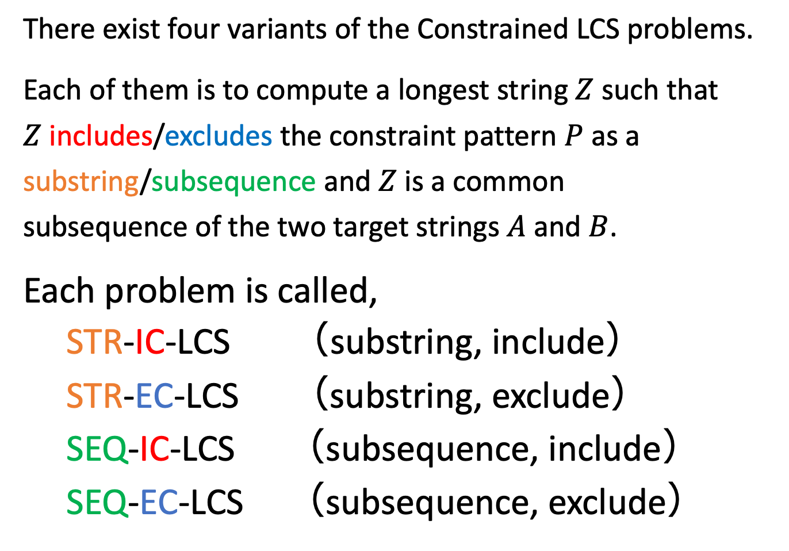
Constrained LCS [Chen et al., 2011]
There exist four variants of the Constrained LCS problems.
Each of them is to compute a longest string $Z$ such that
$Z$ includes/excludes the constraint pattern $P$ as a
substring/subsequence and $Z$ is a common
subsequence of the two target strings $A$ and $B$.
Each problem is called,
STR-IC-LCS （substring, include）
STR-EC-LCS （substring, exclude）
SEQ-IC-LCS （subsequence, include）
SEQ-EC-LCS （subsequence, exclude）
Notes:
There exist four variants of the Constrained LCS problems.
Each of them is to compute a longest string $Z$ such that
$Z$ includes or excludes the constraint pattern $P$ as a
substring or subsequence and $Z$ is a common
subsequence of the two target strings $A$ and $B$.
Each problem is called, STR-IC-LCS, STR-EC-LCS, SEQ-IC-LCS, and SEQ-EC-LCS.
STR and SEQ represent substring and subsequence, respectively.
IC and EC represent inclusion and exclusion, respectively.
制約付きLCS問題には4つのバリエーションがある。
それぞれの問題は、次のような最長文字列𝑍を計算するものである。
zは制約パターン𝑃を部分文字列または部分文字列として含むか、または含まない。
を部分文字列または部分文字列として含み、かつzが共通の
𝐴と𝐵の共通の部分文字列である。
それぞれの問題は、STR-IC-LCS、STR-EC-LCS、SEQ-IC-LCS、SEQ-EC-LCSと呼ばれる。
STRとSEQはそれぞれ部分文字列と部分配列を表す。
ICとECはそれぞれ含むと含まないを表す。

Slide 10
Previous Work of Constrained LCS and Our Work
problem | text 1 | text 2 | text 3 | time complexity
STR-IC-LCS | string | string | string | O(|E₁||E₂|) [Deorowicz, 2012]
STR-EC-LCS | string | string | string | O(|E₁||E₂||E₃|) [Wang et al., 2013]
SEQ-IC-LCS | string | string | string | O(|E₁||E₂||E₃|) [Chin et al., 2004]
 | acyclic graph | acyclic graph | acyclic graph | O(|E₁||E₂||E₃|) (this work)
SEQ-IC-LCS | graph | graph | acyclic graph | O(|E₁||E₂||E₃|+|V₁||V₂||V₃|log|Σ|) (this work)
SEQ-EC-LCS | string | string | string | O(|E₁||E₂||E₃|) [Chen and Chao, 2011]
|E_{i}| : the number of edges in text i , |V_{i} | : the number of vertices in text i ,
|Σ| : the alphabet size .
Notes:
This table shows previous work of Constrained LCS .
Here |E_{i} | is the number of edges in text i , |V_{i} | is the number of vertices in text i , |Σ| is the alphabet size.
When the input graph is a string, then we represent it as one path graph.
As you can see, for string inputs, there is an (order E1 times E2) time algorithm for STR-IC-LCS.
Also, for string inputs, there are (order E1 times E2 times E3) time algorithms except for the STR-IC-LCS problem.
この表は、Constrained LCSの既存研究を示している。
このように、STR-IC-LCSにはO(E1E2)時間アルゴリズムが存在し、STR-IC-LCS問題以外にはO(E1E2E3)時間アルゴリズムが存在することがわかる。

Slide 11
Previous Work of Constrained LCS and Our Work
problem | text 1 | text 2 | text 3 | time complexity
STR-IC-LCS | string | string | string | O(|E₁||E₂|) [Deorowicz, 2012]
STR-EC-LCS | string | string | string | O(|E₁||E₂||E₃|) [Wang et al., 2013]
SEQ-IC-LCS | string | string | string | O(|E₁||E₂||E₃|) [Chin et al., 2004]
 | acyclic graph | acyclic graph | acyclic graph | O(|E₁||E₂||E₃|) (this work)
SEQ-IC-LCS | graph | graph | acyclic graph | O(|E₁||E₂||E₃|+|V₁||V₂||V₃|log|Σ|) (this work)
SEQ-EC-LCS | string | string | string | O(|E₁||E₂||E₃|) [Chen and Chao, 2011]
|E_{i}| : the number of edges in text i , |V_{i} | : the number of vertices in text i ,
|Σ| : the alphabet size .
Notes:
In our work, we consider the SEQ-IC-LCS problem when the three inputs are Labeled graphs.
First, If all of labeled graphs are acyclic, then the SEQ-IC-LCS can be solved in this time.
Next, If two labeled graphs are cyclic and constraint labeled graph is acyclic, then the SEQ-IC-LCS problem can be solved in this time.
本研究では、3つのラベル付きグラフに対するSEQ-IC-LCS問題を考える。
まず、全てのラベル付きグラフが非巡回である場合、SEQ-IC-LCSはO(|E1||E2||E3|)時間で解くことができる。
次に、2つのラベル付きグラフが巡回で、制約ラベル付きグラフが非巡回であれば、SEQ-IC-LCS問題はO(|E1||E2||E3|)時間で解くことができる。

Slide 12
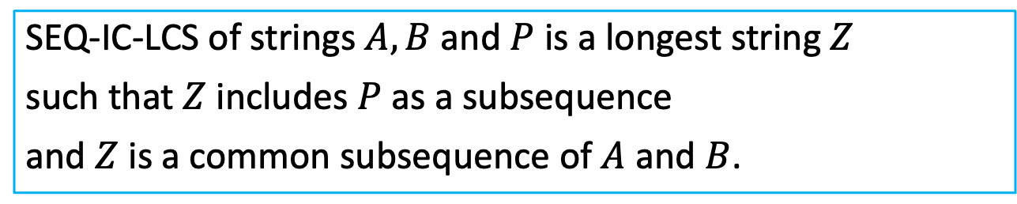
SEQ-IC-LCS
SEQ-IC-LCS of strings $A,B$ and $P$ is a longest string $Z$
such that $Z$ includes $P$ as a subsequence
and $Z$ is a common subsequence of $A$ and $B$.
Notes:
I explain the SEQ-IC-LCS problem in more detail.
For simplicity, I begin with the case of string inputs.
SEQ-IC-LCS is a longest string $Z$ such that
$Z$ includes $P$ as a Subsequence
and $Z$ is a common subsequence of $A$ and $B$.
SEQ-IC-LCS 問題についてもう少し詳しく説明する。
SEQ-IC-LCSは、以下のような最長の文字列Zである。
𝑍は𝑃を部分列として含み、
𝑍は𝐴と𝐵の共通部分列である。

Slide 13
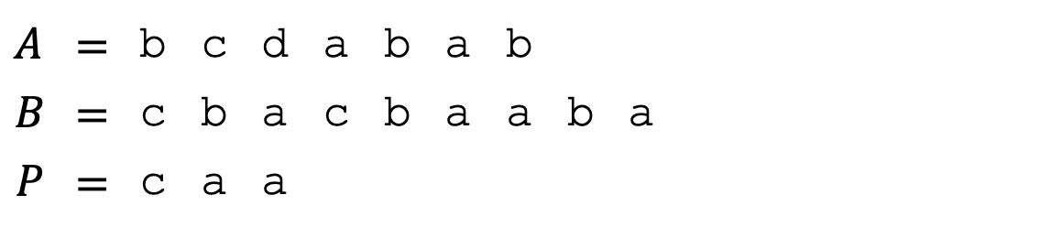

SEQ-IC-LCS
SEQ-IC-LCS of strings $A,B$ and $P$ is a longest string $Z$
such that $Z$ includes $P$ as a subsequence
and $Z$ is a common subsequence of $A$ and $B$.
e.g.
$$A$$ | $$=$$ | b | c | d | a | b | a | b
$$B$$ | $$=$$ | c | b | a | c | b | a | a | b | a
$$P$$ | $$=$$ | c | a | a
c a b a b
is an SEQ-IC-LCS of string $A,B$and $P$.
Notes:
This is an example of an SEQ-IC-LCS of strings A, B and P.
これはAとBとPのSEQ-IC-LCSの例です。

Slide 14
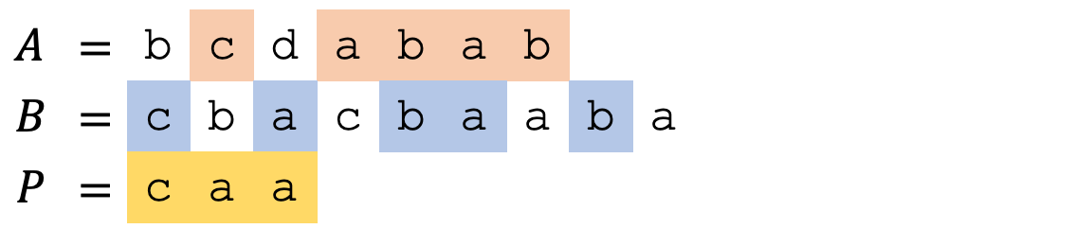
SEQ-IC-LCS
SEQ-IC-LCS of strings $A,B$ and $P$ is a longest string $Z$
such that $Z$ includes $P$ as a subsequence
and $Z$ is a common subsequence of $A$ and $B$.
e.g.
$$A$$ | $$=$$ | b | c | d | a | b | a | b
$$B$$ | $$=$$ | c | b | a | c | b | a | a | b | a
$$P$$ | $$=$$ | c | a | a
c a b a b
is an SEQ-IC-LCS of string $A,B$and $P$.
Notes:
The string “c a b a b” includes $P$ as a Subsequence,
and it is a common subsequence of $A$ and $B$.
There is no such subsequence of length more than 6.
So, “c a b a b” is an SEQ-IC-LCS of string $A,B$and $P$.
This third string P is a constraint for the solutions.
“c a b a b”は、𝑃を部分文字列として含む文字列であり、AとBの共通部分列である。
長さが6以上のこのような部分列は存在しない。
したがって、”c a b a b"は文字列A,𝐵と𝑃のSEQ-IC-LCSである。

Slide 15
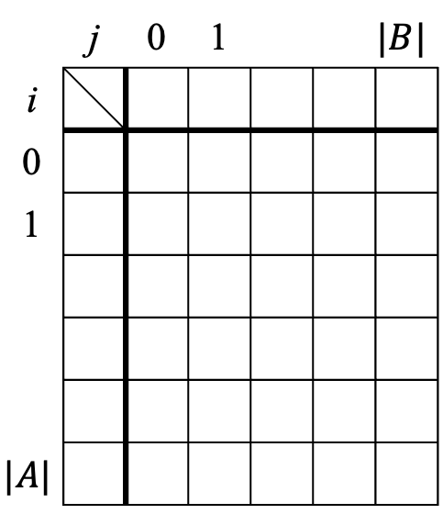

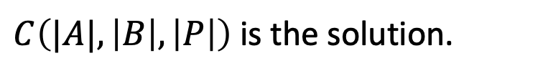
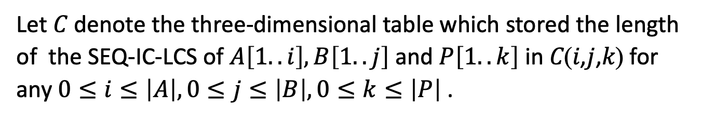
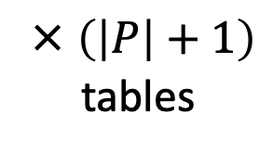
Algorithm for SEQ-IC-LCS of strings [Chin et al., 2004]
Previous work of the SEQ-IC-LCS problem for string inputs
is based on dynamic programming.
Let 𝐶 denote the three-dimensional table which stored the length of the SEQ-IC-LCS of $A\left[1..i\right],B\left[1..j\right]$and $P\left[1..k\right]$ in 𝐶(𝑖,𝑗,𝑘) for any $0≤i≤\left|A\right|, 0≤j≤\left|B\right|, 0≤k≤\left|P\right|$ .
$$C$$
 | j | 0 | 1 |  |  | $$|B|$$
i
0
1
$$|A|$$
computing all 𝐶(𝑖,𝑗,𝑘)
by using the recurrence.
$C\left(|A|,\left|B\right|,\left|P\right|\right)$ is the solution.
× $\left(\left|P\right|+1\right)$
tables
Notes:
Previous work of the SEQ-IC-LCS problem for string inputs is based on dynamic programming.
Let 𝐶 denote the three-dimensional table which stores the length of the SEQ-IC-LCS of $A\left[1..i\right],B\left[1..j\right]$and $P\left[1..k\right]$ in C(𝑖, 𝑗, 𝑘) for any i, j and k.
In the next slide I will explain the recurrence for computing all C(i,j,k).
After computing them, we obtain the solution in the cell C(A, B, P).
SEQ-IC-LCS問題の先行研究は動的計画法に基づいている。
𝑃, 𝑗, 0≤𝑖𝑛, 0≤𝑘の任意の𝑖, 𝑘, 𝑗, 𝑗, 𝑘の要素に𝐴[1..𝐴],𝐵[1..𝑗], 𝑘のSEQ-IC-LCSの長さを格納した3次元の表を𝐶とする。
この要素を𝐶(𝑖,j,k)とする。
漸化式を用いてすべてのC(I,j,k)を計算すると、C(n,n,r)が解となる。

Slide 16


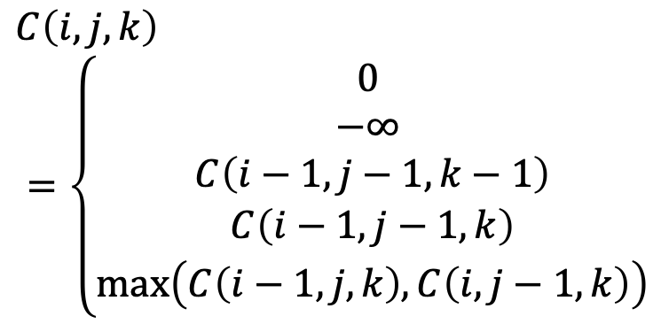
Recurrence of SEQ-IC-LCS algorithm of strings [Chin et al., 2004]
$C\left(i,j,k\right)$ : the length of SEQ-IC-LCS of $A\left[1..i\right],B\left[1..j\right]$ and $P\left[1..k\right]$.
$$C\left(i,j,k\right)$$
$$=\left\{\begin{aligned}0 \\ −∞ \\ C\left(i−1,j−1,k−1\right) \\ C\left(i−1,j−1,k\right) \\ \max\left(C\left(i−1,j,k\right), C\left(i,j−1,k\right)\right)\end{aligned}\right.$$
$$if k=0 and \left(i=0 or j=0\right);$$
$$if k≠0 and \left(i=0 or j=0\right);$$
$$if i,j,k>0 andA\left[i\right]=B\left[j\right]=P\left[k\right];$$
$$if i,j>0 andA\left[i\right]=B\left[j\right]≠P\left[k\right];$$
$$if i,j>0 andA\left[i\right]≠B\left[j\right];$$
This algorithm computes the solution in $O\left(\left|A\right|\left|B\right|\left|P\right|\right)$ time.
Notes:
This is the recurrence of SEQ-IC-LCS algorithm for string inputs.
And this algorithm computes the solution in $O\left(\left|A\right|\left|B\right|\left|P\right|\right)$ time.

Slide 17
Outline
Labeled Graphs
SEQ-IC-LCS (Constrained LCS)
Computing SEQ-IC-LCS of Acyclic Labeled Graphs
Computing SEQ-IC-LCS of Cyclic Labeled Graphs
Conclusions and Future works
Notes:
next, I will talk about SEQ-IC-LCS of acyclic labeled graphs.

Slide 18
Definition about Labeled Graphs
V_{s} : the set of vertices which has no in-coming edges.
V_{e} : the set of vertices which has no out-going edges.
MP(v) : the set of paths that start at v_{s} in V_{s} and end at vertex v .
MP(G) : the set of paths that start at v_{s} in V_{s} and end at vertex v_{e}
in V_{e} in G (= maximal paths).
e.g.
G
V_{s} = {v₁ , v₄} V_{e} = {v₃ , v₅}
d
a
a
MP(v₅) = { v₁v₅ , v₄v₅ }
1
2
3
L(MP(v₄)) = { dc, cc }
c
c
4
5
MP(G) = { v₁v₂v₃ , v₁v₅ , v₄v₅ }
Notes:
Before I explain the problem definition, I explain some definitions about labeled graph.
Here, large v_s is the vertex which has no in-coming edges.
Large v_e is the vertex which has no out-going edges.
MP(v) is the set of paths that start at v_{s} in large vs and end at vertex v.
MP(G) is the set of paths that start at v_{s} in karge vs and end at vertex v_{e} in larage v3 in G.
To simplify, in this talk, I call such path “maximal path”.
In this example,
Large v_s equals the set pf v1 and v4, and large v_e equals the set of v3 and v4.
MP(v4) equals the set of v1v5 and v4v5.
L(MP(v4)) equals the set of dc and cc.
MP(G) equals the set of v₁v₂v₃ , v₁v₅ and v₄v₅.
問題の定義を説明する前に、ラベル付きグラフの定義について説明する。
ここで、v_s は入ってくる辺を持たない頂点である。
v_eは出て行く辺を持たない頂点である。
MP(v)はvsを始点とし、頂点vを終点とするパスの集合である。
MP(G)は、Gのvsを始点とし頂点veを終点とするパスの集合である。
本発表では簡略化のため、このような経路を「極大経路」と呼ぶ。
MP(v4)はv1v4とv3v4の集合に等しい。
L(MP(v4))はabcaabbとabbの集合に等しい。
MP(G)はv1v2、v1v3、v3v4 の集合に等しい。

Slide 19
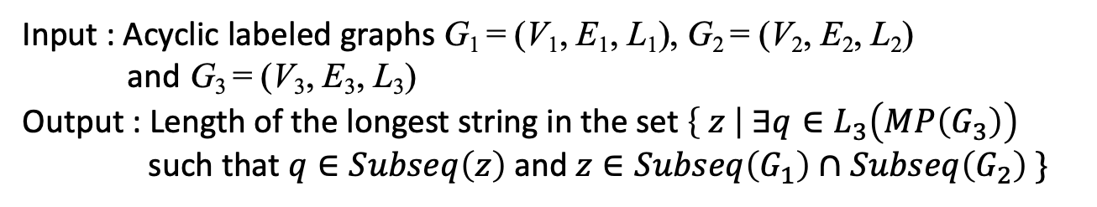
SEQ-IC-LCS Problem for Acyclic Labeled Graphs
Problem 1
Input : Acyclic labeled graphs G₁ = (V₁, E₁, L₁), G₂ = (V₂, E₂, L₂)
and G₃ = (V₃, E₃, L₃)
Output : Length of the longest string in the set $\left\{ z \right| ∃q∈L_{3}\left(MP\left(G_{3}\right)\right)$
such that $q∈Subseq\left(z\right) \text{and} z∈Subseq\left(G_{1}\right)∩Subseq\left(G_{2}\right) \}$
MP(G) : the set of maximal paths in G.
subseq(G) : the set of subsequences of strings in G .
e.g.
G1
G2
G3
a
c
b
a
c
d
d
a
c
d
a
d
b
a
c
c
Notes:
Here is the definition of the SEQ-IC-LCS problem for acyclic labeled graphs.
Given three acyclic labeled graph G₁, G₂ and G3, the problem is to compute the length of a SEQ-IC-LCS of them.
In this problem, SEQ-IC-LCS is a longest string which is a common subsequence of G1 and G2 and includes at least one maximal string in G3 as subsequence.
This problem includes the problem whose inputs are strings.
はじめに
非巡回ラベル付きグラフのSEQ-IC-LCS問題を紹介する。
3つの非巡回ラベル付きグラフG1, G2, G3が与えられたとき、それらのSEQ-IC-LCSの長さを計算する問題である。
この問題では，SEQ-IC-LCSはG1とG2の共通部分列であり， G3中の少なくとも1つの最大文字列を部分列として含む最長の文字列である．
この問題には，入力が文字列であるSEQ-IC-LCS問題も含まれる．

Slide 20
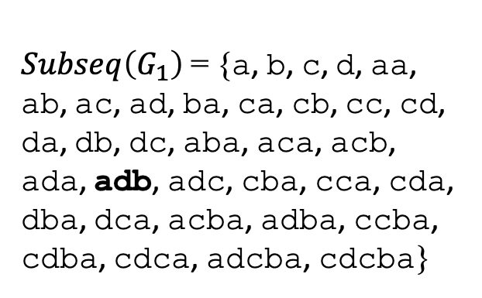
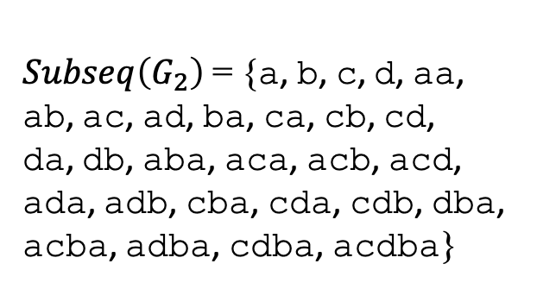
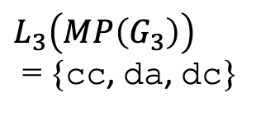
SEQ-IC-LCS Problem for Acyclic Labeled Graphs
Problem 1
Input : Acyclic labeled graphs G₁ = (V₁, E₁, L₁), G₂ = (V₂, E₂, L₂)
and G₃ = (V₃, E₃, L₃)
Output : Length of the longest string in the set $\left\{ z \right| ∃q∈L_{3}\left(MP\left(G_{3}\right)\right)$
such that $q∈Subseq\left(z\right) \text{and} z∈Subseq\left(G_{1}\right)∩Subseq\left(G_{2}\right) \}$
MP(G) : the set of maximal paths in G.
subseq(G) : the set of subsequences of strings in G .
e.g.
G1
G2
G3
a
c
b
a
c
d
d
a
c
d
a
d
b
a
c
c
$Subseq\left(G_{1}\right)$ = {a, b, c, d, aa,
ab, ac, ad, ba, ca, cb, cc, cd,
da, db, dc, aba, aca, acb,
ada, adb, adc, cba, cca, cda,
dba, dca, acba, adba, ccba,
cdba, cdca, adcba, cdcba}
$Subseq\left(G_{2}\right)$ = {a, b, c, d, aa,
ab, ac, ad, ba, ca, cb, cd,
da, db, aba, aca, acb, acd,
ada, adb, cba, cda, cdb, dba,
acba, adba, cdba, acdba}
$L_{3}\left(MP\left(G_{3}\right)\right)$
= {cc, da, dc}
Notes:
Let’s look at this example.
Given three acyclic labeled graph like these,
subseq(G1) and subseq(G2) are these respectevely. And the set of strings of maximal paths of G3 is that.
For example, subsequence “adb” of G1 is a subsequence of this path.
3つの非巡回ラベル付きグラフの例を見てみよう、
subseq(G1)とsubseq(G2)はそれぞれこうなる。そして、G3の最大パスの文字列の集合はこうなる。

Slide 21
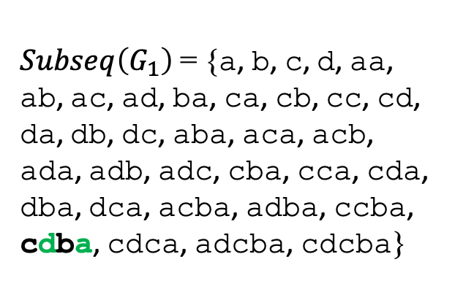
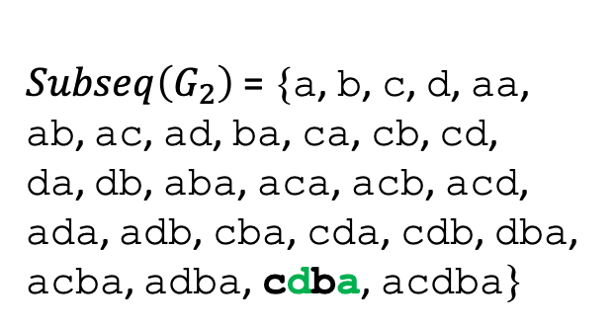
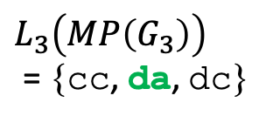
SEQ-IC-LCS Problem for Acyclic Labeled Graphs
Problem 1
Input : Acyclic labeled graphs G₁ = (V₁, E₁, L₁), G₂ = (V₂, E₂, L₂)
and G₃ = (V₃, E₃, L₃)
Output : Length of the longest string in the set $\left\{ z \right| ∃q∈L_{3}\left(MP\left(G_{3}\right)\right)$
such that $q∈Subseq\left(z\right) \text{and} z∈Subseq\left(G_{1}\right)∩Subseq\left(G_{2}\right) \}$
MP(G) : the set of maximal paths in G.
subseq(G) : the set of subsequences of strings in G .
e.g.
G1
G2
G3
a
c
b
a
c
d
d
a
c
d
a
d
b
a
c
c
$Subseq\left(G_{1}\right)$ = {a, b, c, d, aa,
ab, ac, ad, ba, ca, cb, cc, cd,
da, db, dc, aba, aca, acb,
ada, adb, adc, cba, cca, cda,
dba, dca, acba, adba, ccba,
cdba, cdca, adcba, cdcba}
$Subseq\left(G_{2}\right)$ = {a, b, c, d, aa,
ab, ac, ad, ba, ca, cb, cd,
da, db, aba, aca, acb, acd,
ada, adb, cba, cda, cdb, dba,
acba, adba, cdba, acdba}
$L_{3}\left(MP\left(G_{3}\right)\right)$
= {cc, da, dc}
The solution is 4. (cdba)
Notes:
In this example, the solution to the problem is 4, since there is a common subsequence “cdba” which include “da” as subsequence, and this is the longest one.
この例では、"da "を部分列として含む共通部分列 "cad "があるので、問題の解は4となる。

Slide 22
Main Idea of the Algorithm for SEQ-IC-LCS of Acyclic Labeled Graphs
1. Sort vertices of${ G}_{1},G_{2}$ and $G_{3}$in topological order.
Notes:
Next, I present the idea of our algorithm to solve Problem 1.
First, we sort the vertices of G_{1,} G₂ and G3 in topological order.
次に
問題 1 を解くアルゴリズムのアイデアを示す。
まず、G1, G2, G3 の頂点をトポロジカルソートする。

Slide 23
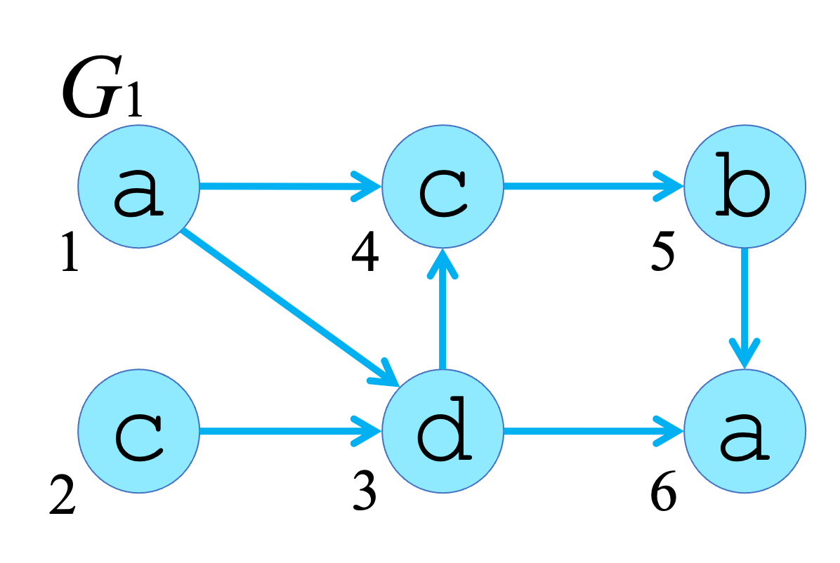
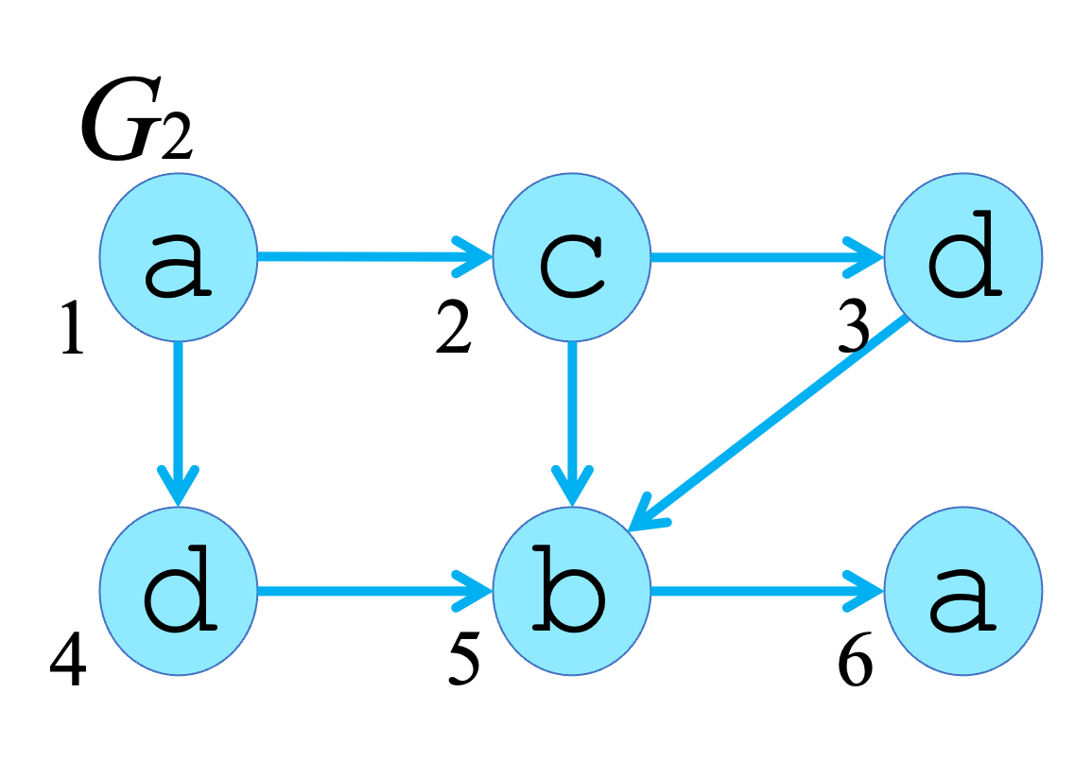
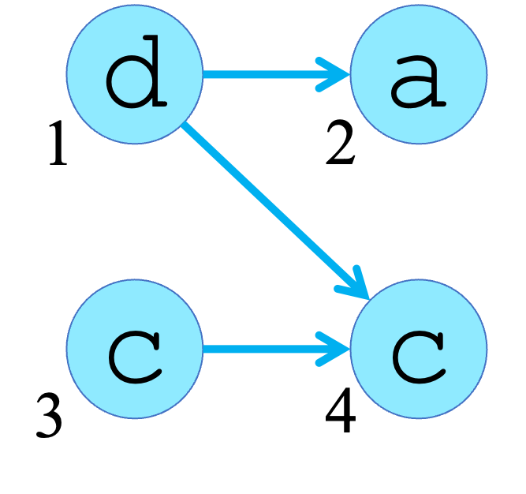
Topological Sort
1. Sort vertices of${ G}_{1},G_{2}$ and $G_{3}$in topological order.
e.g.
G1
a
c
d
c
b
a
1
2
3
4
5
6
sort
G2
a
c
d
d
b
a
1
2
3
4
5
6
G3
G3
d
a
c
c
1
2
3
4
Notes:
To our right is the topologically sorted graphs.
これらはソートの例である。

Slide 24
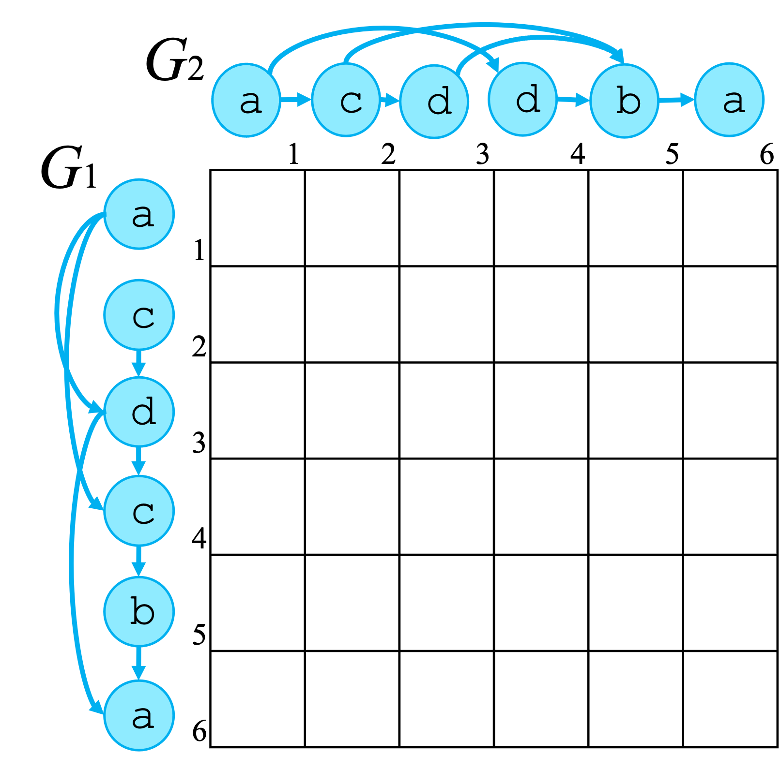
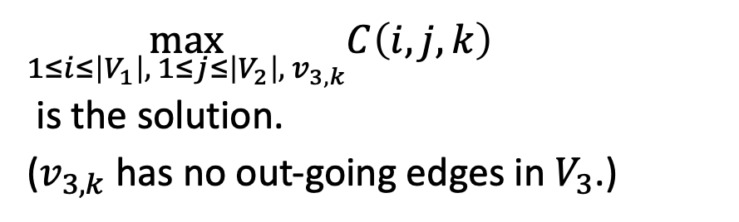

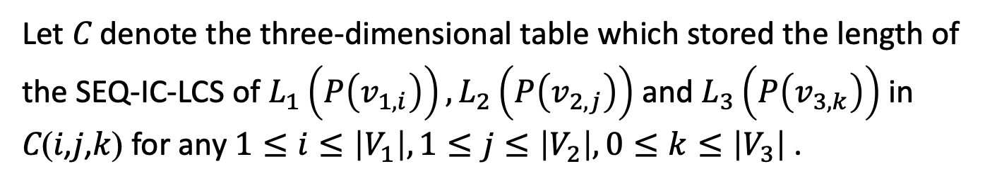

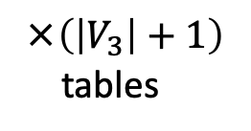
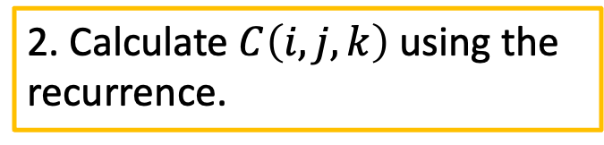
Main Idea of the Algorithm for SEQ-IC-LCS of Acyclic Labeled Graphs
1. Sort vertices of${ G}_{1},G_{2}$ and $G_{3}$in topological order.
Let 𝐶 denote the three-dimensional table which stored the length of the SEQ-IC-LCS of $L_{1}\left(P\left(v_{1,i}\right)\right),L_{2}\left(P\left(v_{2,j}\right)\right)$ and $L_{3}\left(P\left(v_{3,k}\right)\right)$ in 𝐶(𝑖,𝑗,𝑘) for any $1≤i≤\left|V_{1}\right|, 1≤j≤\left|V_{2}\right|, 0≤k≤\left|V_{3}\right|$ .
$$\left(v_{1,i}∈V_{1}, v_{2,j}∈V_{2},v_{3,k}∈V_{3}\right)$$
$$C$$
2. Calculate $C\left(i,j,k\right)$ using the recurrence.
$\max_{1≤i≤\left|V_{1}\right|, 1≤j≤\left|V_{2}\right|, v_{3,k}}C\left(i,j,k\right)$
is the solution.
($v_{3,k}$has no out-going edges in $V_{3}$.)
×$\left(\left|V_{3}\right|+1\right)$
tables
Notes:
Next, let C be a V1 ×(times) V2 times (V3+1) integer table.
Each row of table C corresponds to the vertex in G1,
and each column of table C corresponds to the vertex in G2.
Here Cijk is the length of the SEQ-IC-LCS of strings that end at v1,i , v2,j and v3,k.
We will compute Cijk for all i, j and k using dynamic programing.
次に、CをV1×V2×(V3+1) の整数表とする。
表Cの各行はG1の頂点に対応する．
表Cの各列はG2の頂点に対応する。
ここでCijkは、v1,i、v2,j、v3,kで終わる文字列のSEQ-IC-LCSの長さである。
すべてのi,j,kについて、動的計画法を用いてCijkを計算する。

Slide 25
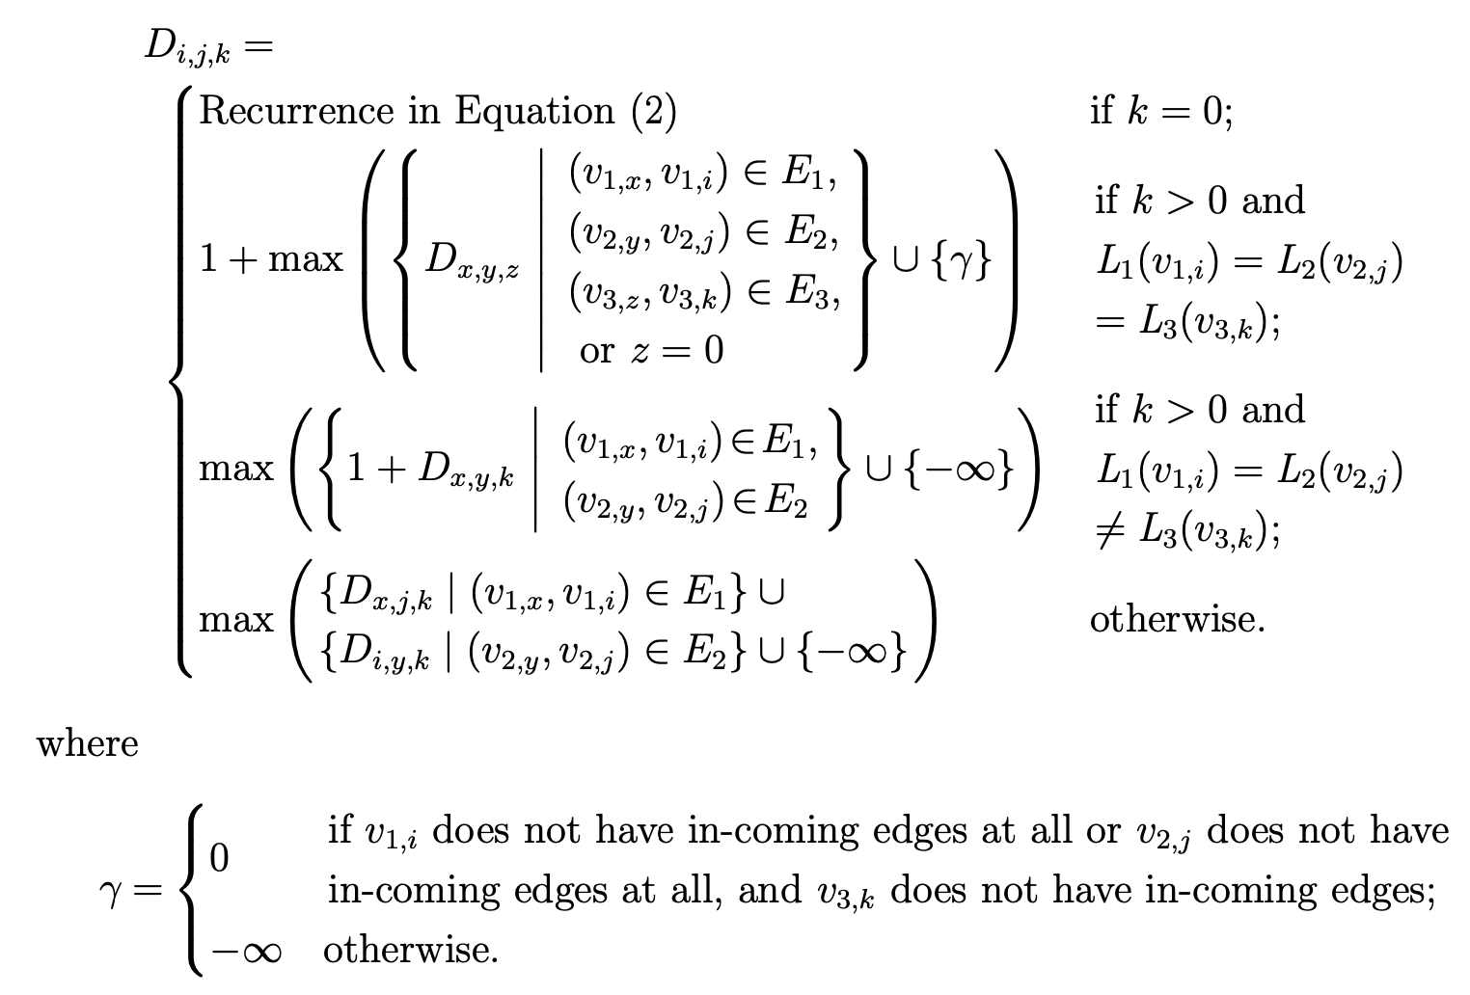







Recurrence of SEQ-IC-LCS of Acyclic Labeled Graphs
$$C_{i,j,k}$$
of LCS of Acyclic Labeled Graph
[Shimohira et al., 2011]
$$C_{x,y,z}$$
$$\left(f\left(v_{1,i}\right)=f\left(v_{2,j}\right)=f\left(v_{3,k}\right)\right)$$
$$C_{x,y,k}$$
$$C_{x,j,k}$$
$$C_{i,y,k}$$
$$\left(f\left(v_{1,i}\right)≠f\left(v_{2,j}\right)\right)$$
Notes:
This is the recurrence of our SEQ-IC-LCS algorithm for acyclic graph inputs.
I want to talk about this recurrence, but we will have to skip the lunch if I talk.
So I skip the details.
これがSEQ-IC-LCSアルゴリズムの漸化式である。 詳細は省略する．

Slide 26
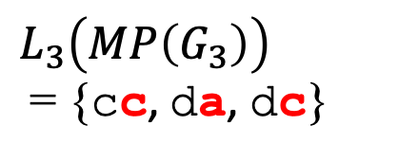
Main Idea of the Algorithm for SEQ-IC-LCS of Acyclic Labeled Graph
1. Sort vertices of${ G}_{1},G_{2}$ and $G_{3}$in topological order.
Let 𝐶 denote the three-dimensional table which stored the length of the SEQ-IC-LCS of $L_{1}\left(P\left(v_{1,i}\right)\right),L_{2}\left(P\left(v_{2,j}\right)\right)$ and $L_{3}\left(P\left(v_{3,k}\right)\right)$ in 𝐶(𝑖,𝑗,𝑘) for any $1≤i≤\left|V_{1}\right|, 1≤j≤\left|V_{2}\right|, 0≤k≤\left|V_{3}\right|$ .
$$\left(v_{1,i}∈V_{1}, v_{2,j}∈V_{2},v_{3,k}∈V_{3}\right)$$
G3
2. Calculate $C\left(i,j,k\right)$ using the recurrence.
d
a
1
2
$\max_{1≤i≤\left|V_{1}\right|, 1≤j≤\left|V_{2}\right|, v_{3,k}}C\left(i,j,k\right)$
is the solution.
($v_{3,k}$has no out-going edges in $V_{3}$.)
c
c
3
4
$L_{3}\left(MP\left(G_{3}\right)\right)$
= {cc, da, dc}
Notes:
we fill the table using the recurrence in the previous slide.,
and find the maximum value in the tables whose $V_{3}$ vertex has no out-going edges
because such a vertex is the end point of some maximal path in G3.
漸化式を用いて表を埋め、 ǔ_3 の頂点が出辺を持たない表の最大値を求める。
なぜなら、その頂点はG3の最大パスの終点だからである。

Slide 27
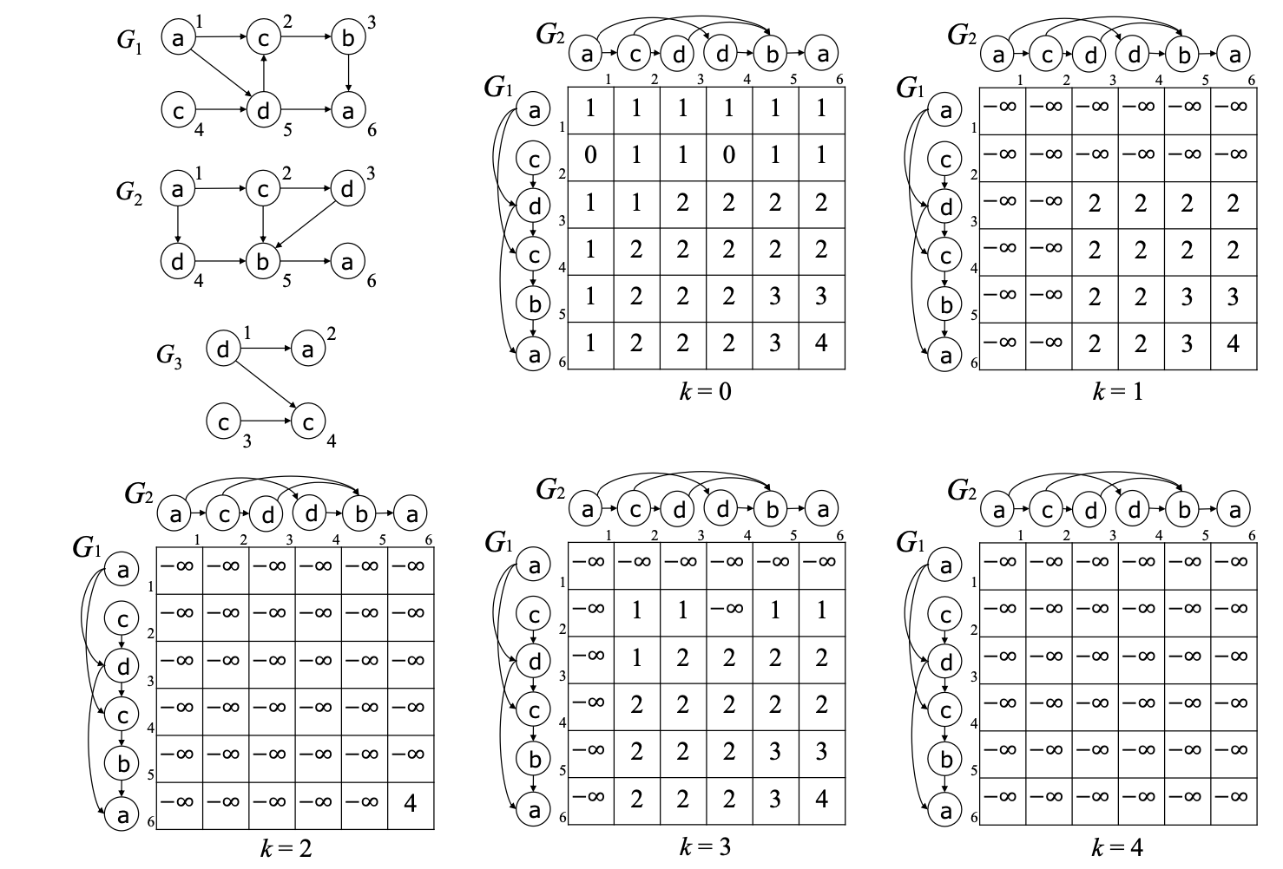
Tables computed by using the recurrence
G3
d
a
1
2
c
c
3
4
Notes:
Here is an example of our dynamic programming tables.
These tables are computed by using the recurrence.
これらの表は漸化式を使って計算される。

Slide 28
Tables computed by using the recurrence
G3
d
a
1
2
c
c
3
4
Notes:
v3,2, and v3,4 has no out-going edges.
And the solution is the maximum value 4.
v3,2、v3,4には出辺がない。
そして、解は最大値4となる。

Slide 29


Time Complexity
1. Sort vertices of${ G}_{1},G_{2}$ and $G_{3}$in topological order.
Let 𝐶 denote the three-dimensional table which stored the length of the SEQ-IC-LCS of $L_{1}\left(P\left(v_{1,i}\right)\right),L_{2}\left(P\left(v_{2,j}\right)\right)$ and $L_{3}\left(P\left(v_{3,k}\right)\right)$ in 𝐶(𝑖,𝑗,𝑘) for any $1≤i≤\left|V_{1}\right|, 1≤j≤\left|V_{2}\right|, 0≤k≤\left|V_{3}\right|$ .
linear time
$$\left(v_{1,i}∈V_{1}, v_{2,j}∈V_{2},v_{3,k}∈V_{3}\right)$$
$O\left(\left|E_{1}\right|\left|E_{2}\right|\left|E_{3}\right|\right)$time
$$C$$
$$C$$
2. Calculate $C\left(i,j,k\right)$ using the recurrence.
$\max_{1≤i≤\left|V_{1}\right|, 1≤j≤\left|V_{2}\right|, v_{3,k}}C\left(i,j,k\right)$
is the solution.
($v_{3,k}$has no out-going edges in $V_{3}$.)
×$\left(\left|V_{3}\right|+1\right)$
tables
Notes:
Now, let me talk about the time complexity.
It is well known that the time complexity of topological sort is linear in the input acyclic graph size.
And the time complexity for computing the tables is order E1 times E2 times E3 time.
Therefore, the total time complexity is $O\left(\left|E_{1}\right|\left|E_{2}\right|\left|E_{3}\right|\right)$time.
さて、時間計算量について話す。
トポロジカル・ソートの時間計算量が線形時間であることはよく知られている。
また、テーブル値の計算の時間計算量はE1×E2×E3のオーダーである。
したがって、全体の時間計算量は O(|𝐸_1 ||𝐸_2 ||𝐸_3 |)時間となる。

Slide 30
Outline
Labeled Graph
SEQ-IC-LCS (Constrained LCS)
Computing SEQ-IC-LCS of Acyclic Labeled Graphs
Computing SEQ-IC-LCS of Cyclic Labeled Graphs
Conclusions and Future works
Notes:
Until now I talked about the case where the labeled graphs are all acyclic.
Next, I’d like to talk about the case where two of the labeled graphs can be cyclic.
これまでは、ラベル付きグラフが非巡回である場合について説明した。
次に、ラベル付きグラフの2つが巡回である場合について話す。

Slide 31
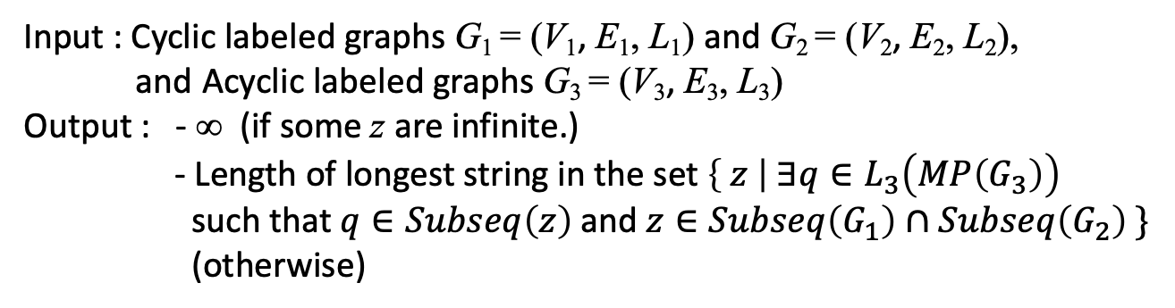
SEQ-IC-LCS Problem for Cyclic Labeled Graphs
Problem 2
Input : Cyclic labeled graphs G₁ = (V₁, E₁, L₁) and G₂ = (V₂, E₂, L₂),
and Acyclic labeled graphs G₃ = (V₃, E₃, L₃)
Output : - ∞ (if some z are infinite.)
- Length of longest string in the set $\left\{ z \right| ∃q∈L_{3}\left(MP\left(G_{3}\right)\right)$
such that $q∈Subseq\left(z\right) \text{and} z∈Subseq\left(G_{1}\right)∩Subseq\left(G_{2}\right) \}$
(otherwise)
e.g. 1
G1
G2
G3
a
b
a
a
c
d
a
b
b
d
a
a
a
b
c
c
Notes:
I introduce the SEQ-IC-LCS problem for cyclic labeled graphs.
The problem 2 is the same as Problem 1, except that the output length can be infinity.
Since the input graphs can be cyclic, the strings produced from them can be infinitely long.
So, the length of the SEQ-IC-LCS of G1, G2 and G3 can be also infinite.
In such a case, we output infinity, and otherwise we output the finite length of the SEQ-IC-LCS of G1 and G2 with respect to G3.
In this example, G1 and G2 have cycles.
巡回ラベル付きグラフのSEQ-IC-LCS問題を紹介する。
問題2は，出力が無限大になることを除けば問題1と同じである．
入力グラフは巡回になりうるので、そこから生成される文字列は無限長になりうる。
そのため、G1, G2, G3のSEQ-IC-LCSの長さも無限大になりうる。
この場合は無限大を出力し、そうでない場合はG1G2,G3のSEQ-IC-LCSの長さを出力する。
この例では、G1とG2はサイクルを持つ。

Slide 32
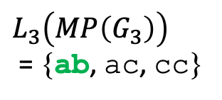

SEQ-IC-LCS Problem for Cyclic Labeled Graphs
Problem 2
Input : Cyclic labeled graphs G₁ = (V₁, E₁, L₁) and G₂ = (V₂, E₂, L₂),
and Acyclic labeled graphs G₃ = (V₃, E₃, L₃)
Output : - ∞ (if some z are infinite.)
- Length of longest string in the set $\left\{ z \right| ∃q∈L_{3}\left(MP\left(G_{3}\right)\right)$
such that $q∈Subseq\left(z\right) \text{and} z∈Subseq\left(G_{1}\right)∩Subseq\left(G_{2}\right) \}$
(otherwise)
e.g. 1
G1
G2
G3
a
b
a
a
c
d
a
b
b
d
a
a
a
b
c
c
$L_{3}\left(MP\left(G_{3}\right)\right)$
= {ab, ac, cc}
$Subseq\left(G_{1}\right)∩Subseq\left(G_{2}\right)$ = {a, b, d, … , aba∞, …}
The solution is $∞$. (aba∞)
Notes:
Character “a” is in a cycle in both G1 and G2.
And common subsequence ‘ab a^∞’ include maximal string ‘a b’ of G3 as subsequence.
Therefore, the output is infinity.
この例では、G1とG2はサイクルを持っている。
文字 "a "はG1とG2の両方でサイクル内にある。
そして、共通部分列‘ab a^∞’は部分列としてG3の極大文字列'a b'を含む。
したがって、出力は無限大となる。

Slide 33
SEQ-IC-LCS Problem for Cyclic Labeled Graphs
Problem 2
Input : Cyclic labeled graphs G₁ = (V₁, E₁, L₁) and G₂ = (V₂, E₂, L₂),
and Acyclic labeled graphs G₃ = (V₃, E₃, L₃)
Output : - ∞ (if some z are infinite.)
- Length of longest string in the set $\left\{ z \right| ∃q∈L_{3}\left(MP\left(G_{3}\right)\right)$
such that $q∈Subseq\left(z\right) \text{and} z∈Subseq\left(G_{1}\right)∩Subseq\left(G_{2}\right) \}$
(otherwise)
e.g. 2
G1
G2
G3
a
a
a
a
c
d
a
b
b
d
a
a
a
b
c
c
$L_{3}\left(MP\left(G_{3}\right)\right)$
= {ab, ac, cc}
$Subseq\left(G_{1}\right)∩Subseq\left(G_{2}\right)$ = {a, b, d, … , aab, …}
The solution is 3. (aab)
Notes:
Here is another example.
Note that character labels are different from the previous slides.
For these graphs, any paths including a cycle don’t include a maximal string of G3.
Common subsequence ‘a a b’ of G1 and G2 includes a maximal string ‘a b’ of G3 as its subsequence, and ’a a b’ is the longest such string. Therefore, the output is 3 for these input graphs.
次に、サイクルを含むパスはG3の最大文字列を含まない。
共通部分列‘a a b’は部分列として極大文字列'a b'を含み、'a a b'はその中で最も長い文字列である。
したがって、出力は3である。

Slide 34
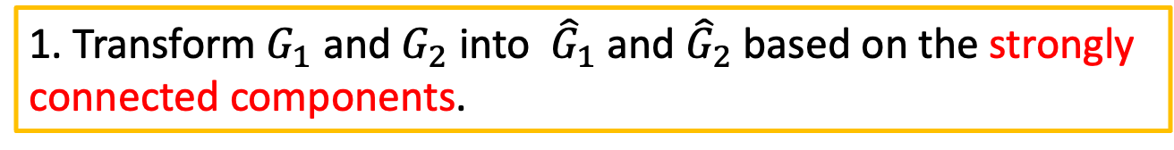
Main Idea of the Algorithm for SEQ-IC-LCS of Cyclic Labeled Graphs
1. Transform $G_{1}$ and $G_{2}$ into ${ \hat{G}}_{1}$ and ${\hat{G}}_{2}$ based on the strongly
connected components.
Notes:
Next, I present the idea of our algorithm to solve Problem 2.
First we transform G1 and G2, based on the strongly connected components.
次に
問題2を解くアルゴリズムのアイデアを紹介する。
まず、強連結成分分解に基づいてG1とG2を変換する。

Slide 35
Strongly Connected Components
1. Transform $G_{1}$ and $G_{2}$ into ${ \hat{G}}_{1}$ and ${\hat{G}}_{2}$ based on the strongly
connected components.
G1
a
a
＾
a
a
a
G₁
b
d
a
transform
b
{a, d}
G2
＾
{a}
c
d
a
c
d
G₂
a
a
b
{a, b}
Cyclic Labeled Graphs
Acyclic Labeled Graphs
Notes:
In this step, first, we group together the vertices which are strongly connected,
so that each strongly connected component is contracted to a single vertex.
Then the resulting graph is acyclic.
For technical reasons, we put self-loops on vertices that consist of more than one original vertex.
このステップにおいて，まず、強連結頂点をグルーピングする。
そうすれば、強連結要素は1つの頂点に収縮する。
そうすると、できあがったグラフは非巡回である。
複数の頂点からなる頂点には自己ループを置く．

Slide 36
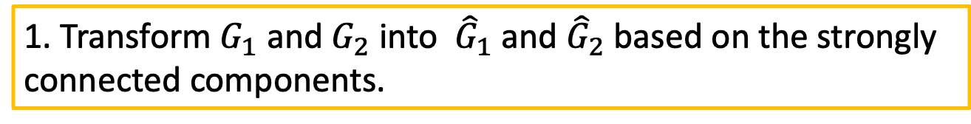
Main Idea of the Algorithm for SEQ-IC-LCS of Cyclic Labeled Graphs
1. Transform $G_{1}$ and $G_{2}$ into ${ \hat{G}}_{1}$ and ${\hat{G}}_{2}$ based on the strongly
connected components.
2. Sort vertices of${ \hat{G}}_{1},{\hat{G}}_{2}$ and $G_{3}$in topological order.
Notes:
Next, we sort vertices of G^1 , G^2 and G3 in topological order,
and number the vertices from 1 to the sizes of V^1, V^2 and V3, respectively.
次に、G^1, G^2, G3の頂点をトポロジカルソートする．
そして頂点に1からV^1, V^2, V3の大きさまでの番号をつける。

Slide 37
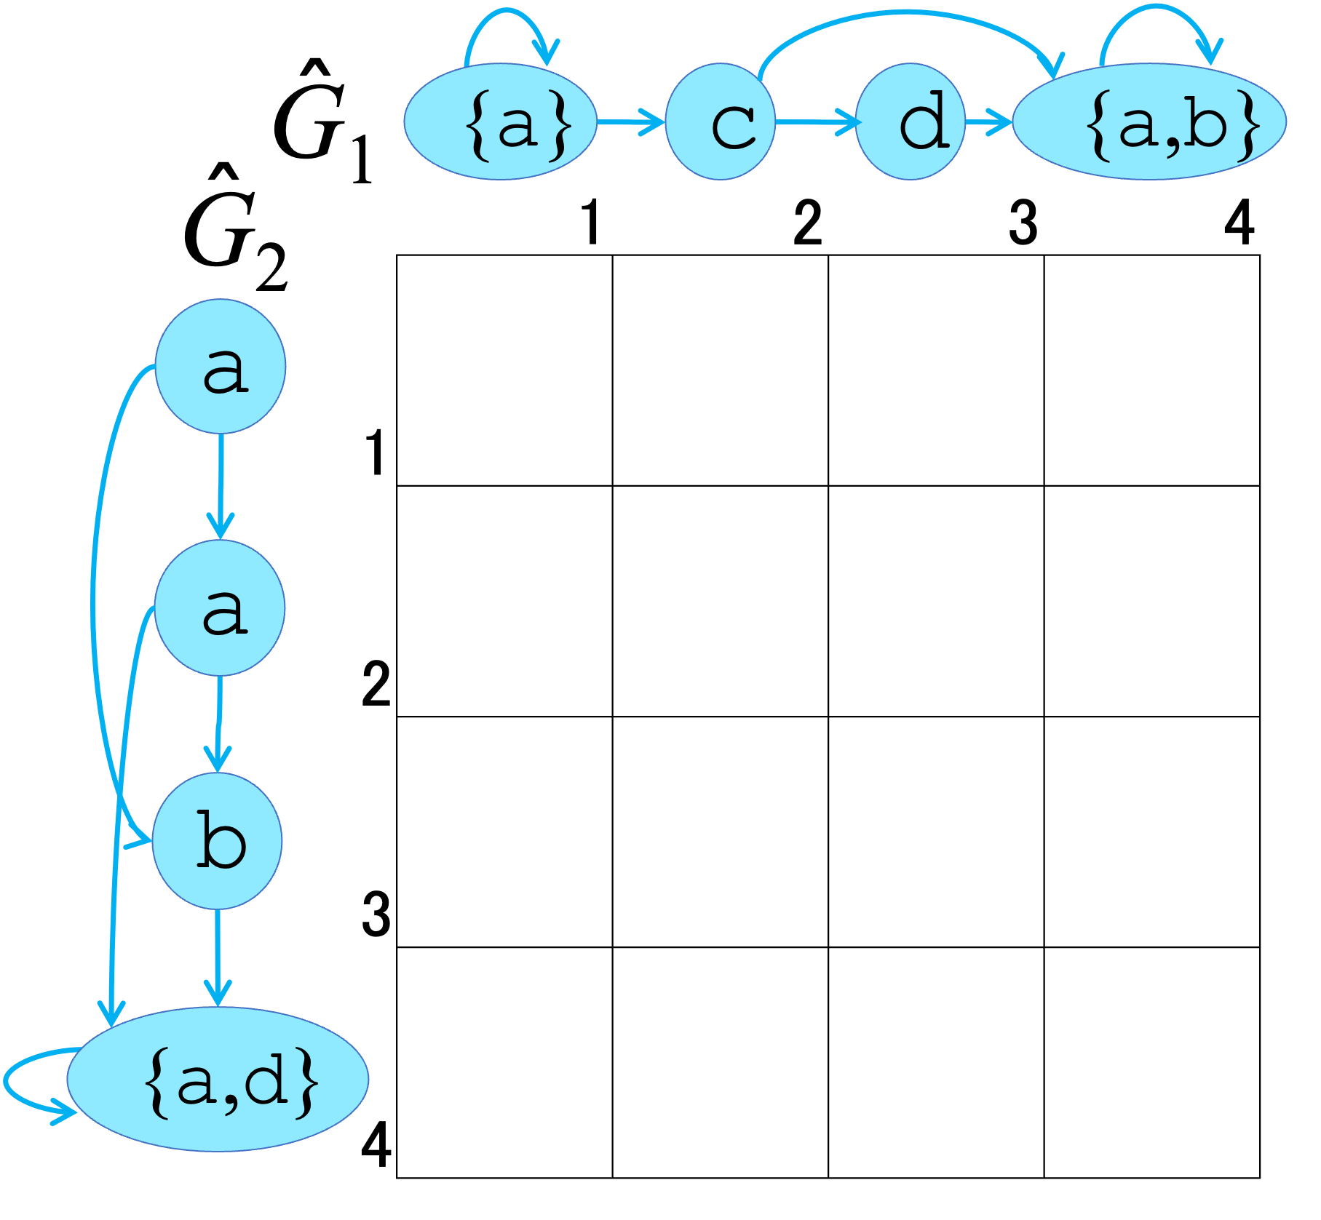
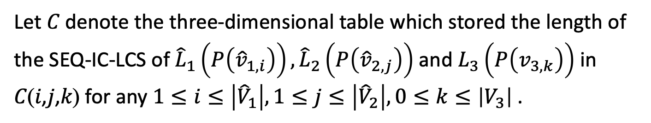
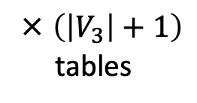

Main Idea of the Algorithm for SEQ-IC-LCS of Cyclic Labeled Graphs
1. Transform $G_{1}$ and $G_{2}$ into ${ \hat{G}}_{1}$ and ${\hat{G}}_{2}$ based on the strongly
connected components.
2. Sort vertices of${ \hat{G}}_{1},{\hat{G}}_{2}$ and $G_{3}$in topological order.
Let 𝐶 denote the three-dimensional table which stored the length of the SEQ-IC-LCS of ${\hat{L}}_{1}\left(P\left({\hat{v}}_{1,i}\right)\right),{\hat{L}}_{2}\left(P\left({\hat{v}}_{2,j}\right)\right)$ and $L_{3}\left(P\left(v_{3,k}\right)\right)$ in 𝐶(𝑖,𝑗,𝑘) for any $1≤i≤\left|{\hat{V}}_{1}\right|, 1≤j≤\left|{\hat{V}}_{2}\right|, 0≤k≤\left|V_{3}\right|$ .
$$\left({\hat{v}}_{1,i} ∈{\hat{V}}_{1},{\hat{v}}_{2,j} ∈{\hat{V}}_{2},v_{3,k} ∈V_{3}\right)$$
× $\left(\left|V_{3}\right|+1\right)$
tables
Notes:
Next, let C be a V hat 1 times V hat 2 times V3+1 integer table.
And each row of table C corresponds to the vertex in G hat 1,
and each columns of table C corresponds to the vertex in G hat 2.
Here Cijk is the length of the SEQ-IC-LCS of v hat 1,i, v hat 2,j, and v^3,k.
次に、CをV^1×V^2×V3+1の整数表とする。
表Cの各行がG^1の頂点に対応し、表Cの各列がG^2の頂点に対応する、
また、表Cの各列はG^2の頂点に対応する。
ここでCijkはv^1,i v^2,j v^3,kのSEQ-IC-LCSの長さである。

Slide 38
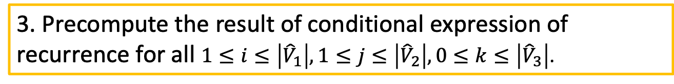
Main Idea of the Algorithm for SEQ-IC-LCS of Cyclic Labeled Graphs
1. Transform $G_{1}$ and $G_{2}$ into ${ \hat{G}}_{1}$ and ${\hat{G}}_{2}$ based on the strongly
connected components.
2. Sort vertices of${ \hat{G}}_{1},{\hat{G}}_{2}$ and $G_{3}$in topological order.
Let 𝐶 denote the three-dimensional table which stored the length of the SEQ-IC-LCS of ${\hat{L}}_{1}\left(P\left({\hat{v}}_{1,i}\right)\right),{\hat{L}}_{2}\left(P\left({\hat{v}}_{2,j}\right)\right)$ and $L_{3}\left(P\left(v_{3,k}\right)\right)$ in 𝐶(𝑖,𝑗,𝑘) for any $1≤i≤\left|{\hat{V}}_{1}\right|, 1≤j≤\left|{\hat{V}}_{2}\right|, 0≤k≤\left|V_{3}\right|$ .
$$\left({\hat{v}}_{1,i} ∈{\hat{V}}_{1},{\hat{v}}_{2,j} ∈{\hat{V}}_{2},v_{3,k} ∈V_{3}\right)$$
3. Precompute the result of conditional expression of recurrence for all $1≤i≤\left|{\hat{V}}_{1}\right|, 1≤j≤\left|{\hat{V}}_{2}\right|, 0≤k≤\left|{\hat{V}}_{3}\right|$.
Notes:
Next, before computing Cijk for all i, j and k using dynamic programing,
we precomputing the result of conditional expression of the recurrence for all i, j and k
次に，動的計画法を用いてすべてのiとjについてCijkを計算する前に、
すべての i,j,k に対する漸化式の条件式の結果を事前に計算する。

Slide 39

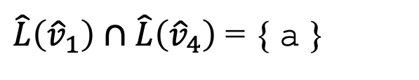
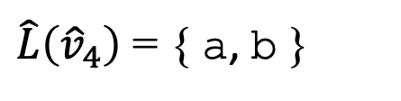
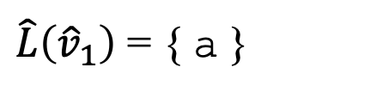
Precompute the Result of Conditional Expressions of Recurrence
$${\hat{L}}_{1}\left({\hat{v}}_{1,i}\right)∩{\hat{L}}_{2}\left({\hat{v}}_{2,j}\right)∩\left\{L_{3}\left(v_{3,k}\right)\right\}≠∅$$
${\hat{L}}_{1}\left({\hat{v}}_{1,i}\right)∩{\hat{L}}_{2}\left({\hat{v}}_{2,j}\right)∩\left\{L_{3}\left(v_{3,k}\right)\right\}=∅$ and ${\hat{L}}_{1}\left({\hat{v}}_{1,i}\right)∩{\hat{L}}_{2}\left({\hat{v}}_{2,j}\right)≠∅$
${\hat{L}}_{1}\left({\hat{v}}_{1,i}\right)∩{\hat{L}}_{2}\left({\hat{v}}_{2,j}\right)∩\left\{L_{3}\left(v_{3,k}\right)\right\}=∅$ and ${\hat{L}}_{1}\left({\hat{v}}_{1,i}\right)∩{\hat{L}}_{2}\left({\hat{v}}_{2,j}\right)=∅$
$L\left(v\right)$ : the character label of vertex $v$ .
$\hat{v}$ : the vertex transformed $G_{1}$ based on the strongly connected components.
$\hat{L}\left(\hat{v}\right)$ : the set of characters labeled to vertex $\hat{v}$ .
＾
G
{a}
c
d
$\hat{L}\left({\hat{v}}_{1}\right)$ = { a }
1
2
3
$\hat{L}\left({\hat{v}}_{4}\right)$ = { a, b }
{a, b}
$\hat{L}\left({\hat{v}}_{1}\right)∩\hat{L}\left({\hat{v}}_{4}\right)$ = { a }
4
Notes:
These are the conditional expressions of the recurrences.
These expressions are the same as our algorithm for Problem 1, except that some vertices can have two or more characters.
Here, v hat is the vertex transformed $G_{1}$ based on the strongly connected components.
L hat v hat is the set of characters labeled to vertex $\hat{v}$ .
In this example,
L hat v hat 1 equals the set of a.
L hat v hat 4 equals the set of a and b.
L hat v hat equals the set of characters labeled to vertex $\hat{v}$ .
the intersection of L hat v hat 1 and L hat v hat 4 is the set of a.
これらは漸化式の条件式である。
これらの式は，いくつかの頂点が2つ以上の文字を持つことができることを除けば，問題1のアルゴリズムと同じである．

Slide 40
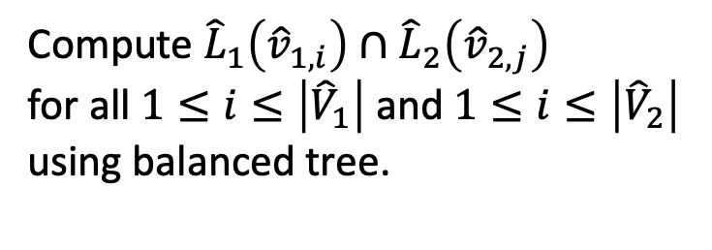
Precompute the Result of Conditional Expressions of Recurrence
$${\hat{L}}_{1}\left({\hat{v}}_{1,i}\right)∩{\hat{L}}_{2}\left({\hat{v}}_{2,j}\right)∩\left\{L_{3}\left(v_{3,k}\right)\right\}≠∅$$
${\hat{L}}_{1}\left({\hat{v}}_{1,i}\right)∩{\hat{L}}_{2}\left({\hat{v}}_{2,j}\right)∩\left\{L_{3}\left(v_{3,k}\right)\right\}=∅$ and ${\hat{L}}_{1}\left({\hat{v}}_{1,i}\right)∩{\hat{L}}_{2}\left({\hat{v}}_{2,j}\right)≠∅$
${\hat{L}}_{1}\left({\hat{v}}_{1,i}\right)∩{\hat{L}}_{2}\left({\hat{v}}_{2,j}\right)∩\left\{L_{3}\left(v_{3,k}\right)\right\}=∅$ and ${\hat{L}}_{1}\left({\hat{v}}_{1,i}\right)∩{\hat{L}}_{2}\left({\hat{v}}_{2,j}\right)=∅$
G₁
＾
{a}
c
d
{a,b}
Compute ${\hat{L}}_{1}\left({\hat{v}}_{1,i}\right)∩{\hat{L}}_{2}\left({\hat{v}}_{2,j}\right)$
for all $1≤i≤\left|{\hat{V}}_{1}\right|$ and $1≤i≤\left|{\hat{V}}_{2}\right|$
using balanced tree.
＾
 |  | 1 |  | 2 |  | 3 |  | 4
 |  | ○ |  | × |  | × |  | ○
1
 |  | ○ |  | × |  | × |  | ○
2
 |  | × |  | × |  | × |  | ○
3
 |  | ○ |  | × |  | ○ |  | ○
4
G₂
a
a
b
{a,d}
Notes:
First, we check common characters in vertices between G hat 1 and G hat 2 by using balanced trees.
まず、平衡木を用いて、G1とG2間のすべての頂点のペアに共通する文字をチェックする。

Slide 41

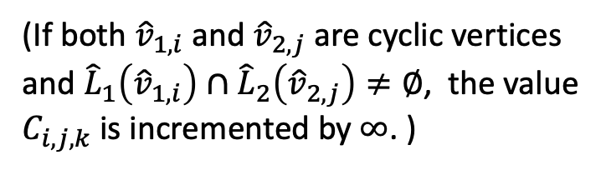
Precompute the Result of Conditional Expressions of Recurrence
$${\hat{L}}_{1}\left({\hat{v}}_{1,i}\right)∩{\hat{L}}_{2}\left({\hat{v}}_{2,j}\right)∩\left\{L_{3}\left(v_{3,k}\right)\right\}≠∅$$
${\hat{L}}_{1}\left({\hat{v}}_{1,i}\right)∩{\hat{L}}_{2}\left({\hat{v}}_{2,j}\right)∩\left\{L_{3}\left(v_{3,k}\right)\right\}=∅$ and ${\hat{L}}_{1}\left({\hat{v}}_{1,i}\right)∩{\hat{L}}_{2}\left({\hat{v}}_{2,j}\right)≠∅$
${\hat{L}}_{1}\left({\hat{v}}_{1,i}\right)∩{\hat{L}}_{2}\left({\hat{v}}_{2,j}\right)∩\left\{L_{3}\left(v_{3,k}\right)\right\}=∅$ and ${\hat{L}}_{1}\left({\hat{v}}_{1,i}\right)∩{\hat{L}}_{2}\left({\hat{v}}_{2,j}\right)=∅$
G₁
＾
{a}
c
d
{a,b}
Compute ${\hat{L}}_{1}\left({\hat{v}}_{1,i}\right)∩{\hat{L}}_{2}\left({\hat{v}}_{2,j}\right)$
for all $1≤i≤\left|{\hat{V}}_{1}\right|$ and $1≤i≤\left|{\hat{V}}_{2}\right|$
using balanced tree.
＾
 |  | 1 |  | 2 |  | 3 |  | 4
 |  | ○ |  | × |  | × |  | ○
1
 |  | ○ |  | × |  | × |  | ○
2
 |  | × |  | × |  | × |  | ○
3
 |  | ○ |  | × |  | ○ |  | ○
4
G₂
a
(If both ${\hat{v}}_{1,i}$ and ${\hat{v}}_{2,j}$ are cyclic vertices
and ${\hat{L}}_{1}\left({\hat{v}}_{1,i}\right)∩{\hat{L}}_{2}\left({\hat{v}}_{2,j}\right)≠∅$, the value
$C_{i,j,k}$ is incremented by $∞$. )
a
b
{a,d}
$$+∞$$
$$+∞$$
Notes:
If both ${\hat{v}}_{1,i}$ and ${\hat{v}}_{2,j}$ are cyclic vertices and the intersection of these string sets is not empty,
the value.$C_{i,j,k}$ is incremented by $∞$.
This is because we can add the common characters to a common subsequence infinitely many times.
v̂(1,𝑖)とv̂_(2,𝑗)の両方がサイクル頂点であり、である場合、値
Cijkに ∞ が追加される。
なぜなら、共通部分列に共通文字を無限に加えることができるからである。

Slide 42

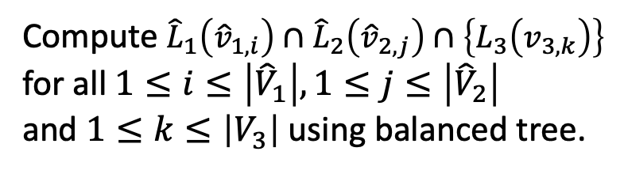
Precompute the Result of Conditional Expressions of Recurrence
$${\hat{L}}_{1}\left({\hat{v}}_{1,i}\right)∩{\hat{L}}_{2}\left({\hat{v}}_{2,j}\right)∩\left\{L_{3}\left(v_{3,k}\right)\right\}≠∅$$
${\hat{L}}_{1}\left({\hat{v}}_{1,i}\right)∩{\hat{L}}_{2}\left({\hat{v}}_{2,j}\right)∩\left\{L_{3}\left(v_{3,k}\right)\right\}=∅$ and ${\hat{L}}_{1}\left({\hat{v}}_{1,i}\right)∩{\hat{L}}_{2}\left({\hat{v}}_{2,j}\right)≠∅$
${\hat{L}}_{1}\left({\hat{v}}_{1,i}\right)∩{\hat{L}}_{2}\left({\hat{v}}_{2,j}\right)∩\left\{L_{3}\left(v_{3,k}\right)\right\}=∅$ and ${\hat{L}}_{1}\left({\hat{v}}_{1,i}\right)∩{\hat{L}}_{2}\left({\hat{v}}_{2,j}\right)=∅$
G₁
＾
{a}
c
d
{a,b}
＾
 |  | 1 |  | 2 |  | 3 |  | 4
 | ○ |  | × |  | × |  | ○
1
 | ○ |  | × |  | × |  | ○
2
 | × |  | × |  | × |  | ×
3
 | ○ |  | × |  | × |  | ○
4
Compute ${\hat{L}}_{1}\left({\hat{v}}_{1,i}\right)∩{\hat{L}}_{2}\left({\hat{v}}_{2,j}\right)∩\left\{L_{3}\left(v_{3,k}\right)\right\}$
for all $1≤i≤\left|{\hat{V}}_{1}\right|,1≤j≤\left|{\hat{V}}_{2}\right|$
and $1≤k≤\left|V_{3}\right|$using balanced tree.
G₂
a
G3
a
a
b
1
2
b
c
c
3
4
$$k=1$$
{a,d}
Notes:
Next, we check common characters in vertices between G hat 1, G hat 2 and G3 by using balanced trees. This is an example of v_3,1 table.
次に、G1,G2,G3間のすべての頂点の組に共通する文字を、バランス木を用いてチェックする。これはv_3,1テーブルの例である。

Slide 43




Main Idea of the Algorithm for SEQ-IC-LCS of Cyclic Labeled Graphs
1. Transform $G_{1}$ and $G_{2}$ into ${ \hat{G}}_{1}$ and ${\hat{G}}_{2}$ based on the strongly
connected components.
2. Sort vertices of${ \hat{G}}_{1},{\hat{G}}_{2}$ and $G_{3}$in topological order.
Let 𝐶 denote the three-dimensional table which stored the length of the SEQ-IC-LCS of ${\hat{L}}_{1}\left(P\left({\hat{v}}_{1,i}\right)\right),{\hat{L}}_{2}\left(P\left({\hat{v}}_{2,j}\right)\right)$ and $L_{3}\left(P\left(v_{3,k}\right)\right)$ in 𝐶(𝑖,𝑗,𝑘) for any $1≤i≤\left|{\hat{V}}_{1}\right|, 1≤j≤\left|{\hat{V}}_{2}\right|, 0≤k≤\left|V_{3}\right|$ .
$$\left({\hat{v}}_{1,i} ∈{\hat{V}}_{1},{\hat{v}}_{2,j} ∈{\hat{V}}_{2},v_{3,k} ∈V_{3}\right)$$
3. Precompute the result of conditional expression of recurrence for all $1≤i≤\left|{\hat{V}}_{1}\right|, 1≤j≤\left|{\hat{V}}_{2}\right|, 0≤k≤\left|{\hat{V}}_{3}\right|$.
4. Calculate $C\left(i,j,k\right)$ using the recurrence.
$\max_{1≤i≤\left|V_{1}\right|, 1≤j≤\left|V_{2}\right|, v_{3,k}}C\left(i,j,k\right)$ is the solution.
($v_{3,k}$has no out-going edges in $V_{3}$.)
Notes:
Finally, compute Cijk for all i and j using the precomputed result,
and find the maximum value in the tables whose $V_{3}$ vertex has no out-going edges.
最後に、事前計算の結果を用いて、すべてのiとjについてCijkを計算する。
そして，V3 の頂点が外向きの辺を持たない表の最大値を求める。

Slide 44
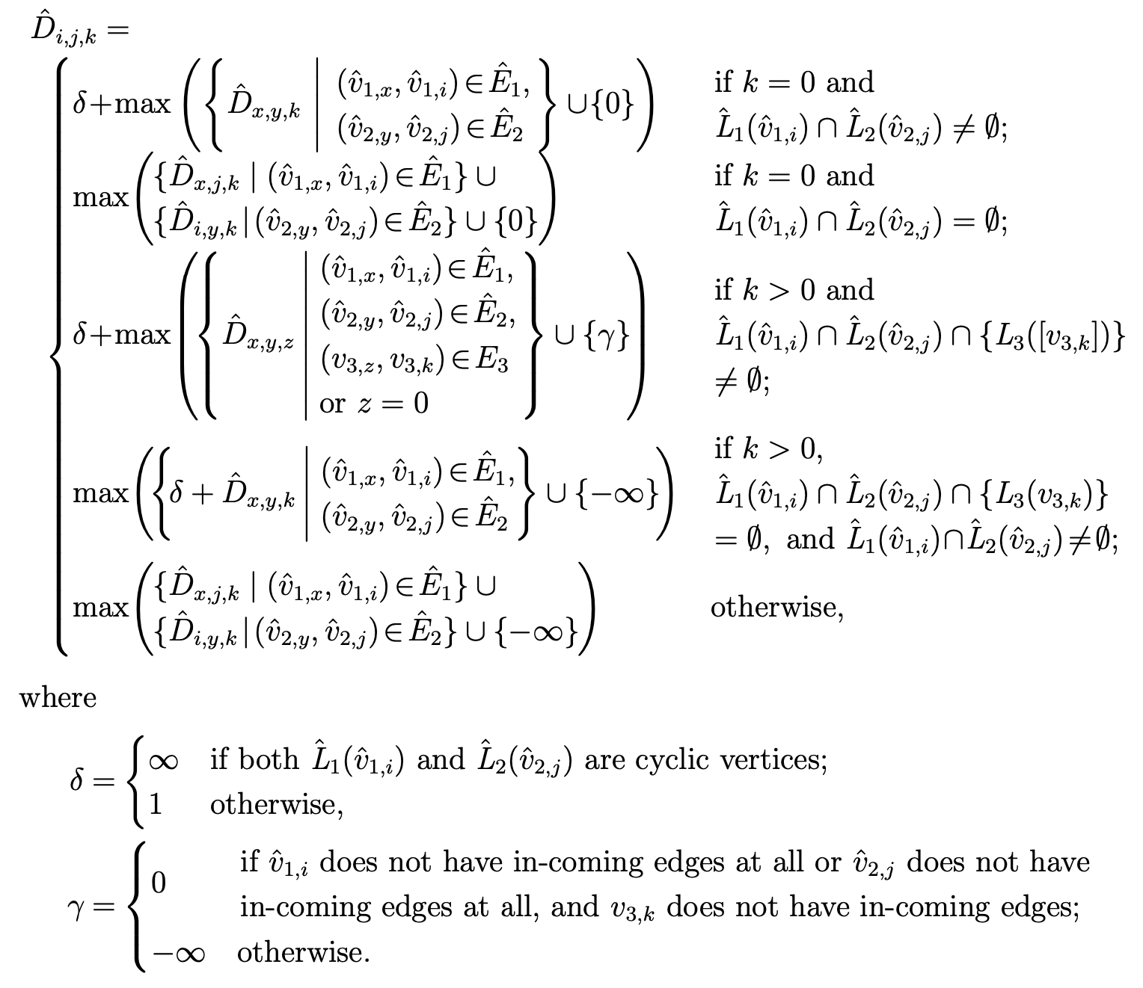








Recurrence of SEQ-IC-LCS of Cyclic Labeled Graphs
$$C_{i,j,k}$$
$$C_{i,j,k}$$
$$C_{x,j,k}$$
$$C_{i,y,k}$$
$$C_{x,y,z}$$
$$C_{x,y,k}$$
$$C_{x,j,k}$$
$$C_{i,y,k}$$
Notes:
This is the recurrence of SEQ-IC-LCS of Cyclic Labeled Graph.
The main difference from the previous problem is that here the solution can be infinite length.
I want to talk about this recurrence, but we will have to skip the dinner if I talk.
I skip the details.
これは巡回ラベル付きグラフのSEQ-IC-LCSの漸化式である。
詳細は省略する。
前の問題との違いは，解が無限長になることを考慮していることである．

Slide 45
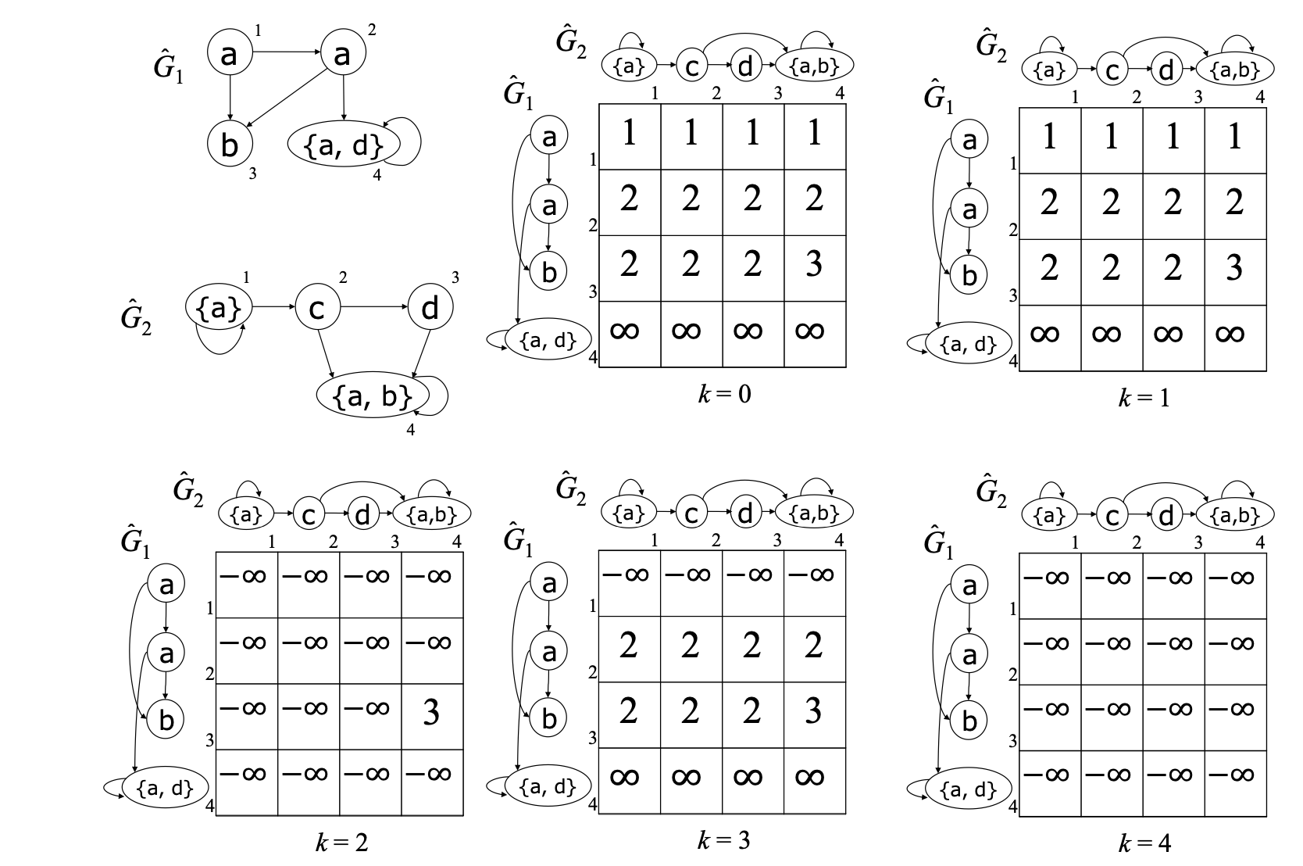
Tables computed by using the recurrence
G3
a
b
1
2
c
c
3
4
Notes:
Here is the example.
These tables are computed by using the recurrence.
これらの表は、漸化式を使用して計算される。

Slide 46
Tables computed by using the recurrence
G3
a
b
1
2
c
c
3
4
Notes:
v3,2, and v3,4 has no out-going edges.
Therefore, the solution is the maximum value 3.
v3,2、v3,4には出辺がない。
よって、解は最大値3となる。

Slide 47
Time Complexity
1. Transform $G_{1}$ and $G_{2}$ into ${ \hat{G}}_{1}$ and ${\hat{G}}_{2}$ based on the strongly
connected components.
2. Sort vertices of${ \hat{G}}_{1},{\hat{G}}_{2}$ and $G_{3}$in topological order.
Let 𝐶 denote the three-dimensional table which stored the length of the SEQ-IC-LCS of ${\hat{L}}_{1}\left(P\left({\hat{v}}_{1,i}\right)\right),{\hat{L}}_{2}\left(P\left({\hat{v}}_{2,j}\right)\right)$ and $L_{3}\left(P\left(v_{3,k}\right)\right)$ in 𝐶(𝑖,𝑗,𝑘) for any $1≤i≤\left|{\hat{V}}_{1}\right|, 1≤j≤\left|{\hat{V}}_{2}\right|, 0≤k≤\left|V_{3}\right|$ .
linear time
linear time
$$\left({\hat{v}}_{1,i} ∈{\hat{V}}_{1},{\hat{v}}_{2,j} ∈{\hat{V}}_{2},v_{3,k} ∈V_{3}\right)$$
3. Precompute the result of conditional expression of recurrence for all $1≤i≤\left|{\hat{V}}_{1}\right|, 1≤j≤\left|{\hat{V}}_{2}\right|, 0≤k≤\left|{\hat{V}}_{3}\right|$.
4. Calculate $C\left(i,j,k\right)$ using the recurrence.
$\max_{1≤i≤\left|V_{1}\right|, 1≤j≤\left|V_{2}\right|, v_{3,k}}C\left(i,j,k\right)$ is the solution.
($v_{3,k}$has no out-going edges in $V_{3}$.)
Notes:
Now, let me talk about the time complexity.
First, it is well-known that the strongly connected components can found in Linear time.
And topological sort can be done in Linear Time.
さて、次は時間計算量について説明する。
まず、強連結成分分解が線形時間で見つけられることはよく知られている。
また、トポロジカルソートも線形時間である。

Slide 48
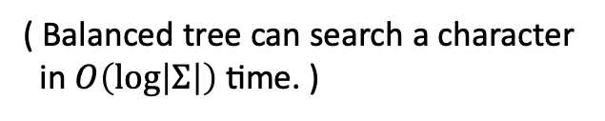
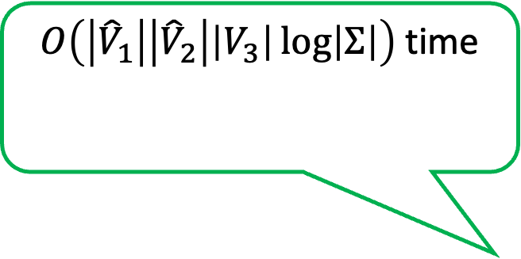
Time Complexity
1. Transform $G_{1}$ and $G_{2}$ into ${ \hat{G}}_{1}$ and ${\hat{G}}_{2}$ based on the strongly
connected components.
2. Sort vertices of${ \hat{G}}_{1},{\hat{G}}_{2}$ and $G_{3}$in topological order.
Let 𝐶 denote the three-dimensional table which stored the length of the SEQ-IC-LCS of ${\hat{L}}_{1}\left(P\left({\hat{v}}_{1,i}\right)\right),{\hat{L}}_{2}\left(P\left({\hat{v}}_{2,j}\right)\right)$ and $L_{3}\left(P\left(v_{3,k}\right)\right)$ in 𝐶(𝑖,𝑗,𝑘) for any $1≤i≤\left|{\hat{V}}_{1}\right|, 1≤j≤\left|{\hat{V}}_{2}\right|, 0≤k≤\left|V_{3}\right|$ .
linear time
linear time
$O\left(\left|{\hat{V}}_{1}\right|\left|{\hat{V}}_{2}\right|\left|V_{3}\right|\log\left|Σ\right|\right)$time
( Balanced tree can search a character
in $O\left(\log\left|Σ\right|\right)$ time. )
$$\left({\hat{v}}_{1,i} ∈{\hat{V}}_{1},{\hat{v}}_{2,j} ∈{\hat{V}}_{2},v_{3,k} ∈V_{3}\right)$$
3. Precompute the result of conditional expression of recurrence for all $1≤i≤\left|{\hat{V}}_{1}\right|, 1≤j≤\left|{\hat{V}}_{2}\right|, 0≤k≤\left|{\hat{V}}_{3}\right|$.
4. Calculate $C\left(i,j,k\right)$ using the recurrence.
$\max_{1≤i≤\left|V_{1}\right|, 1≤j≤\left|V_{2}\right|, v_{3,k}}C\left(i,j,k\right)$ is the solution.
($v_{3,k}$has no out-going edges in $V_{3}$.)
Notes:
Next, in this step, the precomputation for all i, j and k can be done in this time,
because this Balanced tree can search a character in $O\left(\log\left|Σ\right|\right)$ time ．
次に、このステップでは、すべてのi, j, kに対して事前計算をこの時間で計算できる。
なぜなら，バランス木は探索の操作を 𝑂(log|Σ| ) 時間で計算できるからである。

Slide 49
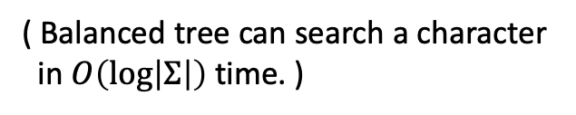
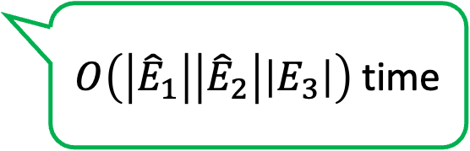
Time Complexity
1. Transform $G_{1}$ and $G_{2}$ into ${ \hat{G}}_{1}$ and ${\hat{G}}_{2}$ based on the strongly
connected components.
2. Sort vertices of${ \hat{G}}_{1},{\hat{G}}_{2}$ and $G_{3}$in topological order.
Let 𝐶 denote the three-dimensional table which stored the length of the SEQ-IC-LCS of ${\hat{L}}_{1}\left(P\left({\hat{v}}_{1,i}\right)\right),{\hat{L}}_{2}\left(P\left({\hat{v}}_{2,j}\right)\right)$ and $L_{3}\left(P\left(v_{3,k}\right)\right)$ in 𝐶(𝑖,𝑗,𝑘) for any $1≤i≤\left|{\hat{V}}_{1}\right|, 1≤j≤\left|{\hat{V}}_{2}\right|, 0≤k≤\left|V_{3}\right|$ .
linear time
linear time
$O\left(\left|{\hat{V}}_{1}\right|\left|{\hat{V}}_{2}\right|\left|V_{3}\right|\log\left|Σ\right|\right)$time
( Balanced tree can search a character
in $O\left(\log\left|Σ\right|\right)$ time. )
$$\left({\hat{v}}_{1,i} ∈{\hat{V}}_{1},{\hat{v}}_{2,j} ∈{\hat{V}}_{2},v_{3,k} ∈V_{3}\right)$$
3. Precompute the result of conditional expression of recurrence for all $1≤i≤\left|{\hat{V}}_{1}\right|, 1≤j≤\left|{\hat{V}}_{2}\right|, 0≤k≤\left|{\hat{V}}_{3}\right|$.
4. Calculate $C\left(i,j,k\right)$ using the recurrence.
$O\left(\left|{\hat{E}}_{1}\right|\left|{\hat{E}}_{2}\right|\left|E_{3}\right|\right)$time
$\max_{1≤i≤\left|V_{1}\right|, 1≤j≤\left|V_{2}\right|, v_{3,k}}C\left(i,j,k\right)$ is the solution.
($v_{3,k}$has no out-going edges in $V_{3}$.)
Notes:
The final step of computing Ci,j,k for all i, j and k takes this time.
次に、このステップでは、この時間で計算できる。
この部分は、すべてのi、j、kについてCikを計算する時間である。

Slide 50
Time Complexity
1. Transform $G_{1}$ and $G_{2}$ into ${ \hat{G}}_{1}$ and ${\hat{G}}_{2}$ based on the strongly
connected components.
2. Sort vertices of${ \hat{G}}_{1},{\hat{G}}_{2}$ and $G_{3}$in topological order.
Let 𝐶 denote the three-dimensional table which stored the length of the SEQ-IC-LCS of ${\hat{L}}_{1}\left(P\left({\hat{v}}_{1,i}\right)\right),{\hat{L}}_{2}\left(P\left({\hat{v}}_{2,j}\right)\right)$ and $L_{3}\left(P\left(v_{3,k}\right)\right)$ in 𝐶(𝑖,𝑗,𝑘) for any $1≤i≤\left|{\hat{V}}_{1}\right|, 1≤j≤\left|{\hat{V}}_{2}\right|, 0≤k≤\left|V_{3}\right|$ .
linear time
linear time
$O\left(\left|{\hat{V}}_{1}\right|\left|{\hat{V}}_{2}\right|\left|V_{3}\right|\log\left|Σ\right|\right)$time
( Balanced tree can search a character
in $O\left(\log\left|Σ\right|\right)$ time. )
$$\left({\hat{v}}_{1,i} ∈{\hat{V}}_{1},{\hat{v}}_{2,j} ∈{\hat{V}}_{2},v_{3,k} ∈V_{3}\right)$$
The total time complexity is
O(|E₁||E₂||E₃|+|V₁||V₂||V₃|log|Σ|) time.
3. Precompute the result of conditional expression of recurrence for all $1≤i≤\left|{\hat{V}}_{1}\right|, 1≤j≤\left|{\hat{V}}_{2}\right|, 0≤k≤\left|{\hat{V}}_{3}\right|$.
4. Calculate $C\left(i,j,k\right)$ using the recurrence.
$O\left(\left|{\hat{E}}_{1}\right|\left|{\hat{E}}_{2}\right|\left|E_{3}\right|\right)$time
$\max_{1≤i≤\left|V_{1}\right|, 1≤j≤\left|V_{2}\right|, v_{3,k}}C\left(i,j,k\right)$ is the solution.
($v_{3,k}$has no out-going edges in $V_{3}$.)
Notes:
Therefore, the total time complexity becomes like this.
したがって、全体の計算量はこの時間になる。

Slide 51
Outline
Labeled Graphs
SEQ-IC-LCS (Constrained LCS)
Computing SEQ-IC-LCS of Acyclic Labeled Graphs
Computing SEQ-IC-LCS of Cyclic Labeled Graphs
Conclusions and Future works
Notes:
Finally I’d like to talk about conclusions and Future work.

Slide 52
Conclusions
problem | text 1 | text 2 | text 3 | Time complexity
STR-IC-LCS | string | string | string | O(|E₁||E₂|) [Deorowicz, 2012]
STR-EC-LCS | string | string | string | O(|E₁||E₂||E₃|) [Wang et al., 2013]
SEQ-IC-LCS | string | string | string | O(|E₁||E₂||E₃|) [Chin et al., 2004]
 | acyclic graph | acyclic graph | acyclic graph | O(|E₁||E₂||E₃|) (this work)
SEQ-IC-LCS | graph | graph | acyclic graph | O(|E₁||E₂||E₃|+|V₁||V₂||V₃|log|Σ|) (this work)
SEQ-EC-LCS | string | string | string | O(|E₁||E₂||E₃|) [Chen and Chao, 2011]
|E_{i} | : the number of edges in text i , |V_{i} | : the number of vertices in text i ,
|Σ| : the alphabet size .
Notes:
This is our conclusion.

Slide 53
Conclusions
problem | text 1 | text 2 | text 3 | Time complexity
STR-IC-LCS | string | string | string | O(|E₁||E₂|) [Deorowicz, 2012]
STR-EC-LCS | string | string | string | O(|E₁||E₂||E₃|) [Wang et al., 2013]
SEQ-IC-LCS | string | string | string | O(|E₁||E₂||E₃|) [Chin et al., 2004]
 | acyclic graph | acyclic graph | acyclic graph | O(|E₁||E₂||E₃|) (this work)
SEQ-IC-LCS | graph | graph | acyclic graph | O(|E₁||E₂||E₃|+|V₁||V₂||V₃|log|Σ|) (this work)
SEQ-EC-LCS | string | string | string | O(|E₁||E₂||E₃|) [Chen and Chao, 2011]
|E_{i} | : the number of edges in text i , |V_{i} | : the number of vertices in text i ,
|Σ| : the alphabet size .
It is likely that these SEQ-IC-LCS algorithms are optimal as we proved $O\left(n^{3−ε}\right)$ ($ε>0$)
time conditional lower bound based on SETH (Strongly Exponential Time Hypothesis).
Notes:
A natural question is whether one could solve these problems faster than cubic time.
It is likely that these cubic-time SEQ-IC-LCS algorithms are optimal,
because we recently have proved an Order n powered by 3-epsiron time conditional lower bound based on Strongly Exponential Time Hypothesis.
So, unless the SETH is false, our algorithm for labeled graphs, and the algorithm by Chin et al. for SEQ-IC-LCS, are optimal.
This lower bound result is new and has not been published.
これらのSEQ-IC-LCSアルゴリズムは最適であると考える。
なぜなら，強指数時間仮説に基づく条件付き下界を証明したからである。

Slide 54
Future work
problem | text 1 | text 2 | text 3 | Time complexity
STR-IC-LCS | string | string | string | O(|E₁||E₂|) [Deorowicz, 2012]
STR-EC-LCS | string | string | string | O(|E₁||E₂||E₃|) [Wang et al., 2013]
SEQ-IC-LCS | string | string | string | O(|E₁||E₂||E₃|) [Chin et al., 2004]
 | acyclic graph | acyclic graph | acyclic graph | O(|E₁||E₂||E₃|) (this work)
SEQ-IC-LCS | graph | graph | acyclic graph | O(|E₁||E₂||E₃|+|V₁||V₂||V₃|log|Σ|) (this work)
SEQ-EC-LCS | string | string | string | O(|E₁||E₂||E₃|) [Chen and Chao, 2011]
・SEQ-EC-LCS problem for labeled graphs could be solved
by similar methods.
・STR-IC/EC-LCS problems for labeled graphs are open.
Notes:
In the remaining three problems, We believe that SEQ-EC-LCS for labeled graphs can be solved by similar methods to our SEQ-IC-LCS methods within the same bounds.
In the future work, I wish to consider the other two kinds of constrained LCS problems for Labeled Graphs.
That’s all, thank you.
今後の課題として、ラベル付きグラフの3つの問題が残る。
以上、ありがとうございました。

Slide 55

Labeled Graphs
L(v) : the character label of vertex v .
P(v) : the set of paths that end at vertex v.
v_{s} : the vertex which has no in-coming edges.
v_{e} : the vertex which has no out-going edges.
MP(v) : the set of paths that start at v_{s} and end at vertex v.
L(P(v)) : the set of strings spelled by paths in P(v) .
P(G) : the set of paths in G. ( P(G) = {P(v) | v ∈ V } )
MP(G) : the set of paths that start at v_{s} and end at vertex v_{e} in G (= maximal paths).
L(π) : the set of strings spelled by paths in π (: the set of paths) .
subseq(L(π)) : the set of subsequences of strings in L(π) .
e.g.
L(v₇) = b
G
P(v₇) = {v₃v₄v₅v₆v₇ , v₁v₂v₇ , … }
L(P(v₇)) = {caabb , abb, … }
aca ∈ subseq(L(P(G)))
Notes:
Here, let L(v) be the character label of vertex v.
P(v) is the set of paths that end at vertex v.
v_s is the vertex which has no in-coming edges.
v_e is the vertex which has no out-going edges.
MP(v) is the set of paths that start at v_{s} and end at vertex v.
L(P(v)) is the set of strings spelled by paths in P(v).
P(G) is the set of paths in G.
So namely P(G) equals union of P(v)s.
MP(G) is the set of paths that start at v_{s} and end at vertex v_{e} in G.
To simplify, in this talk, I call such path “maximal path”.
L(pi) is the set of strings spelled by paths in pi where pi is the set of paths.
subseq(L(pi)) is the set of subsequence of strings in L(pi).
for example, L(v7) equals b.
P(v7) equals the set of v3v4v5v6v7, v1v2v7 and so on.
L(P(v7)) equals the set of abcaabb, abb, and so on.
A string “aca”is in subseq(L(G))
ここで、L(v)を頂点vの文字ラベルとする。
P(v)は頂点vを終点とするパスの集合である。
v_sは入辺を持たない頂点である。
v_e は出辺を持たない頂点である。
MP(v)はvsを始点とし、頂点vを終点とするパスの集合である。
L(P(v))は、P(v)のパスでできる文字列の集合である。
P(G)はGのパスの集合である。
つまりP(G)はP(v)の集合に等しい。
MP(G)は、Gの頂点vsから始まり頂点veで終わるパスの集合である。
簡略化のため、本講演ではこのような経路を「極大経路」と呼ぶ。
L(pi)はpiのパスによってできる文字列の集合であり、piはパスの集合である。
subseq(L(pi))はL(pi)中の文字列の部分集合である。
例えば、L(v7)はbに等しい。
P(v7)はv3v4v5v6v7、v1v2v7などの集合に等しい。
L(P(v7))はabcaabb、abbなどの集合に等しい。
文字列 “aca ”はsubseq(L(G))に含まれる。

Slide 56
Labeled Graphs
L(v) : the character label of vertex v .
P(v) : the set of paths that end at vertex v.
v_{s} : the vertex which has no in-coming edges.
v_{e} : the vertex which has no out-going edges.
MP(v) : the set of paths that start at v_{s} and end at vertex v .
L(P(v)) : the set of strings spelled by paths in P(v) .
P(G) : the set of paths in G. ( P(G) = {P(v) | v ∈ V } )
MP(G) : the set of paths that start at v_{s} and end at vertex v_{e} in G (= maximal paths).
L(π) : the set of strings spelled by paths in π (: the set of paths) .
subseq(L(π)) : the set of subsequences of strings in L(π) .
e.g.
v_{s} = v₁, v_{e} = v₉
G
MP(v₇) = {v₁v₂v₃v₄v₅v₆v₇ , v₁v₂v₇ }
L(MP(v₇)) = {abcaabb , abb }
MP(G) = {v₁v₂v₃v₄v₅v₆v₇v₈v₉ ,
v₁v₂v₃v₄v₅v₆v₈v₉ , v₁v₂v₇v₈v₉ }
Notes:
Next,
MP(v7) equals the set of v1v2v3v4v5v6v7 and v1v2v7.
L(MP(v7)) equals the set of abcaabb and abb.
MP(G) equals the set of v₁v₂v₃v₄v₅v₆v₇v₈v₉ , v₁v₂v₃v₄v₅v₆v₈v₉ and v₁v₂v₇v₈v₉ .
MP(v7)はv1v2v3v4v5v6v7とv1v2v7の集合に等しい。
L(MP(v7))はabcaabbとabbの集合に等しい。
MP(G)はv1v2v3v4v5v6v7v8v9、v1v2v3v4v5v6v8v9、v1v2v7v8v9の集合に等しい。

Slide 57

Topological Sort
Sort vertices of G₁, G₂ and G₃ in topological order.
e.g.
G1
a
c
b
1
4
5
G2
c
d
a
a
c
d
d
b
a
2
3
6
G2
G3
a
c
d
d
a
a
1
2
3
1
2
b
d
b
a
c
c
4
5
6
3
4
G1
c
c
d
b

