Slide 1

Improved Practical Algorithms to Compute Maximal Covers
The Prague Stringology Conference 2023:
Holly Koponen, Neerja Mhaskar, and W. F. Smyth
McMaster University, Canada
koponeh@mcmaster.ca
pophlin@mcmaster.ca
smyth@mcmaster.ca

Slide 2


String
A string is a finite array x[1..n] of elements (letters) chosen from a set of totally ordered symbols Σ (an alphabet).
String | Symbols | Alphabet
010011 | binary integers | {0,1}
ATAGCATT | genomic nucleotides | {A,C,T,G}
“Joshua rose early in the morning” | English letters | {A,B,C,…,a,b,c,…}

Slide 3
Agenda
Definitions
Describe Algorithms OLP-1, OLP-2, OLP-3
Runtime Performance
Conclusion

Slide 4
We only consider regular strings.
Assumptions:
A regular string is when each letter in x represents only a single symbol from the alphabet.
E.g. ‘bat’ or ‘cat’

Slide 5


Definitions Maximal Covers
A cover of $x$ is a repeat $u$ such that $x$ can be entirely reconstructed from (possibly overlapping) instances of $u$.
ababaaba
All positions of $x$ are ‘covered’ by $u$.
Therefore, $u=$aba is a cover of $x$

Slide 6
Definitions Maximal Covers
Since exact covers are uncommon in practice, most recent research focuses on generalized definitions of covers
A ‘partial cover’ relaxes the requirement for the entire string x to be covered by u, to only some positions
E.g., k-cover, enhanced cover, α-partial cover, frequency cover

Slide 7
Maximal Cover
A maximal cover of x is the shortest or longest repeat μ that covers the maximum number of positions in x.

Slide 8

Definitions Maximal Cover
1 2 3 4 5 6 7 8 9 10 11 12 13 14 15 16 17
$$x[1..17] =$$
abacababacabacaba
start
length
SA
17 | 15 | 5 | 11 | 1 | 7 | 13 | 3 | 9 | 16 | 6 | 12 | 2 | 8 | 14 | 4 | 10
LCP
0 | 1 | 3 | 3 | 7 | 7 | 1 | 5 | 5 | 0 | 2 | 2 | 6 | 6 | 0 | 4 | 4
RSF
0 | 9 | 5 | 0 | 3 | 0 | 0 | 3 | 0 | 0 | 5 | 0 | 3 | 0 | 0 | 3 | 0
OLP
0 | 0 | 1 | 0 | 4 | 0 | 0 | 1 | 0 | 0 | 0 | 0 | 2 | 0 | 0 | 0 | 0
RSPC
0 | 9 | 14 | 0 | 17 | 0 | 0 | 14 | 0 | 0 | 10 | 0 | 16 | 0 | 0 | 12 | 0
# of repeats
positions covered
# of positions overlapped

Slide 9

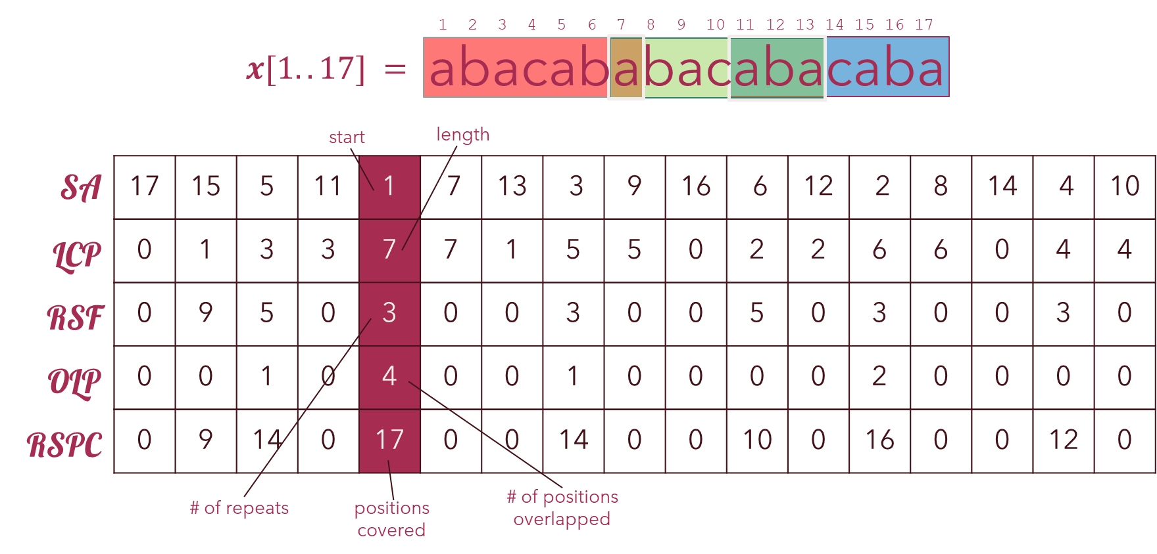

Maximal Cover
A maximal cover of x is the shortest or longest repeat μ that covers the maximum number of positions in x.
MAXCOVER computes longest maximal cover.

Slide 10
Maximal Cover Previous Solutions
In 2015, Kociumaka et al. introduced α-partial covers (where at least α positions are covered)
They presented the AllPartialCovers problem, which solves computing the shortest maximal covers μ
However, uses suffix trees – not ideal for computing long strings
In 2018, Mhaskar and Smyth overcame this concern by using suffix arrays instead – the basis for OLP-1,2,3 algorithms.

Slide 11
Algorithms
OLP-1, OLP-2, & OLP-3

Slide 12


Overall architecture
Main()
$$Compute_MC()$$
SA
Overall algorithm and structure based on pseudocode provided by Mhaskar and Smyth [MS18a]
LCP
RSF
OLP
RSPC
$$MC_List$$
Output
[MS18a] N. Mhaskar and W. Smyth. String covering with optimal covers. Journal of
Discrete Algorithms 51 (2018), 26–38. issn: 1570-8667.

Slide 13

Overall architecture
Main()
$$Compute_MC()$$
$Compute_MC()$begins a sequence of procedures to compute the following arrays:
SA: SA-IS algorithm implemented by Yuta Mori
LCP: Implementation by Simon J. Puglisi and Andrew Turpin
RSF: Implementation by Neerja Mhaskar and W.F. Smyth
OLP: $O(n2)$ and $O(n log⁡n)$ pseudocode by [MS18a]
RSPC: $O(n)$ pseudocode by [MS18a]
$MC_List$: by traversing RSPC for the maximal value, compute the list of maximal covers $μ$ for a given $x$.
pseudocode by [MS18a]
SA
LCP
RSF
OLP
RSPC
$$MC_List$$
Output
[MS18a] N. Mhaskar and W. Smyth. String covering with optimal covers. Journal of
Discrete Algorithms 51 (2018), 26–38. issn: 1570-8667.

Slide 14
Overall architecture
Main()
$$Compute_MC()$$
SA
[MS18a] presented algorithms that can compute OLP in quadratic O(n²) time and logarithmic O(n log n) time.
Implemented quadratic O(n²) version
due to simplicity and algorithmic errors with logarithmic version (refer to the “gaps” problem)
LCP
RSF
OLP
RSPC
$$MC_List$$
Output
[MS18a] N. Mhaskar and W. Smyth. String covering with optimal covers. Journal of
Discrete Algorithms 51 (2018), 26–38. issn: 1570-8667.

Slide 15
OLP-1

Slide 16
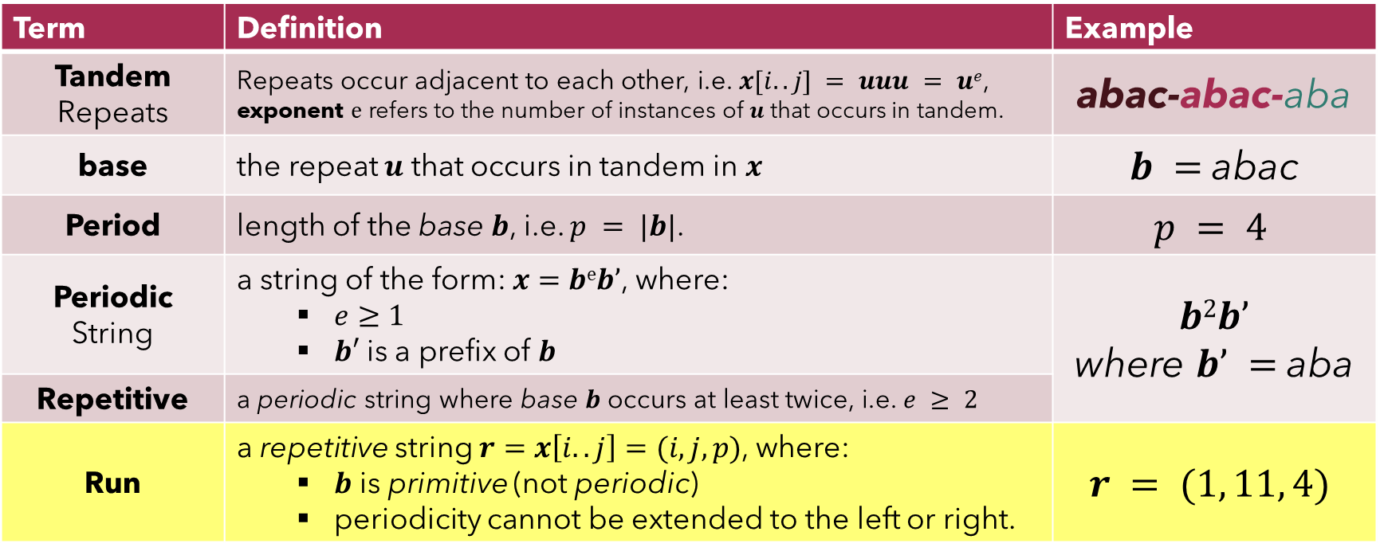
Definitions Preliminaries
Term | Definition | Example
Tandem Repeats | Repeats occur adjacent to each other, i.e. $x[i..j] = uuu = ue$, exponent $e$ refers to the number of instances of $u$ that occurs in tandem. | abac-abac-aba
base | the repeat $u$ that occurs in tandem in $x$ | $b =$abac
Period | length of the base $b$, i.e. $p = |b|$. | $$p = 4$$
Periodic String | a string of the form: $x=beb’$, where: $e≥1$ $b′$is a prefix of $b$ | $$b2b’$$ where $b’ =$aba
Repetitive | a periodic string where base $b$ occurs at least twice, i.e. $e ≥ 2$
Run | a repetitive string $r=x\left[i..j\right]=(i, j, p)$, where: $b$ is primitive (not periodic) periodicity cannot be extended to the left or right. | $$r = (1, 11, 4)$$

Slide 17

OLP-1
Main()
$$Compute_MC()$$
SA
LCP
RSF
OLP
RSPC
$$MC_List$$
Output
[MS18a] N. Mhaskar and W. Smyth. String covering with optimal covers. Journal of
Discrete Algorithms 51 (2018), 26–38. issn: 1570-8667.

Slide 18








OLP-1
Main()
$$Compute_MC()$$
SA
LCP
RSF
The algorithm required data structures that were not described in [MS18a], namely:
R₁ & R_{m} arrays;
computing all runs with $compute_runs()$;
computing eligible runs with$exrun()$.
R₁
R_{m}
$$Compute_Runs()$$
$$Exrun()$$
OLP
$$OLPi()$$
$$Frequency()$$
$$Sum +$$
$$(LCPi – p) ∗ (fr,u − 1)$$
RSPC
$$MC_List$$
Output
[MS18a] N. Mhaskar and W. Smyth. String covering with optimal covers. Journal of
Discrete Algorithms 51 (2018), 26–38. issn: 1570-8667.

Slide 19


OLP-1
Main()
$$Compute_MC()$$
SA
LCP
RSF
The algorithm required data structures that were not described in [MS18a], namely:
R₁ & R_{m} arrays;
computing all runs with $compute_runs()$;
computing eligible runs with$exrun()$.
R₁
R_{m}
$$Compute_Runs()$$
$$Exrun()$$
OLP
$$OLPi()$$
$$Frequency()$$
$$Sum +$$
$$(LCPi – p) ∗ (fr,u − 1)$$
RSPC
$$MC_List$$
Output
[MS18a] N. Mhaskar and W. Smyth. String covering with optimal covers. Journal of
Discrete Algorithms 51 (2018), 26–38. issn: 1570-8667.

Slide 20
OLP-1
Main()
$$Compute_MC()$$
SA
LCP
RSF
The algorithms to compute the OLP array depend on the following concept:
“Suppose u is a substring of x, and r is an eligible run of u.
Then any two consecutive occurrences of u in r must overlap.”
R₁
R_{m}
$$Compute_Runs()$$
$$Exrun()$$
OLP
$$OLPi()$$
$$Frequency()$$
$$Sum +$$
$$(LCPi – p) ∗ (fr,u − 1)$$
RSPC
$$MC_List$$
Output
[MS18a] N. Mhaskar and W. Smyth. String covering with optimal covers. Journal of
Discrete Algorithms 51 (2018), 26–38. issn: 1570-8667.

Slide 21
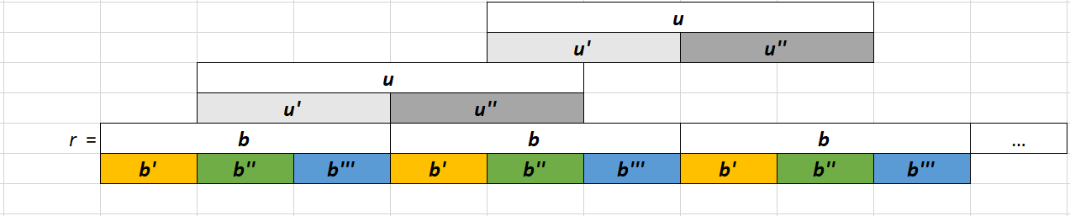
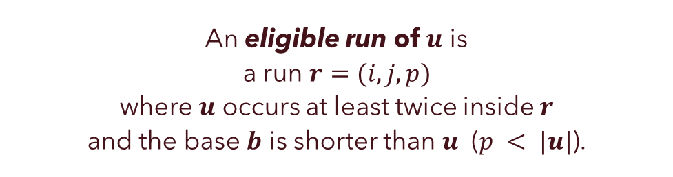


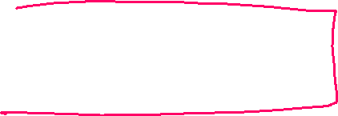
eligible run
An eligible run of $u$ is a run $r=(i, j, p)$ where $u$ occurs at least twice inside $r$ and the base $b$ is shorter than $u$ ($p < |u|$).
“Suppose u is a substring of x, and r is an eligible run of u.
Then any two consecutive occurrences of u in r must overlap.”

Slide 22

OLP-1
Main()
$$Compute_MC()$$
SA
LCP
RSF
R₁
R_{m}
We can determine the eligible runs of $u$ using $exrun(i′,j′)$
Input: the range $x\left[i^{′}..j^{′}\right]$ that $u$ occurs consecutively:
SA$[r1..rm]$ SA values that refer to $u$.
($R1$ & $Rm$ arrays.)
Parse through all runs of $x$ computed with $ComputeRuns()$ [Cro14]
$$Compute_Runs()$$
$$Exrun()$$
OLP
$$OLPi()$$
$$Frequency()$$
$$Sum +$$
$$(LCPi – p) ∗ (fr,u − 1)$$
RSPC
$$MC_List$$
Output
[Cro14] M. Crochemore, C. S. Iliopoulos, M. Kubica, J. Radoszewski, W. Rytter, K. Stencel, and T. Waleń. New Simple Efficient Algorithms Computing Powers and Runs in Strings. Discrete Appl. Math. 163 (Jan. 2014), 258–267. issn: 0166-218X.

Slide 23
OLP-1
Main()
$$Compute_MC()$$
SA
LCP
RSF
R₁
R_{m}
We can determine the eligible runs of $u$ using $exrun(i′,j′)$
Input: the range $x\left[i^{′}..j^{′}\right]$ that $u$ occurs consecutively:
SA$[r1..rm]$ SA values that refer to $u$.
($R1$ & $Rm$ arrays.)
Parse through all runs of $x$ computed with $ComputeRuns()$ [Cro14]
$$Compute_Runs()$$
$$Exrun()$$
OLP
$$OLPi()$$
$$Frequency()$$
$$Sum +$$
$$(LCPi – p) ∗ (fr,u − 1)$$
RSPC
$$MC_List$$
Output
[Cro14] M. Crochemore, C. S. Iliopoulos, M. Kubica, J. Radoszewski, W. Rytter, K. Stencel, and T. Waleń. New Simple Efficient Algorithms Computing Powers and Runs in Strings. Discrete Appl. Math. 163 (Jan. 2014), 258–267. issn: 0166-218X.

Slide 24

OLP-1
Main()
$$Compute_MC()$$
SA
LCP
RSF
R₁
R_{m}
We can determine the eligible runs of $u$ using $exrun(i′,j′)$
Input: the range $x\left[i^{′}..j^{′}\right]$ that $u$ occurs consecutively:
SA$[r1..rm]$ SA values that refer to $u$.
($R1$ & $Rm$ arrays.)
Parse through all runs of $x$ computed with $ComputeRuns()$ [Cro14]
$$Compute_Runs()$$
$$Exrun()$$
OLP
$$OLPi()$$
$$Frequency()$$
$$Sum +$$
$$(LCPi – p) ∗ (fr,u − 1)$$
RSPC
$$MC_List$$
Output
[Cro14] M. Crochemore, C. S. Iliopoulos, M. Kubica, J. Radoszewski, W. Rytter, K. Stencel, and T. Waleń. New Simple Efficient Algorithms Computing Powers and Runs in Strings. Discrete Appl. Math. 163 (Jan. 2014), 258–267. issn: 0166-218X.

Slide 25
OLP-1
Main()
$$Compute_MC()$$
$$Compute_OLPi(index, r1, rm)$$
𝐶𝑜𝑚𝑝𝑢𝑡𝑒_𝑂𝐿𝑃_{𝑖}(𝑖𝑛𝑑𝑒𝑥, 𝑟₁, 𝑟𝑚)
Copy and Sort SA$[r1..rm]$ to SA*$[r1..rm]$ in ascending order
Copy and Sort SA[𝑟₁..𝑟_{𝑚}] to SA*[𝑟₁..𝑟_{𝑚}] in ascending order
For $k∈(r1,rm)$:
For 𝑘∈(𝑟₁,𝑟𝑚):
if (diff < $|uindex|$) then
if (diff < |𝒖_{𝑖𝑛𝑑𝑒𝑥}|) then
$run$ = $eligible run using exrun(i^{′},j^{′})$
𝒓𝒖𝒏 = 𝑒𝑙𝑖𝑔𝑖𝑏𝑙𝑒 𝑟𝑢𝑛 using 𝑒𝑥𝑟𝑢𝑛(𝑖^′,𝑗^′)
freq = number of $uindex$ in $run$ using $frequency()$
freq = number of 𝒖_{𝑖𝑛𝑑𝑒𝑥} in 𝒓𝒖𝒏 using 𝑓𝑟𝑒𝑞𝑢𝑒𝑛𝑐𝑦()
$olpi+=(|uindex|−run.end)∗$ freq
𝑜𝑙𝑝_{𝑖}+=(|𝒖_{𝑖𝑛𝑑𝑒𝑥}|−𝒓𝒖𝒏.𝑒𝑛𝑑)∗ freq
Skip values: k += freq
return $olpi$
return 𝑜𝑙𝑝_{𝑖}
OLP-1 Algorithm
diff = SA$∗_{k+1}−$ SA$∗_{k}$
diff = SA∗_(𝑘+1)− SA∗_𝑘
j’ = SA$∗_{k+1}+|uindex|$
j’ = SA∗_(𝑘+1)+|𝒖_{𝑖𝑛𝑑𝑒𝑥}|
i’ = SA$∗_{k}$
i’ = SA∗_𝑘
SA
LCP
RSF
R₁
R_{m}
$$Compute_Runs()$$
$$Exrun()$$
OLP
$$OLPi()$$
$$Frequency()$$
$$Sum +$$
$$(LCPi – p) ∗ (fr,u − 1)$$
RSPC
$$MC_List$$
Output

Slide 26

“Gaps” problem
When implementing the logarithmic $O(n log⁡n)$ version of the algorithm, we realized during testing that the results between $O(n2)$ version and $O(n log⁡n)$ differed.
This is due to the “gaps” problem
The solution is non-trivial to solve in the given $O(n log⁡n)$ time
Leave to Future work for a deeper explanation and solution

Slide 27
Improved Algorithms

Slide 28









OLP-2
$$Compute_OLPi(index, r1, rm)$$
𝐶𝑜𝑚𝑝𝑢𝑡𝑒_𝑂𝐿𝑃_{𝑖}(𝑖𝑛𝑑𝑒𝑥, 𝑟₁, 𝑟𝑚)
Copy and Sort SA$[r1..rm]$ to SA*$[r1..rm]$ in ascending order
Copy and Sort SA[𝑟₁..𝑟_{𝑚}] to SA*[𝑟₁..𝑟_{𝑚}] in ascending order
For $k∈(r1,rm)$:
For 𝑘∈(𝑟₁,𝑟𝑚):
if (diff < $|uindex|$) then
if (diff < |𝒖_{𝑖𝑛𝑑𝑒𝑥}|) then
$run$ = $eligible run using exrun(i^{′},j^{′})$
𝒓𝒖𝒏 = 𝑒𝑙𝑖𝑔𝑖𝑏𝑙𝑒 𝑟𝑢𝑛 using 𝑒𝑥𝑟𝑢𝑛(𝑖^′,𝑗^′)
freq = number of $uindex$ in $run$ using $frequency()$
freq = number of 𝒖_{𝑖𝑛𝑑𝑒𝑥} in 𝒓𝒖𝒏 using 𝑓𝑟𝑒𝑞𝑢𝑒𝑛𝑐𝑦()
$olpi+=(|uindex|−run.end)∗$ freq
𝑜𝑙𝑝_{𝑖}+=(|𝒖_{𝑖𝑛𝑑𝑒𝑥}|−𝒓𝒖𝒏.𝑒𝑛𝑑)∗ freq
Skip values: k += freq
return $olpi$
return 𝑜𝑙𝑝_{𝑖}
OLP-1 Algorithm
diff = SA$∗_{k+1}−$ SA$∗_{k}$
diff = SA∗_(𝑘+1)− SA∗_𝑘
j’ = SA$∗_{k+1}+|uindex|$
j’ = SA∗_(𝑘+1)+|𝒖_{𝑖𝑛𝑑𝑒𝑥}|
i’ = SA$∗_{k}$
i’ = SA∗_𝑘
OLP-2 Improved O(n²) to compute OLP array
(a) $vi$ occurs more than once
(a) 𝒗_{𝒊} occurs more than once
(b) $vi$ is of the form: $bb$
(b) 𝒗_{𝒊} is of the form: 𝒃𝒃
2. Starting at the current index $i$, traverse backwards in the LCP array to find where $vi$ first occurs in SA, i.e. determine $r1$.
2. Starting at the current index 𝑖, traverse backwards in the LCP array to find where 𝒗_{𝒊} first occurs in SA, i.e. determine 𝑟₁.
3. Define the range $(r1,rm)$ that $vi$ occurs in SA.
3. Define the range (𝑟₁,𝑟𝑚) that 𝒗_{𝒊} occurs in SA.
4. Sort the start position that $vi$ occurs in ascending order.
4. Sort the start position that 𝒗_{𝒊} occurs in ascending order.
5. For each $k∈(r1,rm)$:
5. For each 𝑘∈(𝑟₁,𝑟𝑚):
(a) $diff=($SA*$[k+1]−$SA*$[k])$;
(a) 𝑑𝑖𝑓𝑓=(SA*[𝑘+1]−SA*[𝑘]);
(b) If the distance $diff$ is smaller than the length of $vi$
(b) If the distance 𝑑𝑖𝑓𝑓 is smaller than the length of 𝒗_{𝒊}
...Then $sum+=|vi|−diff$
...Then 𝑠𝑢𝑚+=|𝒗_{𝒊}|−𝑑𝑖𝑓𝑓
6. OLP$[i]=sum$
6. OLP[𝑖]=𝑠𝑢𝑚
(c) $vi$ has a border (See $maxborder()$).
(c) 𝒗_{𝒊} has a border (See 𝑚𝑎𝑥𝑏𝑜𝑟𝑑𝑒𝑟()).
For $i∈[1..n]$ :
For 𝑖∈[1..𝑛] :
1. Check if...

Slide 29

OLP-2
We perform checks at Steps 1 a-c to eliminate unnecessary computation where an overlap could not possibly occur, i.e. OLP$\left[i\right]=0$
If $vi$ occurs only once then $vi$ is not a repeat, and thus, cannot overlap with itself
For a repeat $vi$ to overlap with itself, $vi$ must have a border
$maxborder()$computes the Border Array $β[n]$ of $vi$, and returns the length of the longest border. Code based on Algorithm 1.3.1 in [Smy03].
OLP-2 Improved O(n²) to compute OLP array
(a) $vi$ occurs more than once
(a) 𝒗_{𝒊} occurs more than once
(b) $vi$ is of the form: $bb$
(b) 𝒗_{𝒊} is of the form: 𝒃𝒃
2. Starting at the current index $i$, traverse backwards in the LCP array to find where $vi$ first occurs in SA, i.e. determine $r1$.
2. Starting at the current index 𝑖, traverse backwards in the LCP array to find where 𝒗_{𝒊} first occurs in SA, i.e. determine 𝑟₁.
3. Define the range $(r1,rm)$ that $vi$ occurs in SA.
3. Define the range (𝑟₁,𝑟𝑚) that 𝒗_{𝒊} occurs in SA.
4. Sort the start position that $vi$ occurs in ascending order.
4. Sort the start position that 𝒗_{𝒊} occurs in ascending order.
5. For each $k∈(r1,rm)$:
5. For each 𝑘∈(𝑟₁,𝑟𝑚):
(a) $diff=($SA*$[k+1]−$SA*$[k])$;
(a) 𝑑𝑖𝑓𝑓=(SA*[𝑘+1]−SA*[𝑘]);
(b) If the distance $diff$ is smaller than the length of $vi$
(b) If the distance 𝑑𝑖𝑓𝑓 is smaller than the length of 𝒗_{𝒊}
...Then $sum+=|vi|−diff$
...Then 𝑠𝑢𝑚+=|𝒗_{𝒊}|−𝑑𝑖𝑓𝑓
6. OLP$[i]=sum$
6. OLP[𝑖]=𝑠𝑢𝑚
(c) $vi$ has a border (See $maxborder()$).
(c) 𝒗_{𝒊} has a border (See 𝑚𝑎𝑥𝑏𝑜𝑟𝑑𝑒𝑟()).
For $i∈[1..n]$ :
For 𝑖∈[1..𝑛] :
1. Check if...
[Smy03] W. F. Smyth. Computing Patterns in Strings. ACM Press Bks. Pearson/Addison-Wesley, 2003. isbn: 9780201398397.

Slide 30
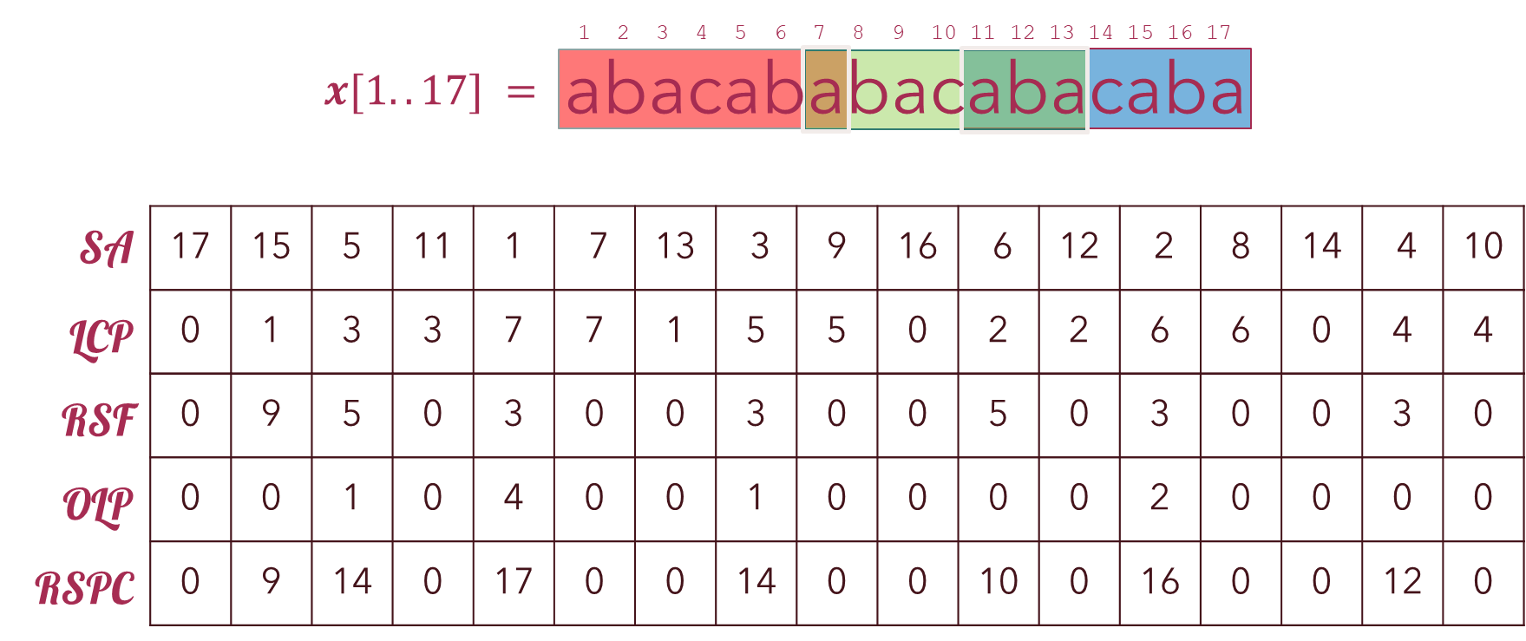

OLP-3
We determine the start positions for all occurrences of $vi$ in $x.$ (Steps 2-4)
Compare each consecutive occurrence of $vi$ to see if the distance is close enough that an overlap must occur. (Step 5 a-b)
OLP-3 Improved O(n²) to compute OLP array
(a) $vi$ occurs more than once
(a) 𝒗_{𝒊} occurs more than once
(b) $vi$ is of the form: $bb$
(b) 𝒗_{𝒊} is of the form: 𝒃𝒃
2. Starting at the current index $i$, traverse backwards in the LCP array to find where $vi$ first occurs in SA, i.e. determine $r1$.
2. Starting at the current index 𝑖, traverse backwards in the LCP array to find where 𝒗_{𝒊} first occurs in SA, i.e. determine 𝑟₁.
3. Define the range $(r1,rm)$ that $vi$ occurs in SA.
3. Define the range (𝑟₁,𝑟𝑚) that 𝒗_{𝒊} occurs in SA.
4. Sort the start position that $vi$ occurs in ascending order.
4. Sort the start position that 𝒗_{𝒊} occurs in ascending order.
5. For each $k∈(r1,rm)$:
5. For each 𝑘∈(𝑟₁,𝑟𝑚):
(a) $diff=($SA*$[k+1]−$SA*$[k])$;
(a) 𝑑𝑖𝑓𝑓=(SA*[𝑘+1]−SA*[𝑘]);
(b) If the distance $diff$ is smaller than the length of $vi$
(b) If the distance 𝑑𝑖𝑓𝑓 is smaller than the length of 𝒗_{𝒊}
...Then $sum+=|vi|−diff$
...Then 𝑠𝑢𝑚+=|𝒗_{𝒊}|−𝑑𝑖𝑓𝑓
6. OLP$[i]=sum$
6. OLP[𝑖]=𝑠𝑢𝑚
(c) $vi$ has a border (See $maxborder()$).
(c) 𝒗_{𝒊} has a border (See 𝑚𝑎𝑥𝑏𝑜𝑟𝑑𝑒𝑟()).
For $i∈[1..n]$ :
For 𝑖∈[1..𝑛] :
1. Check if...

Slide 31


OLP-3
Intended to improve upon OLP-2’s tendency to recompute $r1$ by traversing backwards multiple times.
Instead, OLP-3, keeps track of $r1$ as we traverse LCP.
inspired by the original O(n²) algorithm
This algorithm uses a stack to compute $r1$ and $rm$ by checking the ↑↓ of the LCP values.
When LCP ↗, found $r1$ value for a new $vi$
When LCP ↘, have reached an $rm$ value.
OLP-3 Improved O(n²) to compute OLP array
For $i∈[1..n]$ :
For 𝑖∈[1..𝑛] :
1. If LCP ↗, then push on stack $r1=index−1$.
1. If LCP ↗, then push on stack 𝑟₁=𝑖𝑛𝑑𝑒𝑥−1.
2. If LCP ↦, then disregard this computation since we are already computing the overlap for this $vi$.
2. If LCP ↦, then disregard this computation since we are already computing the overlap for this 𝒗_{𝒊}.
3. If LCP ↘, then:
(a) While $($LCP ↘$)$
(a) While (LCP ↘)
Compute the overlap positions of $vi$ (See $ProcessStack()$)
Compute the overlap positions of 𝒗_{𝒊} (See 𝑃𝑟𝑜𝑐𝑒𝑠𝑠𝑆𝑡𝑎𝑐𝑘())
4. Process the remaining values on the stack. (See $ProcessStack()$)
4. Process the remaining values on the stack. (See 𝑃𝑟𝑜𝑐𝑒𝑠𝑠𝑆𝑡𝑎𝑐𝑘())
$$ProcessStack()$$
𝑃𝑟𝑜𝑐𝑒𝑠𝑠𝑆𝑡𝑎𝑐𝑘()
Procedure to process $vi$ on the stack.
Procedure to process 𝒗_{𝒊} on the stack.
Near replica of Algorithm 1.

Slide 32
Runtime Comparison Random Strings, Fibonacci, Protein Sequences

Slide 33
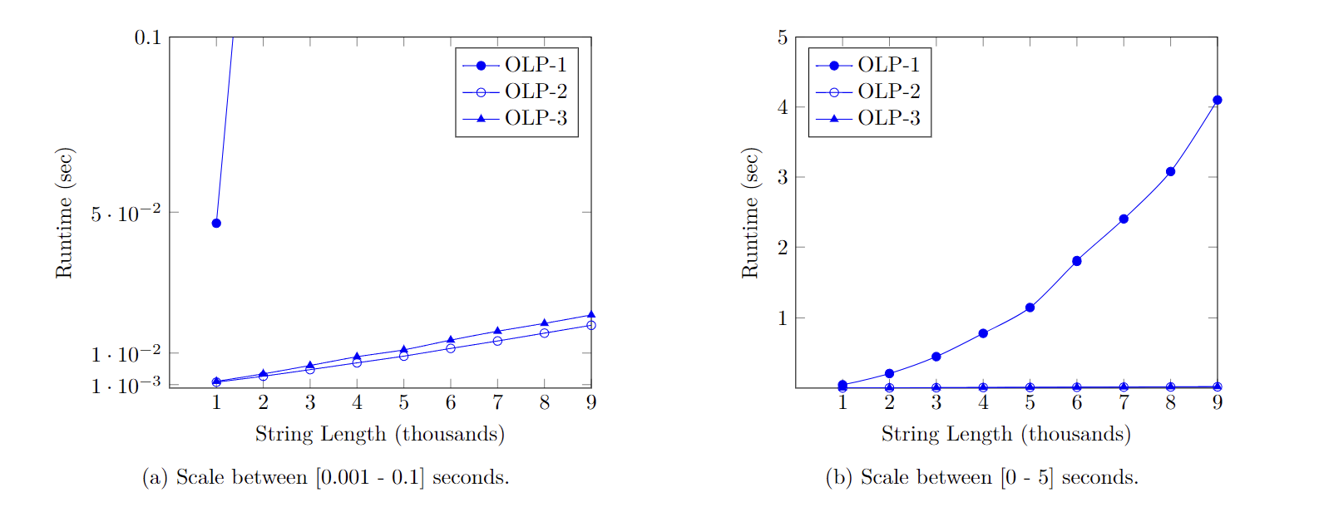
Runtime Comparison of OLP-1,2,3 Random Strings
Scaled charts (a) zoomed in; and (b) zoomed out; of runtime comparison to compute maximal covers using OLP-1, OLP-2, or OLP-3 on random binary strings.

Slide 34
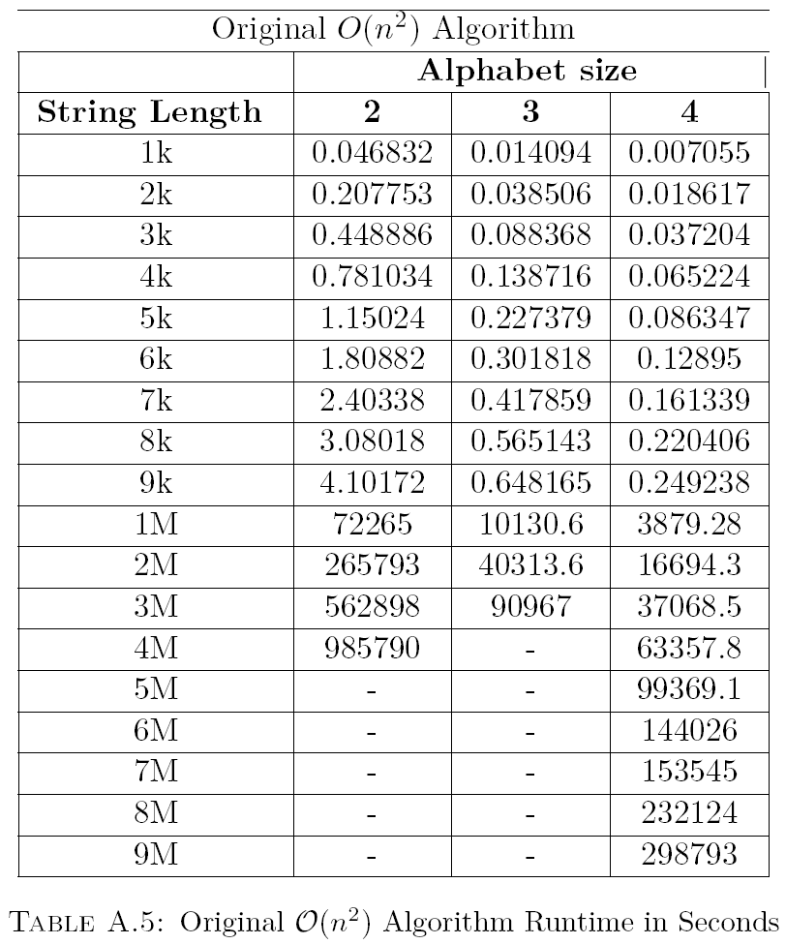
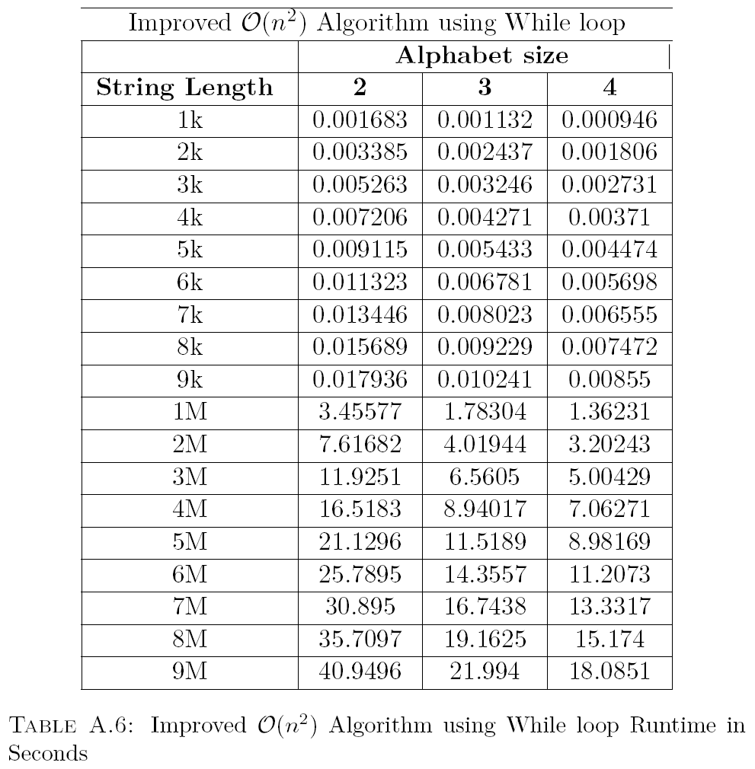
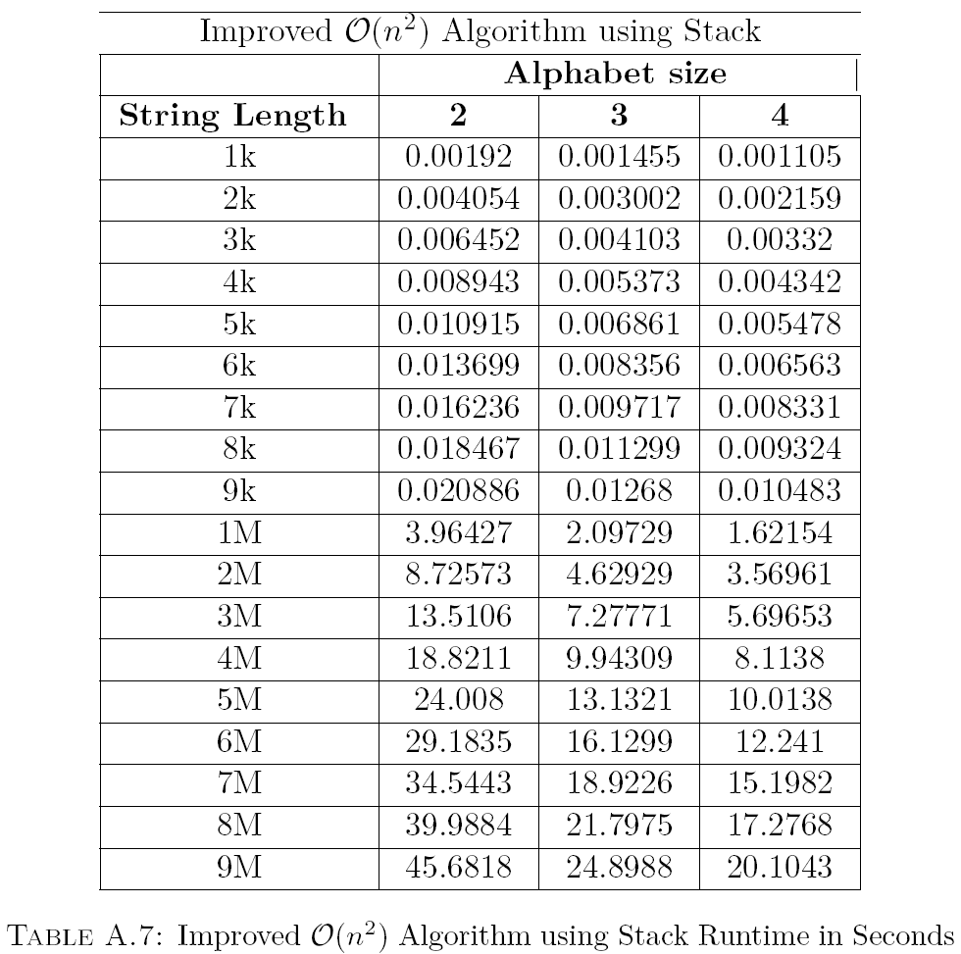



Runtime Comparison
OLP-1
OLP-2
OLP-3
OLP-1 is Missing Data due to arbitrarily long compute times: 9M computation took ∼ 55 hours ≈ 2.3 days
OLP-2 & OLP-3 both took <1 min to compute
OLP-2 performed faster than OLP-3
→ Likely due to simplicity of algorithm

Slide 35
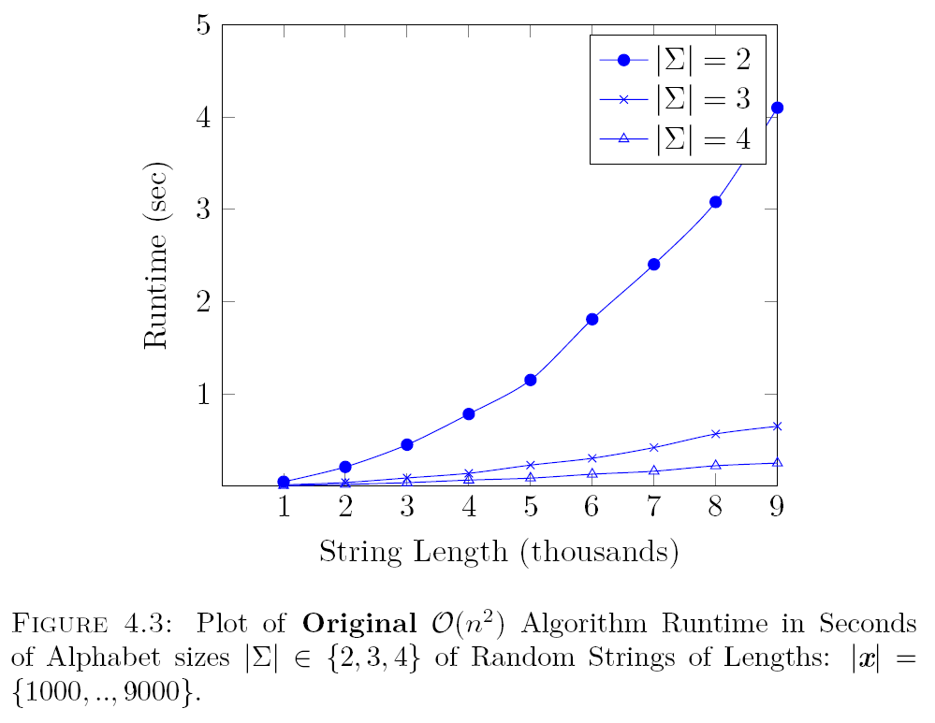
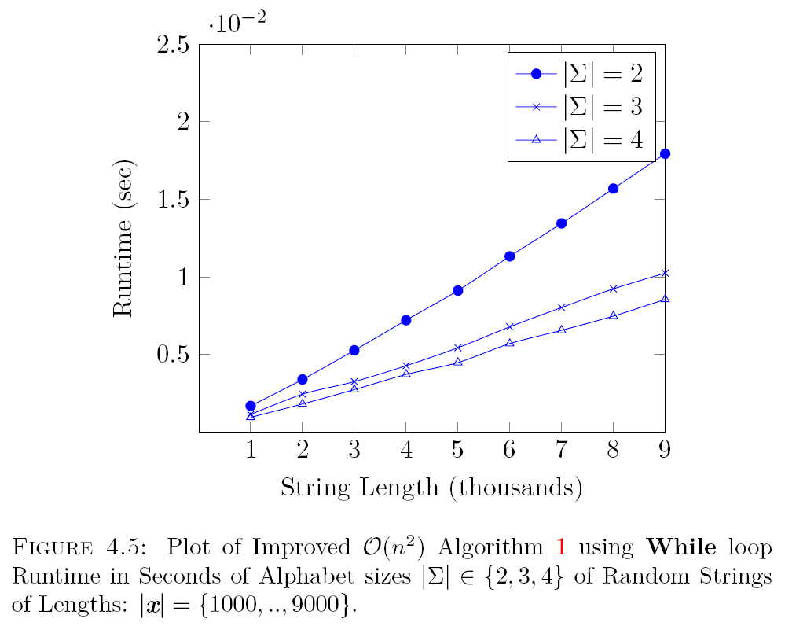
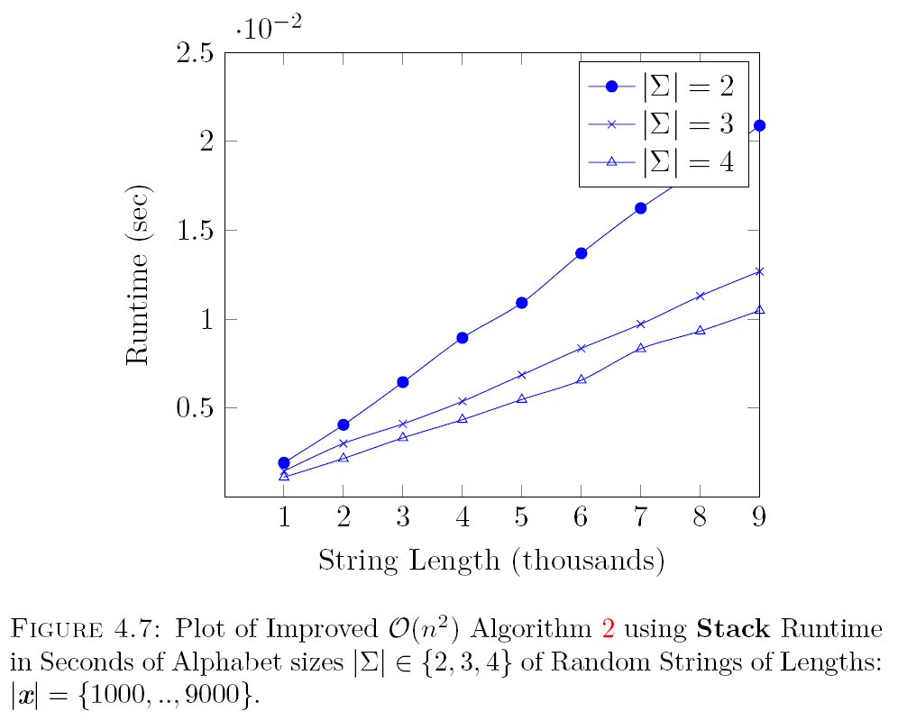
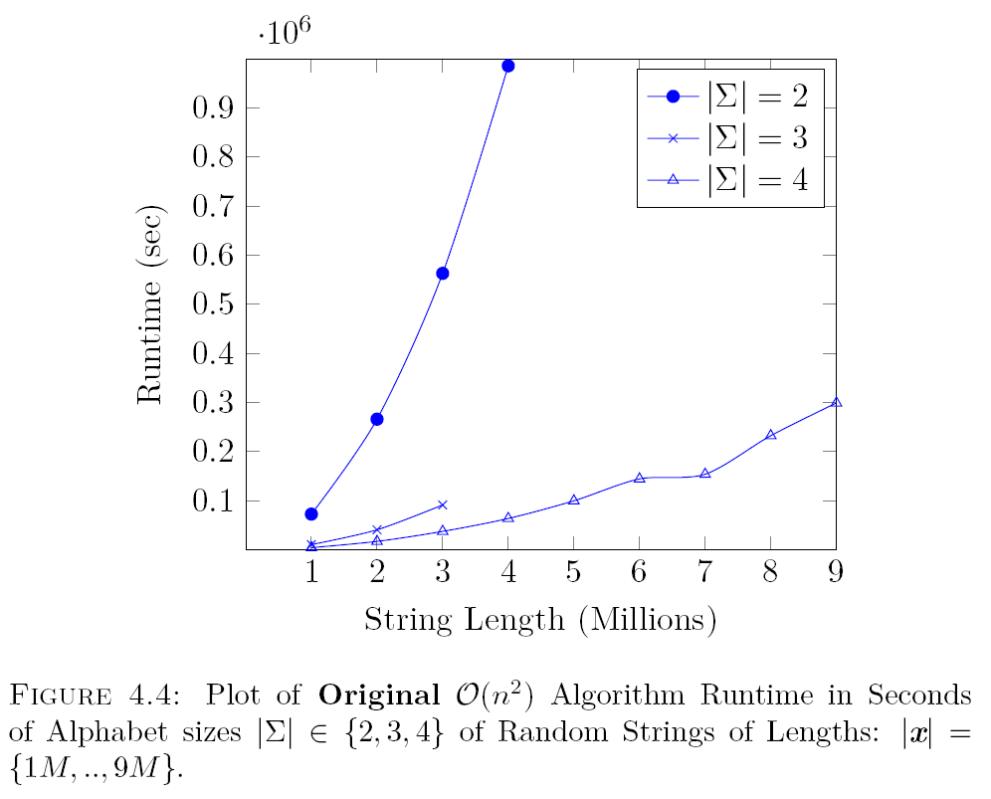
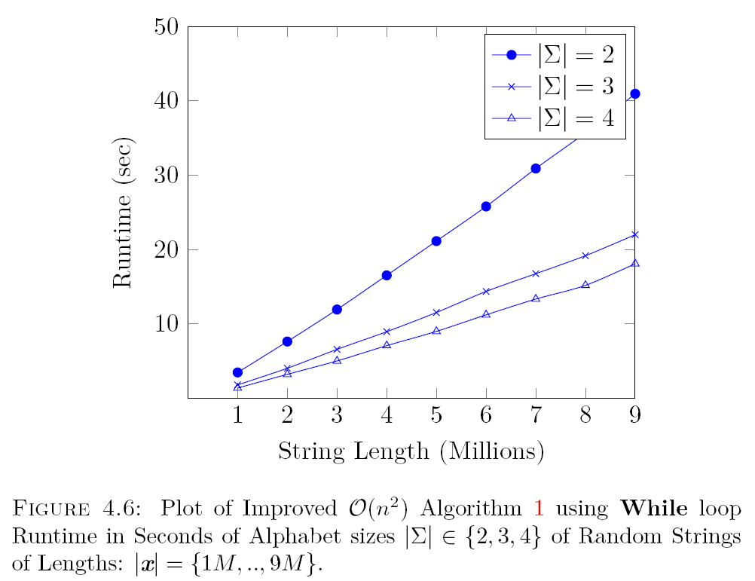
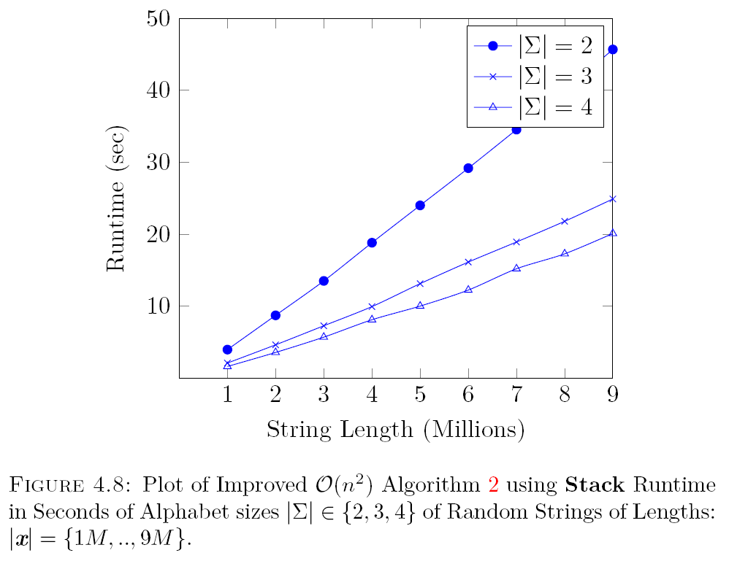
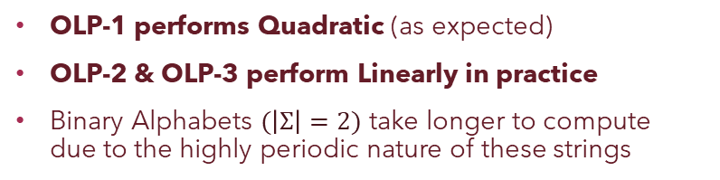
Runtime Comparison
n = thousands
OLP-1
OLP-2
OLP-3
n = millions
OLP-1 performs Quadratic (as expected)
OLP-2 & OLP-3 perform Linearly in practice
Binary Alphabets $(\left|Σ\right|=2)$ take longer to compute due to the highly periodic nature of these strings

Slide 36
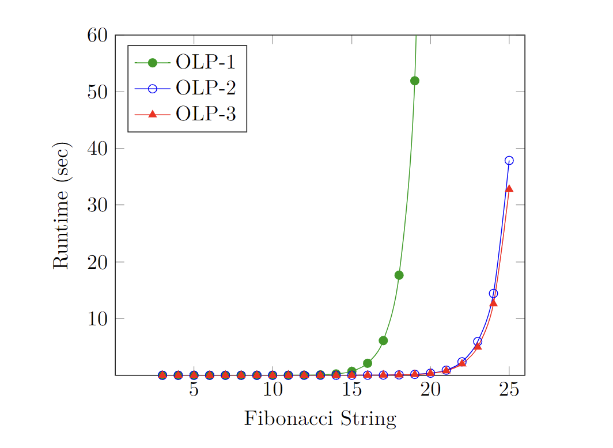
Runtime Comparison of OLP-1,2,3 Fibonacci Strings
OLP-1 takes an order-of-magnitude longer (nearly 9 hours) to compute the maximal covers for F25.
OLP-2 and OLP-3 take only 37 and 32 seconds, respectively.
All three perform quadratically O(n²) on Fibonacci strings
Total runtime (seconds) when computing maximal covers of Fibonacci strings

Slide 37
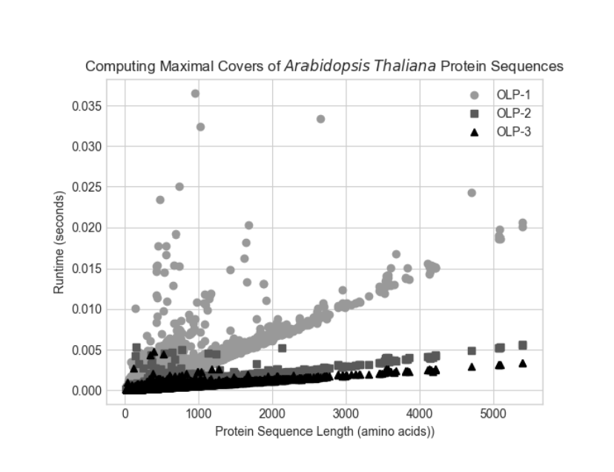
Runtime Comparison of OLP-1,2,3 Protein Sequences
Although some amino acid letters are indeterminate, (i.e. could represent multiple amino acids), for simplicity, we treated them as regular strings.
When there are few repetitions, the algorithms perform in linear time.
When the protein sequence contains large repeats, they are processed quadratically.
OLP-3 was the fastest in each case, likely due to the stack data structure

Slide 38
Conclusion
Contributions – Future Work

Slide 39

Conclusion Contributions
Proposed two new $O(n2)$ algorithms (OLP-2 & OLP-3) that improved runtime by performing linearly $O(n)$ when tested on random strings and protein sequences, treated as regular strings rather than indeterminate.
Showed that despite being theoretically the same $O(n2)$ runtime, the simplicity in OLP-2 and OLP-3 algorithms performs more optimally in practice than OLP-1.

Slide 40
Conclusion Future Work
Improve performance of OLP-3 by using:
system stack instead of program stack.
static stack instead of dynamic stack
Compare the performance of our algorithms with Czajka & Radoszewski in [6] which gives an O(n log n) implementation to compute maximal covers.
Improve experiments:
obtain an average by performing multiple tests for each string type
consider indeterminate string matching for protein sequences.
Investigate computing an iterated maximal cover set (i.e. a set of covers covering the string x) as a compression technique.
[6] P. Czajka and J. Radoszewski: Experimental evaluation of algorithms for computing
quasiperiods. Theoretical Computer Science, 854 2021, pp. 17–29.

Slide 41
Questions?

Slide 42

In 1990, Apostolico and Ehrenfeucht first introduced the concept of a ‘cover’ – a type of repeating substring.
Several types of covers have since been defined, i.e. k-cover, enhanced cover, α-partial cover, frequency cover, and most recently:
maximal cover

Slide 43
In 1990, Apostolico and Ehrenfeucht first introduced the concept of a ‘cover’.

Slide 44
Motivation
In 2015, an O(n log n)-time algorithm to compute a maximal cover was proposed; but the algorithm was complex, making use of annotated suffix trees.
In 2022, an O(n²)-time maximal cover algorithm was implemented and evaluated on protein sequences.
Contribution
We propose two simple O(n²)-time algorithms to compute a maximal cover that, shown experimentally, executes in linear time in many practical cases, and are much faster than the algorithm recently implemented in 2022 – but remain quadratic for highly repetitive strings such as Fibonacci strings.

Slide 45
Performance
MUMmer – Data – Experiments – Comparison

Slide 46

Applications Bioinformatics
Stringology and bioinformatics research are closely related, where string processing algorithms are often tested on biological sequences
Useful to determine repeats and patterns, which can help:
Identify a disease
Reconstruct an entire sequence
Analyze sequence structure
And more…
[KMS21] H. Koponen, N. Mhaskar, and W. F. Smyth. An Overview of String Processing Applications to Data Analytics. In: 2021 Reconciling Data Analytics, Automation, Privacy, and Security: A Big Data Challenge (RDAAPS). 2021, 1–8.
Notes:
Most applied areas of string algorithms. Initially an application area, last 20-25 years developed into it’s own area. Research developed in string algorithms were applied to bioinformatics. Very closely tied
What Bioinformatics is; define. Studying different kinds of data found in biology. E.g. human genome, other dna, protein sequences, etc. essentially strings identify repeats and patterns to identify similarity and occurrence of a disease. Useful to construct the genome itself. Very long genome, so hard to analyze. Stored in certain lengths (“Reads”). When assembling these reads, using an aligner. Aligners are essentially BWT. Most prime application area for string algorithms.
a lot of proposed data structures (SA, suffix tree), give a theoretical bound (suffix tree, so huge memory), SA LCP (practical application).
aligners, BWT. Why BWT is used as apposed to SA and suffix tree

Slide 47
Performance
MAXCOVER is currently the only software available for the computation of maximal covers.
Thus, we need another basis for evaluating its efficiency…

Slide 48
Performance
To evaluate performance, we compared MAXCOVER to existing software (MUMmer) for the similar task of computing non-extendible repeating substrings.

Slide 49
MUMmer
MUMmer is a system for rapidly aligning DNA and protein sequences.
MUMmer 4.x currently has: 658 citations.
→ Well-known and commonly used software
repeat-match feature computes NE repeats.

Slide 50
Definitions Preliminaries
Term | Definition | Example
Repeat | a substring u, where u occurs more than once in x | abacabacaba
Left Extendible | if every instance of u is preceded by the same symbol | abacabacaba
Right Extendible | if every instance of u is followed by the same symbol | abacabacaba
NLE / NRE | Non-Left Extendible / Non-Right Extendible | abacabacaba
NE | NLE + NRE = Non-Extendible (NE) | abacabacaba
NE repeats: a.k.a. “maximal repeats” in literature

Slide 51


Extension of MAXCOVER
Main()
$$Repeat_Matches()$$
SA
iSA
MAXCOVER was extended to also compute NE repeats, a very similar type of repeating substring – nearly identical to maximal covers
LCP
iLCP
RSF
iRSF
R₁
R_{m}
NE
$$Compute_Reported()$$
Output

Slide 52
Data
Database: NCBI (National Center for Biotechnology Information)
File Type: FASTA
Sequence Type: Protein Sequence
Species:
Arabidopsis (48,265 protein sequences)
C.elegans (28,350 protein sequences)
D. melanogaster (30,717 protein sequences)
humans (116,263 protein sequences)
Sampling: 40K protein sequences (10K per species)

Slide 53
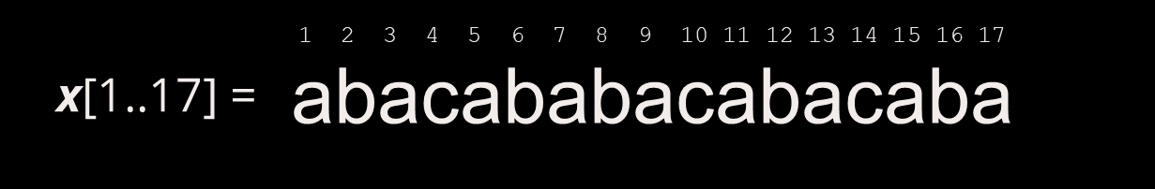
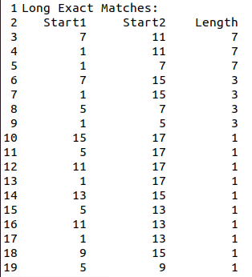









MUMmer Output
Uses suffix-trees to identify maximal exact repeat regions of minimum match length.
Does not report all matches consistently:
Reports redundant triple (1, 7, 7)
But does not report all matches for ‘aba’, E.g., start = 11
Cannot clearly differentiate between substrings of the same length

Slide 54
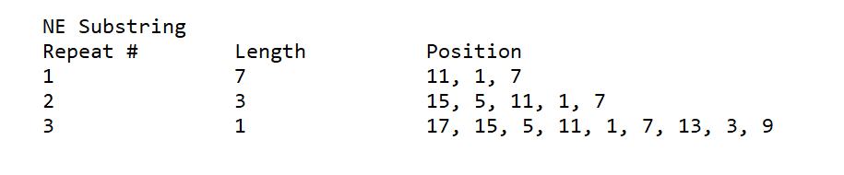
MAXCOVER Output
1 2 3 4 5 6 7 8 9 10 11 12 13 14 15 16 17
x[1..17] =
abacababacabacaba
All redundancies are reported in a condensed tabular format.

Slide 55
Comparison - 40K sampling of protein sequences
 | MUMmer (suffix trees) | MAXCOVER (suffix arrays)
Time | Slower (29 min. 28 sec.) | Faster (1 min. 15 sec.)
Accuracy | Does not report every pair of start positions for matching regions | Reports ALL start positions for matching regions
Output Format | Lengthy; Hard to decipher useful information | Condensed; Clear which set of positions refer to the same region

Slide 56
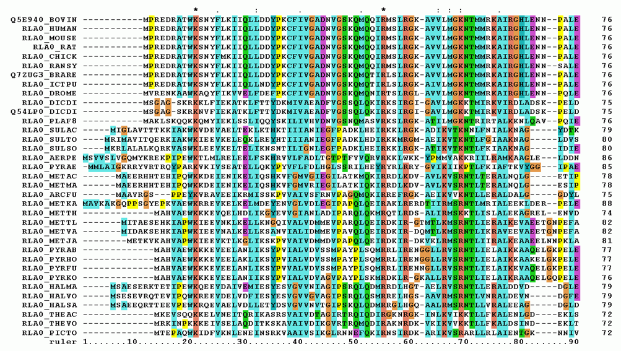
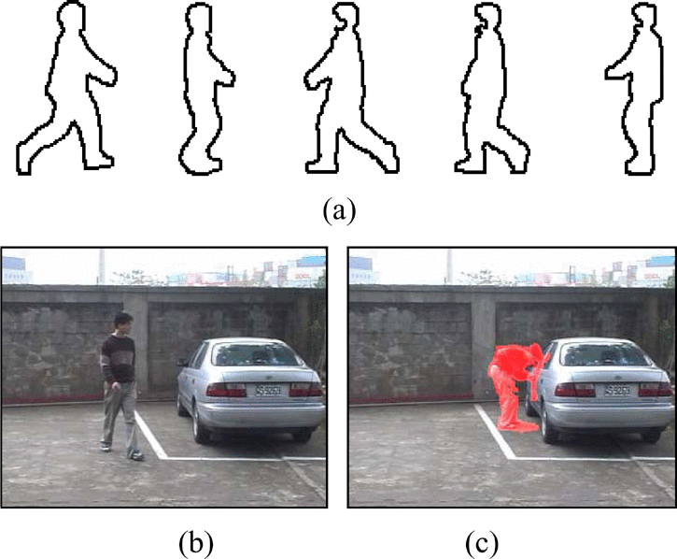
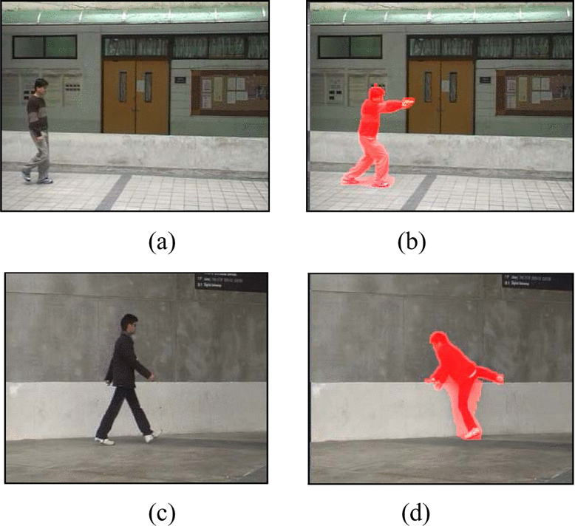
String Processing – Applications
Widely applicable to various fields: e.g.,
Bioinformatics;
Information Security;
Image/Video Analysis;
Signature-based IDS
Malicious Signature DBS
User
Network Packets
[KMS21] H. Koponen, N. Mhaskar, and W. F. Smyth. An Overview of String Processing Applications to Data Analytics. In: 2021 Reconciling Data Analytics, Automation, Privacy, and Security: A Big Data Challenge (RDAAPS). 2021, 1–8.
Top Image by Miguel Andrade, 2006, shared under GNU Free Documentation License
Bottom Left Image from “Video-based Human Movement Analysis and its Application to Surveillance Systems” by J. Hsieh, Y. Hsu, H. M. Liao, and C. Chen
Notes:
Thus, it is essential to identify string types and their uses as well as optimize the algorithms
that compute them.

Slide 57
Thus, it is essential to identify string types and their uses as well as optimize the algorithms that compute them.

Slide 58
Motivation
To test the theoretical and practical usefulness of the latest concept: maximal cover.

Slide 59
Contribution
To study the usefulness of maximal covers, we implemented the first-ever software to compute them: MAXCOVER.

Slide 60
Definitions
Preliminaries – Arrays – Maximal Covers

Slide 61
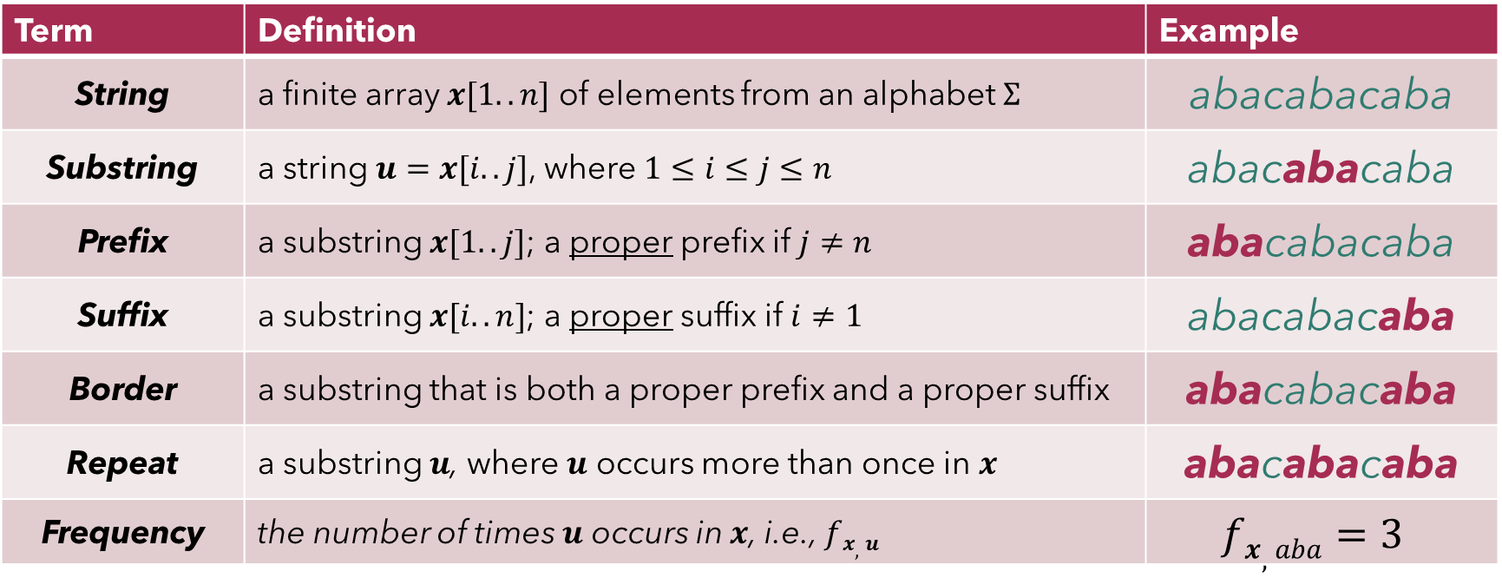
Definitions Preliminaries
Term | Definition | Example
String | a finite array $x[1..n]$ of elements from an alphabet $Σ$ | abacabacaba
Substring | a string $u=x[i..j]$, where $1≤i≤j≤n$ | abacabacaba
Prefix | a substring $x[1..j]$; a proper prefix if $j≠n$ | abacabacaba
Suffix | a substring $x[i..n]$; a proper suffix if $i≠1$ | abacabacaba
Border | a substring that is both a proper prefix and a proper suffix | abacabacaba
Repeat | a substring $u$, where $u$ occurs more than once in $x$ | abacabacaba
Frequency | the number of times $u$ occurs in $x$, i.e., $fx,u$ | $$fx,aba=3$$

Slide 62
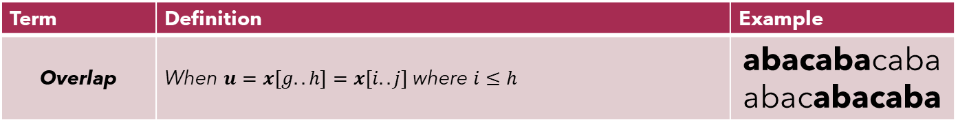
Definitions Arrays
1 2 3 4 5 6 7 8 9 10 11 12 13 14 15 16 17
$$x[1..17] =$$
abacababacabacaba
start
length
SA
17 | 15 | 5 | 11 | 1 | 7 | 13 | 3 | 9 | 16 | 6 | 12 | 2 | 8 | 14 | 4 | 10
LCP
0 | 1 | 3 | 3 | 7 | 7 | 1 | 5 | 5 | 0 | 2 | 2 | 6 | 6 | 0 | 4 | 4
RSF
0 | 9 | 5 | 0 | 3 | 0 | 0 | 3 | 0 | 0 | 5 | 0 | 3 | 0 | 0 | 3 | 0
Term | Definition | Example
Overlap | When $u=x[g..h]=x[i..j]$where $i≤h$ | abacabacabaabacabacaba
# of repeats

Slide 63
Agenda
Definitions
Preliminaries
Arrays
Maximal Cover
MAXCOVER
Applications
Performance
Conclusion
Discussion
Future Work
Software Architecture
Implementation
Improvement
Bioinformatics
Experiments
MUMmer
Extension to MAXCOVER
Data Analytics

Slide 64
MAXCOVER Data Structures
Main()
$$Compute_MC()$$
$$Compute_OLPi(i, r1, rm)$$
𝐶𝑜𝑚𝑝𝑢𝑡𝑒_𝑂𝐿𝑃_{𝑖}(𝑖, 𝑟₁, 𝑟𝑚)
Initialize SA* as a temporary array of size $n$
Initialize SA* as a temporary array of size 𝑛
Copy SA$[r1..rm]$ to SA*$[r1..rm]$
Copy SA[𝑟₁..𝑟𝑚] to SA*[𝑟₁..𝑟𝑚]
if $(r1<rm)$then
if (𝑟₁<𝑟𝑚) then
Sort SA*$[r1..rm]$ in ascending order
Sort SA*[𝑟₁..𝑟𝑚] in ascending order
$$k ← r1$$
𝑘 ← 𝑟₁
▷ $eligible run = (start, end, period)$
▷ 𝑒𝑙𝑖𝑔𝑖𝑏𝑙𝑒 𝑟𝑢𝑛 = (𝑠𝑡𝑎𝑟𝑡, 𝑒𝑛𝑑, 𝑝𝑒𝑟𝑖𝑜𝑑)
while $(k< rm)$ do
while (𝑘< 𝑟𝑚) do
if (SA*$\left[k+1\right]−$SA*$[k])<$ LCP [i]) then
if (SA*[𝑘+1]−SA*[𝑘])< LCP [i]) then
$eligible run←exrun($SA*$[k],$SA*$[k+1]+$LCP$[i]− 1)$
𝑒𝑙𝑖𝑔𝑖𝑏𝑙𝑒 𝑟𝑢𝑛←𝑒𝑥𝑟𝑢𝑛(SA*[𝑘], SA*[𝑘+1]+ LCP [𝑖]− 1)
$fr,u ← compute_frequency(eligible run,$SA*$[k] +$LCP$[i] − 1)$
𝑓_{𝑟,𝑢} ← 𝑐𝑜𝑚𝑝𝑢𝑡𝑒_𝑓𝑟𝑒𝑞𝑢𝑒𝑛𝑐𝑦(𝑒𝑙𝑖𝑔𝑖𝑏𝑙𝑒 𝑟𝑢𝑛, SA*[𝑘] + LCP [𝑖] − 1)
$olpi←olpi+($LCP$[i]−eligible run.end)∗(fr,u−1)$
𝑜𝑙𝑝_{𝑖}←𝑜𝑙𝑝𝑖+(LCP [𝑖]−𝑒𝑙𝑖𝑔𝑖𝑏𝑙𝑒 𝑟𝑢𝑛.𝑒𝑛𝑑)∗(𝑓_{𝑟,𝑢}−1)
$$k ← k + fr,u− 1$$
𝑘 ← 𝑘 + 𝑓_{𝑟,𝑢}− 1
else
$$k ← k + 1$$
𝑘 ← 𝑘 + 1
return $olpi$
return 𝑜𝑙𝑝_{𝑖}
Original O(n²) Algorithm
$$olpi ← 0$$
𝑜𝑙𝑝_{𝑖} ← 0
SA
LCP
RSF
R₁
R_{m}
$$Compute_Runs()$$
$$Exrun()$$
OLP
$$OLPi()$$
$$Frequency()$$
$$Sum +$$
$$(LCPi – p) ∗ (fr,u − 1)$$
RSPC
$$MC_List$$
Output

Slide 65
MAXCOVER Data Structures
Main()
Compute_MC()
R₁
SA
R_{m}
Original Alg here
LCP
Runs_for_exrun()
RSF
OLP
RSPC
MC_List
Output

Slide 66
This thesis only concerns regular strings.
Definitions Preliminaries
A regular string is when each letter in x represents only a single symbol from the alphabet.
E.g. ‘bat’ or ‘cat’
An indeterminate string allows letters to represent any symbol from a subset of the alphabet.
E.g. ‘{b,c}at’ means both ‘bat’ and ‘cat’

Slide 67
Definitions Preliminaries
Term | Definition | Example
Repeat | a substring u, where u occurs more than once in x | -
Overlap | When u = x[g..h] = x[i..j] where i ≤ h | abacabacabaabacabacaba

Slide 68
Definitions Preliminaries
Term | Definition | Example
Repeat | a substring u, where u occurs more than once in x | -
Overlap | When u = x[g..h] = x[i..j] where i ≤ h | abacabacabaabacabacaba

Slide 69
Substring
A substring is a string u = x[i..j], where 1 ≤ i ≤ j ≤ n, which occurs at position i and has length |u| = j − i + 1.
String | Substring | Start | Length
010011 | 100 | 2 | 3
ATAGCATT | CATT | 5 | 4
“Joshua rose early in the morning” | Joshua rose early | 1 | 17

Slide 70
Repeating Substring (a.k.a. ‘Repeat’)
A repeating substring or repeat is a substring u where u occurs more than once in x, i.e. the frequency f_{x,u} > 1, which is the number of times u occurs in x
String | Repeat | Frequency
010011 | 01 | 2
ATAGCATT | AT | 2
“Joshua rose early in the morning” | o | 3

Slide 71

MAXCOVER Data Structures
Main()
Compute_MC()
SA
LCP
RSF
LCS
Implementing the pseudocode consisted of more than transposing the algorithm, but also implementing new data structures that were not described in [MS18a], namely:
R₁ & R_{m} arrays;
computing all runs with $compute_runs()$;
computing eligible runs with$exrun()$.
R₁
R_{m}
RANK
Runs_for_exrun()
REV_ RANK
Compute_Runs()
RMQ
OLP
RSPC
MC_List
Output
[MS18a] N. Mhaskar and W. Smyth. String covering with optimal covers. Journal of
Discrete Algorithms 51 (2018), 26–38. issn: 1570-8667.

Slide 72
Introduction Motivation
To test the theoretical & practical usefulness of maximal covers
Theoretical
Practical
Covers, in general, can provide information about the structure of repeating patterns compactly.
To explore the usefulness of maximal covers in data compression.
Covers, in general, apply to any field where regular strings occur.
To explore the usefulness of maximal covers to study patterns in different sequences, e.g. biological

Slide 73
Introduction
Motivation – Contribution – Agenda

Slide 74
Definitions Arrays
1 2 3 4 5 6 7 8 9 10 11 12 13 14 15 16 17
$$x[1..17] =$$
abacababacabacaba
start
length
SA
17 | 15 | 5 | 11 | 1 | 7 | 13 | 3 | 9 | 16 | 6 | 12 | 2 | 8 | 14 | 4 | 10
LCP
0 | 1 | 3 | 3 | 7 | 7 | 1 | 5 | 5 | 0 | 2 | 2 | 6 | 6 | 0 | 4 | 4
RSF
0 | 9 | 5 | 0 | 3 | 0 | 0 | 3 | 0 | 0 | 5 | 0 | 3 | 0 | 0 | 3 | 0
# of repeats
Term | Definition | Example
Overlap | When $u=x[g..h]=x[i..j]$where $i≤h$ | abacabacabaabacabacaba

Slide 75
MAXCOVER Data Structures
Main()
$$Compute_MC()$$
$$Compute_OLPi(i, r1, rm)$$
𝐶𝑜𝑚𝑝𝑢𝑡𝑒_𝑂𝐿𝑃_{𝑖}(𝑖, 𝑟₁, 𝑟𝑚)
Copy and Sort SA$[r1..rm]$ to SA*$[r1..rm]$ in ascending order
Copy and Sort SA[𝑟₁..𝑟_{𝑚}] to SA*[𝑟₁..𝑟_{𝑚}] in ascending order
For $k∈(r1,rm)$:
For 𝑘∈(𝑟₁,𝑟𝑚):
if (diff < LCP [i]) then
$$eligible run=exrun(i^{′},j^{′})$$
𝑒𝑙𝑖𝑔𝑖𝑏𝑙𝑒 𝑟𝑢𝑛=𝑒𝑥𝑟𝑢𝑛(𝑖^′,𝑗^′)
$fr,u=frequency()$ = # of $vi$ in $r$
𝑓_{𝑟,𝑢}=𝑓𝑟𝑒𝑞𝑢𝑒𝑛𝑐𝑦() = # of 𝒗_{𝒊} in 𝒓
$olpi+=($LCP$[i]−eligible run.end)∗(fr,u−1)$
𝑜𝑙𝑝_{𝑖}+=(LCP [𝑖]−𝑒𝑙𝑖𝑔𝑖𝑏𝑙𝑒 𝑟𝑢𝑛.𝑒𝑛𝑑)∗(𝑓_{𝑟,𝑢}−1)
$$k+= fr,u−1$$
𝑘+= 𝑓_{𝑟,𝑢}−1
return $olpi$
return 𝑜𝑙𝑝_{𝑖}
Original O(n²) Algorithm
diff = $v_{k+1}$.start$− v_{k}$.start SA*$\left[k+1\right]−$ SA*$[k]$
diff = 𝒗_(𝑘+1).start − 𝒗_𝑘.start SA*[𝑘+1]− SA*[𝑘]
i’ = SA*$[k]$
i’ = SA*[𝑘]
j’ = SA*$[k+1]+$LCP$[i]− 1$
j’ = SA*[𝑘+1]+ LCP [𝑖]− 1
SA
LCP
RSF
R₁
R_{m}
$$Compute_Runs()$$
$$Exrun()$$
OLP
$$OLPi()$$
$$Frequency()$$
$$Sum +$$
$$(LCPi – p) ∗ (fr,u − 1)$$
RSPC
$$MC_List$$
Output

Slide 76
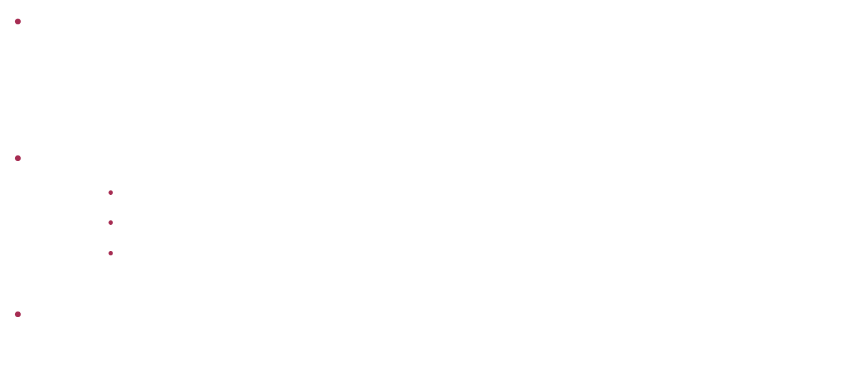

Definitions Preliminaries
Repetitions
Periodic string: if it can be represented as $x = b^{k}b^{′}$, $k ≥ 2$and $b^{′}$ is a (possibly empty) prefix of $u$, or $k = 1$and $b$ is not empty.
Run: a periodic string, where:
$b$ is primitive (not a repetition)
$k≥2$
periodicity cannot be extended to the left or right.
Cover: a substring $u$such that the text can be reconstructed from possibly overlapping instances of $u$
1231231 or 123123
121
111010010010111
01010010 where $u$ = {010}

Slide 77
Introduction Contributions

Slide 78
MUMmer Output
1 2 3 4 5 6 7 8 9 10 11 12 13 14 15 16 17
x[1..17] =
abacababacabacaba
Uses suffix-trees to identify maximal exact repeat regions of minimum match length for a given genome.
Does not report 'redundancies' consistently:
Reports (7, 11, 7); (1, 11, 7); and the redundant triple (1, 7, 7)
But does not report redundant matches for 'aba': (15, 5, 3); (15, 11, 3); (5, 11, 3);

Slide 79

MAXCOVER Software Architecture
Main()
$$Compute_MC()$$
SA
With a pre-computed OLP array, [MS18a] presented a linear-time algorithm to compute the RSPC array.
By traversing RSPC for the maximal value, compute the list of maximal covers $μ$ for a given $x$.
LCP
RSF
OLP
RSPC
$$MC_List$$
Output
[MS18a] N. Mhaskar and W. Smyth. String covering with optimal covers. Journal of
Discrete Algorithms 51 (2018), 26–38. issn: 1570-8667.

Slide 80
MAXCOVER Data Structures
Main()
$$Compute_MC()$$
$$Compute_OLPi(i, r1, rm)$$
𝐶𝑜𝑚𝑝𝑢𝑡𝑒_𝑂𝐿𝑃_{𝑖}(𝑖, 𝑟₁, 𝑟𝑚)
Initialize SA* as a temporary array of size $n$
Initialize SA* as a temporary array of size 𝑛
Copy SA$[r1..rm]$ to SA*$[r1..rm]$
Copy SA[𝑟₁..𝑟_{𝑚}] to SA*[𝑟₁..𝑟_{𝑚}]
if $(r1<rm)$then
if (𝑟₁<𝑟_{𝑚}) then
Sort SA*$[r1..rm]$ in ascending order
Sort SA*[𝑟₁..𝑟_{𝑚}] in ascending order
$$k ← r1$$
𝑘 ← 𝑟₁
▷ $eligible run = (start, end, period)$
▷ 𝑒𝑙𝑖𝑔𝑖𝑏𝑙𝑒 𝑟𝑢𝑛 = (𝑠𝑡𝑎𝑟𝑡, 𝑒𝑛𝑑, 𝑝𝑒𝑟𝑖𝑜𝑑)
For each $k∈(r1,rm)$:
For each 𝑘∈(𝑟₁,𝑟𝑚):
if (SA*$\left[k+1\right]−$SA*$[k])<$ LCP [i]) then
if (SA*[𝑘+1]−SA*[𝑘])< LCP [i]) then
$eligible run←exrun($SA*$[k],$SA*$[k+1]+$LCP$[i]− 1)$
𝑒𝑙𝑖𝑔𝑖𝑏𝑙𝑒 𝑟𝑢𝑛←𝑒𝑥𝑟𝑢𝑛(SA*[𝑘], SA*[𝑘+1]+ LCP [𝑖]− 1)
$fr,u ← compute_frequency(eligible run,$SA*$[k] +$LCP$[i] − 1)$
𝑓_{𝑟,𝑢} ← 𝑐𝑜𝑚𝑝𝑢𝑡𝑒_𝑓𝑟𝑒𝑞𝑢𝑒𝑛𝑐𝑦(𝑒𝑙𝑖𝑔𝑖𝑏𝑙𝑒 𝑟𝑢𝑛, SA*[𝑘] + LCP [𝑖] − 1)
$olpi←olpi+($LCP$[i]−eligible run.end)∗(fr,u−1)$
𝑜𝑙𝑝_{𝑖}←𝑜𝑙𝑝𝑖+(LCP [𝑖]−𝑒𝑙𝑖𝑔𝑖𝑏𝑙𝑒 𝑟𝑢𝑛.𝑒𝑛𝑑)∗(𝑓_{𝑟,𝑢}−1)
$$k ← k + fr,u− 1$$
𝑘 ← 𝑘 + 𝑓_{𝑟,𝑢}− 1
else
$$k ← k + 1$$
𝑘 ← 𝑘 + 1
return $olpi$
return 𝑜𝑙𝑝_{𝑖}
Original O(n²) Algorithm
$$olpi ← 0$$
𝑜𝑙𝑝_{𝑖} ← 0
SA
LCP
RSF
R₁
R_{m}
$$Compute_Runs()$$
$$Exrun()$$
OLP
$$OLPi()$$
$$Frequency()$$
$$Sum +$$
$$(LCPi – p) ∗ (fr,u − 1)$$
RSPC
$$MC_List$$
Output

Slide 81
MAXCOVER Output
1 2 3 4 5 6 7 8 9 10 11 12 13 14 15 16 17
x[1..17] =
abacababacabacaba
All redundancies are reported in a condensed tabular format.

Slide 82
Agenda
Definitions
MAXCOVER
Applications
Performance
Conclusion

Slide 83

Maximal Cover
1 2 3 4 5 6 7 8 9 10 11 12 13 14 15 16 17
$$x[1..17] =$$
abacababacabacaba
start
length
SA
17 | 15 | 5 | 11 | 1 | 7 | 13 | 3 | 9 | 16 | 6 | 12 | 2 | 8 | 14 | 4 | 10
LCP
0 | 1 | 3 | 3 | 7 | 7 | 1 | 5 | 5 | 0 | 2 | 2 | 6 | 6 | 0 | 4 | 4
A maximal cover of x is the shortest or longest repeat μ that covers the maximum number of positions in x.
RSF
0 | 9 | 5 | 0 | 3 | 0 | 0 | 3 | 0 | 0 | 5 | 0 | 3 | 0 | 0 | 3 | 0
OLP
0 | 0 | 1 | 0 | 4 | 0 | 0 | 1 | 0 | 0 | 0 | 0 | 2 | 0 | 0 | 0 | 0
RSPC
0 | 9 | 14 | 0 | 17 | 0 | 0 | 14 | 0 | 0 | 10 | 0 | 16 | 0 | 0 | 12 | 0
# of repeats
positions covered
# of positions overlapped

Slide 84
MAXCOVER Data Structures
Main()
Compute_MC()
SA
LCP
RSF
Implementing the pseudocode consisted of more than transposing the algorithm, but also implementing new data structures that were not described in [MS18a], namely:
R₁ & R_{m} arrays;
computing all runs with $compute_runs()$;
computing eligible runs with$exrun()$.
R₁
R_{m}
Compute_Runs()
OLP
RSPC
MC_List
Output
[MS18a] N. Mhaskar and W. Smyth. String covering with optimal covers. Journal of
Discrete Algorithms 51 (2018), 26–38. issn: 1570-8667.

Slide 85
MAXCOVER Data Structures
Main()
Compute_MC()
SA
LCP
RSF
The algorithms to compute the OLP array depend on the following concept:
“Suppose u is a substring of x, and r is an eligible run of u.
Then any two consecutive occurrences of u in r must overlap.”
R₁
R_{m}
Compute_Runs()
OLP
RSPC
MC_List
Output
[MS18a] N. Mhaskar and W. Smyth. String covering with optimal covers. Journal of
Discrete Algorithms 51 (2018), 26–38. issn: 1570-8667.

Slide 86
MAXCOVER Software Architecture
Main()
Compute_MC()
SA
LCP
RSF*
To improve the time to compute, [MS18a] proposed RSF* and OLP*, where the tandem duplicate values that refer to the same substring are set to 0.
R₁
R_{m}
Runs_for_exrun()
OLP*
RSPC
MC_List
Output
[MS18a] N. Mhaskar and W. Smyth. String covering with optimal covers. Journal of
Discrete Algorithms 51 (2018), 26–38. issn: 1570-8667.

Slide 87
MAXCOVER Software Architecture
Main()
Compute_MC()
SA
LCP
RSF
Overall algorithm and structure based on pseudocode provided by Mhaskar and Smyth [MS18a]
R₁
R_{m}
Runs_for_exrun()
OLP
RSPC
MC_List
Output
[MS18a] N. Mhaskar and W. Smyth. String covering with optimal covers. Journal of
Discrete Algorithms 51 (2018), 26–38. issn: 1570-8667.

Slide 88
MAXCOVER Software Architecture
Main()
Compute_MC()
SA
LCP
RSF
Compute_MC() begins a sequence of procedures to compute the following arrays:
SA
LCP
RSF
OLP
RSPC
R₁
R_{m}
Runs_for_exrun()
OLP
RSPC
MC_List
Output

Slide 89
MAXCOVER Software Architecture
Main()
Compute_MC()
SA
LCP
RSF
The first three arrays make use of code by:
SA: SA-IS algorithm implemented by Yuta Mori
LCP: Implementation by Simon J. Puglisi and Andrew Turpin
RSF: Implementation by Neerja Mhaskar and W.F. Smyth
R₁
R_{m}
Runs_for_exrun()
OLP
RSPC
MC_List
Output

Slide 90
MAXCOVER Software Architecture
Main()
Compute_MC()
SA
LCP
RSF
[MS18a] presented algorithms that can compute OLP in quadratic O(n²) time and logarithmic O(n log n) time.
R₁
R_{m}
Runs_for_exrun()
OLP
RSPC
MC_List
Output
[MS18a] N. Mhaskar and W. Smyth. String covering with optimal covers. Journal of
Discrete Algorithms 51 (2018), 26–38. issn: 1570-8667.

Slide 91
MAXCOVER Data Structures
Main()
$$Compute_MC()$$
SA
LCP
RSF
“Suppose u is a substring of x, and r is an eligible run of u.
Then any two consecutive occurrences of u in r must overlap.”
R₁
R_{m}
$$Compute_Runs()$$
$$Exrun()$$
OLP
$$OLPi()$$
$$Frequency()$$
$$Sum +$$
$$(LCPi – p) ∗ (fr,u − 1)$$
RSPC
$$MC_List$$
Output
[MS18a] N. Mhaskar and W. Smyth. String covering with optimal covers. Journal of
Discrete Algorithms 51 (2018), 26–38. issn: 1570-8667.

Slide 92
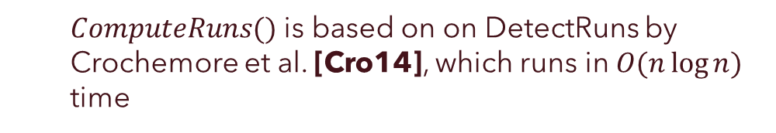
MAXCOVER Data Structures
Main()
Compute_MC()
SA
How you compute runs using crochemores paper (what was the runtime on this?) ThetimecomplexityoftheDetectRunsalgorithmisO(nlogn)
• computing eligible runs with the exrun() function.
LCP
RSF
OLP
$ComputeRuns()$ is based on on DetectRuns by Crochemore et al. [Cro14], which runs in $O(n\log{n})$ time
RSPC
MC_List
Output
[Cro14] M. Crochemore, C. S. Iliopoulos, M. Kubica, J. Radoszewski, W. Rytter, K. Stencel, and T. Waleń. New Simple Efficient Algorithms Computing Powers and Runs in Strings. Discrete Appl. Math. 163 (Jan. 2014), 258–267. issn: 0166-218X.

Slide 93
MAXCOVER Software Architecture
Main()
Compute_MC()
SA
LCP
RSF
The algorithms to compute the OLP array depend on the following concept:
“Suppose u is a substring of x, and r is an eligible run of u.
Then any two consecutive occurrences of u in r must overlap.”
R₁
R_{m}
Runs_for_exrun()
OLP
RSPC
MC_List
Output
[MS18a] N. Mhaskar and W. Smyth. String covering with optimal covers. Journal of
Discrete Algorithms 51 (2018), 26–38. issn: 1570-8667.

Slide 94

eligible run
An eligible run of $u$ in $x$ is a run $r = x[i..j] = (i, j, p)$ where $u$ occurs at least twice inside $r$ ($fr,u≥2$) and the base $b$ is shorter than $u$ ($p<|u|$).

Slide 95
MAXCOVER Software Architecture
Main()
Compute_MC()
SA
With a pre-computed OLP array, [MS18a] presented a linear-time algorithm to compute the RSPC array.
LCP
RSF
OLP
RSPC
MC_List
Output
[MS18a] N. Mhaskar and W. Smyth. String covering with optimal covers. Journal of
Discrete Algorithms 51 (2018), 26–38. issn: 1570-8667.

Slide 96

MAXCOVER Software Architecture
Main()
Compute_MC()
SA
By traversing RSPC for the maximal value, [MS18a] presented a linear-time algorithm to compute the list of maximal covers $μ$ for a given $x$.
LCP
RSF
OLP
RSPC
MC_List
Output
[MS18a] N. Mhaskar and W. Smyth. String covering with optimal covers. Journal of
Discrete Algorithms 51 (2018), 26–38. issn: 1570-8667.

Slide 97

eligible run
An eligible run of $u$ in $x$ is a run $r = x[i..j] = (i, j, p)$ where $u$ occurs at least twice inside $r$ ($fr,u≥2$) and the base $b$ is shorter than $u$ ($p < |u|$).
“Suppose u is a substring of x, and r is an eligible run of u.
Then any two consecutive occurrences of u in r must overlap.”

Slide 98

MAXCOVER Data Structures
Main()
Compute_MC()
R₁
SA
R_{m}
We can determine the eligible run $r$ of $u$ using the $exrun(i′,j′)$ function by providing $x[i′..j′]$where $u$ appears at least twice and ensuring $|u|>p$.
We can determine the range $(i′, j′)$that $u$ occurs consecutively using the SA values that refer to $u$. ($R1$ & $Rm$ arrays.)
LCP
Runs_for_exrun()
RSF
OLP
RSPC
MC_List
Output

Slide 99


MAXCOVER Data Structures
Main()
Compute_MC()
SA
LCP
RSF
We can determine the eligible run of $u$ using the $exrun(i′,j′)$ function
Input: $x[i′..j′]$where $u$ appears at least twice; ensuring $|u|>p$.
R₁
R_{m}
Compute_Runs()
Exrun()
OLP
OLP_{i}()
Frequency()
$$Sum +=$$
$$(LCPi – p) ∗ (fr,u − 1)$$
RSPC
MC_List
Output

Slide 100

MAXCOVER Data Structures
Main()
Compute_MC()
SA
LCP
RSF
We can determine the eligible run of $u$ using the $exrun(i′,j′)$ function
Input: $x[i′..j′]$where $u$ appears at least twice; ensuring $|u|>p$.
$(i′, j′)$ is the range $u$ occurs consecutively (SA$[r1..rm]$)
Use SA values that refer to $u$. ($R1$ & $Rm$ arrays.)
R₁
R_{m}
Compute_Runs()
Exrun()
OLP
OLP_{i}()
Frequency()
$$Sum +=$$
$$(LCPi – p) ∗ (fr,u − 1)$$
RSPC
MC_List
Output

Slide 101
MAXCOVER Data Structures
Main()
Compute_MC()
SA
LCP
RSF
We can determine the eligible run $r$ of $u$ using the $exrun(i′,j′)$ function by providing $x[i′..j′]$where $u$ appears at least twice and ensuring $|u|>p$.
We can determine the range $(i′, j′)$that $u$ occurs consecutively using the SA values that refer to $u$. ($R1$ & $Rm$ arrays.)
R₁
R_{m}
Compute_Runs()
Exrun()
OLP
OLP_{i}()
Frequency()
$$Sum +=$$
$$(LCPi – p) ∗ (fr,u − 1)$$
RSPC
MC_List
Output

Slide 102

MAXCOVER Data Structures
Main()
$$Compute_MC()$$
SA
LCP
RSF
We can determine the eligible run of $u$ using the $exrun(i′,j′)$ function
Input: $x[i′..j′]$is the range $u$ occurs consecutively
SA$[r1..rm]$ = the SA values that refer to $u$. ($R1$ & $Rm$ arrays.)
Parse through all the runs computed with $ComputeRuns()$ [Cro14]
R₁
R_{m}
$$Compute_Runs()$$
$$Exrun()$$
OLP
$$OLPi()$$
$$Frequency()$$
$$Sum +$$
$$(LCPi – p) ∗ (fr,u − 1)$$
RSPC
$$MC_List$$
Output
[Cro14] M. Crochemore, C. S. Iliopoulos, M. Kubica, J. Radoszewski, W. Rytter, K. Stencel, and T. Waleń. New Simple Efficient Algorithms Computing Powers and Runs in Strings. Discrete Appl. Math. 163 (Jan. 2014), 258–267. issn: 0166-218X.

Slide 103


MAXCOVER Data Structures
Main()
$$Compute_MC()$$
SA
LCP
RSF
We can determine the eligible run of $u$ using the $exrun(i′,j′)$ function
Input: $x[i′..j′]$is the range $u$ occurs consecutively
SA$[r1..rm]$ = the SA values that refer to $u$. ($R1$ & $Rm$ arrays.)
R₁
R_{m}
$$Compute_Runs()$$
$$Exrun()$$
OLP
$$OLPi()$$
$$Frequency()$$
$$Sum +$$
$$(LCPi – p) ∗ (fr,u − 1)$$
RSPC
$$MC_List$$
Output

Slide 104
MAXCOVER Data Structures
Main()
$$Compute_MC()$$
SA
LCP
RSF
We can determine the eligible run of $u$ using the $exrun(i′,j′)$ function
Input: $x[i′..j′]$is the range $u$ occurs consecutively
SA$[r1..rm]$ = the SA values that refer to $u$. ($R1$ & $Rm$ arrays.)
R₁
R_{m}
$$Compute_Runs()$$
$$Exrun()$$
OLP
$$OLPi()$$
$$Frequency()$$
$$Sum +$$
$$(LCPi – p) ∗ (fr,u − 1)$$
RSPC
$$MC_List$$
Output

Slide 105
MAXCOVER Data Structures
Main()
$$Compute_MC()$$
SA
LCP
RSF
We can determine the eligible run of $u$ using the $exrun(i′,j′)$ function
Input: $x[i′..j′]$is the range $u$ occurs consecutively
SA$[r1..rm]$ = the SA values that refer to $u$. ($R1$ & $Rm$ arrays.)
R₁
R_{m}
$$Compute_Runs()$$
$$Exrun()$$
OLP
$$OLPi()$$
$$Frequency()$$
$$Sum +$$
$$(LCPi – p) ∗ (fr,u − 1)$$
RSPC
$$MC_List$$
Output

Slide 106

MAXCOVER Data Structures
Main()
$$Compute_MC()$$
SA
LCP
RSF
$ComputeRuns()$ computes and stores all the runs $exrun()$uses
based on $DetectRuns$ ($O(n\log{n})$ time) by Crochemore et al. [Cro14]
R₁
R_{m}
$$Compute_Runs()$$
$$Exrun()$$
OLP
$$OLPi()$$
$$Frequency()$$
$$Sum +$$
$$(LCPi – p) ∗ (fr,u − 1)$$
RSPC
$$MC_List$$
Output
[Cro14] M. Crochemore, C. S. Iliopoulos, M. Kubica, J. Radoszewski, W. Rytter, K. Stencel, and T. Waleń. New Simple Efficient Algorithms Computing Powers and Runs in Strings. Discrete Appl. Math. 163 (Jan. 2014), 258–267. issn: 0166-218X.

Slide 107
Testing
We compared MAXCOVER's performance to that of MUMmer, based on the computation of protein sequences for Arabidopsis, C. elegans, D. melanogaster and humans.

Slide 108
MAXCOVER software First software to compute maximal covers
Development & Application

Slide 109
Applications
Bioinformatics

Slide 110
Applications Data Analytics
[KMS21] H. Koponen, N. Mhaskar, and W. F. Smyth. An Overview of String Processing Applications to Data Analytics. In: 2021 Reconciling Data Analytics, Automation, Privacy, and Security: A Big Data Challenge (RDAAPS). 2021, 1–8.
Stages of Data Analytics ^{[Run12]}
“Data Analytics is defined as the application of computer systems to the analysis of large data sets for the support of decisions.”
– T. A. Runkler ^{[Run12]}
Preparation (data is assessed and selected)
Preprocessing (data is cleaned and filtered)
Analysis (data is visualized and analyzed)
Post-processing (data is interpreted and evaluated)
[Run12] T. A. Runkler, “Introduction,” In Data Analytics. Vieweg+teubner Verlag, 2012, Ch.1, pp.1–3. [Online]. http://Link.Springer.Com/10.1007/978-3-8348-2589-6{\}1

Slide 111
Improved Alg 1
maxborder() procedure to compute the Border Array of a given text, and return the length of the longest border. Code based on Algorithm 1.3.1 in [Smy03].
Algorithm 1 Improved O(n²) to compute OLP array using While loop
1: procedure Compute_OLP()
2: Initialize arrays OLP and SA* of size n full of 0’s.
3: for i from 1 to n − 1 do
4: v_{i} ← x[SA[i].. SA[i] + LCP[i]]
5: if (RSF[i] > 1
6: and ((LCP[i] == 2 and v_{i}[0] == v_{i}[1]) or LCP [i] > 2)
7: and maxborder(v_{i}, LCP[i])) then
8: i′ ← i
9: while (LCP[i′ − 1] ≥ LCP [i]) do
10: i′ ← i′ − 1
11: r₁ ← i′ − 1
12: r_{m} ← r₁ + RSF[i] − 1
13: Copy SA[r₁..r_{m}] to SA*[r₁..r_{m}]
14: Sort SA*[r₁..r_{m}] in ascending order
15: sum ← 0
16: for k from 1 to SA*.size()-1 do ▷ SA*.size() is RSF[i]
17: diff ← SA* [r₁ + k] − SA* [r₁ + k − 1]
18: if (diff < LCP[i]) then
19: sum ← sum + LCP [i] − diff
20: OLP [i] ← sum
21: return OLP

Slide 112
Applications Bioinformatics
Bioinformatics is an interdisciplinary field that applies methodologies from computer science, mathematics, and statistics to biological systems
e.g. genomes, DNA, proteins
[KMS21] H. Koponen, N. Mhaskar, and W. F. Smyth. An Overview of String Processing Applications to Data Analytics. In: 2021 Reconciling Data Analytics, Automation, Privacy, and Security: A Big Data Challenge (RDAAPS). 2021, 1–8.
Notes:
Most applied areas of string algorithms. Initially an application area, last 20-25 years developed into it’s own area. Research developed in string algorithms were applied to bioinformatics. Very closely tied
What Bioinformatics is; define. Studying different kinds of data found in biology. E.g. human genome, other dna, protein sequences, etc. essentially strings identify repeats and patterns to identify similarity and occurrence of a disease. Useful to construct the genome itself. Very long genome, so hard to analyze. Stored in certain lengths (“Reads”). When assembling these reads, using an aligner. Aligners are essentially BWT. Most prime application area for string algorithms.
a lot of proposed data structures (SA, suffix tree), give a theoretical bound (suffix tree, so huge memory), SA LCP (practical application).
aligners, BWT. Why BWT is used as apposed to SA and suffix tree

Slide 113

Improved Alg 1
$maxborder()$computes the Border Array of a given text, and returns the length of the longest border. Code based on Algorithm 1.3.1 in [Smy03].
For i ∈ [1..n], the steps taken are as follows:
1. Check if...
(a) $vi$ occurs more than once, i.e. RSF$[i]>1$;
(a) 𝒗_{𝒊} occurs more than once, i.e. RSF[𝑖]>1;
(b) $vi$ is of the form: $bb$, which means $vi$ has a border, or $vi$ is more than two letters;
(b) 𝒗_{𝒊} is of the form: 𝒃𝒃, which means 𝒗_{𝒊} has a border, or 𝒗_{𝒊} is more than two letters;
(c) $vi$ has a border (See $maxborder()$).
(c) 𝒗_{𝒊} has a border (See 𝑚𝑎𝑥𝑏𝑜𝑟𝑑𝑒𝑟()).
2. Starting at the current index $i$, traverse backwards in the LCP array to find where $vi$ first occurs in SA, i.e. determine $r1$.
2. Starting at the current index 𝑖, traverse backwards in the LCP array to find where 𝒗_{𝒊} first occurs in SA, i.e. determine 𝑟₁.
3. Define the range $(r1,rm)$ that $vi$ occurs in SA.
3. Define the range (𝑟₁,𝑟𝑚) that 𝒗_{𝒊} occurs in SA.
4. Sort the start position that $vi$ occurs in ascending order.
4. Sort the start position that 𝒗_{𝒊} occurs in ascending order.
5. For each $k∈(r1,rm)$:
5. For each 𝑘∈(𝑟₁,𝑟𝑚):
(a) Determine the distance between each consecutive occurrence of $vi$, $diff=($SA*$[k+1]−$SA*$[k])$;
(a) Determine the distance between each consecutive occurrence of 𝒗_{𝒊}, 𝑑𝑖𝑓𝑓=(SA*[𝑘+1]−SA*[𝑘]);
(b) If the distance $diff$ is smaller than the length of $vi$ i.e, $diff<|vi|=$LCP$[i]$
(b) If the distance 𝑑𝑖𝑓𝑓 is smaller than the length of 𝒗_{𝒊} i.e, 𝑑𝑖𝑓𝑓<|𝒗_{𝒊}|= LCP[𝑖]
...Then increment sum by the amount of overlap. i.e, $sum+=|vi|−diff$
...Then increment sum by the amount of overlap. i.e, 𝑠𝑢𝑚+=|𝒗_{𝒊}|−𝑑𝑖𝑓𝑓
6. Set OLP$[i]$ to the total number of overlapped positions for $vi$. i.e. OLP$[i]=sum$
6. Set OLP[𝑖] to the total number of overlapped positions for 𝒗_{𝒊}. i.e. OLP[𝑖]=𝑠𝑢𝑚

Slide 114

Improved Alg 1
We determine the start positions for all occurrences of $vi$ in $x$ (Steps 2-4).
Then we compare each consecutive occurrence of $vi$ to see if the distance is close enough that an overlap must occur (Step 5a-b).
Suppose the distance is small enough, i.e. less than |vi|. In that case, we increase the total number of overlapped positions by |vi| less the distance between each occurrence.
Algorithm 1 Improved O(n²) to compute OLP array
(a) $vi$ occurs more than once
(a) 𝒗_{𝒊} occurs more than once
(b) $vi$ is of the form: $bb$
(b) 𝒗_{𝒊} is of the form: 𝒃𝒃
2. Starting at the current index $i$, traverse backwards in the LCP array to find where $vi$ first occurs in SA, i.e. determine $r1$.
2. Starting at the current index 𝑖, traverse backwards in the LCP array to find where 𝒗_{𝒊} first occurs in SA, i.e. determine 𝑟₁.
3. Define the range $(r1,rm)$ that $vi$ occurs in SA.
3. Define the range (𝑟₁,𝑟𝑚) that 𝒗_{𝒊} occurs in SA.
4. Sort the start position that $vi$ occurs in ascending order.
4. Sort the start position that 𝒗_{𝒊} occurs in ascending order.
5. For each $k∈(r1,rm)$:
5. For each 𝑘∈(𝑟₁,𝑟𝑚):
(a) $diff=($SA*$[k+1]−$SA*$[k])$;
(a) 𝑑𝑖𝑓𝑓=(SA*[𝑘+1]−SA*[𝑘]);
(b) If the distance $diff$ is smaller than the length of $vi$
(b) If the distance 𝑑𝑖𝑓𝑓 is smaller than the length of 𝒗_{𝒊}
...Then $sum+=|vi|−diff$
...Then 𝑠𝑢𝑚+=|𝒗_{𝒊}|−𝑑𝑖𝑓𝑓
6. OLP$[i]=sum$
6. OLP[𝑖]=𝑠𝑢𝑚
(c) $vi$ has a border (See $maxborder()$).
(c) 𝒗_{𝒊} has a border (See 𝑚𝑎𝑥𝑏𝑜𝑟𝑑𝑒𝑟()).
For $i∈[1..n]$ :
For 𝑖∈[1..𝑛] :
1. Check if...

Slide 115


Extension of MAXCOVER
Main()
$$Repeat_Matches()$$
SA
iSA
LCP
iLCP
RSF
iRSF
R₁
R_{m}
NE
$$Compute_Reported()$$
Output

Slide 116

1 2 3 4 5 6 7 8 9 10 11 12 13 14 15 16 17
$$x[1..17] =$$
abacababacabacaba
SA
17 | 15 | 5 | 11 | 1 | 7 | 13 | 3 | 9 | 16 | 6 | 12 | 2 | 8 | 14 | 4 | 10
LCP
0 | 1 | 3 | 3 | 7 | 7 | 1 | 5 | 5 | 0 | 2 | 2 | 6 | 6 | 0 | 4 | 4
RSF
0 | 9 | 5 | 0 | 3 | 0 | 0 | 3 | 0 | 0 | 5 | 0 | 3 | 0 | 0 | 3 | 0
OLP
0 | 0 | 1 | 0 | 4 | 0 | 0 | 1 | 0 | 0 | 0 | 0 | 2 | 0 | 0 | 0 | 0
RSPC
0 | 9 | 14 | 0 | 17 | 0 | 0 | 14 | 0 | 0 | 10 | 0 | 16 | 0 | 0 | 12 | 0

Slide 117

Definition
A repeating substring of x is left (right) extendible if every instance of its occurrence in x is preceded (followed) by the same symbol, otherwise it is non-left (non-right) extendible, NLE (NRE) for short.
non-left extendible (NLE)
u =
GQ
right extendible (RE)
x =
u covers 8 positions in x
1 2 3 4 5 6 7 8 9 10 11 12 13 14 15 16 17 18
string of length n = 18
https://commons.wikimedia.org/wiki/File:Spidroin.jpg
So u = GQ is extendible.

Slide 118
Definition
A non-extendible repeating substring u is both NLE and NRE.
u* =
GQG
x =
u* covers 11 positions in x
1 2 3 4 5 6 7 8 9 10 11 12 13 14 15 16 17 18
string of length n = 18
https://commons.wikimedia.org/wiki/File:Spidroin.jpg
So u* = GQG is non-extendible.

Slide 119


MAXCOVER Software Architecture
Main()
$$Compute_MC()$$
SA
$Compute_MC()$begins a sequence of procedures to compute the following arrays:
SA
LCP
RSF
OLP
RSPC
LCP
RSF
OLP
RSPC
$$MC_List$$
Output

Slide 120
MAXCOVER Software Architecture
Main()
$$Compute_MC()$$
SA
The first three arrays make use of code by:
SA: SA-IS algorithm implemented by Yuta Mori
LCP: Implementation by Simon J. Puglisi and Andrew Turpin
RSF: Implementation by Neerja Mhaskar and W.F. Smyth
LCP
RSF
OLP
RSPC
$$MC_List$$
Output

Slide 121
MAXCOVER Software Architecture
Main()
$$Compute_MC()$$
SA
With a pre-computed OLP array, [MS18a] presented a linear-time algorithm to compute the RSPC array.
By traversing RSPC for the maximal value, compute the list of maximal covers $μ$ for a given $x$.
LCP
RSF
OLP
RSPC
$$MC_List$$
Output
[MS18a] N. Mhaskar and W. Smyth. String covering with optimal covers. Journal of
Discrete Algorithms 51 (2018), 26–38. issn: 1570-8667.

Slide 122

MAXCOVER Software Architecture
Main()
$$Compute_MC()$$
SA
With a pre-computed OLP array, [MS18a] presented a linear-time algorithm to compute the RSPC array.
By traversing RSPC for the maximal value, compute the list of maximal covers $μ$ for a given $x$.
LCP
RSF
OLP
RSPC
$$MC_List$$
Output
[MS18a] N. Mhaskar and W. Smyth. String covering with optimal covers. Journal of
Discrete Algorithms 51 (2018), 26–38. issn: 1570-8667.

