Slide 1

Approximate String Searching with AVX2 and AVX-512
Tamanna Chhabra, Sukhpal Ghuman and Jorma Tarhio

Slide 2

Outline
Introduction
SIMD approaches
Background
Previous algorithms
Experimental results
Concluding remarks

Slide 3
String matching
String matching can be broadly classified into:
  Exact string matching
  Approximate string matching
    k mismatches
    Jumbled matching
    Order preserving matching

Slide 4
k-mismatch and Hamming Distance
For example, let us consider two stings “bbabb” and “bbbab”.
They differ in two letters ("a" instead of "b" and "b" instead of "a"). This difference of 2 is called the Hamming distance between these two strings.
The allowed number of mismatches (k) is 2.

Slide 5
SIMD
The SIMD architecture allows the execution of multiple data on single instruction.
AVX-512 and AVX2: Advanced SIMD extensions for x86 architecture CPUs.
We incorporated AVX-512 and AVX2, to optimize approximate string searching. This approach utilizes the parallelism inherent in SIMD architecture to significantly accelerate string matching algorithms.

Slide 6
Background
“Naive” algorithm presented by Tarhio et al. used SIMD instruction architecture for exact string matching.
The algorithm compares α characters in parallel, where α is 16 or 32.
The key idea of Algorithm was to test α consecutive potential occurrences of the pattern in parallel.

Slide 7
Background
The algorithm utilizes intrinsic functions:
  mm256_loadu_si256
  mm256_cmpeq_epi8
  mm256_movemask_epi8
Loop peeling and unrolling played a key role in the algorithm's efficiency.
  A number of iterations are moved in front of the loop.
  As a result, the code becomes faster because of fewer loop tests.

Slide 8

Improvement in Naive algorithm
Tuning of loop peeling
We introduced the 64-byte variations of the algorithm using AVX-512 for plain order, fixed order and the reverse English frequency order.

Slide 9
Algorithms for approximate matching
We presented new algorithms for the k mismatches version of approximate string matching.
The algorithms handles α consecutive starting positions of an occurrence candidate of P in parallel.
The bit vectors found[0] to found[k] of α bits are used to keep track of mismatches.

Slide 10
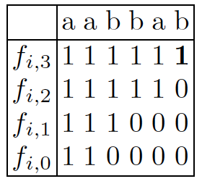
Counting of mismatches
Computation of bitvector found[], with P=aaaaaa, T = aabbab...
With k=3
found[0] : 110000...
found[1] : 111000...
found[2] : 111110...
found[3] : 111111...

Slide 11

Adaptation to AVX-512
For the adaptation of AVX-512:
  We selected the intrinsic function computing the mask as well.
  It eliminated the need for an extra intrinsic function.
  _mm512_cmpeq_epi8_mask(x_ptr, y_ptr)

Slide 12
Performance Analysis and Optimization Strategies
Effect of peeling factor r
  For English data, lower r values produce better speed.
  For DNA and binary data, higher r values yield improved performance.
Choice of comparison vectors
  Our algorithm constructs vectors for each position of the pattern. whereas the original algorithm constructs comparison vectors for each character of the alphabet.
  Our approach offers computational advantage during the search process, which was tested with AVX-512.

Slide 13
Experimental Results
Algorithm Comparison and Performance: The study compared multiple algorithms (including N32A, N64A, N32FA, N64FA, N32EA, N64EA) against ANS2B, BYPSB.
Experimental Results and Speedup: Experiments were conducted for exact and approximate string matching for k = 1, 3, and 5 using different patterns. The results showed that the new algorithms significantly outperformed previous ones.
Data Sets: We conducted our experimental evaluation using English, DNA and Binary Data.

Slide 14
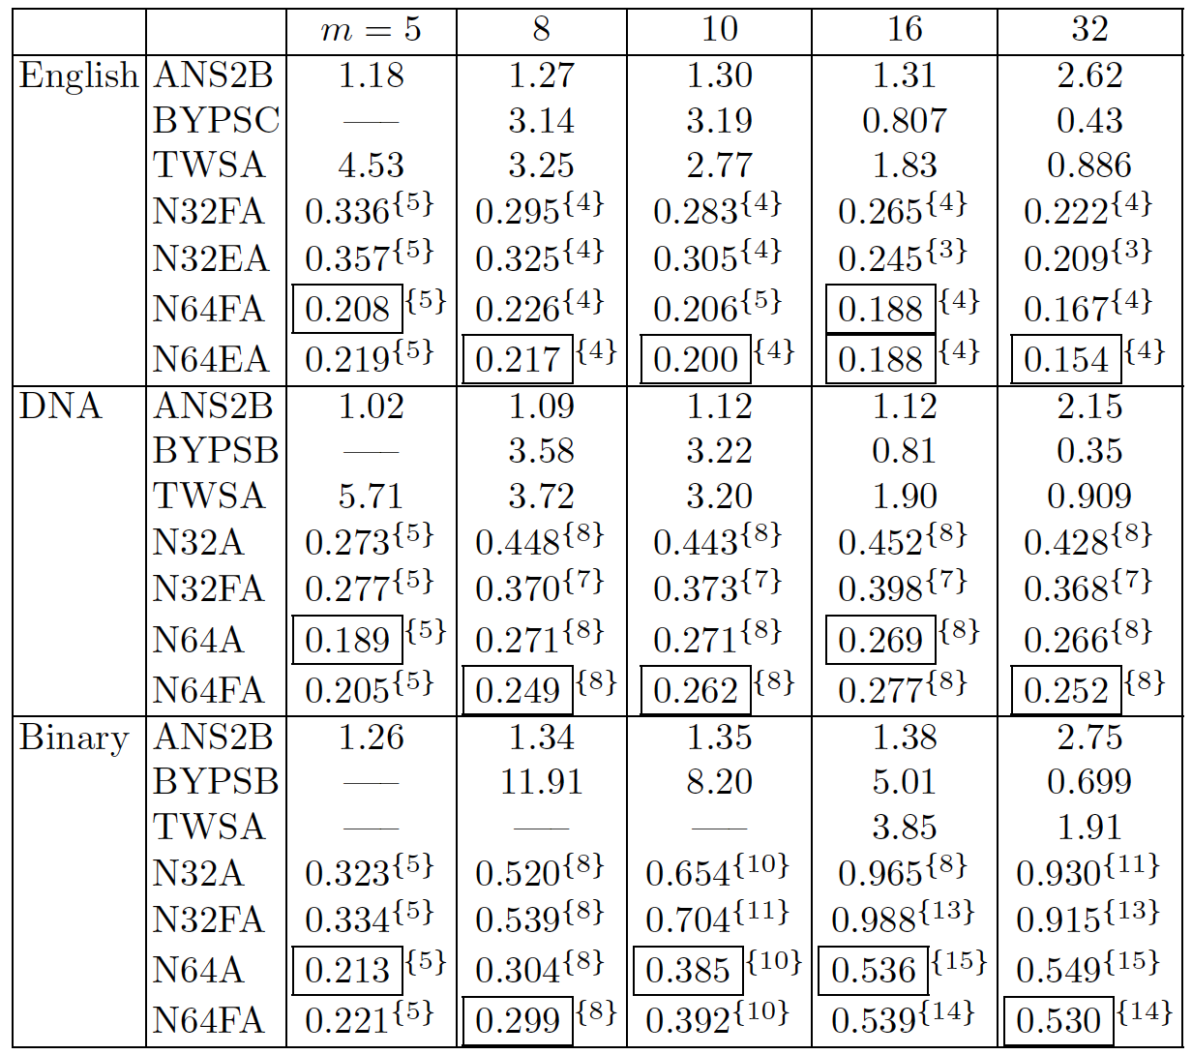
Experimental Results: Approximate search times for k = 1

Slide 15
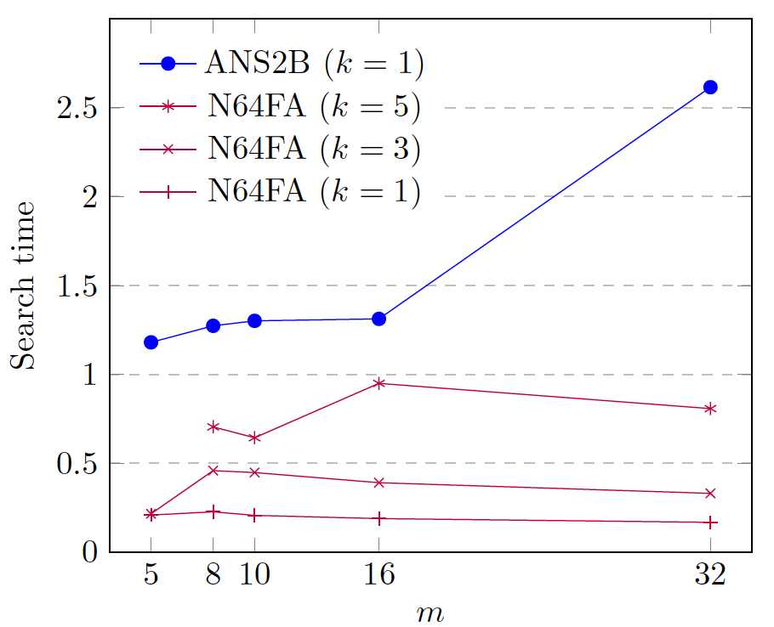
Speedup: AVX-512 offered 1.5 or more speedup over AVX2

Slide 16
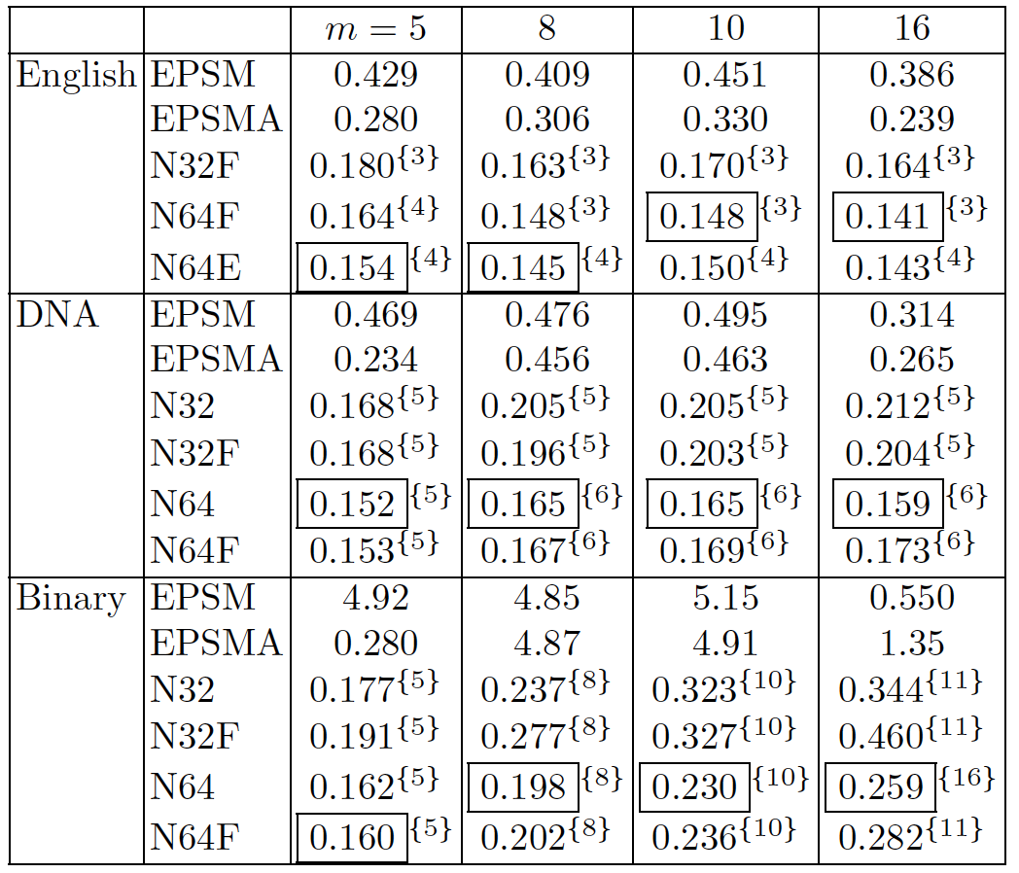
Experimental Results: Exact string matching search times

Slide 17
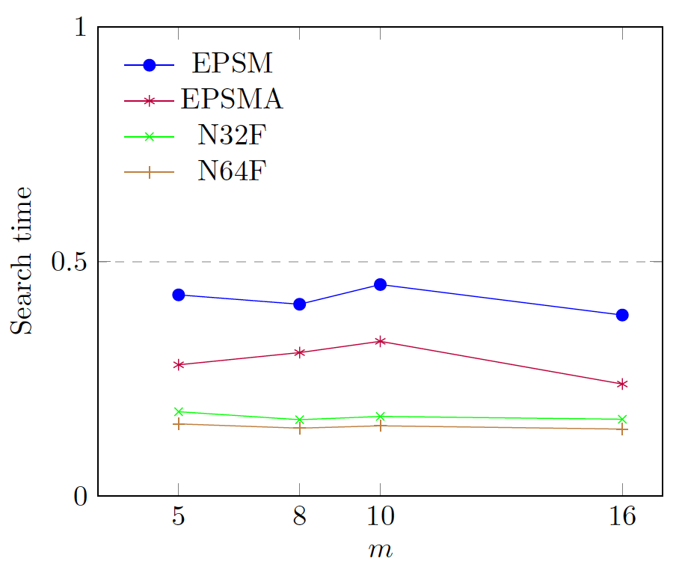
Search times of Exact string matching algorithms for English dataset

Slide 18
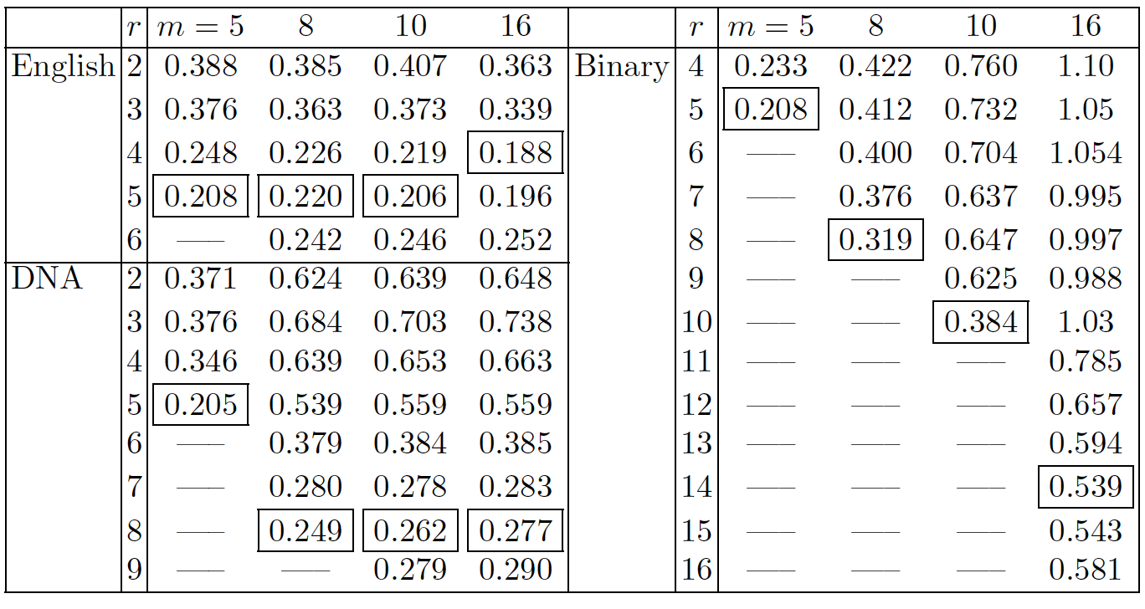
Experimental Results: Search times of N64FA with varied peeling factor, k = 1

Slide 19
Concluding Remarks
We have introduced new algorithms for the k mismatches problem.
N32A and its variations utilize SIMD instructions based on the AVX2 technology.
We adapted N32A into N64A and N64 algorithm which applies the AVX-512 technology.
Additionally, our experiment underscores the critical role of loop peeling.

Slide 20

Thank You!

