Slide 1

Compressed unordered integer sequences with fast direct access
Igor Zavadskyi
Taras Shevchenko National University of Kyiv, Ukraine
Computer science department

Slide 2
Direct access to the element of unordered integer sequence
If integers are arranged in ascending order and deltas between them
are small enough, the problem is reduced to performing the select operation
on a bitmap, where 𝑖-th bit is set if the number 𝑖 belongs to the sequence.
1
5
6
9
17
0 | 1 | 0 | 0 | 0 | 1 | 1 | 0 | 0 | 1 | 0 | 0 | 0 | 0 | 0 | 0 | 0 | 1 | 0
variable-length text encoding
compression of inverted lists
sparse bitmaps
compressed representation of the Ψ function for CSA
But what if integers are not sorted?

Slide 3
Simple Dense Coding vs RMD-codes
K. Fredriksson and F. Nikitin, “Simple compression code supporting random access and fast string matching,” in IEEA Workshop, 2007, pp. 203–216.
SDC
1 | 1 | 1 | 0 | 1 | 0 | 1 | 0 | 1 | 0 | 1 | 0 | 0 | 1 | 0 | 0 | 1 | 0 | 0
Auxiliary bitstream
0 | 1 | 0 | 0 | 0 | 1 | 1 | 0 | 1 | 1 | 0 | 0 | 0 | 0 | 0 | 1 | 0 | 1 | 0
Main bitstream
I. Zavadskyi and A. Anisimov, “Reverse multi-delimiter compression codes,” in DCC, 2020, pp. 173–182.
RMD
0 | 1 | 1 | 0 | 1 | 1 | 0 | 0 | 1 | 1 | 1 | 0 | 1 | 1 | 0 | 0 | 0 | 1 | 1 | 0 | 1 | 0 | 1 | 1 | 1 | 0

Slide 4

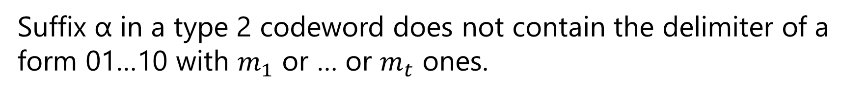
Reverse Multi-Delimiter code: definition
Let m₁ ,… , m_{t} be a sequence of integers, 0 < m₁ <…< m_{t}
Let m₁ ,… , m_{t} be a sequence of integers, 0 < m₁ <…< m_{t}
$$R_{m_{1},…,m_{t}}$$
The code contains:
- codewords of a form 01…1, … , 01…1
- codewords of a form 01…10α, … , 01…10α
(type 1)
m₁
m_{t}
(type 2)
m₁
m_{t}
Suffix α in a type 2 codeword does not contain the delimiter of a form 01…10 with $m_{1}$ or … or $m_{t}$ ones.

Slide 5
Reverse multi-delimiter codes properties
Completeness
Universality
Synchronizability with the delay 1
Direct search in compressed file
etc.

Slide 6
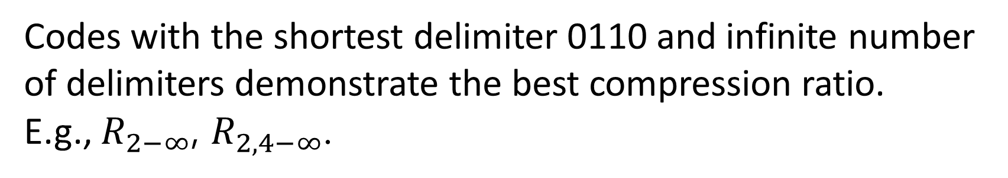
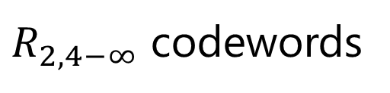
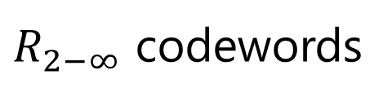
Reverse multi-delimiter codes for NLT compression
Codes with the shortest delimiter 0110 and infinite number of delimiters demonstrate the best compression ratio.
E.g., $R_{2−∞}$, $R_{2,4−∞}$.
$R_{2−∞}$ codewords
$R_{2,4−∞}$ codewords
011
0110
0111
01100
01101
01110
01111
011000
011001
011010
011100
011101
011110
011111
0110000
0110001
0110010
0110100
0110101
0111000
0111001
0111010
0111100
0111101
0111110
0111111
011
0110
01100
01101
01111
011000
011001
011010
011110
011111
0110000
0110001
0110010
0110100
0110101
0110111
0111100
0111101
0111110
0111111

Slide 7
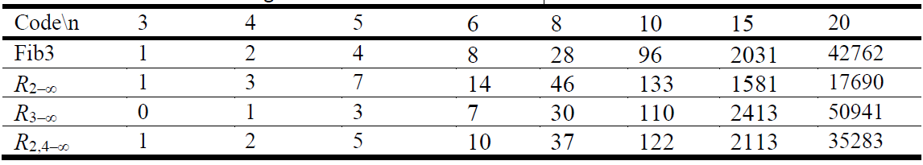
Number of codewords of length ≤n in codes with delimiters

Slide 8
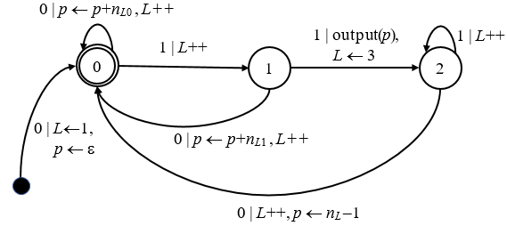
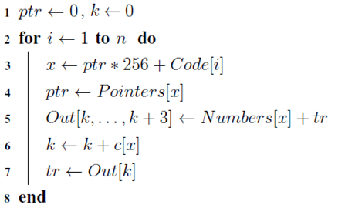
R_{2–∞} decoding
Automaton
Algorithm
input: RMD-bitstream, Code[1..n]
output: Array of numbers Out

Slide 9
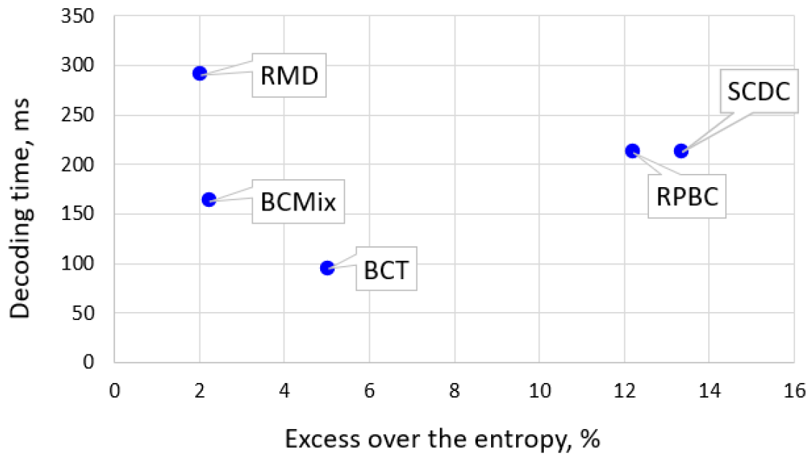
Decoding time vs compression efficiency

Slide 10
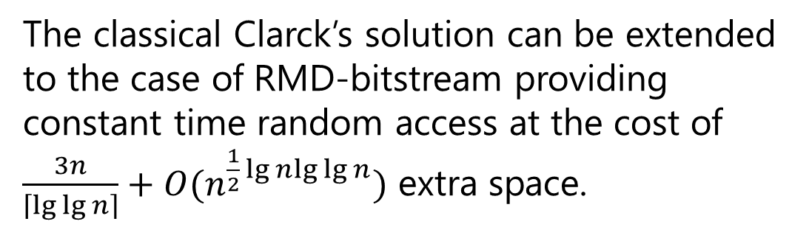
The ‘select’ operation on RMD-bitstream
The classical Clarck’s solution can be extended to the case of RMD-bitstream providing constant time random access at the cost of $\frac{3n}{\left\lceil \lg{\lg{n}}\right\rceil }+O(n^{\frac{1}{2}\lg{n}lg{\lg{n}}})$ extra space.
D. R. Clark. “Compact Pat Trees”. PhD thesis, University of Waterloo, 1996.
However, for bit sequences up to 4GB this value exceeds 60% of the sequence itself.
0 | 1 | 1 | 0 | 1 | 1 | 0 | 0 | 1 | 1 | 1 | 0 | 1 | 1 | 0 | 0 | 0 | 1 | 1 | 0 | 1 | 0 | 1 | 1 | 1 | 0

Slide 11
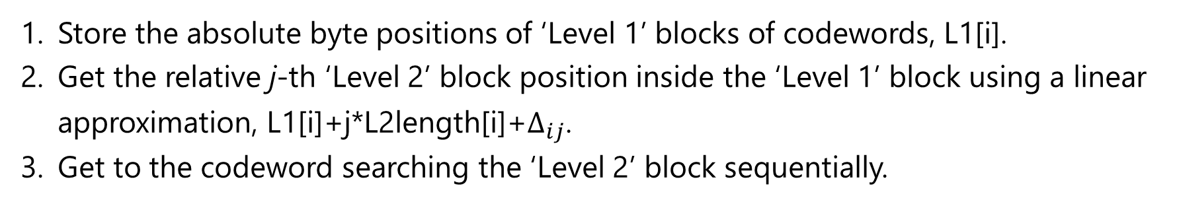


Main algorithm’s idea
A. Boffa, P. Ferragina, and G. Vinciguerra. “A learned approach to design compressed rank/select data structures,” ACM Transactions on Algorithms, 2022.
Store the absolute byte positions of ‘Level 1’ blocks of codewords, L1[i].
Get the relative j-th ‘Level 2’ block position inside the ‘Level 1’ block using a linear approximation, L1[i]+j*L2length[i]+$∆_{ij}$.
Get to the codeword searching the ‘Level 2’ block sequentially.
0 | 1 | 1 | 0 | 1 | 1 | 0 | 0 | 1 | 1 | 1 | 0 | 1 | 1 | 0 | 0 | 0 | 1 | 1 | 0 | 1 | 0 | 1 | 1 | 1 | 0
$L2= 2^{6}\sim 2^{8}$ codewords
$L1= 2^{14}\sim 2^{17}$ codewords
The most memory is occupied by $∆_{ij}$. We allocate different number of bits for $∆$-values in
different ‘Level 1’ blocks.

Slide 12
Byte principle
Although an RMD-encoded sequence is a bitstream, we operate on a byte level to make the method fast, getting all required bit-level data from lookup tables.
0 | 1 | 1 | 0 | 1 | 1 | 0 | 0 | 1 | 1 | 1 | 0 | 1 | 1 | 0 | 0 | 0 | 1 | 1 | 0 | 1 | 0 | 1 | 1 | 1 | 0
Lookup table argument

Slide 13
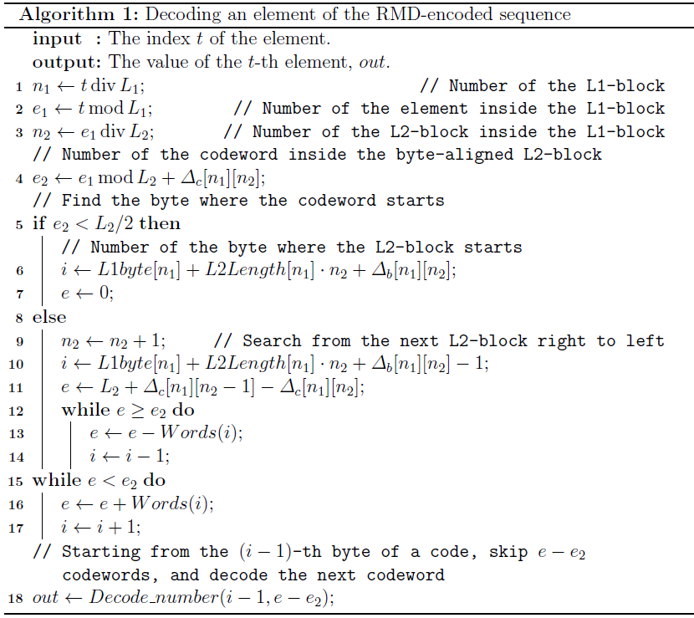
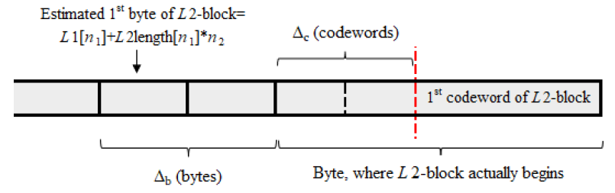
Main Algorithm

Slide 14
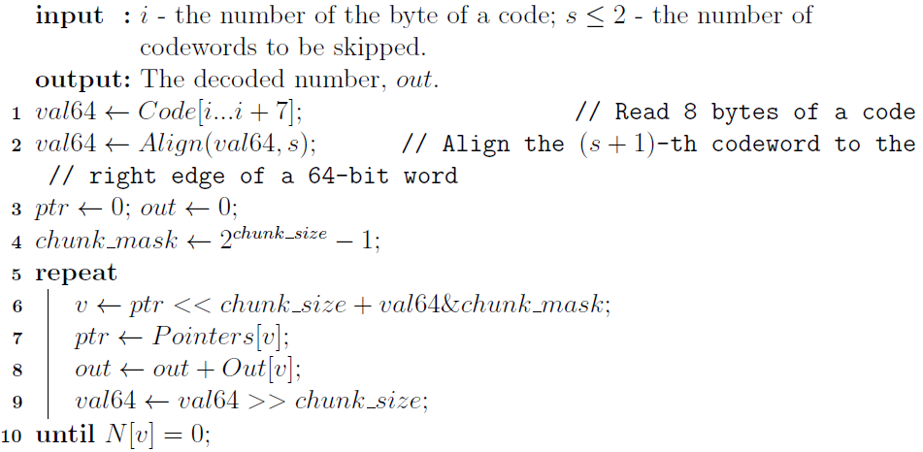
Decode_number function
Decoding the (s + 1)-th codeword starting from the right edge of the i-th byte of a code.

Slide 15

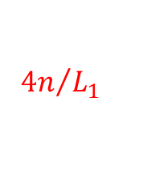
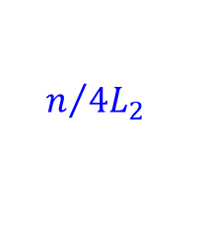

Space complexity
$$n/{4L_{2}}$$
$$Different size \\ for different \\ L1 blocks$$
$${4n}/{L_{1}}$$
$${4n}/{L_{1}}$$
In total:
1-3% of the code size for Δ_{b} ;
< 0.2% for other structures
25-30KB

Slide 16
Experimental set
200 MB English text file from Pizza&Chilie corpus
Schema 1
Schema 2
Word-based alphabet;
compressed file size
compared with H0 entropy
Pairs of characters alphabet;
compressed file size
compared with H1 entropy
P. Ferragina and R. Venturini. A simple storage scheme for strings achieving entropy bounds. In Proc. 18th SODA, pages 690––696, 2007.

Slide 17
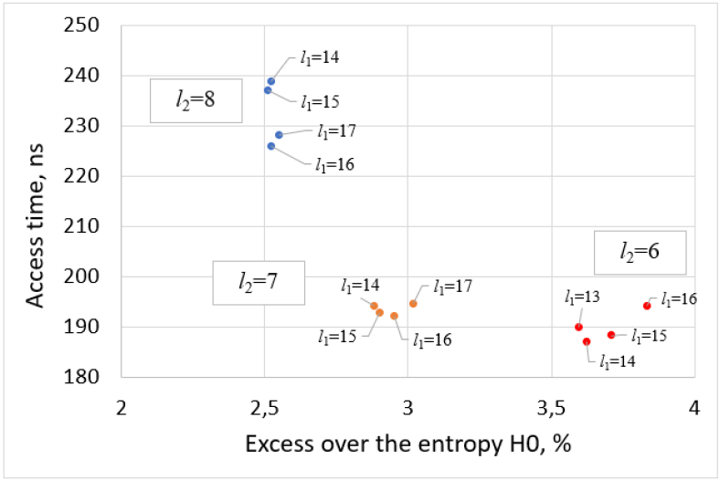
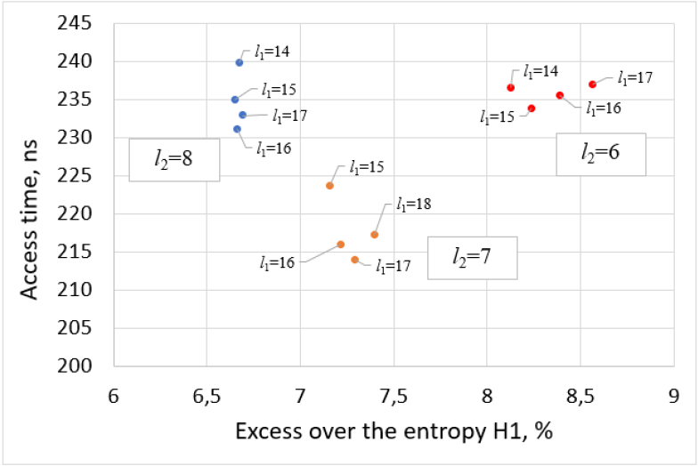
Element extraction from the RMD-encoded integer sequence
Word-based alphabet
Character-based alphabet
$L_{1}=2^{l_{1}}$ is the L1-block size; $L_{2}=2^{l_{2}}$ is the L2-block size

Slide 18






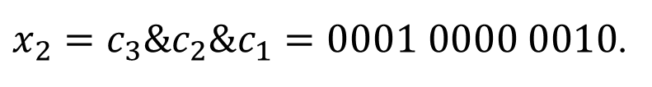


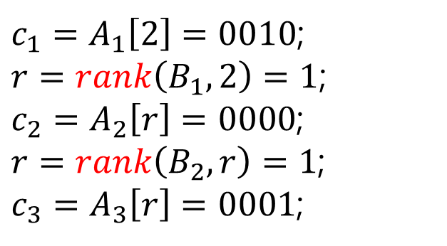
Directly Addressable variable-length Codes
N. R. Brisaboa, S. Ladra, and
G. Navarro, “Directly addressable variable-length codes,”
in SPIRE, 2009, pp. 122–130.
Chunk 3
Chunk 2
Chunk 1
0 | 1 | 0 | 0
$$x_{1}=4$$
0 | 0 | 0 | 1 | 0 | 0 | 0 | 0 | 0 | 0 | 1 | 0
$$x_{2}=258$$
0 | 0 | 1 | 0 | 0 | 1 | 1 | 1
$$x_{3}=39$$
Getting x₂
$$A_{1}=$$
0 | 1 | 0 | 0
0 | 0 | 1 | 0
0 | 1 | 1 | 1
$c_{1}=A_{1}\left[2\right]=0010$;
$r=rank\left(B_{1},2\right)=1$;
$c_{2}=A_{2}\left[r\right]=0000$;
$r=rank\left(B_{2},r\right)=1$;
$c_{3}=A_{3}\left[r\right]=0001$;
$$B_{1}=$$
0
1
1
$$A_{2}=$$
0 | 0 | 0 | 0
0 | 0 | 1 | 0
$$B_{2}=$$
1
0
$$A_{3}=$$
0 | 0 | 0 | 1
$x_{2}=c_{3}\&c_{2}\&c_{1}=0001 0000 0010$.

Slide 19
Experiments
Have been provided on integer sequence obtained by applying either word-based or
character-based frequency compression to 200MB English text from Pizza&Chili corpus.
Word-based
Character-based

Slide 20
Conclusions
We offer the very space-efficient method of an unordered integer
sequence compression supporting the fast direct access to its elements.
It is based on the use of variable-length reverse multi-delimiter codes.
In English text compression, our method is the fastest among competitive
solutions that compress the text with a ratio exceeding the entropy
by less than 15%.

Slide 21
Thank You!
Igor Zavadskyi
ihorza@gmail.com

