Slide 1
Turning Compression Schemes into
Crypto-Systems
Kfir Cohen
Bar Ilan University
Yonatan Feigel
Bar Ilan University
Shmuel T. Klein
Bar Ilan University
Dana Shapira
Ariel University
PSC 2023

Slide 2
Compression
Encryption
Compression Crypto-System
Single process
Secret Key
Previous work: control the model
Current work: control the code generation
Notes:
2
2

Slide 3
Previous work: use log(n) bits of the key
Current work: use a single bit
n size of alphabet, may be large
Add binary decisions to the compression process
no loss, or just minor loss
completely different cipher

Slide 4
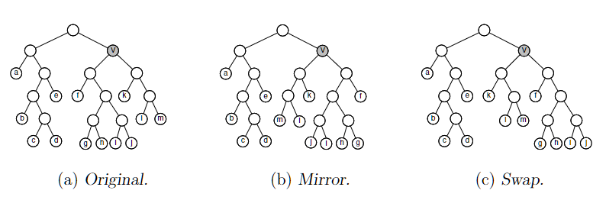
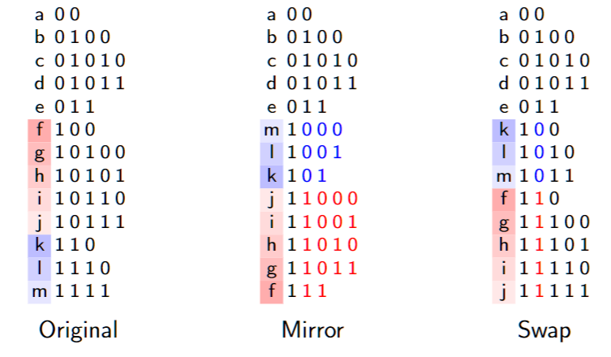
Huffman Coding

Slide 5
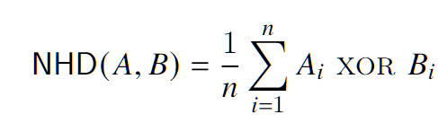
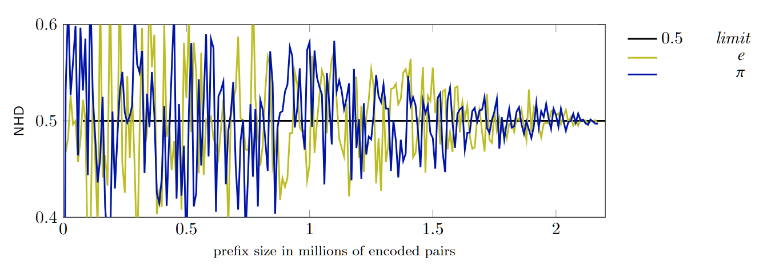
Huffman Coding
Normalized Hamming Distance

Slide 6
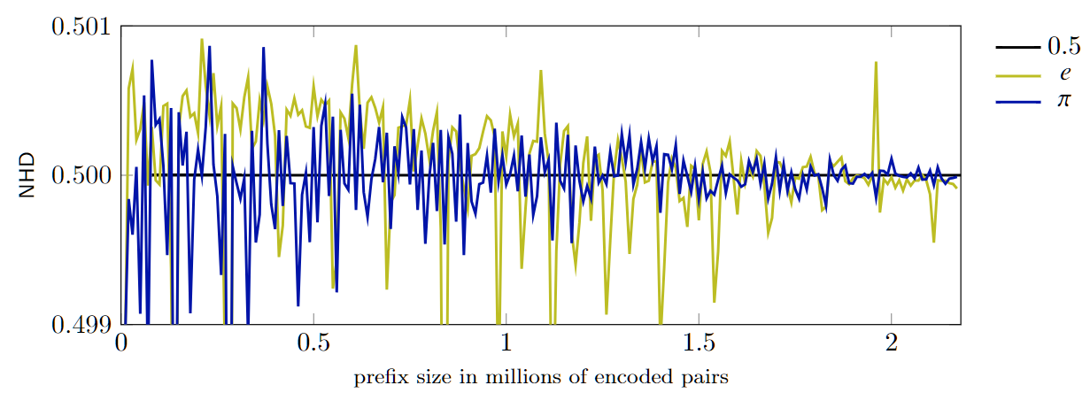
Arithmetic Coding
Swap intervals to the LEFT or to the RIGHT

Slide 7
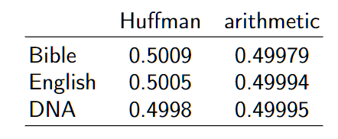
Arithmetic Coding
Limit for keys differing only in 1 bit

Slide 8
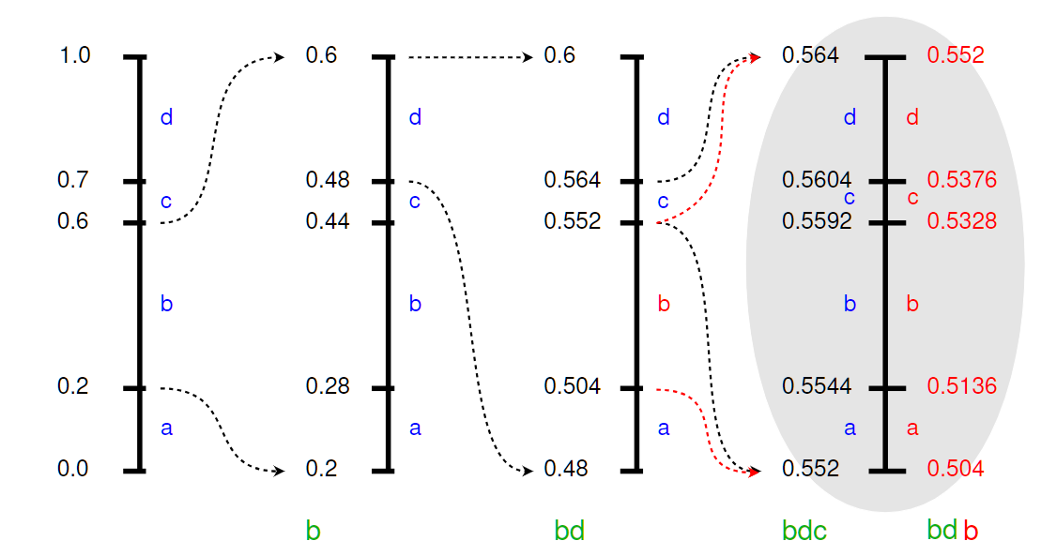
Arithmetic Coding
Adding small lies

Slide 9
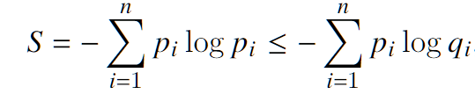
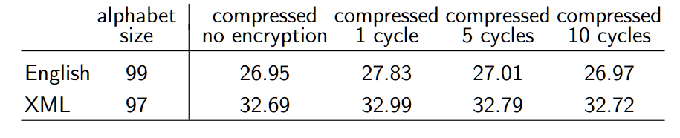
Arithmetic Coding
Adding small lies
Partition the shifting heuristic into several cycles

Slide 10
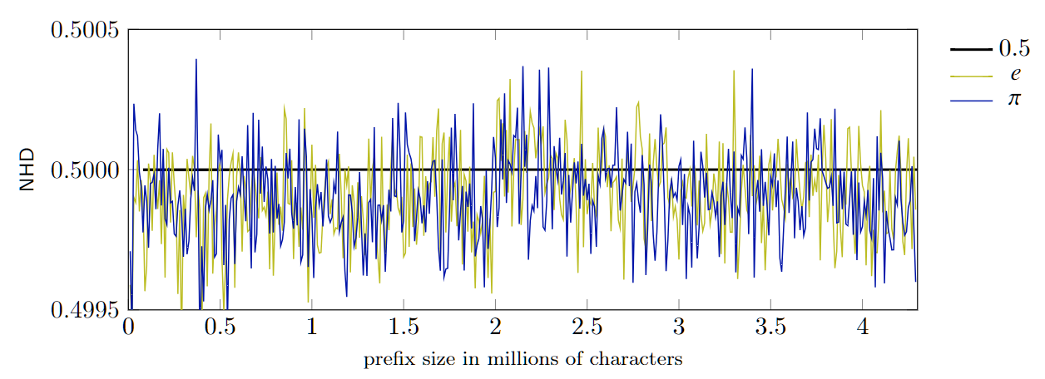
LZW
Parse text by finding longest element A in D matching next chars
Insert new element B=Ax into D
Update the dictionary according to the 1-bits of the secret key
Loss: 1 - 3%

Slide 11
LZ77
Parse text into a sequence of
chars and
(offset, length) pairs
Small lies: add small integer d to offset if bit=1
Twist: make d also depend on secret key
Loss: 2 - 4%

Slide 12
Burrows-Wheeler Transform
Tendency to produce long runs of identical chars
Cascading with MTF followed by RLE
Use bits of secret key to alternate between
MTFront and MTMiddle
Loss: up to 8%

Slide 13
Conclusion and future work
New methods to turn classical compression methods into Crypto-Systems
Security showed only randomness
needs more analysis
Future: trying to show NP-completeness
of breaking the code

Slide 14
Thank you !

