Slide 1

Best Practices in Adaptive Encoding
Igor Zavadskyi and Maksym Kovalchuk
Taras Shevchenko National University of Kyiv, Ukraine
Computer science department

Slide 2
Adaptive encoding
Characters probabilities are calculated ‘on the fly’.
S=
f | i | t | t | i | n | g
P(f)=1
P(f)=1/2
P(i)=1/2
P(f)=1/3
P(i)=1/3
P(t)=1/3
P(f)=1/4
P(i)=1/4
P(t)=1/2
P(f)=1/5
P(i)=2/5
P(t)=2/5
P(f)=1/6
P(i)=1/3
P(t)=1/3
P(n)=1/6
P(f)=1/7
P(i)=2/7
P(t)=2/7
P(n)=1/7
P(g)=1/7

Slide 3
Adaptive vs Static Compression
Encoding abacus: traditional approach
Encoding abacus: adaptive approach
Symbol | a | b | a
Code | 0 | 1 | 0
Huffman tree
0
1
0
0
1
0
1
a
a
b
a
b
0
1
0
1
a
u
s
Symbol | c | u | s
Code | 11 | 101 | 111
Huffman tree
0
1
b
c
0
1
0
1
0
1
a
a
a
0
1
0
1
Symbol | a | b | a | c | u | s
Code | 00 | 010 | 00 | 011 | 10 | 11
0
1
b
c
c
0
1
0
0
1
b
u
b
u
с
s
14 bits
11 bits

Slide 4
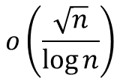
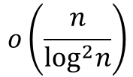
Existing solutions (worst case complexity per symbol)
Algorithm
Idea
Code
length
Enc.
time
Dec.
time
Alphabet
size
FGK (1973-1985)
Vitter (1987)
Updating Huffman tree after every bit processing
H+2+δ
O(H+1)
O(H+1)
H+1+δ
Karpinski and
Nekrich (2006)
Quantize adaptive canonical
coding; updating code at intervals
$$o\left(\frac{n}{\log^{2}n}\right)$$
H+1
O(1)
O(log H+1)
Shannon coding over smoothed distribution; updating code at intervals
$$o\left(\frac{\sqrt{n}}{\log{n}}\right)$$
H+1
O(1)
O(1)
Gagie (2022)
Lower bound for the worst-case: H+1-o(1) bits per symbol

Slide 5
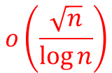
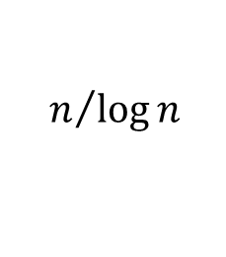
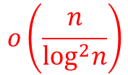
Existing solutions (complexity per symbol)
Algorithm
Idea
Code
length
Enc.
time
Dec.
time
Alphabet
size
FGK (1973-1985)
Vitter (1987)
Updating Huffman tree after every bit processing
H+2+δ
O(H+1)
O(H+1)
H+1+δ
Karpinski and
Nekrich (2006)
Quantize adaptive canonical
coding; updating code at intervals
$$o\left(\frac{n}{\log^{2}n}\right)$$
H+1
O(1)
O(log H+1)
Shannon coding over smoothed distribution; updating code at intervals
$$o\left(\frac{\sqrt{n}}{\log{n}}\right)$$
H+1
O(1)
O(1)
Gagie (2022)
The typical size of a word-based alphabet is
$$n/{\log{n}}$$

Slide 6
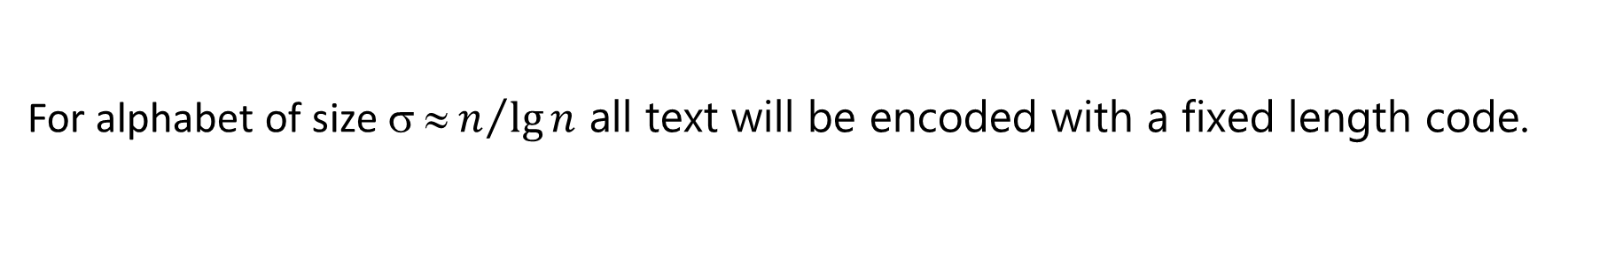
Existing solutions vs large alphabets
Karpinski and Nekrich (2006)
The quantized Shannon coding uses $\left(H+1\right)n+O(σq\log{(n+σq)})$ bits.
For large alphabets our coding uses significantly less than $Hn$ bits.
Gagie (2022)
First, Alice encodes S[1..⌈σ lg n⌉] using a Shannon code C₀ for the uniform distribution, that assigns every character a codeword of length ⌈lg σ⌉.
For alphabet of size ${ ≈ n}/{\lg{n}}$ all text will be encoded with a fixed length code.

Slide 7
Large alphabets – new algorithm idea
Code update
Update the codeword set
Change the correspondence
between symbols and codewords
It is the time bottleneck
Requires O(1) time per symbol
Can we do it only a few times
or avoid it at all?

Slide 8
Idea in more details
Zavadskyi, I., Kovalchuk, M. Binary Mixed-Digit Data Compression Codes. In: String Processing and Information Retrieval. SPIRE 2023. Lecture Notes in Computer Science, vol 14240, pp. 381–392, 2023.
Use the fixed universal codeword set.
Arrange codewords in the order of increasing lengths.
Maintain the list of symbols in the order of decreasing frequences.
Store the boundaries of groups of symbols having a particular frequency.
When a symbol is read:
  swap it with the first symbol having the same frequency;
  increase the lower boundary of the group of symbols having that frequency.

Slide 9
BCMix(2,1,1,…) codeword set re-indexing
(NYT)C(NYT)O(NYT)N(NYT)F(NYT)E(NYT)R E N C E
0 11 6 NYT
1 001
2 011 1 O
3 101 1 N
4 0001 1 F
5 0101 1
6 1001 1 R
1
C
2
E

Slide 10
BCMix(2,1,1,…) codeword set re-indexing
(NYT)C(NYT)O(NYT)N(NYT)F(NYT)E(NYT)R E N C E
0 11 6 NYT
1 001 2 E
2 011
3 101 1
4 0001 1 F
5 0101 1 C
6 1001 1 R
2
1
O
N

Slide 11
BCMix(2,1,1,…) codeword set re-indexing
(NYT)C(NYT)O(NYT)N(NYT)F(NYT)E(NYT)R E N C E
0 11 6 NYT
1 001 2 E
2 101 2 N
3 011
4 0001 1 F
5 1001 1
6 0101 1 R
3
2
2
1
O
C

Slide 12

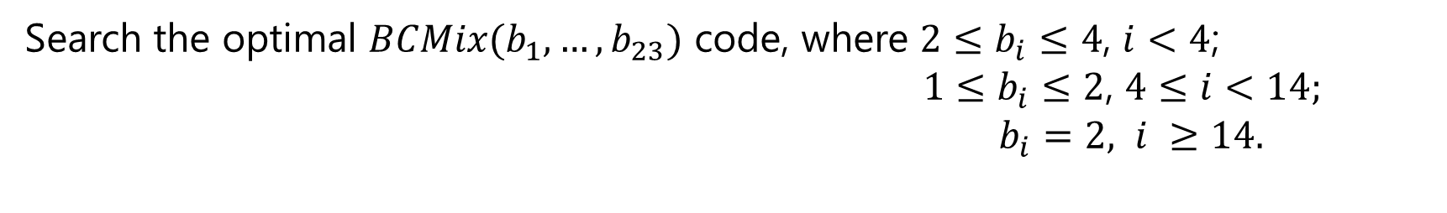


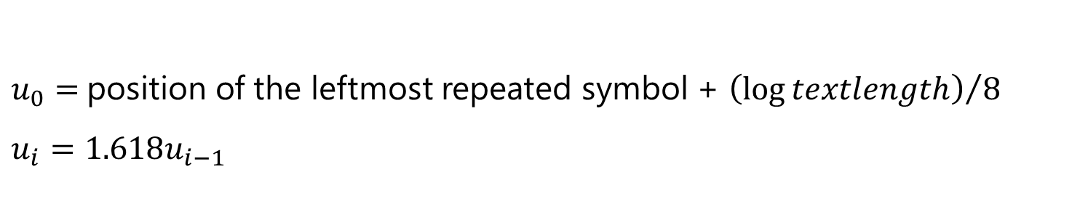




Adaptive encoding with codeword set update
Idea: search the optimal BCMix-code at some increasing intervals using
fast recursive search function.
$$u_{0}$$
$$u_{1}$$
$$u_{2}$$
$$u_{3}$$
$$u_{4}$$
$$u_{5}$$
$$u_{6}$$
update
positions
$u_{0}=$position of the leftmost repeated symbol + ${\left(\log{textlength}\right)}/8$
$$u_{i}=1.618u_{i−1}$$
Search the optimal $BCMix(b_{1},…,b_{23})$ code, where $2≤b_{i}≤4$, $i<4$;
$1≤b_{i}≤2$, $4≤i<14;$
$b_{i}=2, i ≥14.$

Slide 13
Large alphabets – experimental results
 | Vitter’s modified algorithm |  |  | New Algorithm
Text | Compressed size (bytes) | Encoding time (s) | Decoding time (s) | Compressed size (bytes) | Encoding time (s) | Decoding time (s)
Harry Potter (430 KB) | 87,151 | 0.073 | 0.245 | 88,036 (+1.02%) | 0.0044 16x faster | 0.0051 48x faster
Shakespeare (5,09 MB) | 1,138,174 | 1.838 | 1.947 | 1,149,684 (+1.00%) | 0.042 44x faster | 0.047 41x faster
Pizza&Chilie corpus (50 MB) | 12,164,227 | 28.756 | 28.591 | 12,304,232 (+1.15%) | 0.404 71x faster | 0.398 72x faster
Zavadskyi, I. Fast practical adaptive encoding on large alphabets. In: Proc. Data Compression Conference. DCC, 2025, p. 141–150.

Slide 14
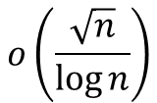
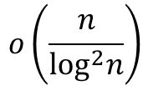
Existing solutions (complexity per symbol)
Code length per symbol
Algorithm
Idea
Enc.
time
Dec.
time
Alphabet
size
FGK (1973-1985)
Vitter (1987)
Updating Huffman tree after every bit processing
H+2+δ
O(H+1)
O(H+1)
H+1+δ
Karpinski and
Nekrich (2006)
Quantize adaptive canonical
Shannon coding; updating code at intervals
$$o\left(\frac{n}{\log^{2}n}\right)$$
H+1
O(1)
O(log H+1)
Shannon coding over smoothed distribution; updating code at intervals
$$o\left(\frac{\sqrt{n}}{\log{n}}\right)$$
H+1
O(1)
O(1)
Gagie (2022)

Slide 15
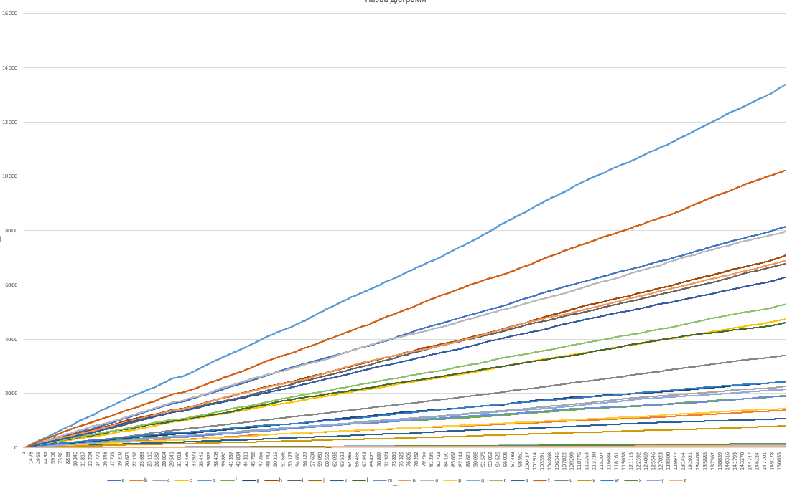
Short alphabets – symbol frequencies
Neither the frequent swapping of the (symbol, codeword) map elements nor the frequent update of the codeword set is necessary.

Slide 16
Update code at intervals
Fixed length intervals
Increasing intervals

Slide 17


Smoothing symbol probabilities
Non-smoothed symbol probabilities
0
$$\overline{P}$$
Smoothing
0
$$\overline{P}$$
Result: - the smallest symbol probability is bigger;
- the longest codeword is shorter;
- the decoding lookup table is smaller;
- its construction and processing is faster.

Slide 18
Shannon codes
Useful property
A symbol having probability p is assigned to a codeword of length at most ⌈log 1/p⌉.
Shannon codes are convenient to prove the worst-case complexity.

Slide 19
Canonical codes
M. Liddell and A. Moffat: Decoding prefix codes. Software Practice and Experience, 36, 2006, pp. 1687–1710.
00
01
100
101
1100
1101
1110
….
Useful property
Codewords of the same length form a contiguous set of integers.
Fast decoding
The index of the codeword cwd of length l in the list of codewords ordered by increasing length is baseSym[l] + cwd − baseCwd[l].
baseSym[l] – the index of the first codeword of length l;
baseCwd[l] – the value of the first codeword of length l.

Slide 20
Basic schema
Encoding
get codewords from the lookup table indexed by characters
update the codeword set together with the lookup tables over some intervals.
Decoding
use several bits from the encoded bitstream as indices of lookup tables allowing us to get the output character and the bit length of the decoded codeword; shift the bitstream read position by this length

Slide 21
Options upon the basic schema
update the code over fixed-length or variable-length intervals;
use smoothed or non-smoothed symbol probabilities;
use Shannon or Huffman codes;
use canonical or non-canonical codes.

Slide 22
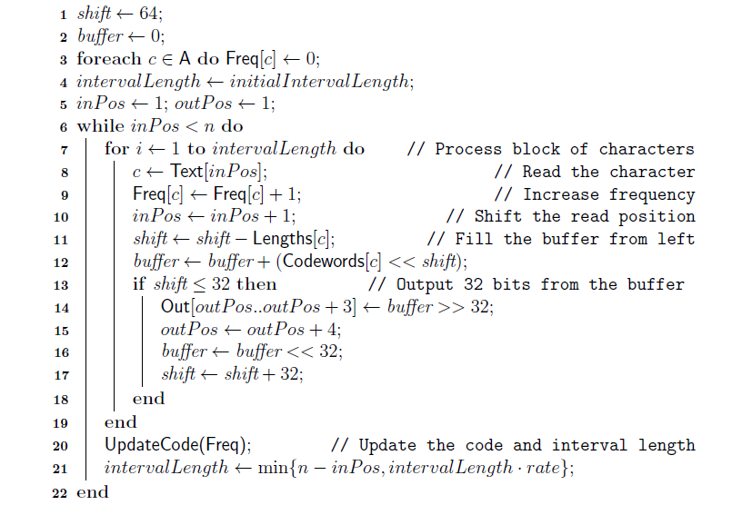
Encoding algorithm

Slide 23
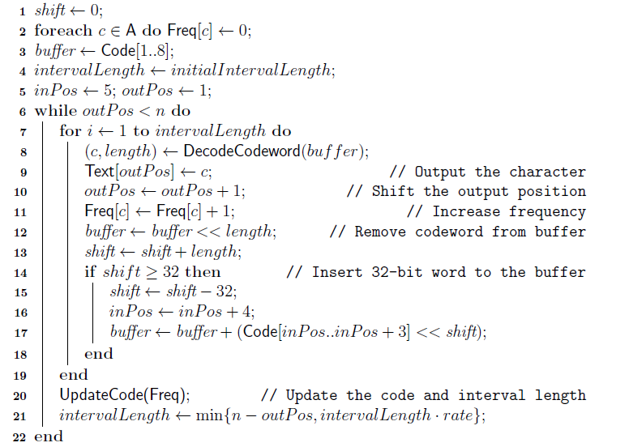
Decoding algorithm

Slide 24
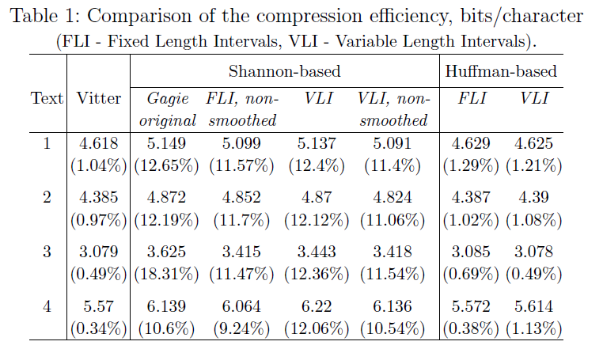
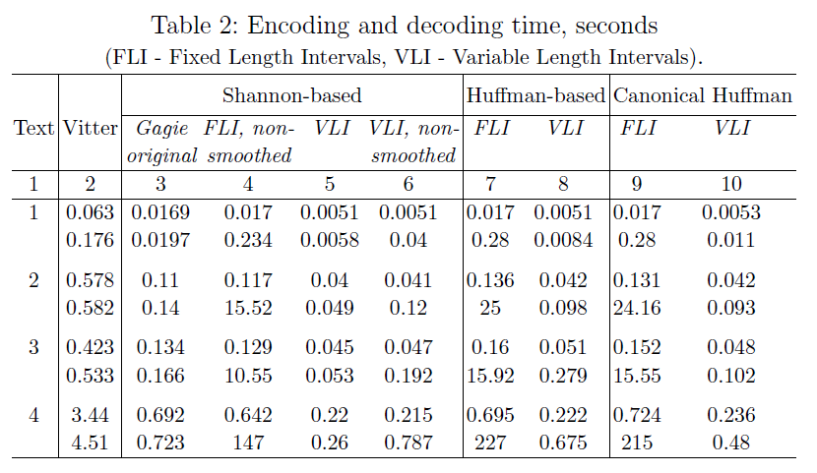
Experimental results
FLI – Fixed length intervals
VLI – Variable length intervals
Up – encoding
Bottom – decoding

Slide 25

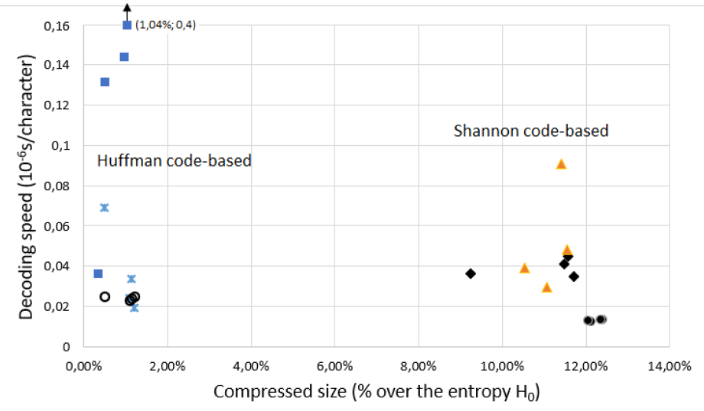




Experimental results

Slide 26
Conclusions
Vitter’s algorithm provides the best compression ratio.
Alternative approaches may outperform it in terms of encoding and decoding speed in times at the cost of 1-2% loss in compression efficiency.
All Shannon code-based adaptive methods, including worst-case-optimal Gagie’s algorithm, provide 10-12% worse compression ratio than Huffman-based methods.
Symbol probabilities smoothing accelerates the decoding significantly at the cost of a few percent loss in compression ratio.

Slide 27
Conclusions
Updating code at geometrically increasing intervals speeds up encoding and decoding in times providing almost the same compression efficiency, if to compare with fixed-length intervals.
The best solution for short alphabets is based on Huffman canonical code, which is updated at intervals of increasing length.
The best approach for large alphabets is to update the mapping between symbols and codewords at each step, and update the codeword set itself at geometrically increasing intervals.

Slide 28
Thank You!
Igor Zavadskyi
ihorza@gmail.com

